Slide 1

Technology in Action
15th Edition
Chapter 11
Behind the Scenes: Databases and Information Systems
Notes:
If this PowerPoint presentation contains mathematical equations, you may need to check that your computer has the following installed:
1) MathType Plugin
2) Math Player (free versions available)
3) NVDA Reader (free versions available)

Slide 2
Learning Objectives (1 of 2)
11.1 Explain what a database is and why databases are useful.
11.2 Discuss the benefits of using a database.
11.3 Describe features of relational databases.
11.4 Describe features of object-oriented databases.
11.5 Describe features of multidimensional databases.
11.6 Describe how relational databases organize and define data.
11.7 Describe how data is inputted and managed in a database.
Notes:
Slide 2 is a partial list of textbook Learning Objectives numbers and statements.

Slide 3
Learning Objectives (2 of 2)
11.8 Explain what data warehouses and data marts are and how they are used.
11.9 Describe data mining and how it works.
11.10 Describe the main types of business information systems and how they are used by business managers.
Notes:
Slide 3 is the final list of textbook Learning Objectives numbers and statements.

Slide 4
Database Advantages The Need for Databases (2 of 2) (Objective 11.1)
Databases can prevent the following problems that often occur with lists:
Data redundancy
Data inconsistency
Inappropriate data
Incomplete data
Notes:
Databases can prevent the following problems that often occur with lists:
Data redundancy occurs when there is a great deal of duplicated data in two or more lists.
Data inconsistency occurs when different versions of the same data appear in different places.
With a list, there are few checks to make sure that data entered is valid.
It is difficult to tell by looking at a record whether data is available and just wasn’t entered or is truly missing.

Slide 5

Database Advantages Advantages of Using Databases (Objective 11.2)
Manage large amounts of data efficiently
Enable information sharing
Promote data integrity
Data centralization
Normalization
Notes:
Databases provide several advantages; they manage large amounts of data efficiently, enable information sharing, and promote data integrity.
Often, large amounts of data are complex and need to be organized in specific ways to be used more efficiently.
With a database, only one file is maintained. Because of this, databases provide data centralization.
Data integrity means that the data is accurate and reliable. Data centralization goes a long way toward ensuring data integrity.
With a database, only one file is maintained. Because of this, databases provide data centralization.
Data integrity means that the data contained in the database is accurate and reliable.
The process to ensure data is organized most efficiently is called data normalization.

Slide 6
Database Types Relational Databases (Objective 11.3)
Relational databases
Organizes data in table format
Logically groups similar data into a relationship
Common field in one table linked to common field in second table
Types of relationships
One-to-many
One-to-one
Many-to-many
Notes:
Relational databases operate by organizing data into various tables based on logical groupings. In relational databases, a link between tables that defines how the data is related is referred to as a relationship.
The common field in one table is linked to the common field in another table.
There are three types of relationships that can be created:
One-to-many.
One-to-one.
Many-to-many.

Slide 7
Database Types Object-Oriented Databases (Objective 11.4)
Store data in objects rather than tables
Contain methods for processing or manipulating data
Can store more types of data
Can access data faster
Better at handling unstructured data
Data known as a binary large object (BLOB)
Query language is designed to manipulate or extract data
Notes:
An object-oriented database stores data in objects rather than in tables. Objects contain not only data but also methods for processing or manipulating that data.
This allows object-oriented databases to store more types of data than relational databases and to access that data faster.
They are also better at handling unstructured data.
Data of this type is known as a binary large object (BLOB) because it’s encoded in binary form.
A query language is designed to manipulate or extract data from a database.

Slide 8
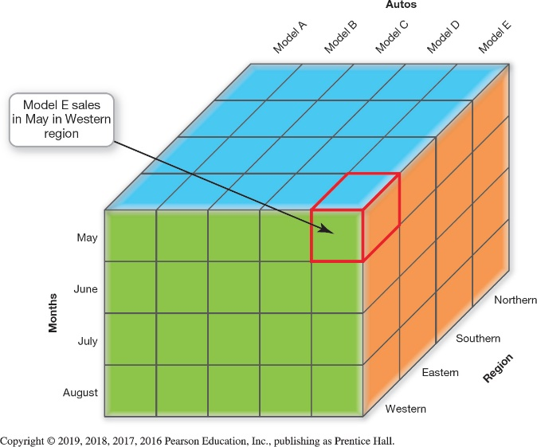
Database Types Multidimensional Databases (1 of 2) (Objective 11.5)
Stored data can be analyzed from different perspectives (dimensions)
Relational database has only two dimensions (fields and records)
Multidimensional databases organize in cube format
Measure attribute
Feature attribute
Notes:
A multidimensional database stores data that can be analyzed from different perspectives, called dimensions. This distinguishes it from a relational database, which stores data in tables that have only two dimensions—fields and records.
Multidimensional databases organize data in a cube format.
Each data cube has a measure attribute, which is the main type of data that the cube is tracking.
Other elements of the cube are known as feature attributes, which describe the measure attribute in some meaningful way.

Slide 9
Database Types Multidimensional Databases (2 of 2) (Objective 11.5)
Advantages
Customized to provide information to a variety of users based on their needs
Process data much faster than pure relational databases
Notes:
The two main advantages of multidimensional databases are as follows:
They can be customized to provide information to a variety of users based on their needs.
They can process data much faster than pure relational databases can.

Slide 10
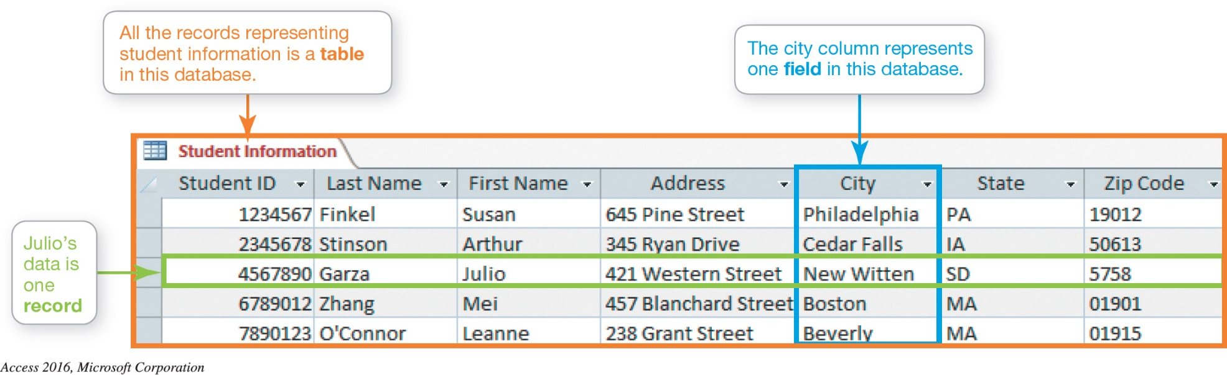
Database Basics Database Components and Functions (1 of 4) (Objective 11.6)
Storing and Defining Data
Fields are categories of data
Records are groups of related fields
Tables are groups of records
Notes:
Data is stored in a database in:
Fields: categories into which a database organizes data.
Records: a group of related fields.
Tables: a group of related records.

Slide 11
Database Basics Database Components and Functions (2 of 4) (Objective 11.6)
Data (field) types indicate what kind of data is stored in the field
Short Text
Long Text
Number and Currency
Date/Time
Yes/No
Calculated
OLE Object
Hyperlink
Notes:
Data (field) types indicate what kind of data stored in the field. The following are the available field type:
Short Text
Long Text
Number and Currency
Date/Time
Yes/No
Calculated
OLE Object
Hyperlink

Slide 12
Database Basics Database Components and Functions (3 of 4) (Objective 11.6)
Field properties help to define field data
Field size defines the maximum number of characters a field can hold
Default value is what is used unless the user enters another value
Caption enables the display of the field name in a more meaningful or readable manner
Notes:
Field properties help to define field data. Three common field properties are:
Field size, which defines the maximum number of characters a field can hold.
The default value is what is used unless the user enters another value.
A caption enables you to display the field name in a more meaningful or readable manner.

Slide 13
Database Basics Database Components and Functions (4 of 4) (Objective 11.6)
Using Keys
Primary key field
Foreign key
Referential integrity
Data dictionary
Metadata
Describes other data
Notes:
When creating a table the use of primary keys is very important.
A primary key is a field in the table which uniquely identifies a record.
In related tables, the common field which is linked to a primary key in one table is called the foreign key in the linked table.
Referential integrity ensures that relationships between tables remain constant and guarantees the quality of the data in the database.
It’s useful, especially for large databases, to access the data dictionary (or the database schema).
The attributes that define the data in the data dictionary are metadata: data that describes other data.

Slide 14
Database Building Blocks Inputting and Managing Data (1 of 2) (Objective 11.7)
Input forms control how new data is entered
Data validation ensures that only valid data is entered in a field
Range check
Field constraint
Completeness check
Consistency check
Alphabetic / Numeric checks
Notes:
Input forms are used to control how new data is entered into a database.
Data validation is the process of ensuring that data entered into a field meets specified guidelines.
A range check ensures that the data entered into the field falls within a certain range of values.
A field constraint is a property that must be satisfied for an entry to be accepted into the field.
A completeness check ensures that all required fields have been completed.
A consistency check compares the values of data in two or more fields to see if those values are reasonable.
An alphabetic check confirms that only textual characters are entered in a field. A numeric check confirms that only numbers are entered in the field.

Slide 15
Database Building Blocks Inputting and Managing Data (2 of 2) (Objective 11.7)
Viewing and Sorting Data allows you to display and reorder data
Extracting or Querying Data
Use a filter
Use a query
Outputting Data
Structured Query Language (SQL)
Notes:
Displaying the tables on-screen and browsing through all the data is an option with most databases. You can easily sort data into ascending or descending order.
There are two ways to display only those records that match particular criteria:
Use a filter.
Use a query.
The most common form of output for any database is a viewable (or printable) electronic report.
SQL uses relational algebra to extract data from databases.

Slide 16
Data Warehousing and Storage Data Warehouses and Data Marts (1 of 3) (Objective 11.8)
Data Warehous
Large-scale collection of data
Contains and organizes data in one place
Data comes from multiple databases
Consolidates information from various systems
Presents enterprise-wide view of operations
Organized by subject
Notes:
A data warehouse is a large-scale collection of data that contains and organizes all the data from an organization’s multiple databases in one place.
Individual databases contain a wealth of information, but each database’s information usually pertains to one area in the organization.
Data warehouses, therefore, consolidate information from various operational systems to present an enterprise-wide view of business operations.
Data in the data warehouse is organized by subject.

Slide 17
Data Warehousing and Storage Data Warehouses and Data Marts (2 of 3) (Objective 11.8)
Time-variant data means it pertains to more than one time period
Sources of data
Internal sources
External sources
Clickstream data
Data staging steps
Extraction of data
Transformation (reformatting) of data
Storage of data
Notes:
Time-variant data means it pertains to more than one time period.
Sources of data include:
Internal sources.
External sources.
Clickstream data.
Data staging steps are:
Extraction of the data.
Transformation (reformatting) of data.
Storage of data.

Slide 18
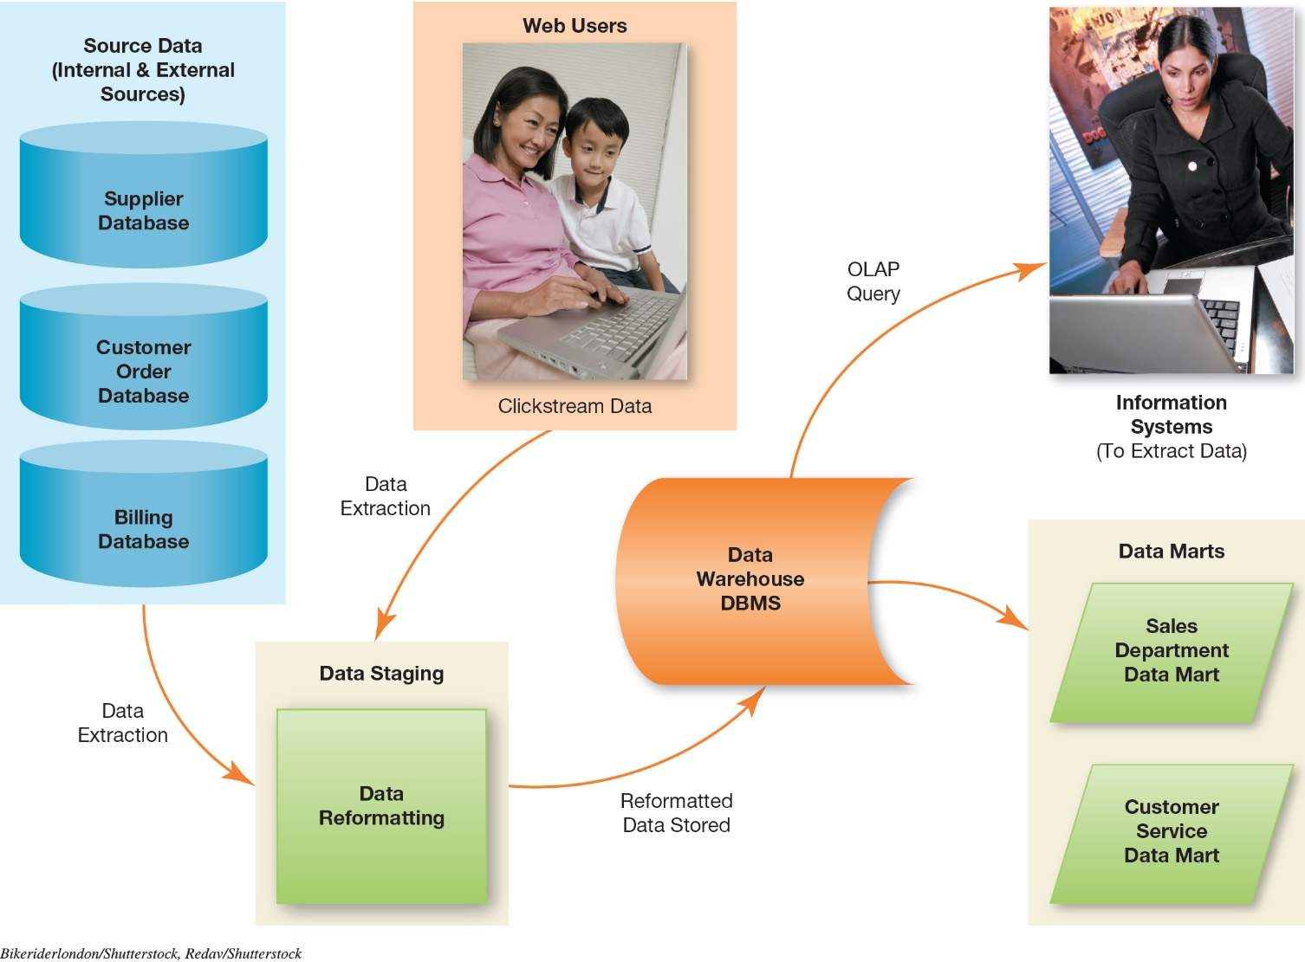
Data Warehousing and Storage Data Warehouses and Data Marts (3 of 3) (Objective 11.8)
Notes:
An overview of the data-warehousing process is illustrated in Figure 11.24.

Slide 19
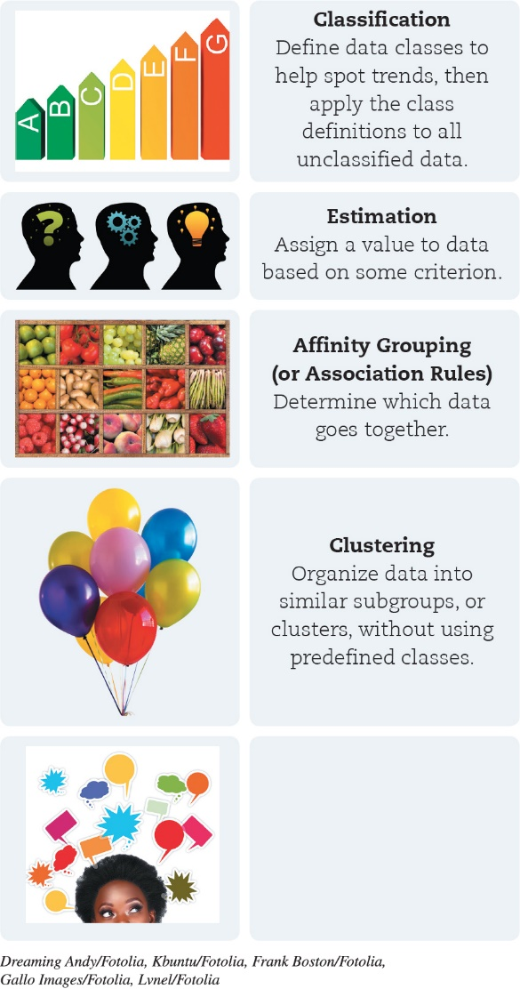
Data Warehousing and Storage Data Mining (Objective 11.9)
Data mining
Process by which data are analyzed and investigated
Spot patterns and trends
Techniques
Classification
Estimation
Affinity grouping
Clustering
Description and Visualization
Notes:
Data mining is the process by which data are analyzed and investigated, trying to spot patterns and trends.
The techniques used are:
Classification.
Estimation.
Affinity grouping.
Clustering.
Description and Visualization.

Slide 20
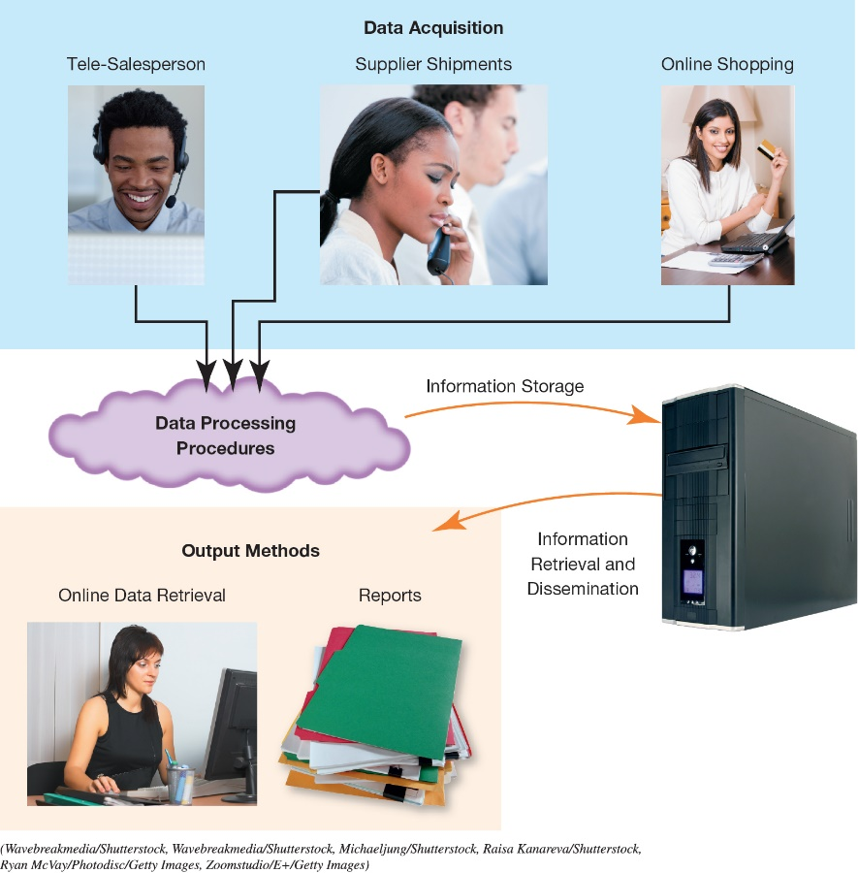
Using Databases to Make Business Decisions Business Information Systems (1 of 6) (Objective 11.10)
Software-based solutions to gather and analyze information
Deliver up-to-the-minute data
Integral because they store the functional information
All perform similar functions
Notes:
An information system is a software-based solution used to gather and analyze information.
Databases, data warehouses, and data marts are integral parts of information systems because they store the information that makes information systems functional.
All information systems perform similar functions, including acquiring data, processing that data into information, storing the data, and providing the user with a number of output options with which to make the information meaningful and useful.

Slide 21
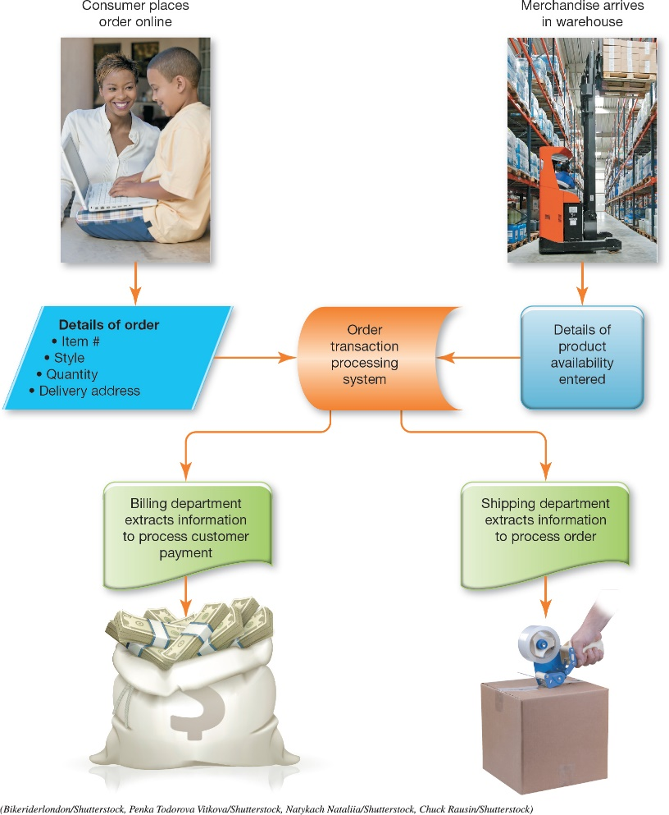
Using Databases to Make Business Decisions Business Information Systems (2 of 6) (Objective 11.10)
Transaction-processing system (TPS)
Tracks everyday business transactions
Real-time processing ensures that the data is current
Batch processing is appropriate for activities that aren’t time sensitive
Notes:
Transaction-processing system (TPS) tracks everyday business transactions.
Real-time processing ensures that the data is current.
Batch processing is appropriate for activities that aren’t time sensitive.

Slide 22
Using Databases to Make Business Decisions Business Information Systems (3 of 6) (Objective 11.10)
Management information system (MIS)
Provides timely and accurate information
Enables managers to make critical decisions
Directs outgrowth of TPS
Powerful if organized and outputted in useful form
Often included as a feature of TPS
Can generate various reports
Notes:
A management information system (MIS) provides timely and accurate information that enables managers to make critical business decisions. MISs were a direct outgrowth of TPSs. Managers realized that the data could be a powerful tool if the information could be organized and outputted in a useful form. Today’s MISs are often included as a feature of TPSs.
MISs generate three types of reports:
A detail report.
A summary report.
An exception report.

Slide 23
Using Databases to Make Business Decisions Business Information Systems (4 of 6) (Objective 11.10)
Decision support system (DSS)
Another type of business intelligence system
Designed to help managers develop solutions for specific problems
Uses information from databases and data warehouses
Users can add their own insights and experiences to solution
Notes:
A decision support system is another type of business intelligence system designed to help managers develop solutions for specific problems.
A DSS might provide statistical information on customer attributes, such as income levels or buying patterns, that would assist managers in making advertising strategy decisions.
A DSS not only uses data from databases and data warehouses, it also enables users to add their own insights and experiences and apply them to the solution.

Slide 24
Using Databases to Make Business Decisions Business Information Systems (5 of 6) (Objective 11.10)
Model management system
Assists in building management models in DSS
Knowledge-based system
Provides intelligence that supplements the user’s own intellect
Natural language processing (NLP) system
Artificial intelligence
Fuzzy logic
Notes:
A model management system assists in building management models in DSS.
A knowledge-based system:
Provides intelligence that supplements the user’s own intellect.
Natural language processing (NLP) system enables users to communicate with computer systems using a natural spoken or written language.
Artificial intelligence is the branch of computer science that deals with the attempt to create computers that think like humans.
Fuzzy logic enables the interjection of experiential learning into the equation by considering probabilities.

Slide 25
Using Databases to Make Business Decisions Business Information Systems (6 of 6) (Objective 11.10)
Business intelligence (BI) is the ability to improve business decision making with databases
Used to analyze and interpret large sets of data
Enables executives and senior managers to make informed decisions
Enterprise resource planning (ERP) system accumulates all information relevant to running a business
Notes:
Business intelligence (BI) is the ability to improve business decision making with databases.
It is used to analyze and interpret large sets of data.
It enables executives and senior managers to make informed decisions.
An enterprise resource planning (ERP) system accumulates all information relevant to running a business.

Slide 26
Questions
?

Slide 27

Copyright
All rights reserved. No part of this publication may be reproduced, stored in a retrieval system, or transmitted, in any form or by any means, electronic, mechanical, photocopying, recording, or otherwise, without the prior written permission of the publisher. Printed in the United States of America.

