Slide 1


Martial Arts

Slide 2
About Trident Martial Arts Academy
Philosophy: We commit to developing confidence and balance, functional strength and a high level of fitness for our students.
Functional Fitness: the area's premier training and instruction center specializing in a wide range of styles and systems.
Experience is NOT Required

Slide 3

What Trident Offers
For Kids | 4-6 Year Olds: Muay Thai Brazilian Jiu-Jitsu | 7-12 Year Olds: Muay Thai Brazilian Jiu-Jitsu Filipino Martial Arts
For Adults | Striking: Jeet Kune Do Muay Thai JTX Kickboxing Tier One Krav Maga | Grappling Brazilian Jiu-Jitsu Combat Submission Wrestling | Weapons Filipino Martial Arts

Slide 4
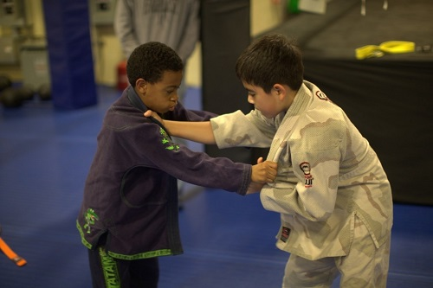
Location: 3310 Noble Pond Way Suite 104,
Woodbridge, VA 22193
Phone: (703)490-2425
Prices: Free Pass Available for First Lesson
Adults/Teen/Private Lessons: Check Front Desk
Kids: Staring at $129/month

