Slide 1
Water Conservation
By Afeefah manzoor

Slide 2

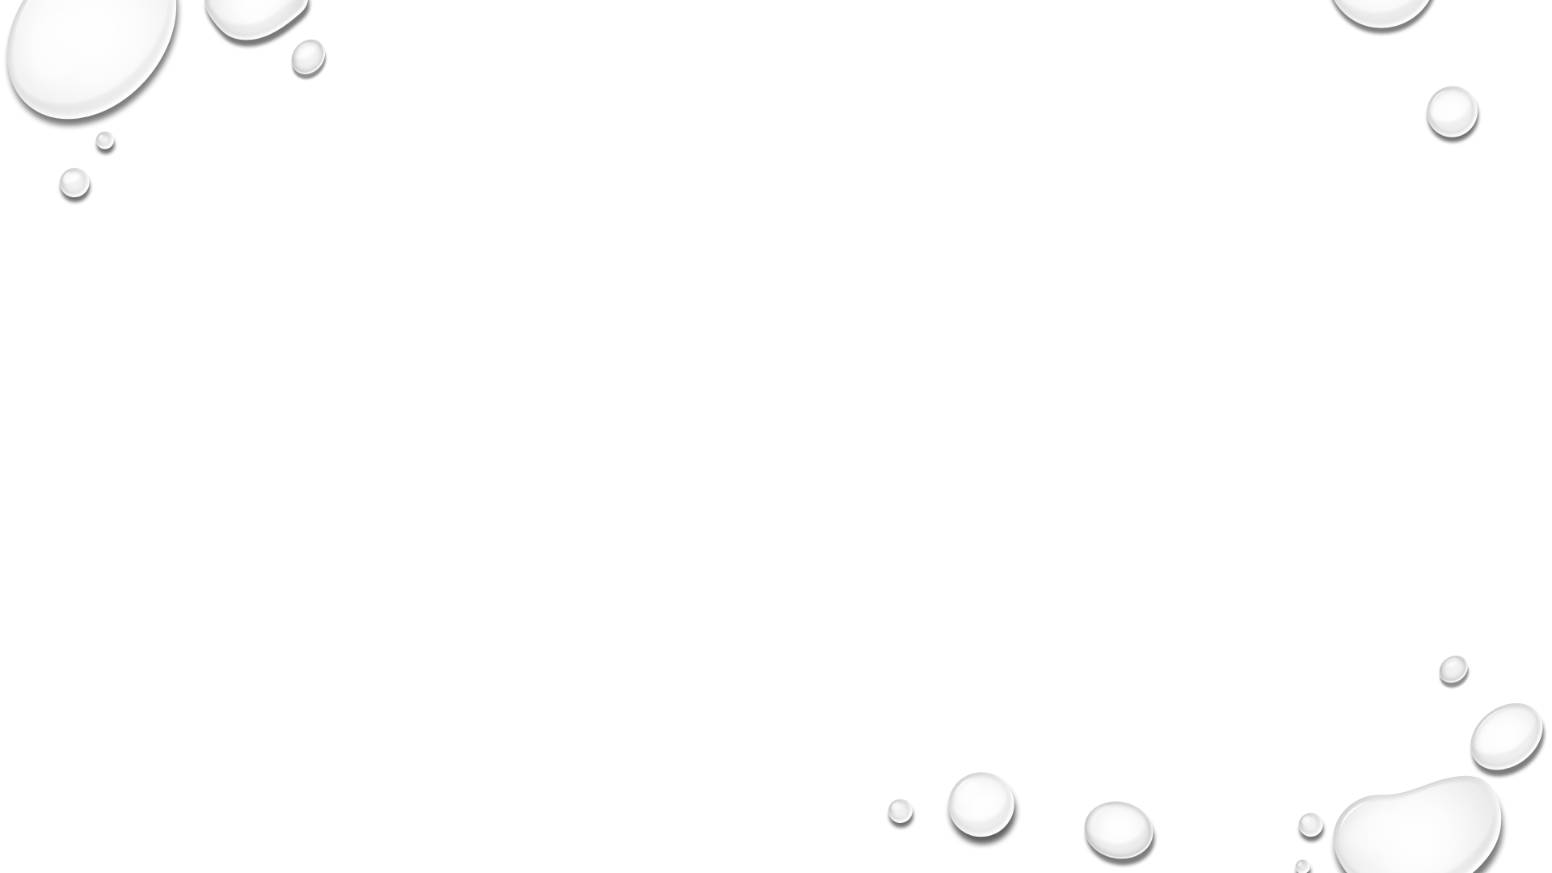

Benefits of Water Conservation
Saves Money
Protects drinking water resources
Minimizes water pollution and health risks
Reduces the need for costly water supply and new wastewater treatment facilities
Maintains the health of aquatic environments
Saves energy used to pump, heat, and treat water
From:https://www.ecotechwater.com/Health/Water%20Consevation.html

Slide 3
Water Demand
Projected to increase by 55% between 2000 & 2050
Much of the demand is driven by agriculture which accounts for 70% of global freshwater
And food production will need to grow by 69% by 2035 to feed growing populations

