Slide 1
KnoWhere
An App for Automatically Profiling your Commute using Smart Phone Sensor Data

Slide 2
Commutes are Bad for you!
Higher Blood Sugar
Higher Cholesterol
Higher Depression Risk
Higher Anxiety
High Blood Pressure
Back Aches
Source: http://time.com/9912/10-things-your-commute-does-to-your-body/

Slide 3
Adding Data is a Drag

Slide 4
KnoWhere: Automatically Profile Your Commute

Slide 5



The Front End
Turn meaningful analysis into appealing, interpretable visualizations

Slide 6
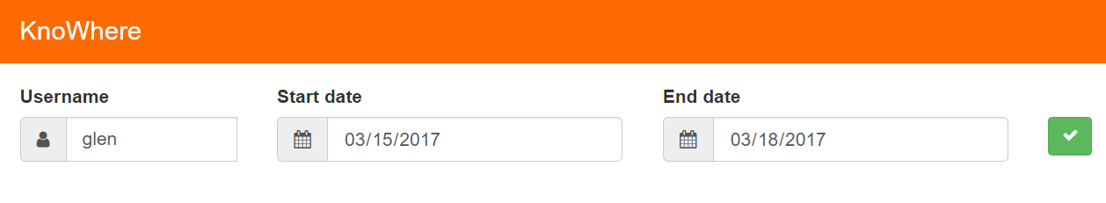
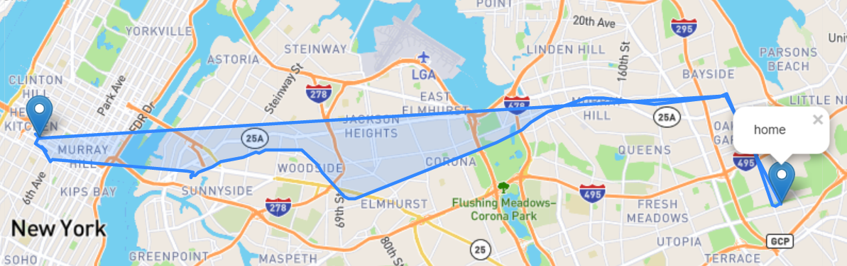
The Front End
Plot the user’s coordinates for the last day in their chosen date range

Slide 7
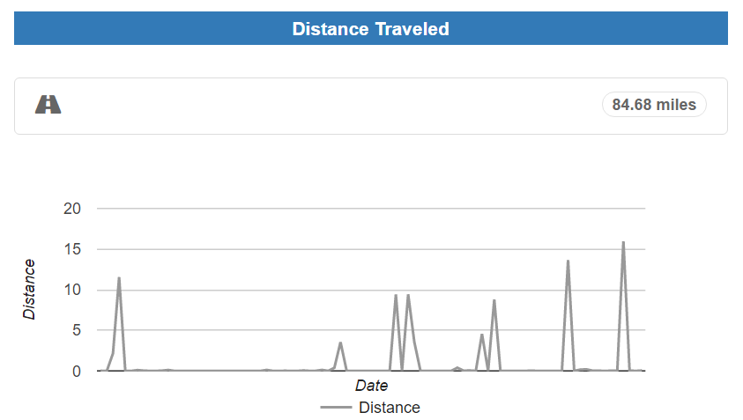
The Front End
Total distance traveled with hourly plots for a date range

Slide 8
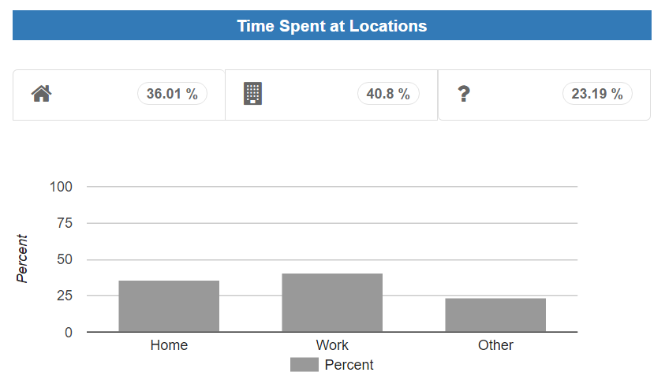
The Front End
Percent of time spent at certain locations for chosen date range

Slide 9
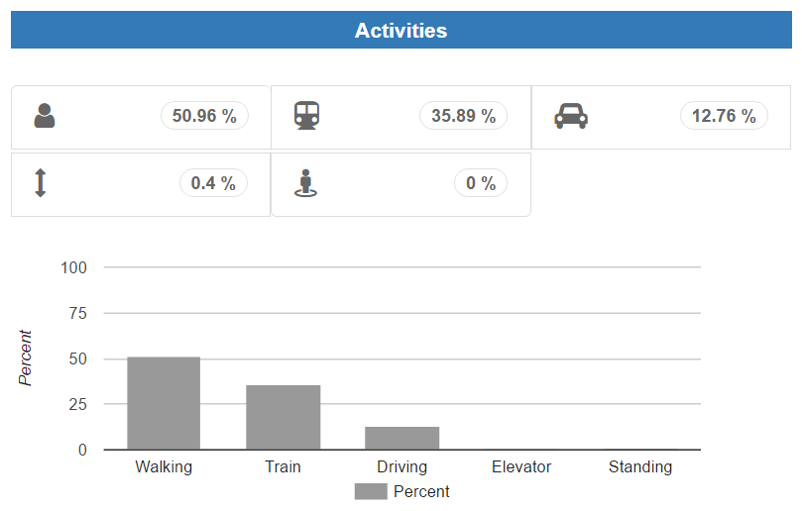
The Front End
Percent of time spent on activities

Slide 10
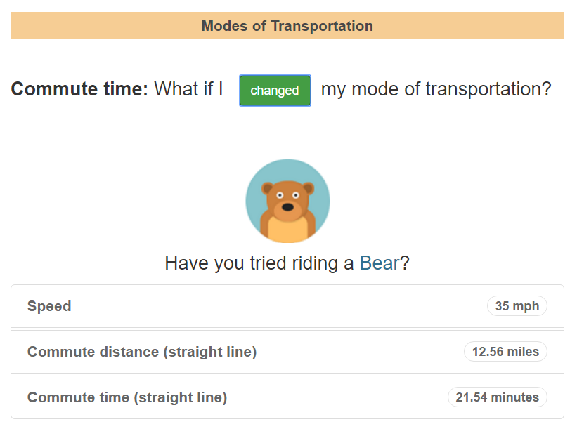
The Front End
Have a little fun!

Slide 11
The Database

Slide 12
Data Collection from Smart Phones

Slide 13
Agglomerative Clustering

Slide 14
Sensor Data

Slide 15
Machine Learning: Predicting Times During a Commute

Slide 16
Feature Selection: GPS free tracking

Slide 17
Into the Woods: Random Forest Classification

Slide 18
ROC for the Classes

Slide 19
Demonstration!

Slide 20
Audiobook Recommendation System

Slide 21
Future Development

Slide 22
Thank You!

