Slide 1
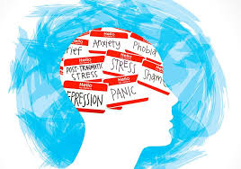
Mental Health Risk Text Classifier Can Text Data Identify Risk?
By Leah Pilossoph, RN

Slide 2
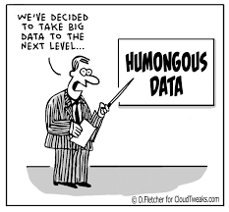
The Problem
Diagnosing is limited
Based on infrequent conversations between clinicians and patients
Some questionnaires; but many feel they are outdated
Need More Data!!!

Slide 3

Text Classification with Reddit Posts
Methods:
PRAW for web-scraping Reddit data
Multinomial Naïve Bayes classification
Deep neural networks
Feature Extraction
Count Vectorization
TF-IDF Vectorization

Slide 4

RESULTS
Mental Health Risk / Non-Mental Health Risk Classifier
Precision: 0.76
Recall: 0.78
Accuracy: 0.77
F1 Score: 0.77

Slide 5

RESULTS
Suicide Risk Classifier
Accuracy: 0.66
Precision: 0.64
Recall: 0.77
F1 Score: 0.70

Slide 6
IMPORTANT FEATURES
"anxiety”
Higher use contributed to more non-suicidal posts
"suicide
"life”
"die”
"kill”
"anymore”
Post Length
shorter contributed to more suicidal posts
"live”
"fuck”
Percentage Absolutist Words used
Higher percentage contributed to more suicidal posts

Slide 7
RECOMMENDATIONS
Clinicians can utilize to identify/diagnose
Clinicians can track progress
New medications
Can also be used by family members
Parents
spouses

Slide 8
FUTURE WORK
More data!
My measly computer couldn’t handle that much text data…
Better data!
Relying on redditors to self-diagnose themselves by posting in suicide/depression/anxiety forums is not reliable!
Control forums used: cannot rule out that these redditors are also in fact suffering from mental illness

Slide 9
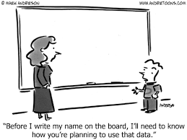
FUTURE WORK CONTINUED
PRIVACY!!!
Ensure that text is not being used improperly
Especially if future data utilizes unpublished texts

Slide 10


QUESTIONS?

