Slide 1

Café Harmony
Key Performance Indicators and Business Insights for Years 2024 – 2026.
By Hamzat Afe Isede

Slide 2
Key Performance Indicators (KPI)
$12,589.95
1,003
Café Harmony with their Customer base of 1,003 and 1,000 Employees, utilized 10 Stock items to produce 6 menus, amounting to a combined sales quantity of 3,012 and yielding a total sale of $12,590 in the period under review – 2024 to 2026. They garnered an average review of 3 stars from their customers.
Total Sale
Customers
3,012
1,000
Total Quantity
Employees
10
3
Stock Items
Average Rating
02
Café Harmony

Slide 3
The trend of Total Sales across the 3 years under review indicate that Total sales primarily peaks in August. May and March also experience lesser peaks.
The month that has the least Total sales is November, with surrounding months of October and December following suit. February and June also experience troughs in the Total Sales trend.
03
Café Harmony

Slide 4
The Revenue chart shows that the menu item that performed the best was Muffin, closely followed by Cappuccino and Ice tea.
Sandwich sold the least, doing slightly better than Croissant.
04
Café Harmony

Slide 5
A look at the customer spending pattern reveals that Females (54%) spent slightly more than the Males (46%).
The Age bracket that spent the most in the five age brackets between 18 to 65 years was the 28 – 37 years bracket with 22%.
In the 6 Menu items, Muffin was the most preferred by the customers. While Sandwich was the least preferred.
05
Café Harmony

Slide 6
The Stock management indicates that Juice Concentrate had the best optimal utilization. Lemon had a fairly optimal utilization, with an over-stock of 13.
Milk and Croissant Dough suffered the worst Stock management with an availability shortfall of 79 and 74 respectively.
06
Café Harmony

Slide 7
A substantial number of the customers gave no rating.
The Customer Ratings across the timeline indicates a prevalent rating of 3 stars for those that rated.
With the number of Customers who rated above 3 and below 3 almost evenly split.
07
Café Harmony

Slide 8
The Employee performance chart indicates that Megan White is the top performing employee followed by Elizabeth Johnson.
The least performing employee is Elizabeth Green who did slightly better than Linda Lee.
The best performing Location is the Airport while Uptown is the location that performed the least.
08
Café Harmony

Slide 9
Key Findings, Trends, and Business Recommendations.
Key Findings
The top selling menus are Muffin, Cappuccino and Ice Tea.
By demography, the customer age group that spend the most are those between the ages of 28 and 37 years. While the females spend slightly more than males.
Milk, Croissant Dough, and Iced Tea Bags are the stock items suffering from under-stocking.
At 3/5, the customer ratings are below standard for a café.
The number of employees performing below par is high.
09
Café Harmony

Slide 10
Trends
The Total Sales is low at the end of the year, during the months of October, November, and December. It is also trending low around February and June.
It is worrisome to see that a a large number of customers gave no rating.
Recommendation
The least selling menus Croissant, Sandwich and Latte, should be improved in terms of service delivery so that their Total sales can be at par with their counterparts.
The oldest customers age bracket is between 58 and 65 years, they may be spending the least because of the current ambience of the locations. An improvement in the interior and sitting for comfort is required to attract and make them linger for longer period during their visits.
The stocking of Milk, Croissant Dough, and Iced Tea Bags need to be improved. An inventory software should be acquired for all locations to alert the managers when stocks are running low.
An improved staff welfare is needed to motivate the employees to do well. Those already performing well should be celebrated and rewarded. These will foster a healthy competition among them.
Meeting the above recommendations will encourage all customers to leave a review and make them increase their ratings from the current average of 3/5.
10
Café Harmony

Slide 11
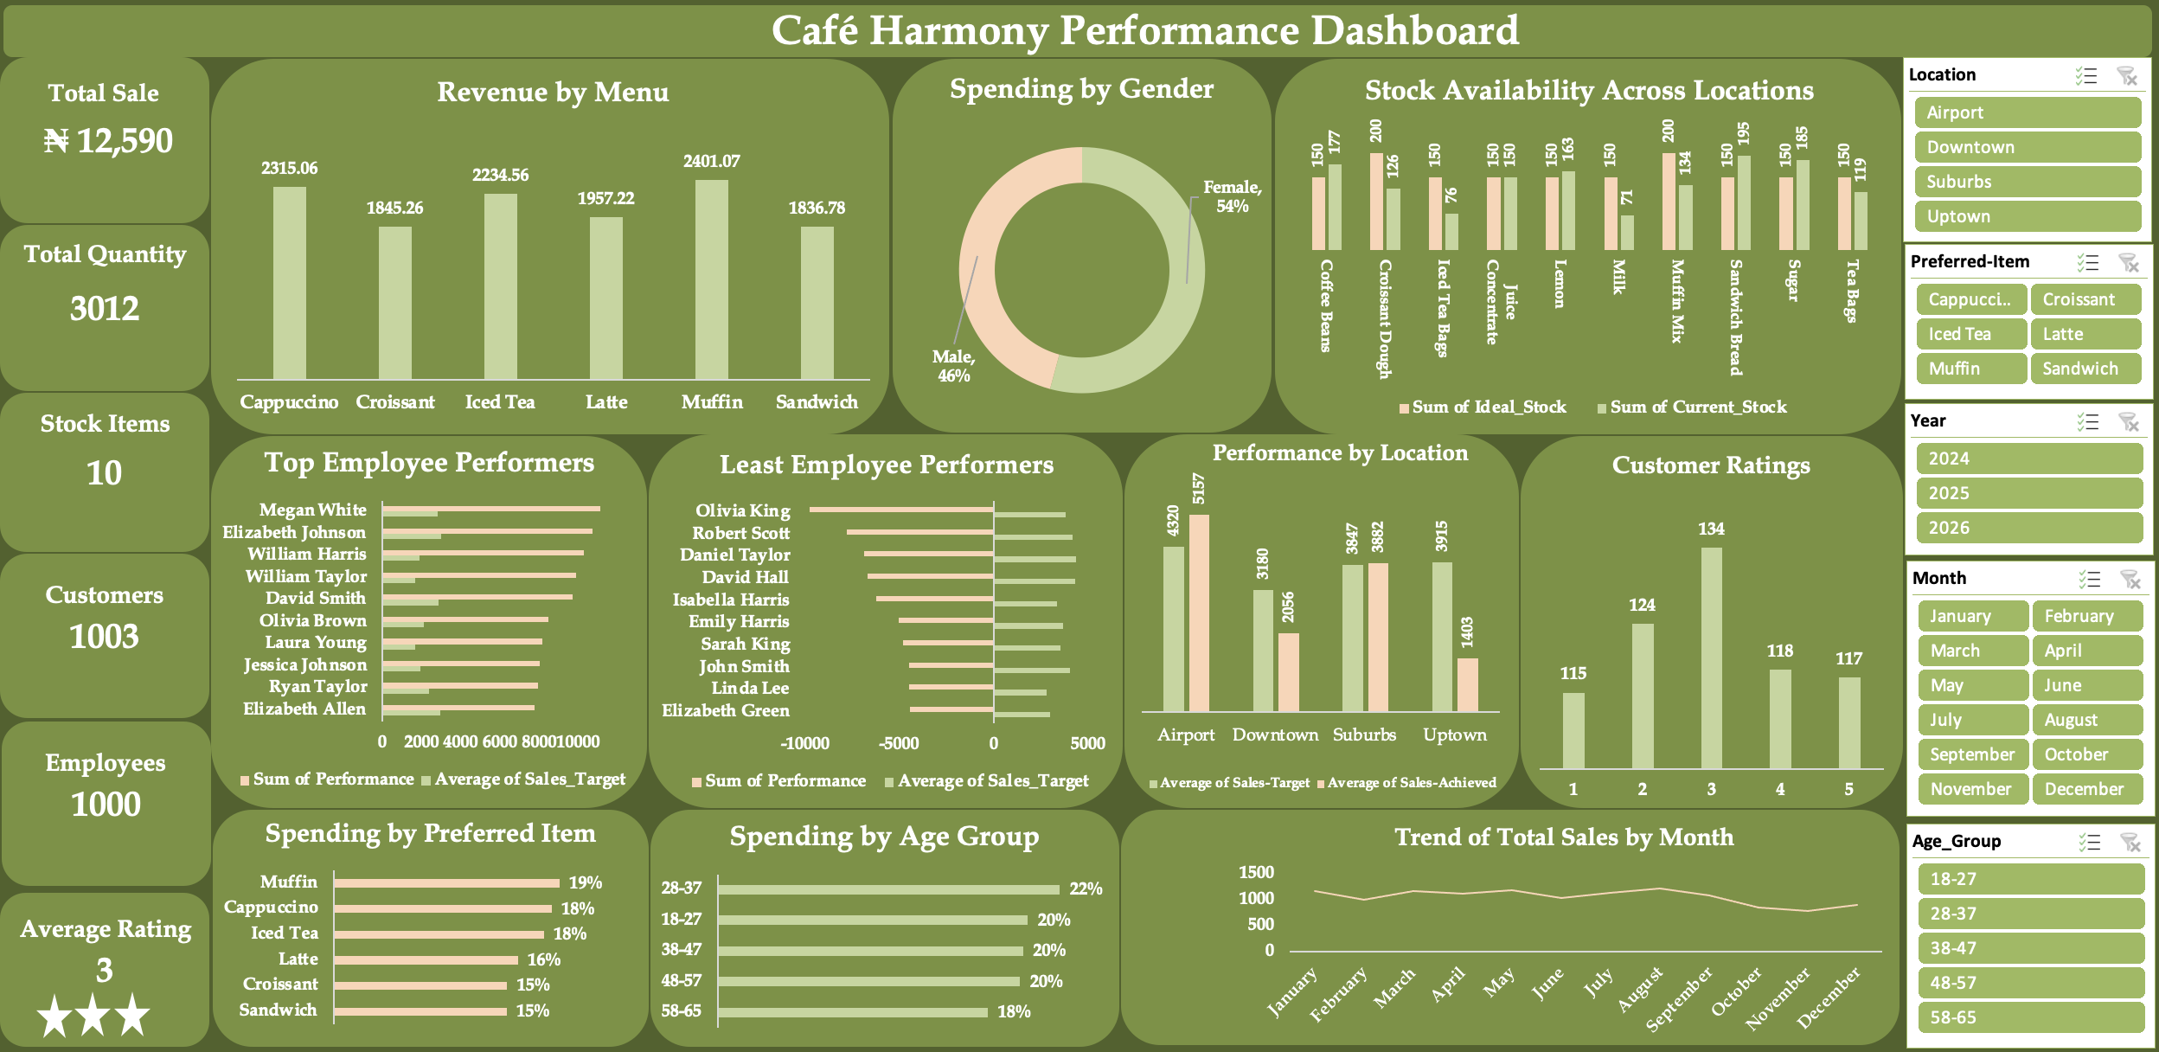
06
Café Harmony

