Slide 1
NextGen Corp.
Employee Retention, Performance, and Remuneration Analyses.
By Hamzat Isede
June 29, 2025.

Slide 2
Business Overview
NextGen Corp. is a growing technology company focused on developing innovative solutions in the software and hardware spaces. A company that prides itself on attracting top talent and maintaining high employee satisfaction to drive growth has sadly realized that it is nothing but. This is due to an increasing concern regarding employee turnover, performance variability, and salary disparities within its departments.
The goal of this business evaluation is three-prong:
Identify trends and patterns in employee retention and turnover.
Track and evaluate performance across different departments.
Assess the relationship between salary and performance to ensure fairness and employee satisfaction.

Slide 3
Understanding the employee turnover trends and identifying the root causes of high turnover rates.
In the following slides we aim to analyze the key trends informing the high employee turnover and determine its root causes. Questions we need to answer are:
Who are the top 5 highest serving employees?
What is the turnover rate for each department?
Which employees are at risk of leaving based on their performance?
What are the main reasons employees are leaving the company?

Slide 4
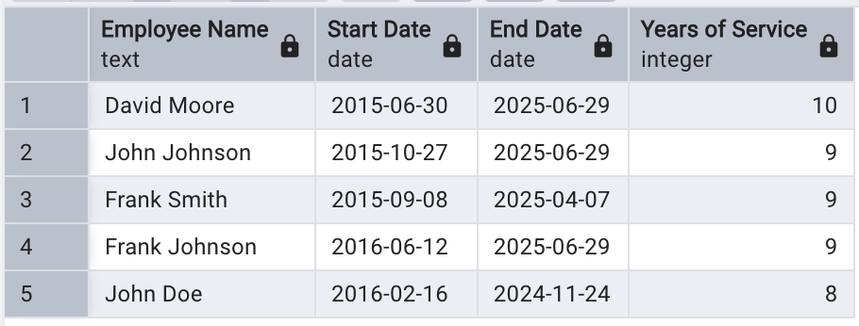

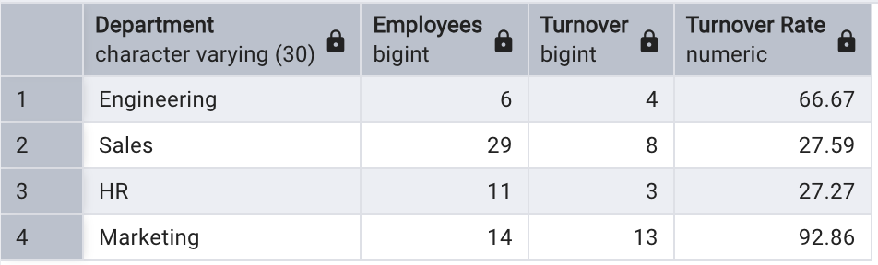
1. Who are the top 5 highest serving employees? 2. What is the turnover rate for each department?
Table 1.1: Serving Employees
Table 1.2: Turnover Rate By Department

Slide 5
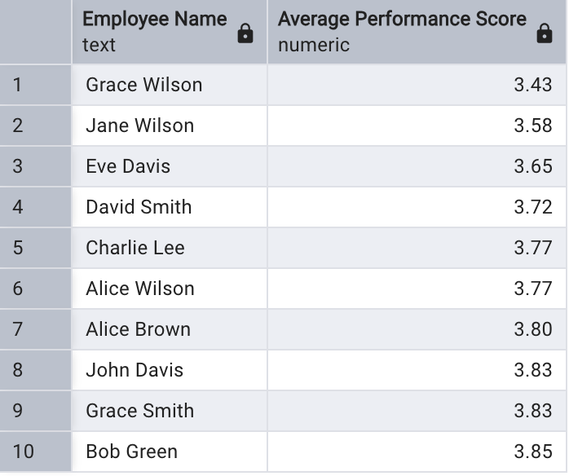
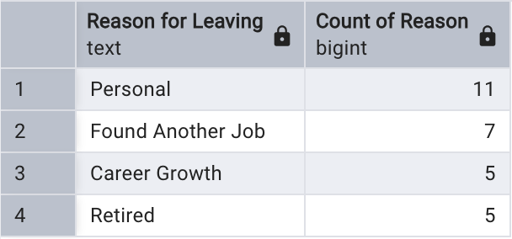
3. Which employees are at risk of leaving based on their performance? 4. What are the main reasons why employees are leaving the company?
Table 1.4: Employee Reasons For Leaving The Company
Table 1.3: Lowest Average Performance By Employees

Slide 6
Evaluating employee performance across different departments and identifying areas where performance can be improved.
In the following slides we take aim at employee performance and their impact on the organization across the departments. Questions we need to answer here are:
How many employees has left the company?
How many employees have a performance score of 5.0? And below 3.5?
How many employees have a performance score of 5.0? And below 3.5?
What is the average performance score by department?

Slide 7
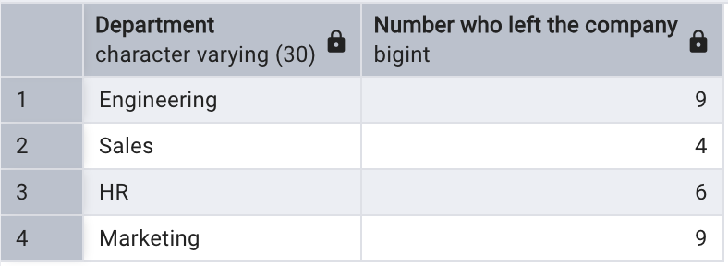
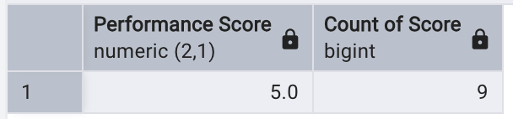
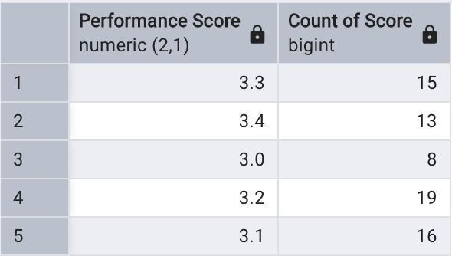
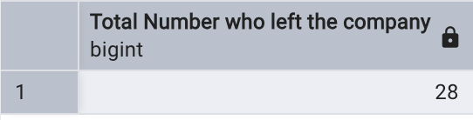
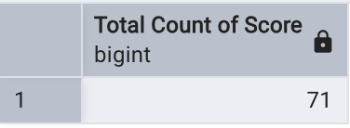
5. How many employees has left the company? 6. How many employees have a performance score of 5.0? And below 3.5?
Table 2.2a: Number of Employees With A P-Score of 5.0
Table 2.1: Number of Employees That Has Left The Company
Table 2.2b: Number of Employees With A P-Score of less than 3.5

Slide 8
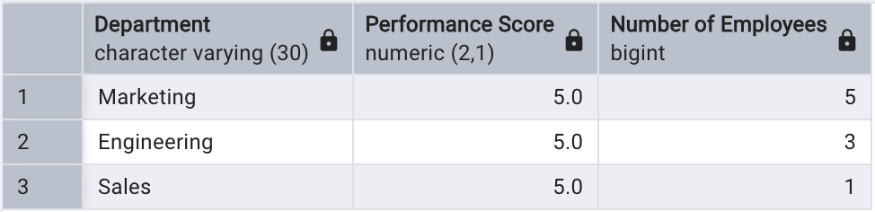
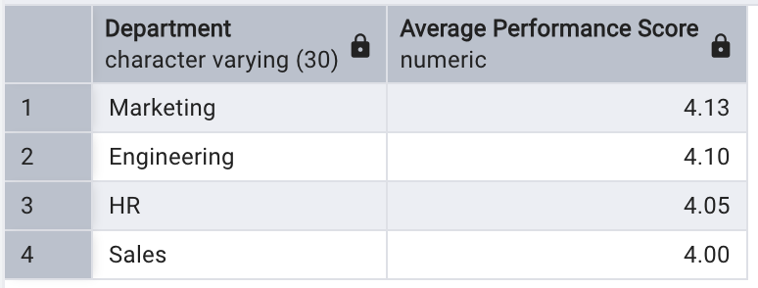
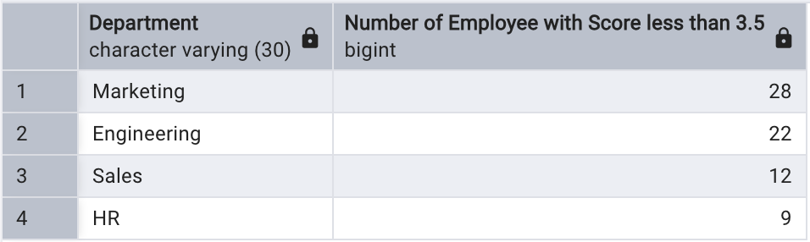
7. Which department has the most employees with a performance score of 5.0 ? And below 3.5? 8. What is the average performance score by department ?
Table 2.3a: Department With Employees with P-Score of 5.0
Table 2.4: Average Performance Score By Department
Table 2.3a: Department With Employees with P-Score of less than 3.5

Slide 9
Analyze salary distribution and ensure fair compensation based on performance and departmental benchmarks.
The following slides analyzes the company’s remuneration policy with a view to recommending fair compensation based on departmental benchmark and performance. Questions to answer here are:
What is the total salary expense for the company?
What is the average salary by job title?
How many employees earn above 80,000?
How does performance correlate with salary across departments?

Slide 10
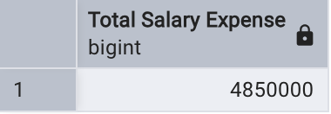
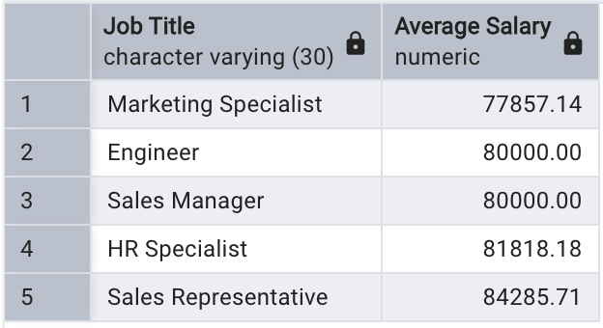
9. What is the total salary expense for the company? 10. What is the average salary by job title?
Table 3.1: Total Salary Expense Of The Company
Table 3.2: Average Salary By Job Title

Slide 11
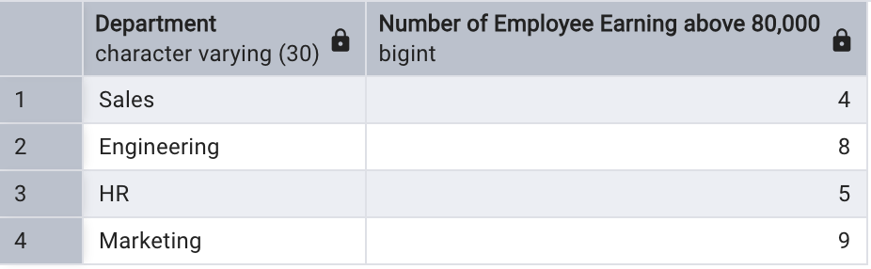
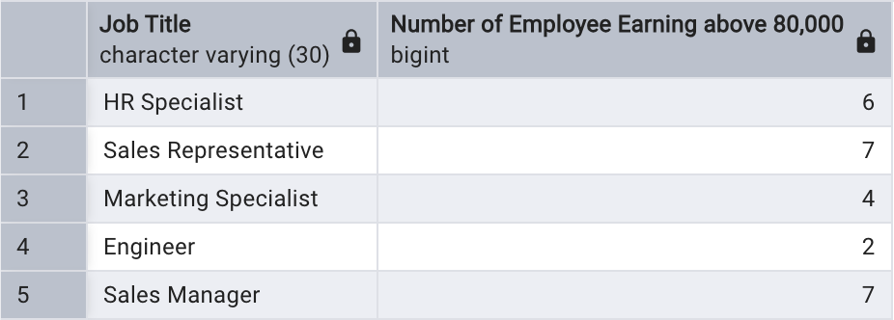
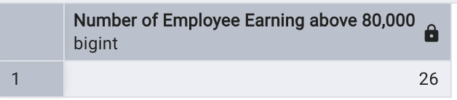
11. How many employees earn above 80,000? (a) Across Departments 11. How many employees earn above 80,000? (b) Across Job Titles
Table 3.3a: Employees Earning above 80,000 Across Departments
Table 3.3b: Employees Earning above 80,000 Across Job Titles

Slide 12
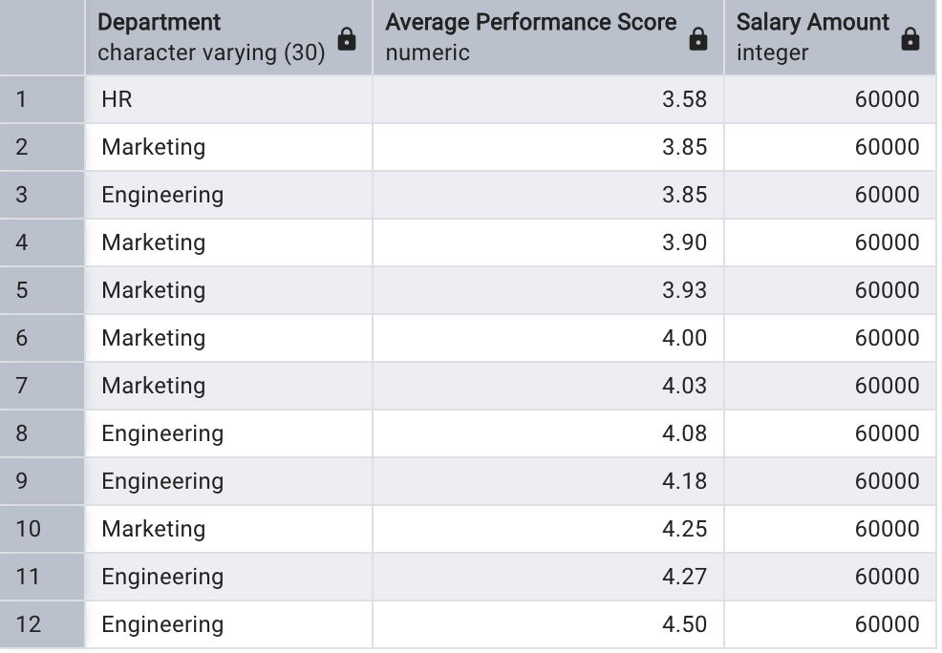
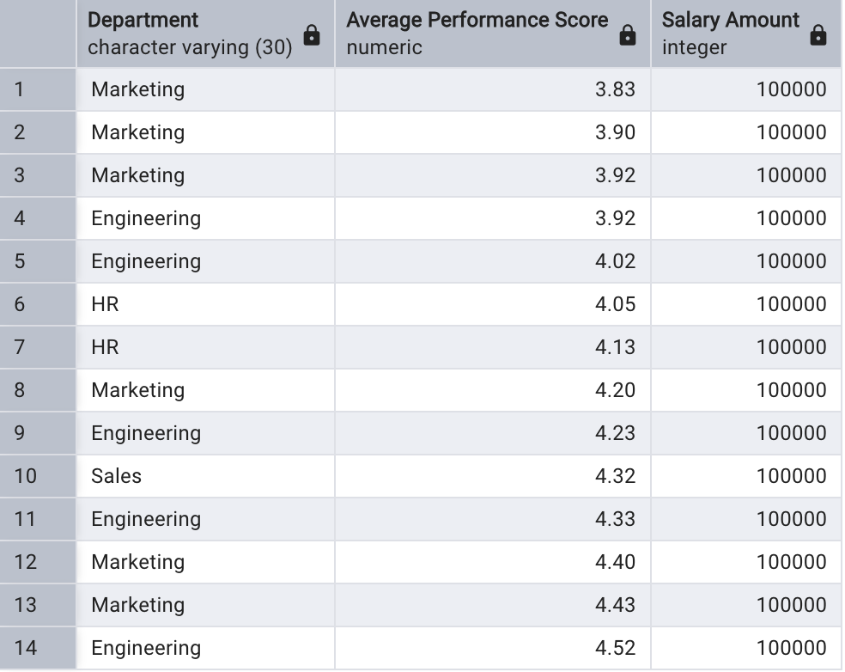
12. How does performance correlate with salary across departments? (a) For the lowest salary of 60,000. 12. How does performance correlate with salary across departments? (b) For the highest salary of 100,000.
Table 3.4a: Performance Correlation With Lowest Salary
Table 3.4b: Performance Correlation With Highest Salary

Slide 13
Strategic Insights For employee retention, performance tracking, and salary analysis (1/3)
Employee Retention
Of the 60 employees at NextGen, only one has served up to 10 years while about a quarter has served for more than 8 years among the long serving employees. On the flip side, 5 of the 60 (about 8%) did not stay up to 1 year, while another 7 of the 60 (about 12%) stayed just 1 year. This means about 20% stayed a year or less! This indicate a huge turnover rate. (Table 1.1)
The departments with the highest turnover rate are Marketing and Engineering with 93% and 67% respectively - (Table 1.2). A cursory look into this trend reveals an unequal correlation between performance and remuneration in these two departments.
If the performance score are anything to go by, more than a few of the employees may be considering leaving the company based on their current average performance score. (Table 1.3)
Personal Reasons and Found Another Job are the top two reasons for leaving the company - (Table 1.4). Since Salary is a foremost motivating factor with employees, a. low salary is definitely the cause behind these two reasons for leaving.

Slide 14
Strategic Insights For employee retention, performance tracking, and salary analysis (2/3)
Performance Tracking
A total of 28 employees has left NextGen. Of this number, Engineering and Marketing departments has the highest of 9 each. While 6 has left HR and 4 left Sales - (Table 2.1). The poor correlation between employee performance and salary is the root cause of the high turnover in Engineering and Marketing as seen in Table 3.4a, where the departments with the lowest salary of 60,000 are predominantly Engineering and Marketing, even though their average Performance score range from 3.5/5.0 – 4.5/5.0.
A total of 9 employees has ever had the highest Performance Score of 5.0. While a total of 45 employee had performance scores below 3.5. Because some had the score multiple times, the cumulative count of scores below 3.5 was 71. (Tables 2.2a and 2.2b).
The Marketing department had the most number of employees with a Performance Score of 5.0. Ironically, Marketing department also had the most number of employees with a Performance Score below 3.5. (Tables 2.3a and 2.3b).
Marketing department had the highest average Performance Score ( of 4.13), while Sale department had the lowest average Performance Score (of 4.0). (Table 2.4).

Slide 15
Strategic Insights For employee retention, performance tracking, and salary analysis (3/3)
Salary Analysis
The total Salary Expense of NextGen. is 4,850,000. (Table 3.1).
The Job Title with the highest Average Salary is Sales Representative with 84,285.71, followed by HR Specialist with 81,818.18. While Engineer and Marketing Specialist bring up the rear with 80,000.00 and 77,857.14 respectively. (Table 3.2). This poor relative remuneration of the Marketers and Engineers buttresses the reason for their high turnover.
A total of 26 employees earn a Salary above 80,000. Across Departments, Marketing has 9, Engineering has 8, HR has 5, and Sales has 4 employees. While Across Job Titles, 7 Sales Managers, 7 Sales Representatives, 6 HR Specialists, and 4 Marketing Specialists earn Salary above 80,000. (Tables 3.3a and 3.3b).
The correlation of Performance with Salary are shown for the 12 employees earning the lowest salary of 60,000 - (Table 3.4a), and for the 14 employees earning the highest salary of 100,000 - (Table 3.4b). It is clearly seen here that there is no correlation between the Performance Score and Salary. Employees with higher performance score don’t necessarily get higher salaries.

Slide 16
Conclusion & Recommendations
The root causes of high turnover rates – Actionable recommendation to mitigate it.
An unequal correlation between performance and remuneration in the Marketing and. Engineering departments is the major cause for the high turnover rates in these departments – 93% and 67% respectively.
There should be fair Performance-Wage scale. A software can be deployed to track employee performance and trigger an appropriate salary increment. The use of an automated software will prevent human interference.
Areas where performance can be improved – Actionable recommendation to mitigate it.
From Table 2.3a, Marketing and Engineering has the highest employees with a performance score below 3.5 of 28 and 22 respectively. This is expected because of the unfair performance-wage scale.
The areas(department) where performance can be improved are Engineering and Marketing. And a fair and incentivized performance-wage scale will bring about the much-needed improvements.
Ensure fair compensation based on performance and departmental benchmarks – Actionable recommendation to mitigate it.
From Table 3.3b, of the employees earning above 80,000, 7 each are Sales Managers and Sales Representatives; while only 2 and 4 are Engineers and Marketing Specialists respectively. This existing mode of compensation is not fair.
To ensure fairness a policy should be instituted to make sure that the hierarchies in the departments are at par in terms of salaries and compensations. Foe instance a Manager in Engineering should earn the same as a Manager in Sales, HR, and Marketing.

