Slide 1
AIRPORT INVESTMENT INTELLIGENCE
01 / 06
Where should the
next terminal go?
402
A conversational analyst for airport
modernization opportunities.
US PRIMARY AIRPORTS
Deterministic scores. Public sources. Visible evidence.
Screens candidates for due diligence; project profitability requires further analysis.
PUBLIC AVIATION DATA / OCTOBER 2026
Notes:
The assignment is a US airport-modernization screening agent. The FAA CY2025 primary-airport universe in data/snapshot/manifest.json contains 402 airports. Source deck: docs/deck.pptx, slide 1. Investment Opportunity Score is a screening signal, not a financial return estimate. Actual score inputs and dates appear on slide 3. The deployed demo is https://airport-investment-agent-n37j.onrender.com; reviewer access is provided separately. No credentials are included in this deck.

Slide 2
AIRPORT INVESTMENT INTELLIGENCE
02 / 06
Airport analyst architecture
Claude chooses the tools. Python calculates the numbers.
01 ASK
02 CHECK ACCESS
03 CHOOSE TOOLS
04 CALCULATE
Chat + evidence
FastAPI
Claude analyst
Python tools
Next.js
Vercel AI SDK
Session, rate and
recorded-spend checks
Pydantic AI
Tool selection + explanation
Rankings, comparisons
and route analysis
Save / restore
Fetch live context
Read-only SQL
Answer with
visible evidence
Postgres
Live APIs
Snapshot data
Sources and dates
Coverage + confidence
Sessions, history
and model usage
BTS, DOT and FAA
Context only
Read-only DuckDB
over dated Parquet
One Render container serves the UI + API. Model keys stay on the server.
Notes:
Presenter explanation: A reviewer asks a question in the Next.js chat. FastAPI checks the signed session, per-session rate limit and recorded-spend thresholds. Pydantic AI runs the Claude analyst, which chooses typed tools and explains their outputs. Deterministic Python tools compute rankings, comparisons, route mix and unmet-demand indicators over a dated Snapshot. DuckDB exposes read-only views over committed Parquet files. The answer and typed tool outputs stream back through the Vercel AI SDK protocol, populating the Mission evidence panel with sources, dates, coverage and confidence. Live government tools call BTS, DOT and FAA NAS APIs with timeouts, retries and caching, and their signals never alter Snapshot scores. Postgres stores app sessions, conversation history and usage. Production uses one Docker container for FastAPI and the static Next.js export, plus a separate Render Postgres. Optional voice uses OpenAI for audio and delegates analytic questions to the same Claude agent. Anthropic and optional OpenAI API keys stay in server environment variables. The spend guard checks recorded usage rather than reserving worst-case spend in advance.
Repository evidence verified in the preceding architecture review at commit c1dcc727cc408b0a1bf57eaf12cb3049437495b7:
https://github.com/afek5/airport-investment-agent/blob/c1dcc727cc408b0a1bf57eaf12cb3049437495b7/backend/app/api/__init__.py
https://github.com/afek5/airport-investment-agent/blob/c1dcc727cc408b0a1bf57eaf12cb3049437495b7/backend/app/agent/__init__.py
https://github.com/afek5/airport-investment-agent/blob/c1dcc727cc408b0a1bf57eaf12cb3049437495b7/backend/app/snapshot.py
https://github.com/afek5/airport-investment-agent/blob/c1dcc727cc408b0a1bf57eaf12cb3049437495b7/backend/app/main.py
https://github.com/afek5/airport-investment-agent/blob/c1dcc727cc408b0a1bf57eaf12cb3049437495b7/render.yaml
https://github.com/afek5/airport-investment-agent/blob/c1dcc727cc408b0a1bf57eaf12cb3049437495b7/backend/app/api/voice.py

Slide 3
AIRPORT INVESTMENT INTELLIGENCE
03 / 06
How the analyst works
01
02
03
04
Ask
Choose
Calculate
Inspect
Chat or voice
One analytical agent
Deterministic Python
Answer and evidence
Next.js chat receives the question and preserves conversational context.
Pydantic AI runs Claude Sonnet 5.5, which selects tools and explains results.
Tools rank airports and calculate congestion, route mix and demand indicators.
The Mission panel exposes values, source dates, assumptions and the tool trace.
A dated snapshot anchors the scores.
Live APIs add current context.
FAA, BTS and Census / DuckDB reads Parquet
BTS traffic, DOT airfares and FAA NAS status
ARCHITECTURE
Notes:
Architecture evidence: DESIGN.md sections 2, 3 and 5; backend/app/agent/__init__.py; backend/app/contracts.py. Browser uses Vercel AI SDK useChat; FastAPI exposes the application; DuckDB queries dated Parquet; Postgres persists sessions, conversations and usage. The flow describes the request and verification process, with tool data returning to the agent and then to the interface. Live Signals never alter deterministic snapshot scores. Voice, where enabled, delegates analytics to the same analytical agent. Public sources: https://www.faa.gov/airports/planning_capacity/passenger_allcargo_stats/passenger ; https://www.transtats.bts.gov/ ; https://nasstatus.faa.gov/api/airport-status-information ; https://data.transportation.gov/resource/tfrh-tu9e.json .

Slide 4
AIRPORT INVESTMENT INTELLIGENCE
04 / 06
Growth, pressure and market size
35%
Demand Momentum
FAA forecast growth (60%) and observed enplanement growth (40%)
40%
Capacity Pressure
Passenger load factor (40%), departure delays (30%) and taxi-out (30%)
25%
Market Scale
Annual enplanements (70%) and metro-area population (30%)
Seven metric percentiles; a weighted geometric mean
Score = exp[ Σ weight × ln(max(pillar, 1)) ]
DATA CONFIDENCE
Missing metrics use percentile 50 and are named.
No measured metric in a pillar: airport excluded.
High: 7/7 Medium: 5–6/7 Low: ≤4/7
Scenarios and ad-hoc results: at most Medium.
SCORING METHODOLOGY
Notes:
Source: docs/SPEC.md §4, DESIGN.md §4, backend/app/analytics/common.py coverage_level, and docs/adr/0002-geometric-mean-of-percentile-pillars.md. Metric percentiles are across primary airports with each measured metric. Forecast CAGR is TAF FY2024 actual to FY2035 forecast, including international passengers. Observed growth is FAA CY2024 to CY2025. Passenger load factor uses T-100 Aug 2025–Jul 2026, class F; delay and taxi-out use reporting-carrier domestic On-Time data Sep 2025–Aug 2026. Scale uses CY2025 enplanements and Census 2025 CBSA population. Default pillar weights are 0.35/0.40/0.25 and are analyst assumptions. Missing metrics are imputed at percentile 50 and named; scores are provisional. The slide summarizes coverage confidence; live-source failures can reduce confidence to Low and scenario/ad-hoc results never exceed Medium. Sources: https://taf.faa.gov/ ; https://www.faa.gov/airports/planning_capacity/passenger_allcargo_stats/passenger ; https://www.transtats.bts.gov/ ; https://www2.census.gov/programs-surveys/popest/datasets/2020-2025/metro/totals/cbsa-est2025-alldata.csv .

Slide 5
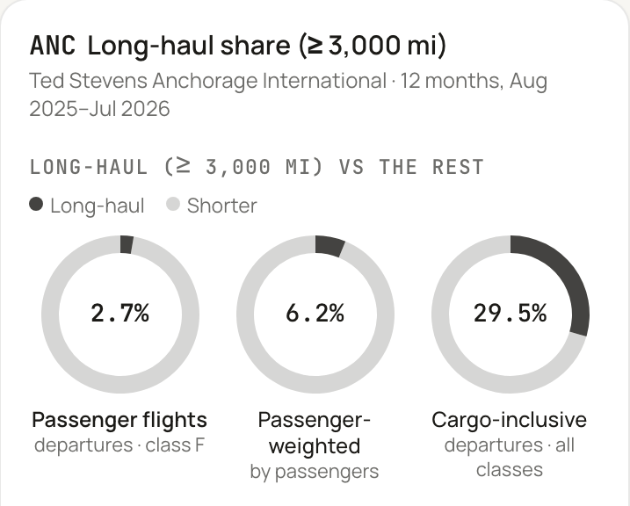
AIRPORT INVESTMENT INTELLIGENCE
05 / 06
Live answers and conversational follow-ups
NEW ENGLAND / FOLLOW-UP
ANCHORAGE / ACTUAL TOOL EVIDENCE
“What if growth matters
twice as much?”
Airport | Default rank | Growth ×2 rank | New score
BGR Bangor | 2 | 1 | 75.6
HVN New Haven* | 4 | 2 | 74.8
BTV Burlington | 3 | 3 | 71.3
BOS Boston | 1 | 4 | 66.4
2.7%
Passenger flights
(class F)
Growth weight: 0.35 to 0.70 before normalization.
The six-state scope stays the same.
*HVN is provisional: 5 of 7 metrics measured.
3,000-mile segments / Aug 2025–Jul 2026
LIVE DEMONSTRATION
Notes:
Native table source: docs/examples.md G1 and G5, generated by live agent tests. Baseline: BOS 73.1/rank1, BGR 72.4/rank2, BTV 71.9/rank3, HVN 69.9/rank4. Doubling the momentum weight from 0.35 to 0.70 with pressure 0.40 and scale 0.25, then normalizing, produces: BGR 75.6/rank1, HVN 74.8/rank2, BTV 71.3/rank3, BOS 66.4/rank4. HVN coverage is 5/7 with delay_share and taxi_out imputed; overall displayed ranking confidence Medium. Same New England scope: CT, ME, MA, NH, RI, VT. The screenshot is an authentic crop of docs/deck/g3-anchorage-app.png, captured from the deployed demo on 2026-10-22. It is a separate example, not a screenshot of the ranking follow-up. ANC values are 2.7%, 6.2%, 29.5%, as also recorded in docs/examples.md G3. Long-haul threshold is 3,000 statute miles. Image source is the user’s application, https://airport-investment-agent-n37j.onrender.com. The screenshot was cropped only, without changing its data.

Slide 6
AIRPORT INVESTMENT INTELLIGENCE
06 / 06
A useful screen,
with clear limits
CURRENT LIMIT
NEXT STEP
Judgment-based weights
The weights have not been fitted to
completed investment outcomes.
Backtest against past
terminal projects.
Incomplete operating data
Domestic reporting-carrier delays;
missing metrics require imputation.
Add gate utilization
and refresh snapshots.
Project economics absent
Traffic pressure alone cannot establish
renovation cost, return or feasibility.
Add cost, revenue and
feasibility evidence.
Try the live analyst
airport-investment-agent-n37j.onrender.com
Reviewer access supplied separately
SCOPE AND NEXT STEPS
Notes:
Sources: DESIGN.md §§4,6,7; docs/SPEC.md scoring and limitations; application behavior verified in the browser on 2026-10-22. This deck does not claim a backtest, causal effect of expansion, ROI estimate, or unrestricted public access. Public source datasets support screening and show evidence of pressure, not project returns. The automated live suite checks selected answer percentages and numerical values against tool results; it is not a guarantee for all future answers. Specifically, backend/tests/grounding.py checks percentages and numbers with at least three significant digits (plus count-format and other assertions in the suite). Follow-up and ad-hoc queries are supported, but missing periods and unsupported financial estimates must be disclosed. Demo link: https://airport-investment-agent-n37j.onrender.com. Credentials are deliberately omitted.

