Slide 1
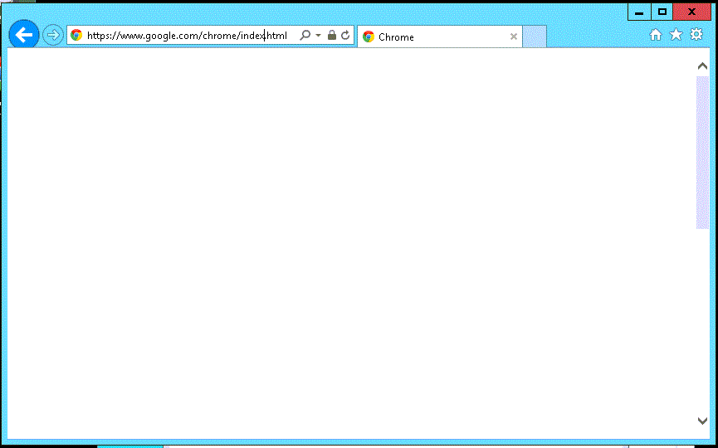




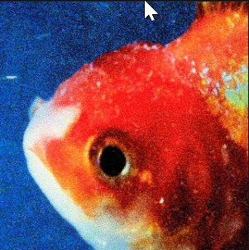
justNoise
Hi, Anson
Log in
Sign up
Browse
Contributors
Weekly Music Mixtape
Your Groups
101
Anson
82
Lucas
High School Gang
54
Paige
12
Weekly Music Mixtape
Tarun
1
Ultimate Frisbee Group
Matt
Work Hard, Sing Hard
Add member
Create New Group
ILYSB
by LANY
Contributed 20 minutes ago by Lucas
4
Burnout Blues
by Washed Out
Contributed 2 days ago by Anson
1
Slide
by Calvin Harris
Contributed 3 days ago by Matt
8
Big Fish
by Vince Staple
Contributed 20 minutes ago by Tarun
2

Slide 2
User
Sign In
Log In
Log Out
Group
Create Group
Edit Group
Post
Create Post
Edit Post
Delete Post
Create Note
Contributor
Create contributor
Remove contributer

