Slide 1
justNoise

Slide 2
Concept
Unite
Share
Enjoy

Slide 3
User Stories
User Management
Group Management
Post Management
Browsing
Technical
Sign Up
Create Group
Create Post
Browse Posts
Configure Database Interface (CRUD)
Log In
Edit Group
Edit Post
Browse Group
Configure Database Interface (CRUD)
Log Out
Add Contributor
Comment On Post
Set up Spotify API
Note Management
Like Post
Remove Contributor
View Likes

Slide 4
Engineering Roadmap

Slide 5
Personas
Kyle wants to create a group for his friends from college to stay in touch through music
Kyle uses Spotify frequently throughout the day
Jane went to college with Kyle
Jane received an invite to join JustNoise from Kyle

Slide 6
Architecture
Views
Routes
Models

Slide 7
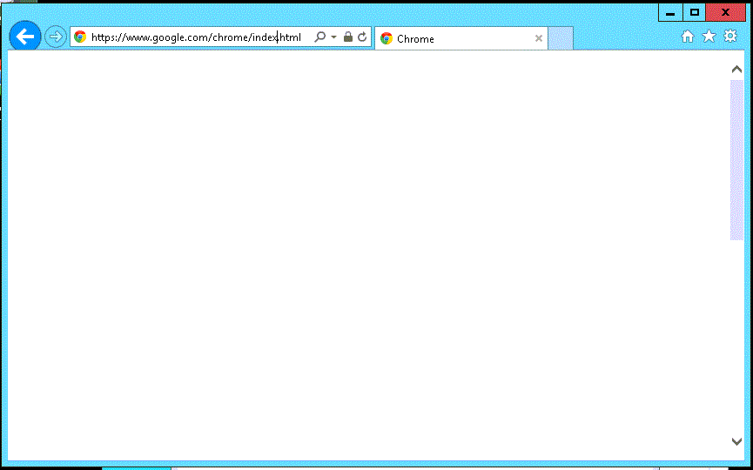




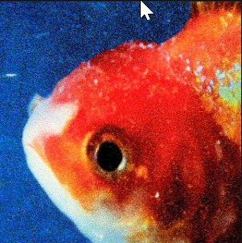
justNoise
Hi, Anson
Log in
Sign up
Browse
Contributors
Weekly Music Mixtape
Your Groups
101
Anson
82
Lucas
High School Gang
54
Paige
12
Weekly Music Mixtape
Tarun
1
Ultimate Frisbee Group
Matt
Work Hard, Sing Hard
Add member
Create New Group
ILYSB
by LANY
Contributed 20 minutes ago by Lucas
4
Burnout Blues
by Washed Out
Contributed 2 days ago by Anson
1
Slide
by Calvin Harris
Contributed 3 days ago by Matt
8
Big Fish
by Vince Staple
Contributed 20 minutes ago by Tarun
2

Slide 8
JustNoise Model
Contributor
userID (string) (FK)
groupID (string)
groupNotes (number)
dateJoined (date)
Creator (Boolean)
User
userID (string) (PK)
displayName (string)
profileURL (string)
totalNotes (Number)
Token (String)
rToken (String)
Group
groupID (string) (PK)
Name (string)
dateCreated (date)
PlaylistID (string)
Description (string)
Post
postID (PK)
userID (string) (FK)
groupID (string) (FK)
spotifyID (string) (FK)
datePosted (date)
Comment (string)
Note
noteID (string) (PK)
postID (string) (FK)
dateLiked (date)
userID (string) (FK)
internal (Boolean)
Spotify API
User
Display_name (string)
Href (string)
Id (string)
Images (image objects)
Type (string)
Uri (string)
Playlist
Collaborative (Boolean)
Description (string)
Href (string)
Id (string)
Images(image objects)
Name (string)
Tracks (track object)
Type (string)
Uri (string)
Playlist track
Added_at (timetamp)
Added_by (user)
Is_local (Boolean)
Track (track)
Track
Artists (artists)
Disc_number (integer)
Duration_ms (integer)
Explicit (Boolean)
Href (string)
Id (string)
Is_playable (Boolean)
Name (string)
Preview_url (string)
Track_number (integer)

Slide 9
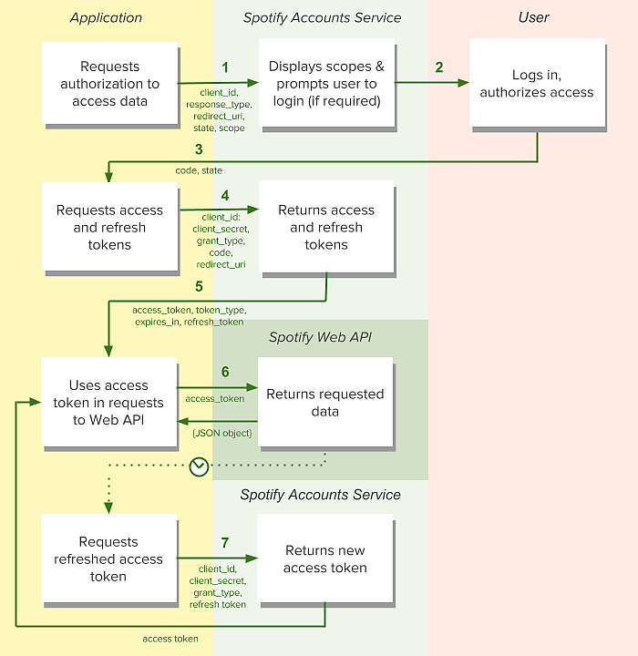
Spotify Authorization
https://developer.spotify.com/web-api/authorization-guide/#authorization_code_flow

Slide 10
Page Flow
Create Group Page
Sign Up Page
Landing Page
Home Page
Group Page
Create Post Page
Log In Page
Post Page

Slide 11
Landing Page

Slide 12
Log In Page

Slide 13
Sign In Page

Slide 14
Home Page

Slide 15
Create Group Page

Slide 16
Group Page

Slide 17
Create Post Page

Slide 18
Post Page

