Slide 1
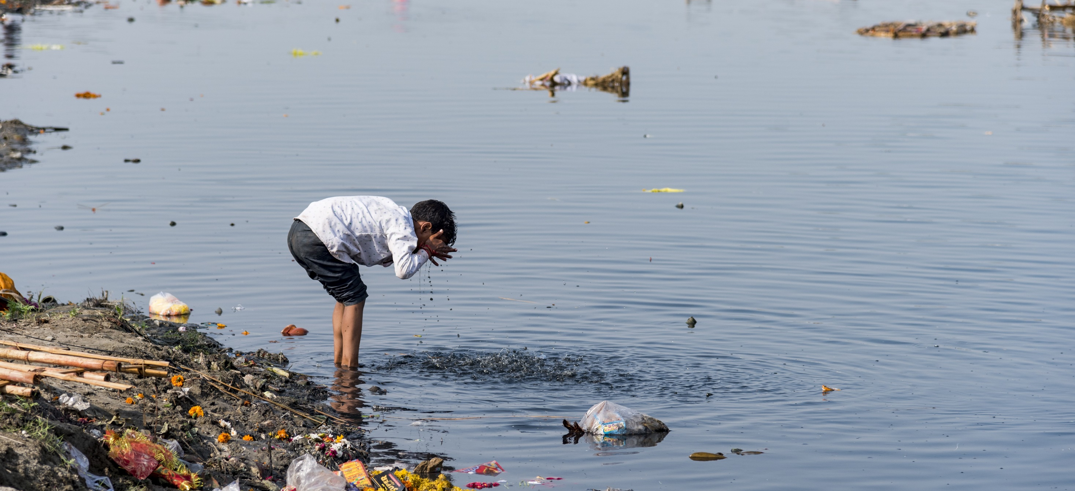




Water Quality Data Interoperability Experiment Kick-off
What is an OGC Interoperability Experiment ?
Sylvain Grellet - BRGM, pôle INSIDE
WEATHER CLIMATE WATER

Slide 2
OGC Innovation Continuum
Innovation Roadmap Development
( What )
Innovation Roadmap Execution
( How )
Call for Sponsors
DWG discussion
Create public call
SWG formation
Identify
Project
Innovation
Cycle
Standardization Cycle
Standards development
Select best members
Interest gathering
DWG/SWG Presentation
Executive
Project
Generate Results
Formulation of enhancements

Slide 3
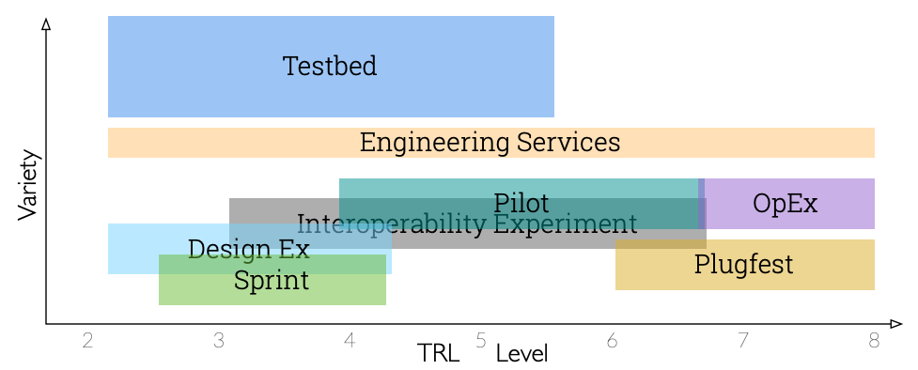
OGC Innovation initiatives
We are here

Slide 4
What is an OGC Interoperability Experiment (IE) ?
Applied research initiative led by OGC members and supported by OGC staff
Most of the time building on the current standards and best practices : the ‘OGC Baseline’ (pushing them to their limits / applying them to a new domain)
Non-OGC member participation is allowed (just need to sign an Observer agreement)
In several IEs: GitHub + mailing list + meetings are open (will be the case for this IE)
so the ‘observers’ can be really active
Topics are focused with the objective of solving interoperability issues of interest to the member leadership
really flexible, it’s up to the IE participants to scope the action

Slide 5
What is an OGC Interoperability Experiment (IE) ?
All participation is in-kind
Depending on each organization capacity/knowledge, participation can correspond to a light or heavy workload. Can be IT And / Or Domain.
But: no need to be a 5 stars OGC expert to participate !
Providing data (along with some explanations ☺ ) is participating
Setting up services/APIs is participating
Reviewing the content produced is participating
Helping tools evolution to support the IE findings is participating …
Normally run 6 – 12 months
Some last longer (ex : 18 months but we should not exceed this)

Slide 6
What is an OGC Interoperability Experiment (IE) ?
Results documented in Engineering Report(s) or other OGC documents and generally used to define new Standardization work.
Some lead to Change Request to the ‘OGC Baseline’
Some to Best Practices in applying it
Some fill in gaps in the ‘OGC Baseline’ proposing document ready for the standardization process: exactly what happened to all the WaterML2.0 series of standards
Most important : it’s during the IE that the group decides what the output of the IE will be : through experimentation

Slide 7
What is an OGC Interoperability Experiment (IE) ?
OGC Hydro DWG community has a long history of IEs
See : https://external.ogc.org/twiki_public/HydrologyDWG/WebHome
Surface Water IE
Rating & Gaging IE
Hydrologic Forecasting IE
2 GroundWater IEs
ELFIE & SELFIE : Environmental Linked Feature IE
Borehole IE (overlap with OGC Geoscience DWG)
2022 : now we have enough organizations/people willing to take part to a
Water Quality IE

Slide 8
2022 Water Quality IE overview
1°/ Domain Use Cases (list & prioritize)
2°/ Try to realize the Use Cases building on
the experience and data assets from existing systems,
the OGC baseline :
semantics: WaterML2.0 suite of standards, “Observations, Measurements and Samples”
technical: OGC API - Features, OGC SensorThings API, …
early attempts applying interoperability best practices in this field (ex: “OGC WaterML-WQ” Best practice : 14-003, EU “API4INSPIRE” project, “A Harmonized Vocabulary For Water Quality” DOI:10.13140/RG.2.1.2490.4404 …),
W3C practices: (spatial) data on the web best practices, SOSA/SSN,
Vocabularies : observable properties (RDA:I-ADOPT), ChEBI, UnitOfMeasures, etc…
3°/ Iterate
4°/ Report

Slide 9
Water Quality IE – group organization
Open contribution to maximize the uptake
An open Github project
Under https://github.com/opengeospatial/WaterQualityIE/
Open Webconferences using OGC infrastructure - GoToMeeting
Meeting log in a shared and open place (G.doc) for everyone to catch up when caught in other projects (we all have other projects commitments)
Meeting frequency
To be refined
Rule of thumb : Weekly to every other week meetings depending on work load required.

