Slide 1
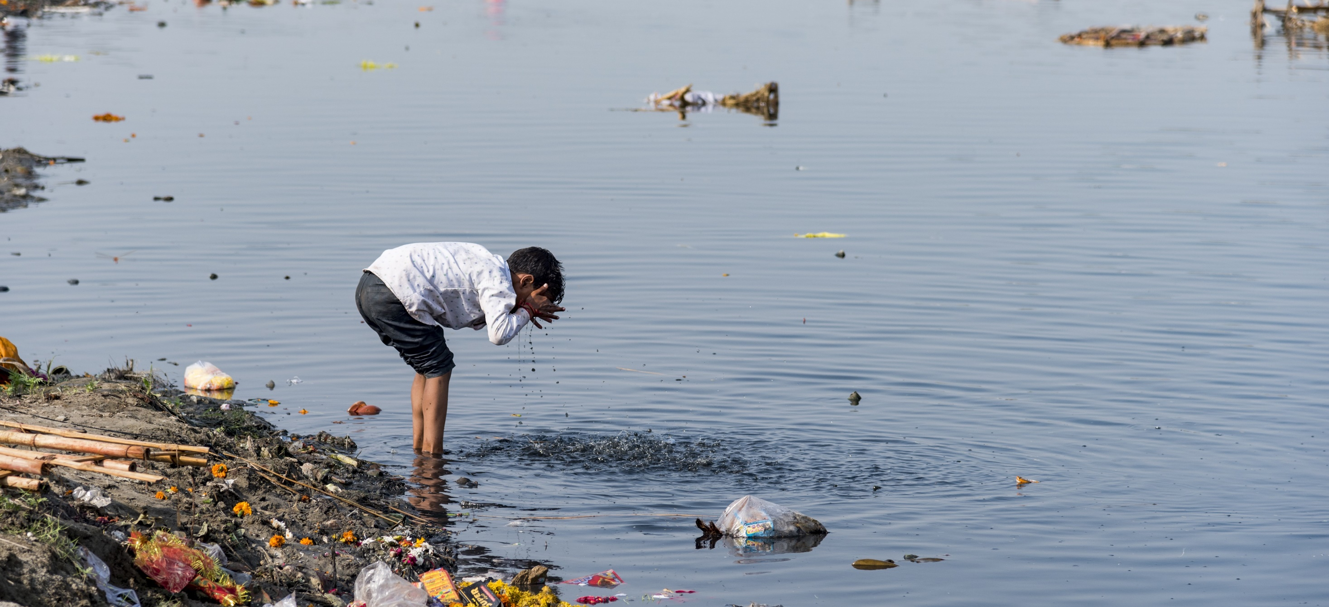




Water Quality Data Interoperability Experiment Kick-off
Setting the scene : Domain Wise
Sylvain Grellet - BRGM, pôle INSIDE
WEATHER CLIMATE WATER

Slide 2
Water Quality workshop Mars 2022
https://external.ogc.org/twiki_public/HydrologyDWG/WaterQualityWorkshopSprint2022
Days 1 & 2 : About the added value of working together -> some quotes
WMO
“We don’t have all the right impact because we are not entirely sure if the people who deal with water quality are well connected with our communications channels. So, the first added value is the connectivity we could get if we create a better way of managing and systematizing our collaboration on water quality”
“…have a coordinated set of regulatory and guidance material on water quality which is developed by different agencies from their perspective”

Slide 3
Water Quality workshop Mars 2022
International Atomic Energy Agency
“There has been a lot of discussion on how the data is compiled, stored, and shared. Having this discussion on how different UN agencies talk about water quality is helpful to make sure that our language and terminology are compatible with other people's language and terminology, and data can be transferred across sections”
UNEP
“keen to explore how further collaboration can extend the database we have as a monitoring program, and that is another aspect we would like to see reflected as a value proposition from our side that brings together different types of data on water quality”
“draw on collective knowledge and expertise from different agencies, to avoid duplicating efforts”

Slide 4
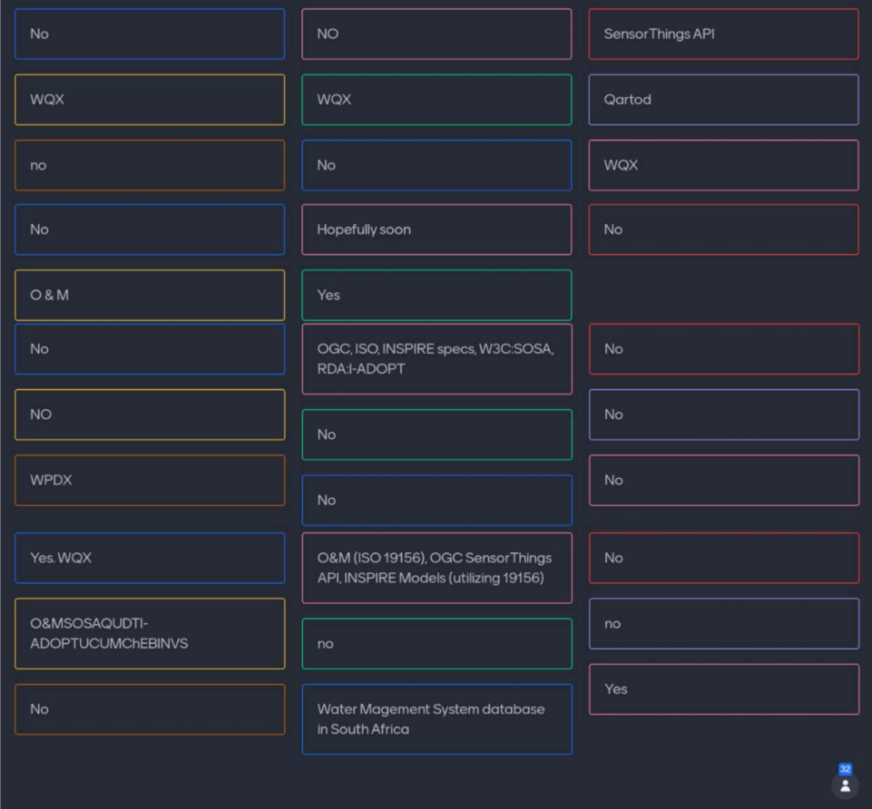
Water Quality workshop Mars 2022
Day 3 discussions : interoperability focused
“Do you know standards that you can use
for an Information System
on WaterQuality ?”

Slide 5
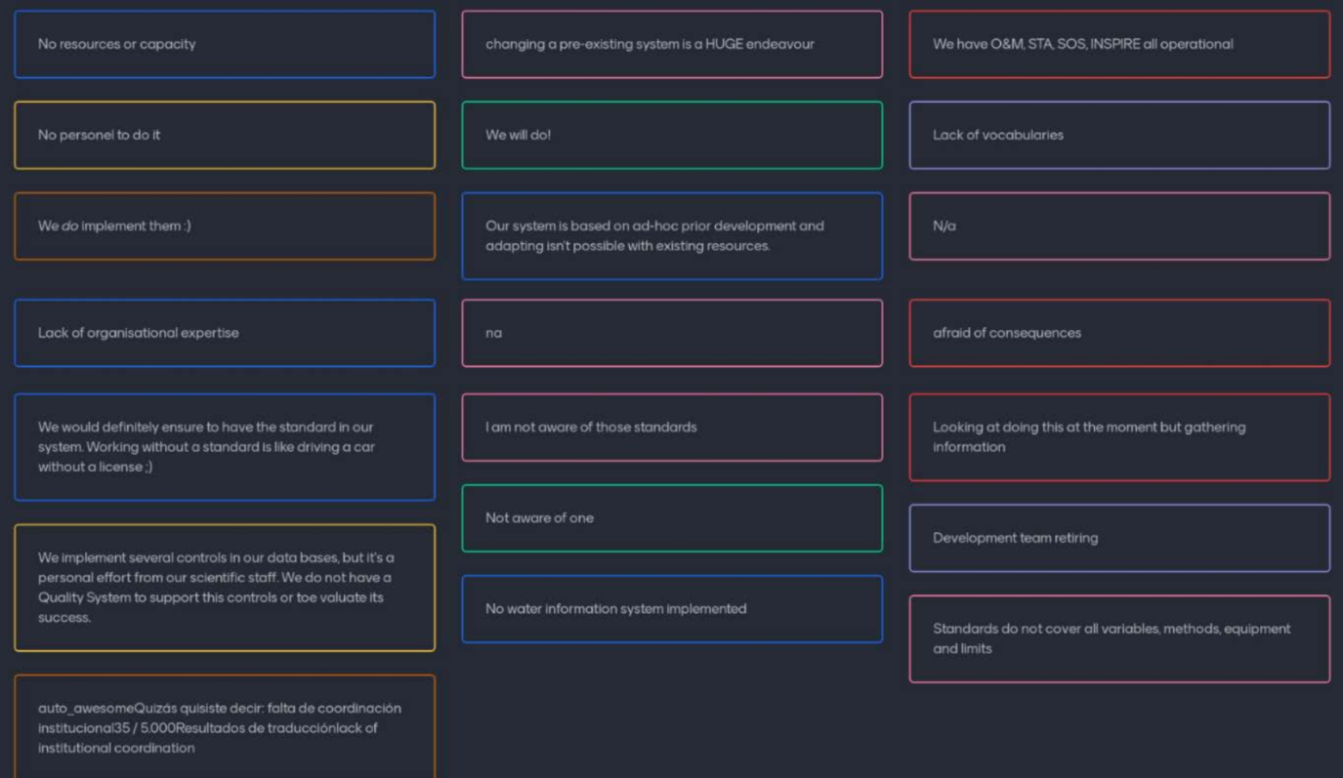
Water Quality workshop Mars 2022
Day 3 discussions
“If some were listed, why
don’t you implement those
standards in your
System ?”

Slide 6
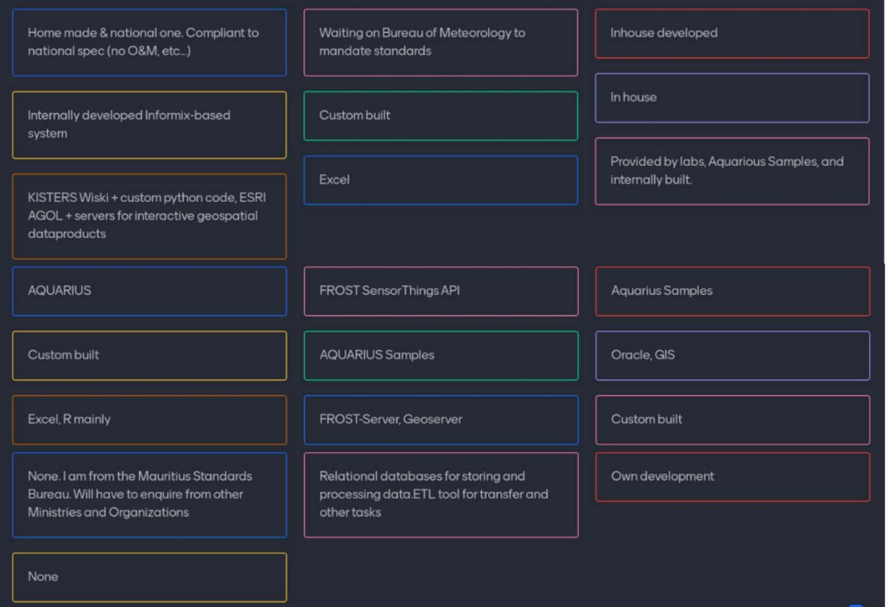
Water Quality workshop Mars 2022
Day 3 discussions
“What WQ data
software/tooling is your
organization using ?”

Slide 7
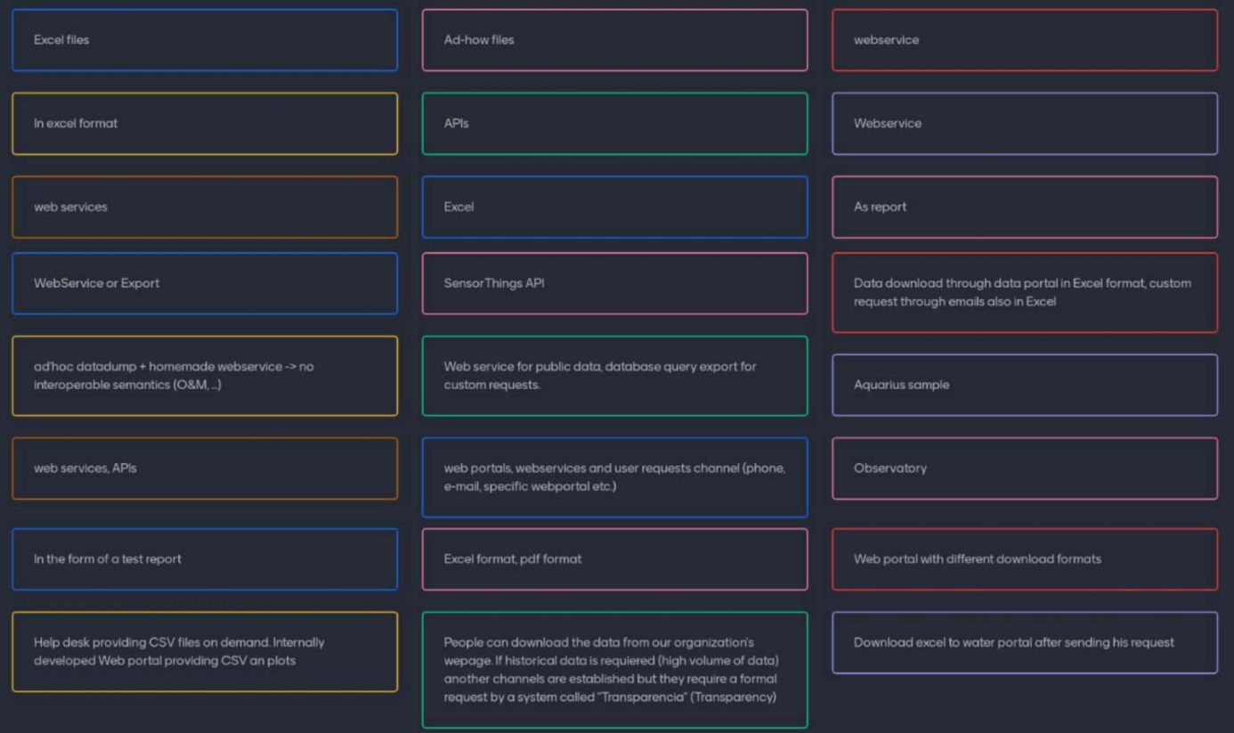
Water Quality workshop Mars 2022
Day 3 discussions
“How to you provide
Data to people
asking for them ?”

Slide 8
Water Quality workshop Mars 2022
Day 3 discussions
“How to you provide
Data to people
asking for them ? ”

Slide 9
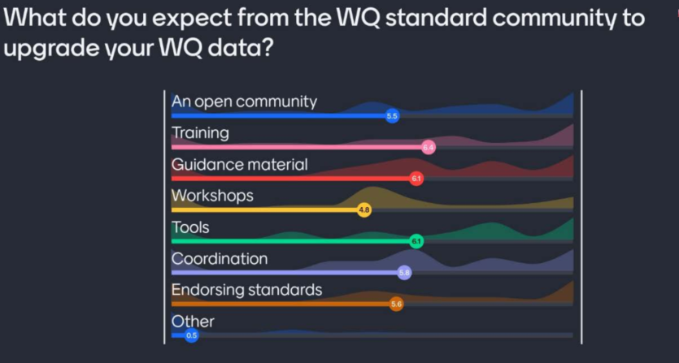
Water Quality workshop Mars 2022
Day 3 discussions

Slide 10
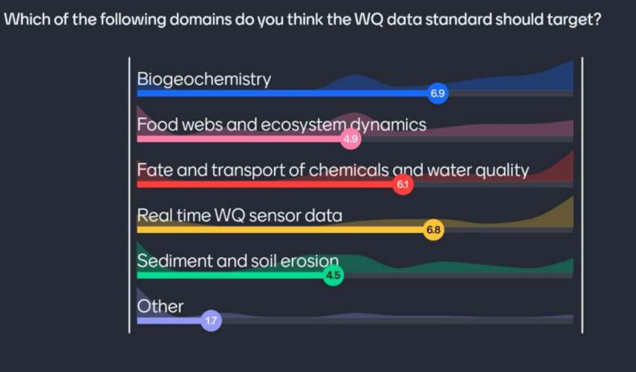
Water Quality workshop Mars 2022
Day 3 discussions

Slide 11
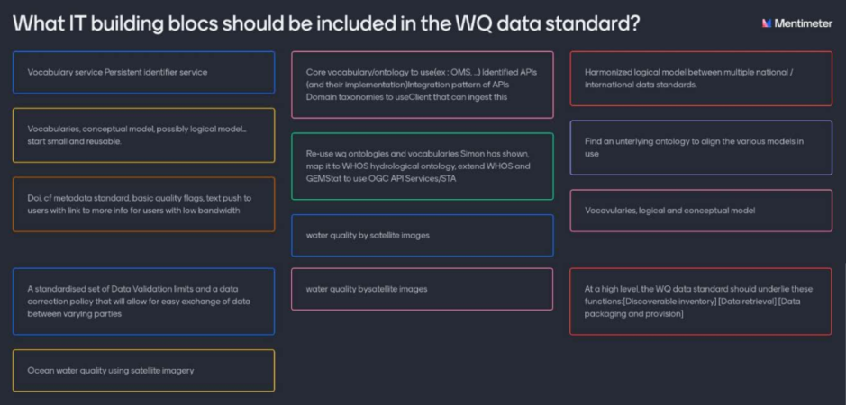
Water Quality workshop Mars 2022
Day 3 discussions

Slide 12
Water Quality IE – Domain Use Cases
Initial list to be refined with participants (food for thoughts)
Surface water chemistry : mainly water samples and chemical concentrations
Surface water hydrobiology, microbiology : here we'll have taxa occurrence, indices calculation
Surface water hydromorphology: here we'll have category observation (shape/type of bank, flow ‘morphology’, etc…)
Ground water chemistry: mainly water samples and chem concentration
Ground water microbiology: here we'll have taxa occurrence, indices calculation
…
Developed in the “IT Interoperability Considerations” presentation

Slide 13
Water Quality IE – IT viewpoint
Experiment #A: OGC semantic baseline : Compatibility and utility of existing models/ formats -- is a best practice possible ? if none, how much needs to change (extension, profiling) to achieve interoperability?
Experiment #B: OGC API baseline : which API (& pattern between APIs) to serve what ? how much change (extension, profiling) to achieve interoperability?
Experiment #C: Bridging the gap with research activities (ex : I-ADOPT). Targeting a fine grain description of vocabularies (observable properties, observing procedure….)
Developed in the “IT Interoperability Considerations” presentation

Slide 14
Water Quality IE – intensions
What do we target ?
We are not on a ‘blank page’ situation
Guts feelings that we already have ‘almost’ all we need with the current semantic and technical Baseline
+ some LinkedData & Semantic Web best practices
Let’s identify and lay down Best Practice to cover the domain and generate the necessary Change Request to pre-existing standards (if need be)
AND let’s not forget about tooling (server, client side) to help implement our findings
Developed in the “IT Interoperability Considerations” presentation

Slide 15
P 6/13
Draft activity plan
https://github.com/opengeospatial/WaterQualityIE/tree/master/activity_plan
add
Some content from it

