Slide 1
Dplyr Presentation
Simeon Markind
Federal Reserve Board + Howard University
Expository Data Analysis
February 17, 2017

Slide 2
Logistics
Before we begin students should have the following:
Download the Dplyr_notes.html file from github
This is a reference guide, the lecture will follow this guide but will not repeat it verbatim.
You are expected to review this guide on your own time and use it as one of your resources for the homework.
Download the lecture_code_students.R file from github
This file allows you to follow the lecture interactively
Open the lecture_code_students.R file in an Rstudio session

Slide 3
Package Basics
What is a package in R?
Allows you to use code and functions developed by others
Where can I find packages?
CRAN – https://cran.r-project.org
Download a package with install.packages()
Use the quoted package name as an argument
Load a package with library()
Use the package name (quoted or unquoted) as an argument
To learn more about a package use help(), ?, browseVignettes, etc
Packages come with manuals on CRAN:
Here is the Dplyr manual: https://cran.r-project.org/web/packages/dplyr/dplyr.pdf
Load the Dplyr package

Slide 4
Introduction
Dplyr: A useful package written by Hadley Wickham
Allows for efficient manipulation of data
Provides a grammar for data analysis
Our Data: nycflights13
Data for the three main New York City airports: EWR (Newark), JFK, and LGA (LaGuardia)
Install and load the nycflights13 package like you did with Dplyr
Take a look at the flights dataset: nycflights::13
How does this look compared to a dataframe?
Overview of a Tibble

Slide 5
Dplyr Verbs
Dplyr is built around 5 main functions:
Select certain columns of data.
Filter your data to specific rows
Arrange the rows of your data into an order
Mutate your data frame to update or add columns
Summarize chunks of your data
The first half of today’s lecture will discuss how to use these five verbs
Before we get started it’s a good practice to examine our data:
Print the the names of the columns, and type “?flights”
How many rows and columns does our data have, what functions could you use to find this out?

Slide 6
Verb 1: Select
Select allows us to choose to keep only certain columns of our data.
What are the arguments to select? “?select”
In Base R we can select columns by using quoted names, with the select function we DO NOT quote the variable names
Select Example 1
Can also deselect columns by putting a minus sign (-) in front of the column name
Deselect example
In Class exercise: Now that we have the flights data loaded and dplyr package loaded it's time for you to test it out. Create a table called inClass1 where you select the following columns from flights: hour, minute, dep_delay, arr_delay, air_time.

Slide 7
Verb 2: Filter
Select allows us to choose specific columns of our data, filter allows us to choose specific rows of our data
What are the arguments to the filter function?
We are going to filter our flights data based on the month variable which has numbers corresponding to the 12 months
We will take a subset of the data corresponding to January
Filter Example 1
For a filter to work, you need to provide a condition, what happens if you forget?
Try the following: inClass2 <- filter(flights, day)

Slide 8
Filter Cont.
We can filter on multiple columns by adding more arguments to the filter function
Multiple filter example
So we see that day is greater than 10 and departure delay is less than or equal to 5 and arrival time is not NA.
is.na() tests if something is equal to NA, putting the ! in front of the function negates the function, so !is.na() returns TRUE for everything that is not equal to NA.
InClass Exercise: now make a data frame, inClass3 of rows from the flights data from only flights in the months after June, only flights before the 15th of the month, and with a departure time after noon.

Slide 9
Filter Cont.
Separating each argument in the filter function is the same as using an & in between each filter.
Our multiple filter example is the same as: flights[ flights$day > 10 & flights$dep_delay <= 5 & !is.na(flights$arr_time),]
We can also use the OR option for filtering by using the | symbol found on the key above “Enter”
Filtering with OR example
We can also use the %in% operator.
%in% compares the vector of input with the vector of options and returns TRUE for each element of input that is also in the vector of options.
Filtering with %in%
We can also use & in place of commas in our filter command like so:
Filtering with &
All 3 methods return the same result
In class exercise: You can use any of the methods described above to return the following table, inClass4: month of 1, 4, 7, or 9, arrival time before noon or after 6 pm (note the use of 24 hour time in the dataset), a departure delay of greater than 10, and an arrival delay that is not NA.

Slide 10
Verb 3: Arrange
Arrange function orders your table based on the variables you specify and in the hierarchy of your arguments.
What are the arguments to arrange?
Arrange Example 1
If you change the argument order in arrange you will get a different output
In Class exercise: Create table inClass5 which should be the flights data arranged first by arr_time, then sched_dep_time, then dep_time.
The default order of arrange is ascending, but we can sort to descending by using either the desc() function around our column name or putting a minus sign “-” in front of the column name
You can sort some columns by descending and some by ascending in the same call to the arrange function
Descending Arrange Example

Slide 11
Verb 4: Mutate
Mutate allows us to add new columns to a data frame
The function creates a new value for every row
Mutate adds columns to the end of the dataset
What are the arguments to mutate?
Mutate Example 1
Notice that we are able to use a column we added in a mutate command within the same mutate command if desired. (we calculated the gains column and then use it in the calculation of gains_per_hour within the same function).
We can also use mutate to change existing variables. Right now the air_time variable is in minutes, we instead want it to be in hours.
Mutate Example 2
How does the ifelse function work?

Slide 12
Mutate cont.
Notice that our air_time variable is updated, not a new column, we overwrote the values that we previously had
In Class exercise: Create a data frame inClass6 where you take the flights data for the columns: dep_time, arr_time, air_time. Create two new columns: "deviance" as arr_time - dep_time and "match" as a boolean value of whether air_time is equal to deviance. Would you expect air time to equal arrival time - departure time?
We can check what fraction of flights have a deviance equal to their air time by summing the “match” column.
Since match of type logical, <lgl> in the tibble, we have values corresponding to 1 == TRUE and 0 == FALSE
Let’s find the sum of the match column, type sum(inClass6$match), what do you get?

Slide 13
Verb 5: Summarize
We can create a new variable aggregating data from multiple observations
Let’s compute the average departure delay, arrival delay, and average gain
Summarize Example 1
In class exercise: Compute the average air time and standard deviation of air time with the sd() function
Right now summarize doesn’t seem all that useful, but once we talk about group_by() it will become much more powerful

Slide 14
Putting it All Together: Pipes %>%
We can chain our commands together using the pipe operator
Example without pipes
Example with pipes
Using Pipes makes it easier to understand the flow of our code
The pipe operator replaces the first argument to the next function by default. We use the “.” which means “result of the last function” to explicitly define where we want the pipe operators output to go
You do not need to use the dots if by default the first argument of your function should take the output from the previous function
Example without dots
Pipes Also prevent us from writing indecipherable nested functions
Indecipherable example

Slide 15
Aggregating Data: Group_by()
Group_by allows us to summarize data separately for different subgroups of observations. We can group on multiple columns at once.
What are the arguments to group_by?
The group_by function does not inherently change anything about your data, it merely adds metadata to your tibble
Group by No Summary
Notice that now at the top of the tibble we have the information about "Groups:“

Slide 16
Group_by Example
Let’s calculate the number of flights, average arrival delay, and average departure delay by airport
How would you do this in Base R?
Yeah, sounds pretty miserable, right? Instead we can do this with Dplyr in just 5 lines of code and the code is readable!
Group By example
What is the n() function?
In Class exercise: Create a data frame, inClass8, using the flights data and again group by the origin airport. This time filter to only data without an NA in the air_time column. Calculate the average air_time for each origin airport.

Slide 17
Grouping cont.
You can use function on columns you create within the same chain of pipes:
Group By example 3
Why didn’t I need to include the na.rm = T argument in the mean() calls?
We can save output from a chain of pipes by assigning to an object
Pipe Assignment

Slide 18
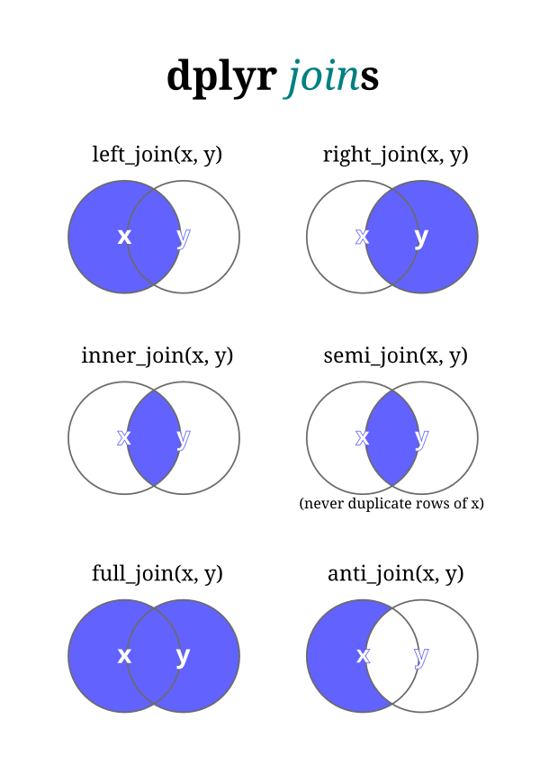
Joins
Most of the data analysis you do will require you to merge multiple datasets.
The join functions of dplyr are a family of functions that act similarly to Base::merge()
For example of the join functions we will use the weather dataset included in the nycflights13 data
Weather Overview
We have columns for origin, year, month, day, hour in both our weather and flights table, those are the columns we want to match on

Slide 19
Left Join Examples
We will go through the left_join function
As you can see from the picture on the previous slide, the left join function adds data from the right-hand table to the left hand table and keeps all of the left hand table’s data
Left_join Example
Now we will use the join function to try and answer the question of how wind speed seems to impact average delays
Wind speed delay example
From the table it looks like we might have a positive correlation. We would want to plot the data and use the cor() function to be sure.
What arguments does cor() take?
Cor of Wind Speed and Delays
Cleanup

Slide 20
Conclusion
Dplyr is Awesome!!
In addition to the functions we covered today, there are hundreds more!
Such as glimpse() which allows you to see a transposed version of your data and others
Dplyr makes it easy to write clear readable code allowing you to focus on the details of your data analysis and to understand what you did in the future when you reread your code.
Resources for more info:
Cheatsheet: https://www.rstudio.com/wp-content/uploads/2015/02/data-wrangling-cheatsheet.pdf
Explanation from Hadley (package author): http://r4ds.had.co.nz/transform.html
Free online tutorial: https://www.datacamp.com/courses/dplyr-data-manipulation-r-tutorial

