Slide 1
Why Do We Need Big Banks?
Andrew Cohen
Federal Reserve Board of Governors* and Howard University
*The opinions expressed as those of the author and do not represent the opinions of the Board of Governors or its staff.

Slide 2
Historical functions of banks (1): Financial Intermediation
Source money from one party and invest with another party
Intermediaries must earn a spread
Source funds from savers at a lower price/rate than the return that they earn on the loans/investments that they make
Intermediaries must also offer a return to savers that is more than the savers could earn by investing the money themselves
Thus, Return Earned by Bank on Money Provided by Savers >
Return Bank promises to pay Savers >=
Return Savers could Earn without putting their money into the Bank
You’ll learn in this course how banks ability to gather information, conduct monitoring, and diversify allows them to satisfy the inequalities above
The difference between these 2 quantities is the “spread”

Slide 3
Historical functions of banks (2): Fractional Reserve Banking
Fractional reserve banking – store money and perform payment and other services for a fee
The bank also will invest excess reserves
Cash that isn’t earning a return is a no-no for a bank

Slide 4
Risks of Fractional Reserve Banking
Insolvency
Losses on investment of excess reserves reduce the size of the banks assets to the point where the bank does not have the ability to pay off what it owes (i.e., it’s liabilities)
Bank run due to
Assets owned by the bank are not liquid
Illiquid assets can’t be turned into cash quickly, or can only be turned into cash quickly by selling at a deep discount
Having the bank depositors and other creditors demand payment on liabilities
Bank has liquid liabilities and depositors/creditors demand payment of those liabilities en masse
Liquid liabilities are obligations that creditors can demand the bank repay in a very short period of time
Different from insolvency – classic example of deadweight loss where societal interest is in preventing solvent institutions from failing
A “financial crisis” can result when a large number of banks experience runs

Slide 5
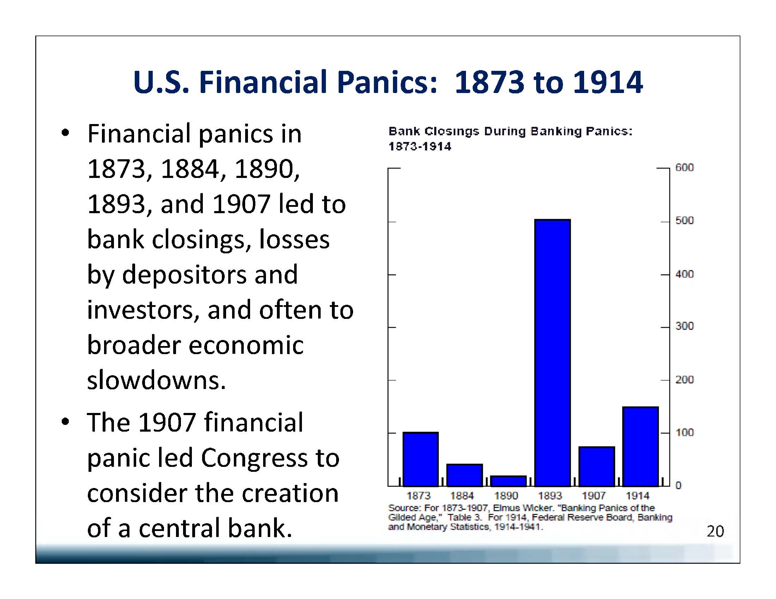

Slide 6
The Financial Crisis of 2008-2009
Numerous Large Insolvencies
Value of the bank’s assets (loans to its customers, bond holdings etc…) was less than the value of the bank’s liabilities (deposits, borrowings)
Numerous pseudo-runs
Commercial and investment banks had to produce cash to anxious depositors and other creditors, but their cash was tied up in “illiquid” loans that they could not sell quickly (or could only sell quickly for a large loss)
Banks/thrifts that went away
Lehman Brothers, Countrywide, Bear Sterns, Wachovia, Merrill Lynch, IndyMac, Washington Mutual, National City
Unemployement above 10%
Estimated costs of the crisis to the US run from $20K - $120K … per citizen
Figures do not necessarily include the increase in suicides, domestic violence, and sexual assaults that have been linked to the crisis

Slide 7
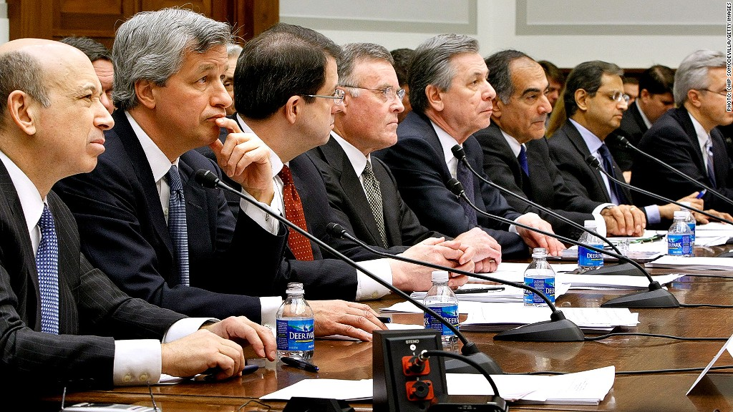
Congressional testimony by CEOs of the largest US banks after the financial crisis

Slide 8
Why do we need big banks?
What do we mean by “big banks”?
How do the finance and economics literatures think about what financial intermediaries do
A customer-centric view of banking
Economic factors that promote larger banks
Some well-hedged conclusions

Slide 9
Note: Total assets for all Other US Banking Organizations= $8,747 Billion

Slide 12
Treatment of Financial Intermediaries in Finance and Economics
Finance literature has a greater tendency to
Measure performance of the financial sector in terms of the efficient allocation of capital or efficient operation of financial markets
Focus on role of banks in reducing frictions related to credit access, information gathering and monitoring firms’ use of financial capital
Economics literature has a greater tendency to focus on banks’ contributions to a total welfare function
Depends upon the consumer and producer surplus that the bank generates

Slide 13
Bank Contributions to Total Welfare
Who are a banks’ customers?
Individuals
Commercial firms
Governments
Other financial institutions (including other banks)
Why do we care about financial crises?
A financial crisis is characterized by widespread distress among financial institutions and disruptions in financial markets
We care most about a financial crises whose effects transmit to the real economy – i.e., affect individuals, commercial firms, and governments

Slide 14
A customer-centric view of banking

Slide 15
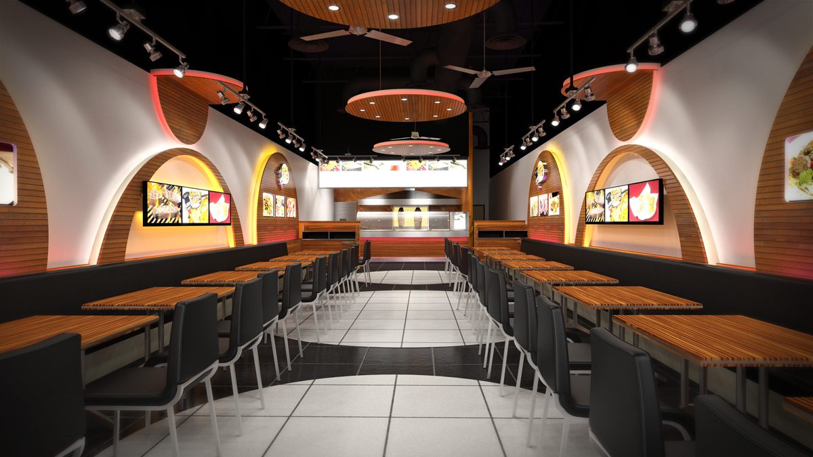
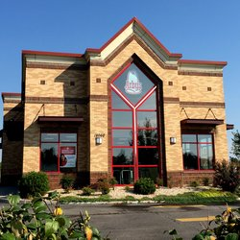
Femi’s NaturalFast Food
Femi’s

Slide 16
1st Location
Femi’s
BANKING SERVICES BEING USED BY FEMI’S
Transaction Services | Corporate Checking Account
Credit | Bank loan to fund building, equipment and initial salaries
Credit | Personal credit card to buy raw materials (food)
Transaction Services / Access to the payment system | Credit/debit card processing

Slide 17

Femi’s 1st Location is a Success!
BANKING SERVICES BEING USED BY FEMI’S
Transaction Services | Corporate Checking Account
Credit | Bank loan to fund building, equipment and initial salaries
Credit | Line of credit to buy raw materials (food)
Transaction Services / Access to the payment system | Credit/debit card processing
Femi’s

Slide 18

Femi’s Opens More Locations!
BANKING SERVICES BEING USED BY FEMI’S
Transaction Services | Corporate Checking Account
Credit | LARGER bank loan to fund new buildings & equipment
Credit | LARGER Line of credit card to buy raw materials (food)
Transaction Services/ Access to the payment system | Credit/debit card processing
Guarantee (credit) | Letter of credit guaranteeing payment of bulk orders from vendors
Femi’s
Femi’s
Femi’s
Femi’s
Femi’s

Slide 19
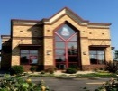
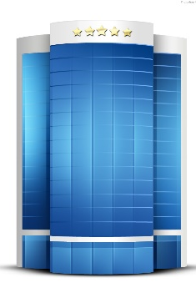
Femi’s Starts to Franchise
Femi’s Franchises in Philadelphia
Fem’s
Fem’s
Fem’s
Fem’s
Fem’s
Fem’s
Fem’s
Femi’s
HQ
And DC
Locations
Fem’s
Fem’s
Fem’s
Fem’s
Femi’s
Femi’s Franchises in New York
Fem’s
Fem’s
Fem’s
Fem’s
Fem’s
Fem’s
Fem’s
Fem’s
Fem’s
Fem’s
Fem’s
Fem’s

Slide 20
Now that Femi’s has a number of franchises …
BANKING SERVICES BEING USED BY FEMI’S
Transaction Services | Corporate Checking Account
Credit | Large bank loan to fund buildings & equipment directly owned by Femi’s
Credit | Large line of credit to buy raw materials (food)
Transaction services/ Access to the payment system | Credit/debit card processing
Guarantee (credit) | Letter of credit guaranteeing payment of bulk orders from vendors
Credit | Another large loan to Femi’s so that it can lend money to its franchisees to allow them to pay their franchise fee
Credit | Loans to fund building and equipment at franchise locations
Asset Management | Pension and 401K plan for corporate employees

Slide 21
Femi’s goes to Wall Street for an IPO…
BANKING SERVICES BEING USED BY FEMI’S
Transaction Services | Corporate Checking Account
Credit | Large bank loan to fund buildings & equipment directly owned by Femi’s
Credit | Large line of credit to buy raw materials (food)
Transaction services/ Access to the payment system | Credit/debit card processing
Guarantee (credit) | Letter of credit guaranteeing payment of bulk orders from vendors
Credit | Large loan to Femi’s so that it can lend money to its franchisees to allow them to pay their franchise fee
Credit | Loans to fund building and equipment at franchise locations
Asset Management | Pension and 401K plan for corporate employees
Equity Underwriting and Trading | Placement of Femi’s stock and commitment to make secondary markets
Corporate Trust | Track ownership, shareholder voting, make dividend payments

Slide 22
Femi’s hits the traditional debt markets
BANKING SERVICES BEING USED BY FEMI’S
Transaction Services | Corporate Checking Account
Credit | Large bank loan to fund buildings & equipment directly owned by Femi’s
Credit | Large line of credit card to buy raw materials (food)
Transaction services/ Access to the payment system | Credit/debit card processing
Guarantee (credit) | Letter of credit guaranteeing payment of bulk orders from vendors
Credit | Large loan to Femi’s so that it can lend money to its franchisees to allow them to pay their franchise fee
Credit | Loans to fund building and equipment at franchise locations
Equity Underwriting and Trading | Placement of Femi’s stock and commitment to make secondary markets
Corporate Trust | Track ownership, shareholder voting, make dividend payments, and bond payments
Debt underwriting and trading | Placement of Femi’s commercial paper and corporate bonds and commitment to make secondary markets in the bonds

Slide 23
Femi’s monetizes its franchisees’ mortgage loans
BANKING SERVICES BEING USED BY FEMI’S
Transaction Services | Corporate Checking Account
Credit | Large bank loan to fund buildings & equipment directly owned by Femi’s
Credit | Large line of credit card to buy raw materials (food)
Access to the payment system | Credit/debit card processing
Guarantee (credit) | Letter of credit guaranteeing payment of bulk orders from vendors
Credit | Large loan to Femi’s so that it can lend money to its franchisees to allow them to pay their franchise fee
Credit | Loans to fund building and equipment at franchise locations
Asset Management | Pension and 401K plan for corporate employees
Equity and Debt Underwriting and Trading | Placement of Femi’s stock, bonds and commercial paper and commitment to make secondary markets in the stock and bonds
Corporate Trust | Track ownership, shareholder voting, make dividend payments, and bond payments
ABS underwriting | Package mortgages on franchise buildings & equip into CMBS (commercial-mortgage-backed securities), and place with investors
Trust/Loan Servicing | Collect mortgage payments, advance payment when borrower is late, workout distressed mortgages, and make regular payments to the holders of the CMBS

Slide 24
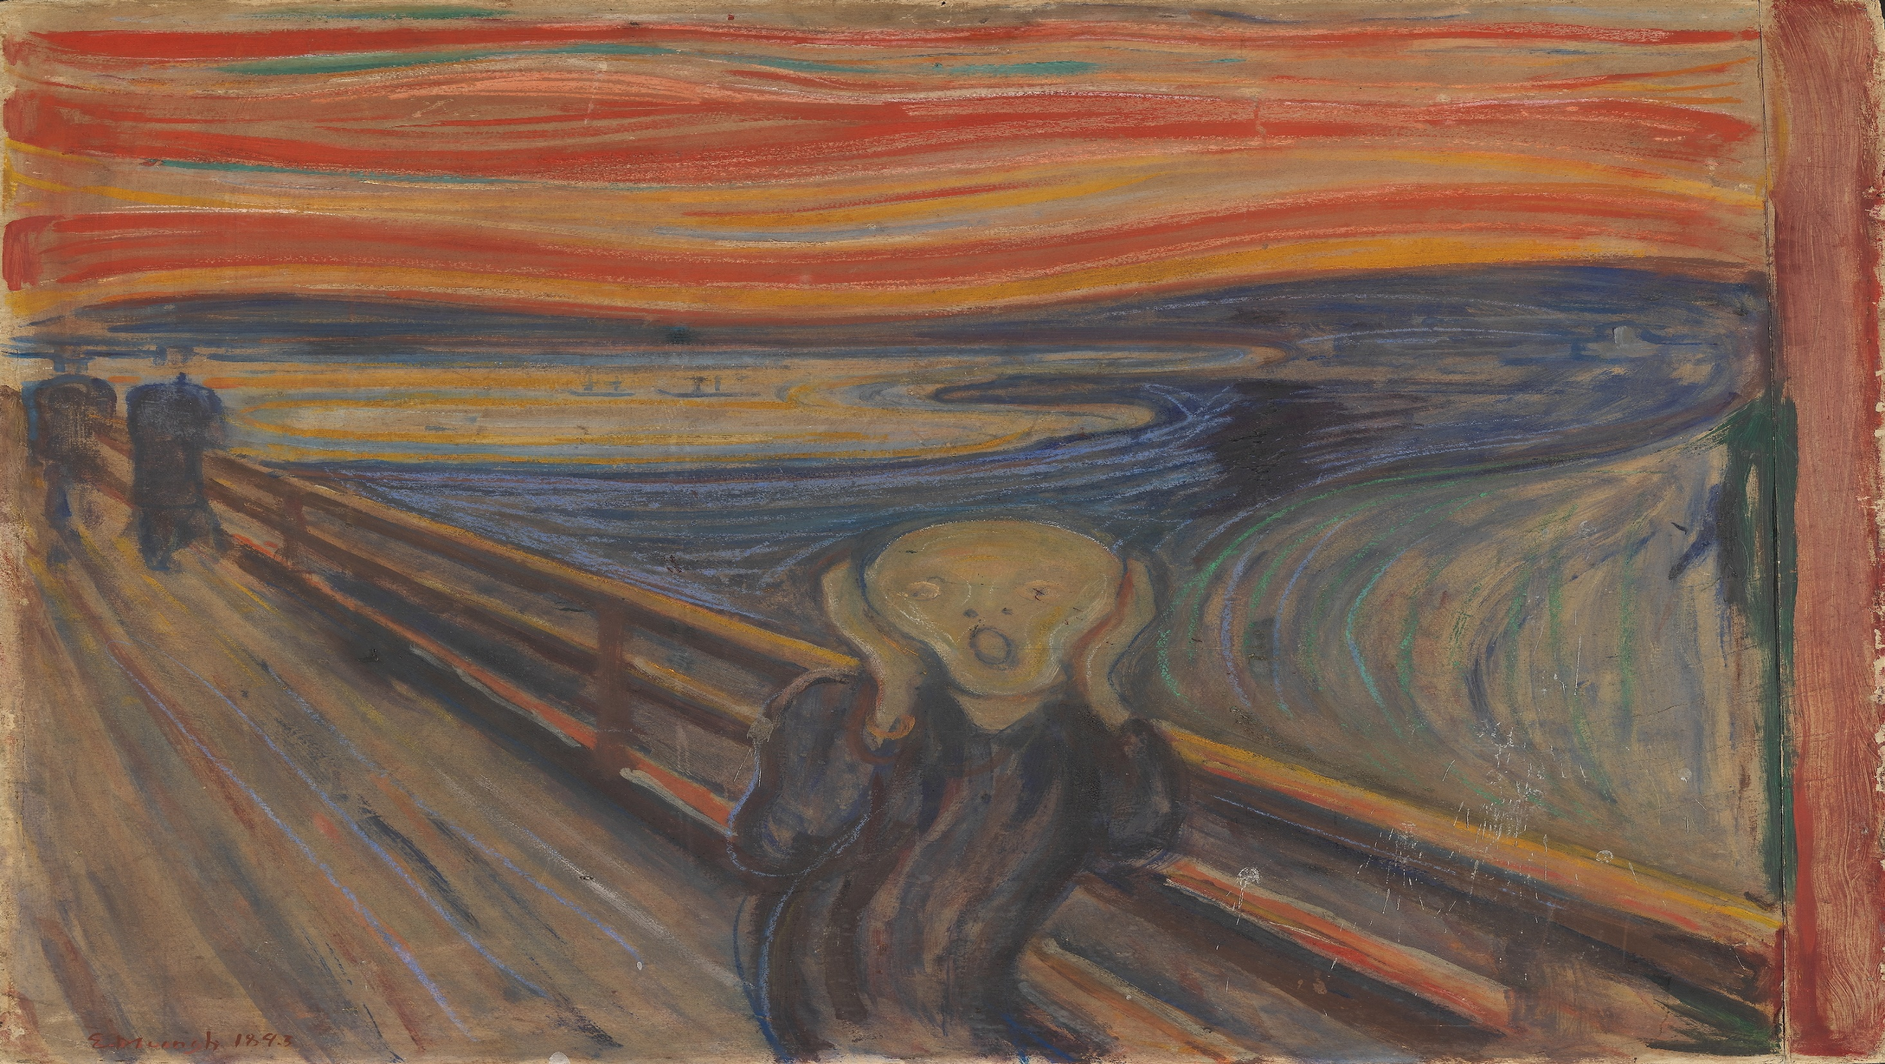
Now Femi’s wants to hedge its exposure to rising food prices using derivative contracts
No More New Banking Services Please
BANKING SERVICES BEING USED BY FEMI’S
Transaction Services | Corporate Checking Account
Credit | Large bank loan to fund buildings & equipment directly owned by Femi’s
Credit | Large line of credit card to buy raw materials (food)
Transaction services/ Access to the payment system | Credit/debit card processing
Guarantee (credit) | Letter of credit guaranteeing payment of bulk orders from vendors
Credit | Large loan to Femi’s so that it can lend money to its franchisees to allow them to pay their franchise fee
Credit | Loans to fund building and equipment at franchise locations
Equity and Debt Underwriting and Trading | Placement of Femi’s stock, bonds and commercial paper and commitment to make secondary markets in the stock and bonds
Corporate Trust | Track ownership, shareholder voting, make dividend payments, and bond payments
ABS underwriting | Package mortgages on franchise buildings & equip into CMBS (commercial-mortgage-backed securities), and place with investors
Trust/Loan Servicing | Collect mortgage payments, advance payment when borrower is late, workout distressed mortgages, and make regular payments to the holders of the CMBS

Slide 25
Do we need very large banks for Femi’s to get the financial services it needs?
As an empirical matter, a number of products Femi’s requires are only offered by a handful of banks
In more cases than not, these banks are quite large (as measured by assets)
However, banks can syndicate or effectively subcontract with other banks to provide certain services
Banks also frequently transact with one another (especially large banks)
The existence, and persistence, of very large banks can result from –
TBTF funding cost advantages
Legitimate funding cost advantages (access to more funding markets, lower risk premia demanded due to greater diversification, etc…)
Market power
Structural features of the market for banking services

Slide 26
Some economic reasons for big banks
Economies of scale in production of financial services
Usually due to high fixed costs (often capital-related)
Economies of scope in production of financial services
Benefits to customers due to bank scale
Includes ability to make larger loans
Benefits to customers due to scope of products offered by bank
Includes “one-stop shopping”
Benefits to customers may take the form of lower prices or lower transactions costs
Benefits may simply be a broader set of financial services available to bank customers

Slide 27
Example of benefit of large bank for Femi’s
Femi’s can require its franchises to use the same bank that it does for corporate checking
Possible only if bank has wide enough geographic scope
Benefits could include:
Reducing operational frictions between Femi’s and franchises
Greater flexibility to move funds across franchises
Better ability to bargain with the bank(s) for better terms
Better terms for Femi’s on franchise-related bank credit
Femi’s can capture some of savings on information gathering and monitoring costs that result from the fact that the bank is already providing a number of services for Femi’s

Slide 28
Example: M&A Advisory, Underwriting and Financing
Economies of scale: Scale in advisory allows fixed costs necessary to offer sufficient industry coverage to be spread over more transactions
Economies of scope:
M&A financing shop is able to perform necessary due diligence at lower cost by leveraging from the work of its advisory team
If bonds are used as part of the financing, underwriters with large brokerage client networks can more easily place those bonds
Consumer benefits from bank scale: Corporate acquirer has lower transaction costs because all financing is from one firm
Bank can only provide all of the financing b/c it has the balance sheet capacity, and it operates at sufficient scale so that one transaction doesn’t breach concentration limits
Consumer benefits from bank scope: Dealing with a single firm for both financing and advising reduces corporate acquirer’s transactions costs

Slide 29
Conclusions
There are legitimate economic reasons for the presence of large banking organizations
Financial institutions that are as large and interconnected as the largest US banks can pose significant risks to the stability of the financial system
Breaking up these banks, or otherwise limiting their activities with regulatory interventions likely has costs … to people like Femi (and many many others)
This is the cost of crisis vs. efficiency in normal periods tradeoff
What we don’t know is whether an alternative industry structure with smaller-sized banking organizations could provide a set of financial services that would result in similar total welfare
It’s well-worth it to the profession for many of us to spend the next decade or two working on this

