Slide 1
Borrowing
January 27, 2017

Slide 2
Outline
Interest Rate on a Loan
Compound interest
What affects the interest rate on a loan
Revolving debt with compound interest
Types of Amortization
Adjustable rate and interest-only loan terms

Slide 3
Simple loan with payment of principal and interest at the end of the loan term
Suppose my brother wants to start a school named the Flower School.
I decide to lend my brother $100 in principal for a term of one year, at an annual interest rate of 10% (and no compounding)
He will owe me $100*(1+.10)=$110 at the end of one year
$100 of that is repayment of principal and $10 is interest
More generally, he will owe –
Principal*(1+[Annual Interest * Length of loan term in years])

Slide 4
Compounding
What if I reduce the annual interest rate by 25 basis points from 10% to 9.75% if my brother lets the interest compound daily for a term of 1 year?
Compounding means that the interest I incur is added to the principal of the loan (i.e., the amount that I owe)
The balance of the loan today is the balance I had yesterday compounded by the daily interest rate – which, in our case, is 0975/365 = .000267
Balance at day 0 : 100
Balance at day 1: 100 * (1+.000267)
Balance at day 2: [100 * (1+.000267)] * (1+.000267)
Balance at day 3: { [100 * (1+.000267)] * (1+.000267) } * (1+.000267)
…
Balance at 365 days: 100 * (1+.000267)^365

Slide 5
Simple Compounding
Balance after t compounding periods = Initial Principal* (1 + r_{period})^{t}
r_{period} = r / CompPeriodsYr
r = annual interest rate
CompPeriodsYr = # of times loan compounds per year
t = # of times the loan has compounded (i.e., accrued interest) at the time that the balance is calculated
In the example, my brother would owe me
100 * (1 + .0975/365)³⁶⁵ = $110.24
giving my brother an effective interest rate of 10.24%.

Slide 6
Exercise
Balance after t compounding periods = Initial Principal* (1 + r_{period})^{t}
r = annual interest rate
CompPeriodsYr = # of times loan compounds per year
r_{period} = r / CompPeriodsYr
t = # of times the loan has compounded (i.e., accrued interest) at the time that the balance is calculated
Use the formula above to show how much will my brother will owe me at the end of each loan term if I lend him $100 –
For a term of two years, at an annual interest rate of 10% (and no compounding)?
For a term of six months, at an annual interest rate of 10% (and no compounding)?
For a term of two years (24 months), at an annual interest rate of 10% with monthly compounding?

Slide 7
Exercise Answers
Balance after t compounding periods = Initial Principal* (1 + r_{period})^{t}
Use the formula above to show how much will my brother will owe me at the end of each loan term if I lend him $100 –
For a term of two years, at an annual interest rate of 10% (and no compounding)?
100*(1 + .1/.5) = 120
For a term of six months, at an annual interest rate of 10% (and no compounding)?
100*(1 + .1/2) = 105
For a term of two years (24 months), at an annual interest rate of 10% with monthly compounding?
100* (1 + .1/12)²⁴ = 122.04

Slide 8
Effective Interest Rate formula for simple compounding
With a constant interest rate, no amortization, and repayment of all interest and principal at the end of the loan term, the effective interest rate is:
Effective Interest Rate = [ (1 + r_{period})^{t}] – 1
= [ (1 + .0975/365)³⁶⁵ ] – 1 = .1024 = 10.24%
r = annual interest rate
r_{period} = r / CompPeriodsYr
t = total # of times the loan compounds

Slide 9
What affects the interest rate on a loan?
Funding costs and value of alternative investments
Heart of financial intermediation
Interest rate risk
Can affect economic value of lender’s income from the loan and funding costs if lender is borrowing short to fund the loan
Longer-term loans will have higher interest rates
Credit risk
Probability of default
Measuring riskiness of the borrower
Debt service burden, Debt to income, maximum possible debt to income
Borrower credit history
Loss given default
Secured vs. unsecured borrowing
Loan-to-value (LTV)
How is loan collateral valued?
Role of amortization in building equity (LTV)
Competition

Slide 10
Revolving Loans (credit cards and lines of credit – home equity or business)
Revolving loans don’t have a term associated with them. The balance is based on the amount you borrow, the amount that you repay, and the terms of interest (when you pay interest and the rate)
At each time period (e.g., month) – you
Carry forward any balance that you owe
Can (maybe) borrow additional money
Incur interest on the balance that you carry and (depending) the additional money borrowed
Incur any fees related to late payment or failure to make minimum payment
Make a payment against the interest, and any portion of the payment that exceeds the interest is applied to reducing the loan principal

Slide 11
Credit Card Example
February 5: I use my new credit card to buy a taco-delivering drone for $1,000
i.e., I borrowed $1,000 for an impulse buy
March 1: I receive a bill for $1,000, with a due date of March 10 and a minimum payment equal to 2% of my balance, or $20
I get the float on my balance, i.e., I don’t pay interest on the loan from February 5 to March 10
March 10: I pay $500 of my bill, leaving my balance at $500
I don’t get the float on my balance anymore, since I’ve carried a balance into the next cycle
March 11: I begin incurring interest, 18%, compounded daily, on my $500 balance
March 20: I use my credit card to spend another $1,000 to buy a pizza-delivering drone
My new balance is $500 compounded for 9 days at an 18% annual rate PLUS $1,000
Balance = 500(1+.18/365)^9 + 1000
I immediately begin incurring interest on the new balance, compounded daily

Slide 12
Credit Card Example continued
April 1 – I receive my bill reflecting charges through March 31
Balance = Balance as of March 20 compounded daily for 11 days
Balance = [500(1+.18/365)^9 + 1000] * (1 +.18/365)^11 = $1,510.39
My minimum payment is $30.20
April 10 – I pay $30 of my bill
Because I carried a balance from my last statement, I continue to incur interest on that
I also incur a $20 finance charge because I did not make my minimum payment
Balance = (1,510.39)*(1 +.18/365)^10 – 30 + 20 = 1,507.85
April 30 – I receive an offer from another credit card to transfer my existing credit card balance.
Homework problem: If I take the offer –
What is the amount that I will be “transferring” to the new card?
In total, how much will I have paid on my $2,000 in purchases from the “old” credit card company?

Slide 13
Features of Amortizing Loans
The loan accrues interest (i.e., compounds) each period
For our purposes, we focus on
The case (as in a first mortgage) where there isn’t any additional borrowing applied to the loan after it is originated
The case where both the interest rate, r, and the payment amount, A, are the same each period
The payment, A, covers the interest, I, due for that period, with the excess being applied to reduce the principal, P
Unless we have a “negative amortizing loan”, the payment each period will exceed the interest
Thus, the principal owed on the loan in any period, t, can be written as:
P_{t} = P_{t-1} + I _{t} - A _{t}
= P_{t-1} - (A _{t} - I _{t} )
where I _{t} = P _{t-1}*r
so that P _{t} = P _{t-1} - (A _{t} - P_{t -1}*r) = P _{t -1}*(1+r) - A _{t}
Think of t as today/this month,
t-1 as yesterday/last month,
and t+1 as tomorrow/next month

Slide 14

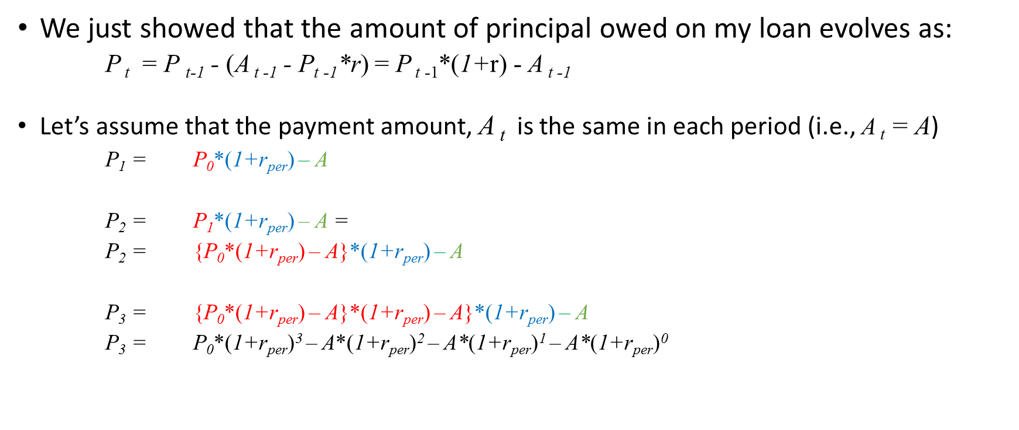
The balance of an amortizing loan
We just showed that the amount of principal owed on my loan evolves as:
P _{t} = P _{t-1} - (A _{t -1} - P_{t -1}*r) = P _{t -1}*(1+r) - A _{t -1}
Let’s assume that the payment amount, A _{t} is the same in each period (i.e., A _{t} = A)
P₁ = P₀*(1+r_{per}) – A
P₂ = P₁*(1+r_{per}) – A =
P₂ = {P₀*(1+r_{per}) – A}*(1+r_{per}) – A
P₃ = {P₀*(1+r_{per}) – A}*(1+r_{per}) – A}*(1+r_{per}) – A
P₃ = P₀*(1+r_{per})³ – A*(1+r_{per})² – A*(1+r_{per})¹ – A*(1+r_{per})⁰
More generally:
$$\text{P}\text{t}\text{ = }\text{P}\text{0}\text{∗(}\text{1+}\text{r}\text{per}\text{)}\text{t}\text{ – }\text{A}\text{∗}\sum_{k=1}^{k=t}{\left(1+\text{r}\text{per}\right)}\text{k}\text{−1}$$

Slide 15
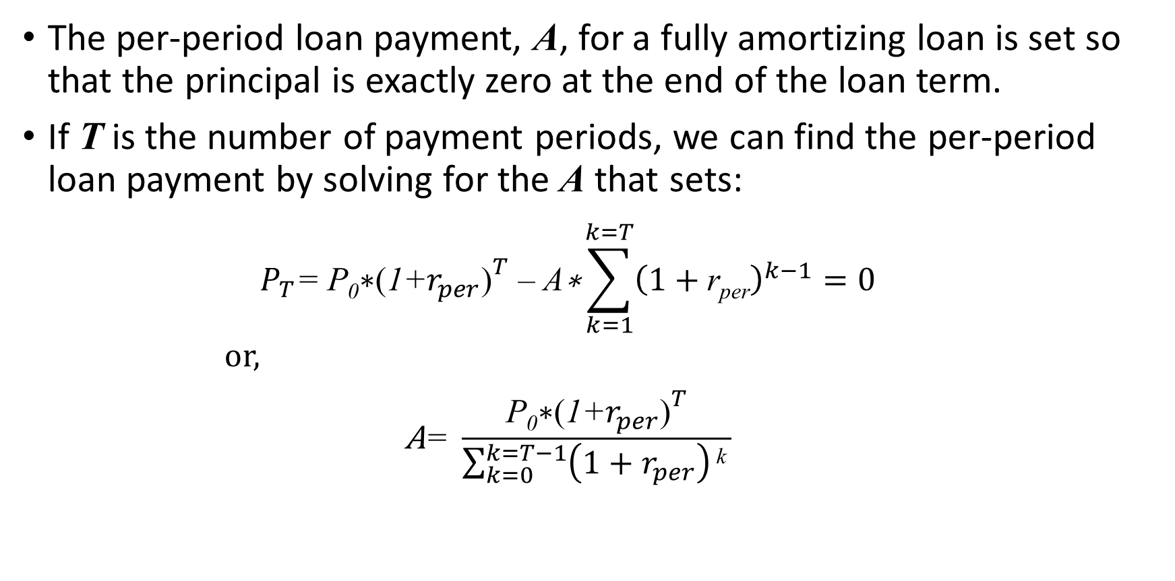
Fully Amortizing Loans
The per-period loan payment, A, for a fully amortizing loan is set so that the principal is exactly zero at the end of the loan term.
If T is the number of payment periods, we can find the per-period loan payment by solving for the A that sets:
$$P_{T}\text{= }\text{P}\text{0}\text{∗}{\text{(}\text{1+}r_{per}\text{)}}^{T}\text{ – }\text{A}\text{∗}\sum_{k=1}^{k=T}{{\left(1+\text{r}\text{per}\right)}^{k−1}=0}$$
or,
$$\text{A}\text{= }\frac{\text{P}\text{0}\text{∗}{\text{(}\text{1+}r_{per}\text{)}}^{T}}{\sum_{k=0}^{k=T−1}{\left(1+r_{per}\right)}\text{k} }$$

Slide 16
Partial Amortization with Balloon
Partial amortization means that loan payments exceed the interest that accrues each period thereby reducing the amount of principal owed on the loan, BUT, there is still principal owed at the end of the loan term (when the remaining principal must be paid)
Oftentimes, the monthly loan payment will be determined as if the loan were being fully amortized for a longer period than the actual loan term
For example, the monthly loan payment may be determined based on a 30 year (fully amortizing) amortization schedule, but the loan is structured to be paid back in full after 10 years

Slide 17
Adjustable Rate and Interest-only loans
Adjustable rate loans feature a low “teaser” rate for the beginning of the loan term, which resets after some period of time.
The low rate can be offered because the funding costs of the lender are lower for shorter-term loans and, relatedly, there is less interest rate risk
Thus, the longer the “teaser period” the less of a break you will get on the interest rate
When the interest rate resets, the payment will reflect a different interest rate and amortization schedule
Interest only loans allow the borrower to pay just the interest on the loan for some period of time after which they may:
Have to pay off the entire balance (balloon payment)
Move to an amortizing loan (full or partial)
Interest-only features can be combined with adjustable rate features

