Slide 1
GIT
Adrian Yuan—XVM683

Slide 2
Agenda
GIT Introduction in SCM Area
Basic Concept
Daily Work with GIT
Continue Integration with GIT
Migration to GIT?
Are you ready to GIT ? Do you want ?

Slide 3
GIT Introduction in SCM Area
Benefit with GIT
CDC with GIT
MSI with GIT
ClearCase VS GIT

Slide 4
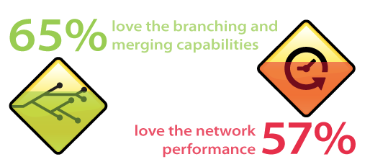
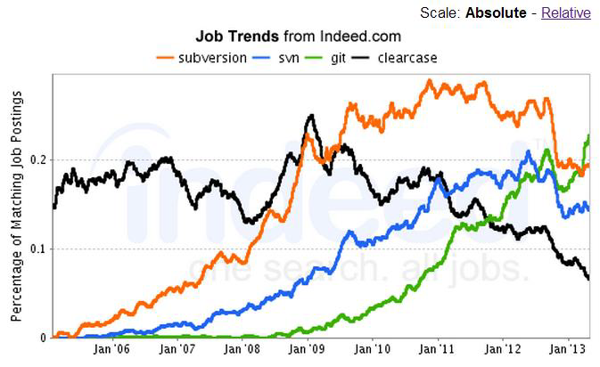
What developers love about GIT?
65% of ‘Git using’ organizations like ‘powerful branching & merging’ (and 57% like this the most)
•57% of ‘Git using’ organizations like ‘network performance’ (and 22% like this the most)
•32% of ‘Git using’ organizations like ‘Git’s popularity’ (and 10% like this the most)

Slide 5
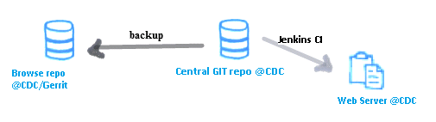
Git Doc from CDC
http://zch49view01.ap.mot-solutions.com/SCM/git.html

Slide 6
2014 GIT
Project Summary Information
All milestones on or ahead of schedule
All milestones on schedule
Some milestones are not on schedule & timelines at risk unless resolved
Key milestones not on schedule & timeline won’t happen unless resolved
Completed
REASON:
Become the GIT expert in CE SCM level.
ACTION:
Build up GIT knowledge.
Based on usages of ClearCase to find the corresponding solutions on GIT
Actively participate in MSI GIT progress.
RESULT:
The complete operation mapping list
Git Function/Performance/Security report
Migration effort and impact report
Status
Versus
Forecast
Outlook
Versus
Forecast
Major Milestones
Status
Description | Due | Last | Now
Setup GIT centralize repository and basic GIT knowledge build up | 3/28/14 |  | Completed
Setup Permission control system and basic GIT operation with ClearCase | 4/25/14 |  | Completed
Setup the version tree and code review system | 5/30/14 |  | Completed
Find out the 'dynamic view' solution on Git. | 6/27/14 |  | Completed
Summary the gap of GIT on MSI process. | 7/31/14 |  | Ongoing
Find out the project or developer team for trial purposes | 8/29/14 |  | Ongoing
GIT performance review | 9/26/14 |  | Not Start
Deliver the GIT function and performance report | 11/14/14 |  | Not Start
Deliver the GIT migration effort and impact report | 12/19/14 |  | Not Start
Major Decisions / Status / Milestones Completed
GIT centralize repository workstation is ready @ 17th Feb 2014
GIT version have been upgrade from V1.7 to V1.9 @17th Mar 2014
GIT permission control have been setup on Gerrit @21th Apr 2014
GIT code review system are ready @13 May 2014
GITTK should be enough for version tree function @20 May 2014
GIT develop and code review process trial in SCM team @27 May 2014
GIT can’t provide the fully dynamic view of Clearcase, but there is the workaround to get main feature of dynamic view with Git @27 June2014
New Cross-Program/Project Linkages
Critical Decisions Due / Open Follow-Up Risks/Issues
Description of any new dependencies and linkages with other projects
Description | Due | Status Update

Slide 7
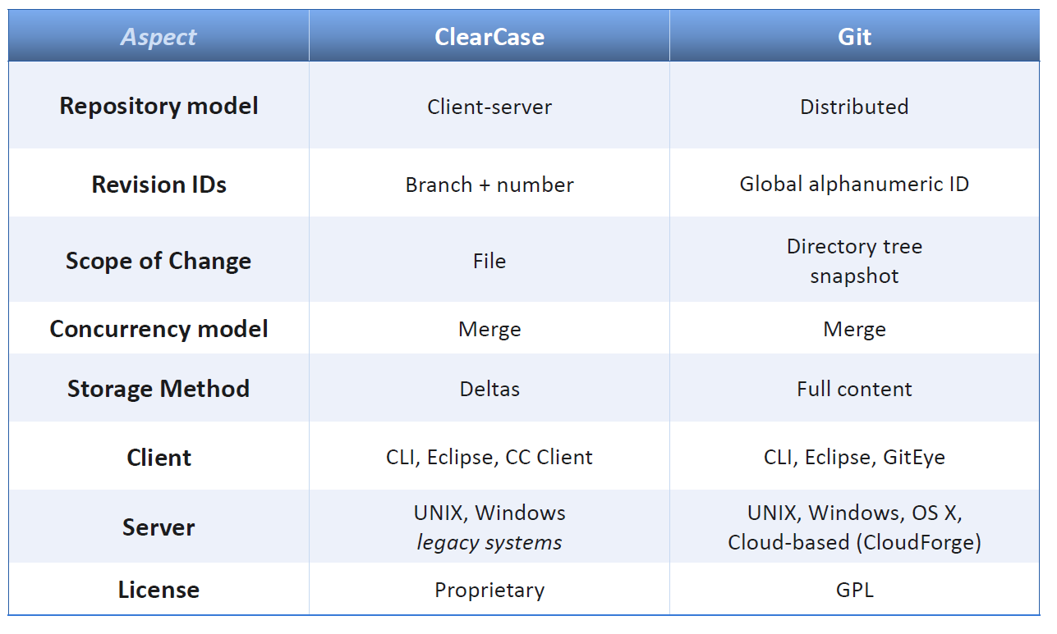
ClearCase Vs Git

Slide 8
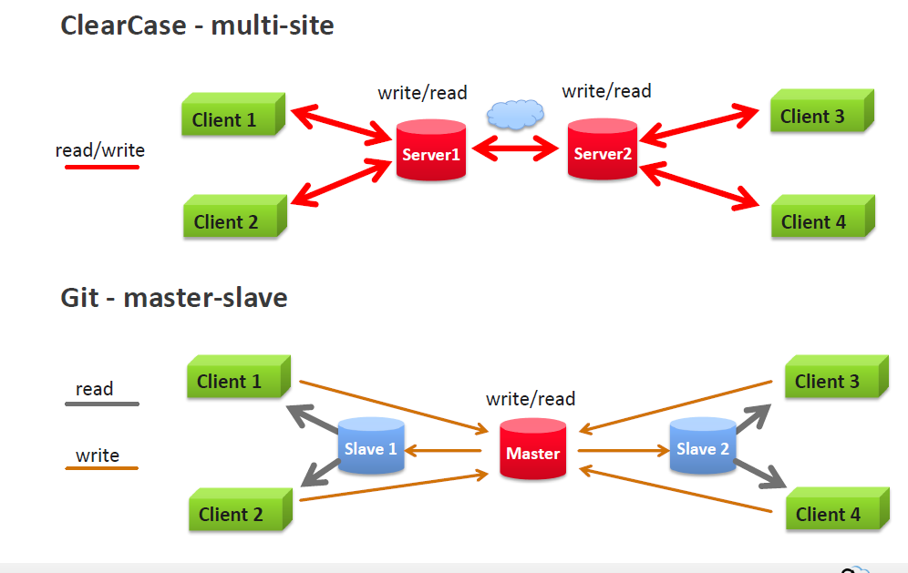
Git Multi-site

Slide 9
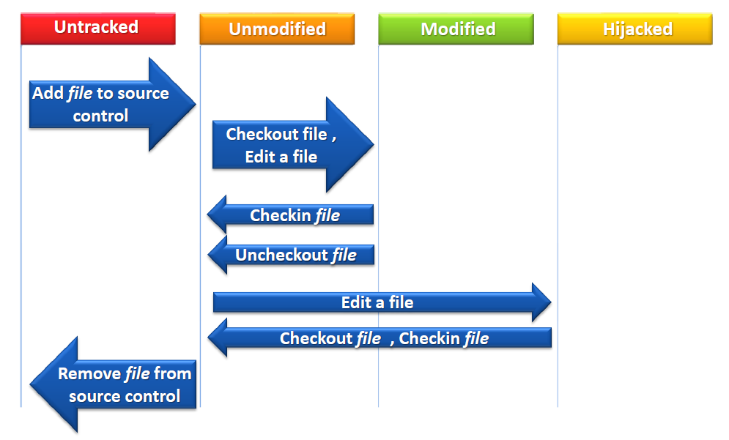
Clearcase handle the files

Slide 10
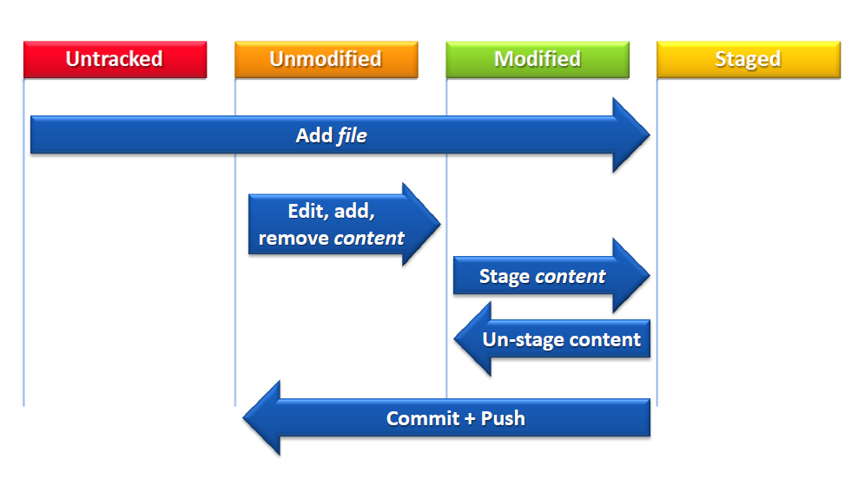
Git to handle files

Slide 11
GIT Basic Concept
Distributed version control
Repository
Version number-SHA1
HEAD/master/branch/
tag/Baseline

Slide 12
Distributed Version Control
GIT
Mercurial
BitKeeper
…

Slide 13
Repository
GIT Repository
View VOB
Bare Repository
Empty Repository

Slide 14
Version number-SHA1
author Botter <WJNB78@motorolasolutions.com>
Tue, 2 Sep 2014 18:10:35 +0800 (18:10 +0800)
committer Botter <WJNB78@motorolasolutions.com>
Tue, 2 Sep 2014 18:10:35 +0800 (18:10 +0800)
commit ab9ab08f1060a8df90d1fc30a6c95d0477b69cd3
tree 7c208f50f3afc9ba7c4e31fb50cdf07f7e3d8b75
parent bfc629f1150e1a7ddc839fce153995e092c4a55a

Slide 15
HEAD/master/branch
HEAD
HEAD^
HEAD^^^^^=HEAD^5=Master~5
Master is the default branch
Branch:
Every repo is the branch

Slide 16
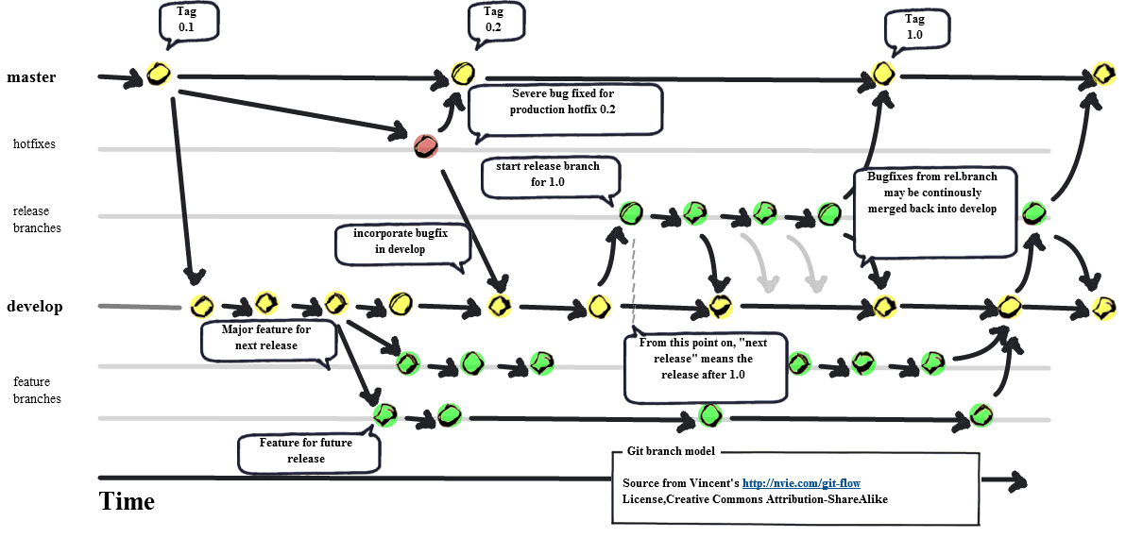
Git with branch

Slide 17
Tag
Lightweight Tag: a pointer
Annotated Tag: the full objects in GIT databases;
Signed Tag: GPG(GNU Private Guard) with the private key.

Slide 18
Next time?
1: Git Stage
2: Git diff
3: Git merge
4: Git reset
5: Git merge
6: Git patch
7: Git Cherry pick
…

Slide 19
Daily Work with GIT
Work with git in CDC
Gerrit/GitLab
Clone the repo
Checkout/checkin
Mkbranch
Working at home

Slide 20
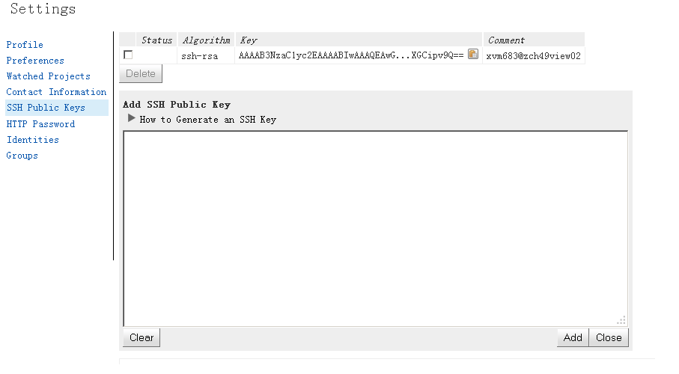
Typical working procedure for developer on Gerrit
1:Login with OneIT account : https://zch49git01:8443
2:2:Add the ssh pulic key into Gerrit for repository access;

Slide 21
Config
3:Check the ssh-key with your account(user name should be the upper case):
$ ssh -p 29418 XVM683@10.193.226.173 It should be ready if you get the following echo:
[xvm683@zch49view02 ref]$ ssh -p 29418 XVM683@10.193.226.173
**** Welcome to Gerrit Code Review ****
Hi Yuan Wei-XVM683, you have successfully connected over SSH. Unfortunately, interactive shells are disabled. To clone a hosted Git repository, use: git clone ssh://XVM683@zch49git01:29418/REPOSITORY_NAME.git Connection to 10.193.226.173 closed
4: Setting for personal info and push hook...(all of the developer have to do it, otherwise, git server will reject your check-in):
git config --global user.name "Your Name"
git config --global user.email "your_email@motorolasolutions.com"
keep "your_email@motorolasolutions.com" as same as https://zch49git01:8443/#/settings/

Slide 22
Config parameter
Git config
# it’ll impact current repo
Git config –global
#it’ll impact the current user configuration
Git config –system
#it’ll impact the current system configuration.

Slide 23
Clone the repo
Clone from Gerrit server:
git clone ssh://XVM683@zch49git01:29418/pcr_kernel
Clone between developers:
git clone /net/zch49view02/viewstore1/amb4116/git/pcr_kernel
Clone for another task:
mkdir ccmpd123456789
cd ccmpd123456789
git clone /net/zch49view02/viewstore1/amb4116/git/pcr_kernel

Slide 24
Checkout/Checkin
Checkout:
Switch the branch, tag, version.
Git clone/pull/fetch will be used to checkout file from remote repo
Check-in:
git add .
git commit –m ”your comments”
git push

Slide 25
Mkbranch
Create new branch
git branch xvm683_ccmpd123456
switch to new branch
git checkout xvm683_ccmpd123456
Remove the branch
git branch –D xvm683_ccmpd123456

Slide 26
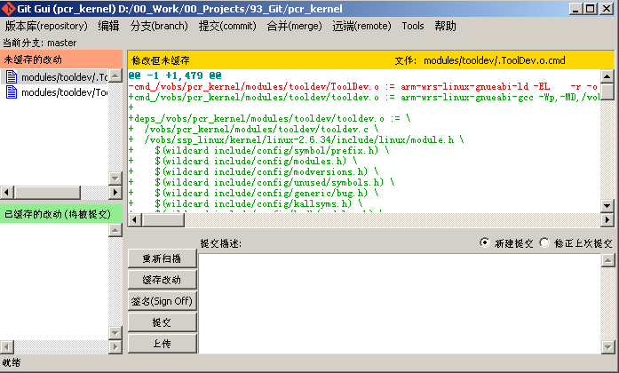
Working at home
Working at home? Without network?
\\zch49scm02\DeployArea\GIT\ Git-1.9.2-preview20140411.exe

Slide 27
Continue Integration with GIT
GIT+Gerrit+Jenkins

Slide 28
GIT+Gerrit+Jenkins
GIT can be integration with Jenkins directly. Any changes in Central repo will be monitor and trigger the new Continue integration.
Continue integration results will be the reference in Gerrit code review workflow.

Slide 29
GIT CI workflow
Jenkins
Update code
Push to
Git
Gerrit code review
CI Pipeline

Slide 30
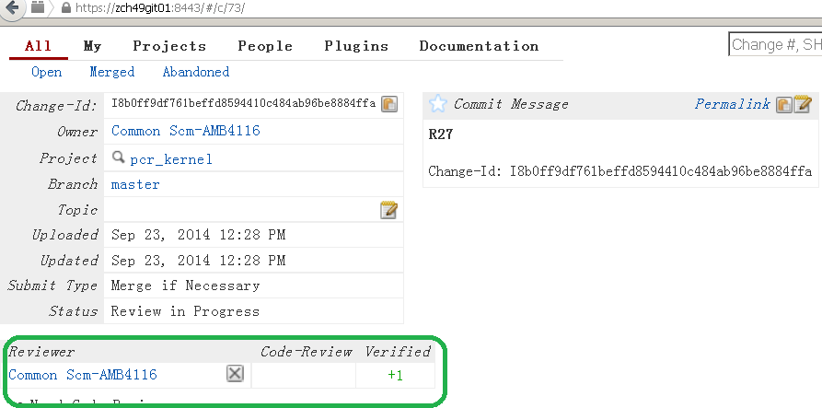
Gerrit

Slide 31
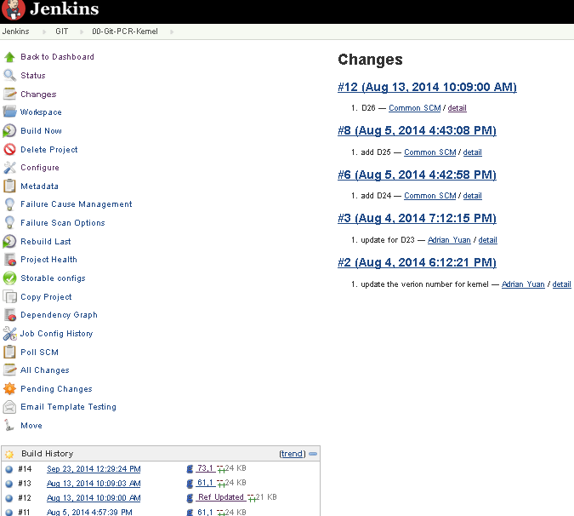
Jenkins interface

Slide 32
Migration to GIT?
Are you ready to GIT ?
Do you want?

Slide 33
Migration to GIT?
0: basic Linux knowledge
1: Git knowledge and competence build up
2: Combine current process with GIT/Gerrit
3: ClearCase history handling? Or sync between VOB and GIT
4:Ownership of project;
5: The migration step will be published in GIT ebook

Slide 34

Guide in CDC
GIT Ebook

Slide 35
Reference
Official GIT document :
git-scm-book:
http://git-scm.com/book/en/Getting-Started
(Chinese:http://git-scm.com/book/zh)
git-scm-manul:
http://git-scm.com/docs
git-online training (step by step)
http://gitimmersion.com/lab_01.html
MSI GIT group:
https://converge.motorolasolutions.com/groups/git-scm
CDG GIT ebook:
http://zch49view01.ap.mot-solutions.com/SCM/git.html

