Slide 1
Improve Requirement Documentation
July, 2006
Denny Li
GSG China
Motorola Internal Use Only

Slide 2
Revision History
Revision No. | Release Date | Authors | Reason of revisions | Review date | Reviewers
0.0.1 | 05/19/2006 | Denny Li | Initial Draft | 05/30/2006 | LG512&LG548 PLs/SSEs/QE
0.0.2 | 06/23/2006 | Denny Li | Update after review | 06/26/2006 | Vivi Zhou, Zhang Lei, Jenny Shui
1.0.0 | 07/04/2006 | Denny Li | Baseline for Operation pilot training

Slide 3
Objective
After this training, the audience will be able to
Know the concept of software requirement;
Improve the documentation technique of writing good requirements;
Avoid the common mistakes in requirement documentation.
This training does NOT cover areas:
Requirement gathering technique;
Requirement analysis technique;
Requirement management tool;
Requirement change control;
Requirement verification and validation technique.

Slide 4
Agenda
Get to know “requirement” ->
Requirement basis ->
Attributes for good requirements ->
Guidelines for good requirements ->
Pitfall Examples ->
Common Problems and Solutions ->

Slide 5
Get to know “requirement” –
Reasons for project failure
Incomplete Requirements 13.1%
Lack of User Involvement 12.4%
Lack of Resources 10.6%
Unrealistic Expectations 9.9%
Lack of Executive Support 9.3%
Changing Requirements & Specifications 8.7%
Lack of Planning 8.1%
Didn't Need It Any Longer 7.5%
Lack of IT Management 6.2%
Technology Illiteracy 4.3%
Other 9.9%
Source: Standish Group 1995 (www.standishgroup.com)

Slide 6
Get to know “requirement” –
The Definition in CMMI SE/SW, V1.1
Requirement -
  (1) A condition or capability needed by a user to solve a problem or achieve an objective.
  (2) A condition or capability that must be met or possessed by a product or product component to satisfy a contract, standard, specification, or other formally imposed documents.
  (3) A documented representation of a condition or capability as in (1) or (2).
  [IEEE 610.12-1990]

Slide 7
Get to know “requirement” –
What requirements are for
To show results the users want from the system.
To communicate the basics about the system in non-technical terms to all participants.
To form a basis for the design.
To test the system or any of its parts during development.
To show traceability back to sources and enable a logical approach to change management.
To act as a foundation for acceptance and payment.

Slide 8
Get to know “requirement” –
A “requirement” is NOT…
A design
A goal
A specific implementation
General guidance or information
Descriptive material
Some thoughts on a subject
Notes:
“Goal” definition in Longman dictionary: Something that you hope to achieve in the future [= aim]

Slide 9
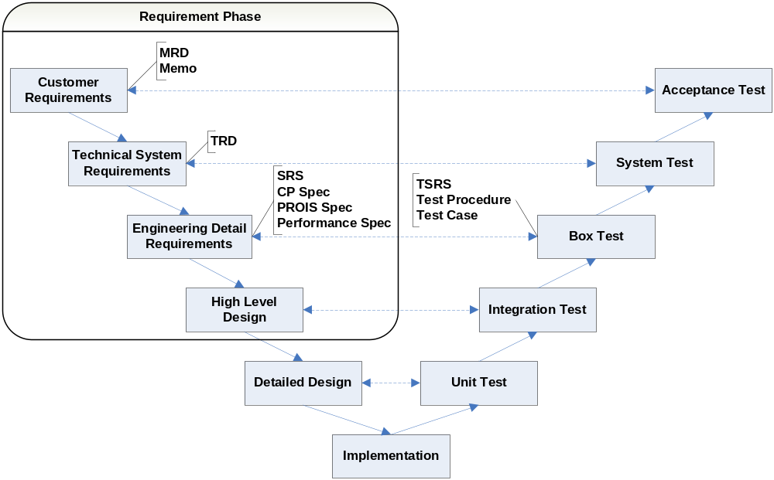
Get to know “requirement” –
Requirements in Project Life Cycle

Slide 10
Get to know “requirement” –
User Req vs. Engineering Req
User Requirements (MRD, Memo) | Engineering Requirements (TRD, SRS, Spec)
Description of the problem | Abstract solution
In user language | In developer language
Organized by goals | Organized by functions in a hierarchy or by objects
Subject: a type of user | Subject: the system or subsystem
Defines what the user gets | Defines what the system does
Owned by users | Owned by developers

Slide 11
Get to know “requirement” –
Types of Requirements
Functional requirements
Performance requirements (MIPS, system access time, response time, recovery time…)
Interface requirements (specify only two end points and specify the purpose and the payload across the interface)
Safety requirements (rounded edges, grounding, hazardous materials, noise levels, and all the hazards and faults that could threaten safety)
Training requirements (training’s type, location, length and people to be trained)
Documentation requirements (user manual, installation guides, training materials, maintenance manuals…)
Reliability, Portability, Maintainability, Security, Exception Handling…requirements

Slide 12
Get to know “requirement” –
Simple steps to create requirements
Identify users (and stakeholders).
Find out what users want.
Help organize their needs into a clear document structure.
Fill the structure with neatly sorted requirements.
Check it out with users.
Have it formally reviewed and baseline.
Ensure that the solution stays in line with the requirements as they evolve.

Slide 13
Get to know “requirement” –
Tips in project
Keep focused on results during development work. The results wanted by users are the developers' goals, they are maybe not standards or developers’ expectations.
It is normal that users change their requirements continually. Keep pay attention to the changes and well track the changes during development.
Demonstrate success and do not wait for the project to end before showing results. Early on, create presentations and prototypes to show progress, and to check out your understanding with users.

Slide 14
Requirement basis
Each requirement shall be a separate numbered entity.
  PWR_OFF_TRD_01, PWR_OFF_SRS_01
A requirement shall be a complete sentence:
  Radio shall be powered up on the last selected channel when it was powered off.
Recommend to use “shall” in most cases. Avoid “may” or “maybe” which denote non-mandatory or optional requirements. “Will” is used to indicate possible future events. “Should” is for goal. Use “shall be able to” instead of “can”.
  Turning the Channel Selector knob in the clockwise direction shall select the next available pre-programmed channel.
  Only 256KB ROM models will be the base for creating the new Chinese models.
A requirement shall be written only once within the document, found in a logical place and appropriately positioned in the hierarchy of requirements

Slide 15
Attributes for good requirements
Is it correct? (asks for something possible, do-able, legal)
Is it complete? (a complete sentence covering needed components)
Is it clear? (unambiguous, not confusing and unique)
Is it consistent? (not in conflict with other requirements)
Is it verifiable? (can we determine that the system meets the requirement?)
Is it traceable? (uniquely identified and can be tracked)
Is it feasible? (accomplished within cost and schedule)
Is it prioritized? (nice to have)
Check the set of requirements as a whole, assess that all the requirements together are realistic, complete, consistent, concise and formal.

Slide 16
Guidelines for good requirements
So we need to learn more ……

Slide 17
Guidelines for good requirements
Identify the subject who owns each requirement.
  User shall be able to power up radio on the last selected channel.
  Radio shall generate alert tone for each channel change.
Focus on stating what result is to be provided for that subject.
  Radio shall generate alert tone for each channel change.
Define verifiable criteria.
  Radio shall generate alert tone for each channel change.
  Radio shall be able to receive transmissions on the current personality.

Slide 18
Guidelines for good requirements
Use simple direct sentence.
  In Smart PTT Keyup Mode, the Smart PTT Periodic Timer shall be started when PTT releasing if the RA&RI Telegram or RI telegram has been sent or is sending upon pressing PTT.
  → In Smart PTT Keyup Mode, if the RA&RI Telegram or RI telegram has been sent, the Smart PTT Periodic Timer shall be started when PTT released.
  → In Smart PTT Keyup Mode, if the RA&RI Telegram or RI telegram is being sent upon pressing PTT, the Smart PTT Periodic Timer shall be started when PTT released.

Slide 19
Guidelines for good requirements
Define one requirement at a time.
  Radio shall be powered up by turning the rotary knob clockwise.
  Radio shall also be powered up via the External Emergency Switch.
  CCBxxx development is based on WARIS Conventional Portable latest version R05.09.13. In this version, there are only 14 bytes left in Bank1, 10 bytes left in Bank3, and 68 bytes left in bank4. But we must add some new code to support Chinese display which need about 4k bytes. So we must rearrange these Bank ROM to resolve this issue.
  On the other hand, according to TRD, FW must support Chinese front library level 1 and level 2, total 6763 Chinese characters. It will occupy about 60K bytes, so we must append 4 banks to store those characters library.
  → Bank xx shall be rearranged to have 4K free bytes.
  → 4 banks shall be appended to store Chinese font library level 1 and level 2, total 6763 Chinese characters.

Slide 20
Guidelines for good requirements
Avoid conjunctions (and, or, also, with) that make multiple requirements (ambiguity).
  New Chinese model will not allow user to input any extend ASCII code from keypad. But as to the new non-Chinese model, the extend ASCII will allow to be input from keypad as before. All the extend ASCII codes please reference to the Appendix C, Extend ASCII code table.
  → New Chinese model shall not allow user input any extend ASCII code from keypad.
  → New non-Chinese model shall allow user input extend ASCII code from keypad.
  → (State “All the extend ASCII codes please reference to the Appendix C, Extend ASCII code table” in Introduction section of SRS.)
  If Tone is ON in menu, then CALL_ALERT tone shall be generated while decode successfully and ID match, and vice reverse.
Notes:
Avoid conjunctions (and, or, also, with) that make multiple requirements (ambiguity).
----Requirements which contain conjunctions - words that join sentences together - are dangerous. Problems arise when readers try to puzzle out which part applies, especially if the different clauses seem to conflict, or if the individual parts apply separately. Dangerous conjunctions include: and, or, with, also.

Slide 21
Guidelines for good requirements
Don't ramble
  Once the call request completed for unsuccessful call setup, ie the radio received acknowledgment, the display will inform user the call status prior reverting back to traffic channel display. The display will revert back or changed after DISPLAY TIMER expired or any key has been pressed. And the DISPLAY TIMER will be fixed to 3 seconds.
  → Break up to 4 requirements.
Avoid let-out clauses (unless, except, if necessary, but, although)
  Whatever the original call is individual call or group call, both the calling radio and the called radio can include another called party except the units (s) already exist in the call.
  → Break up to 2 requirements.
Notes:
Don't ramble
----Long rambling sentences quickly lead to confusion and error.
Avoid let-out clauses
----Requirements which contain let-outs are dangerous. They look as though they are asking for something definite, but at the last moment they back down and allow for other options. Problems arise when the requirements are to be tested and someone has to decide what, if anything, could prove the requirement was not met. Dangerous let-outs include: but, except, unless, although. The word always often introduces a let-out.

Slide 22
Guidelines for good requirements
Don't design the system (names of components, materials, software objects/procedures, database fields)
  "Radio ID" menu is controlled by a bit named "Radio ID menu entry enable" in codeplug. This bit is located in Radio Option Block, at offset 0x52, bit 4. If this bit is cleared (is set to 0), "Radio ID" menu will be hided to prevent the end user from view or change the Radio ID.
Don't mix requirements and plans or schedule
  Below are base model information and new model information; In phase 1(SER6.1)released, we only support the Waris conv full keypad and display models and AOBA models. When in phase 2(Planned SER6.2), we will support the limited keypad models.
Notes:
Don't design the system
----Specifying design rather than actual need often increases the cost of systems by placing needless constraints on development and manufacture. Design constraints are sometimes necessary, but not as often as some requirements writers seem to think. Knowing why is much better than knowing what.
Don't mix requirements and plans or schedule
----Plans are essential, but they do not belong in the requirements. Usually they are updated throughout the project, whereas the requirements should stabilize. Mixing requirements with plans tends to increase the requirements workload through extra revisions and review meetings. Danger signs are references to dates, project phases, and development activities.

Slide 23
Guidelines for good requirements
Don't use vague, undefinable terms (user-friendly, versatile, flexible, approximately, as possible, efficient, improved, high performance, modern, timely, suitable, convenient)
  Upon press and hold of button, the display will show the status of the battery charge when it is fully charged, approximately.
  The implementation allows the background hunt for home channel hunting type and preferential NDD subset hunting type be carried out more efficiently.
Avoid wishful thinking (100% reliable, Safe, Never fail, Handle all unexpected failures…)
  The gearbox shall be 100% safe in normal operation.
  Monitoring A-B/Long B while sending C-B, with C the adjacent tone, the software component adjacent code failure shall be less than 8 per 8000.
Notes:
Don't use vague, undefinable terms
----Many words used informally to indicate desired qualities are too vague for use in requirements. Requirements using these terms are unverifiable because there is no definite test to show whether the system has the indicated property.
Avoid wishful thinking
----Engineering is a real-world activity. No system or component is perfect. Wishful thinking means asking for the impossible. Developers will rightly query or reject wishful requirements. Wishful terms include: 100% reliable. Safe. Handle all unexpected failures. Please all users. Run on all platforms. Never fail. Upgradable to all future situations.

Slide 24
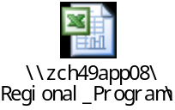
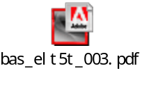
Guidelines for good requirements
Don't speculate (usually, generally, often, normally, typically)
  Users normally require early indication of intrusion into the system.
Don’t embed
  Below are base model information and new model information…
  Please refer to codeplug spec ( ) for more details.
Keep terms consistent
  “talkgroup rotary” vs. “channel selector knob”
Use a limited (500 word) vocabulary (especially if your audience is international).
  The airline shall be able to change the aircraft from business to holiday charter use in less than 12 hours.
  There is no need to use words like reconfigured.
Notes:
Don't speculate
Requirements are part of a contract between customer and developer, with users as interested third parties. There is no room for "wish lists" - general terms about things that somebody probably wants. Danger signs include vagueness about which type of user is speaking, and generalization words: usually, generally, often, normally, typically.

Slide 25
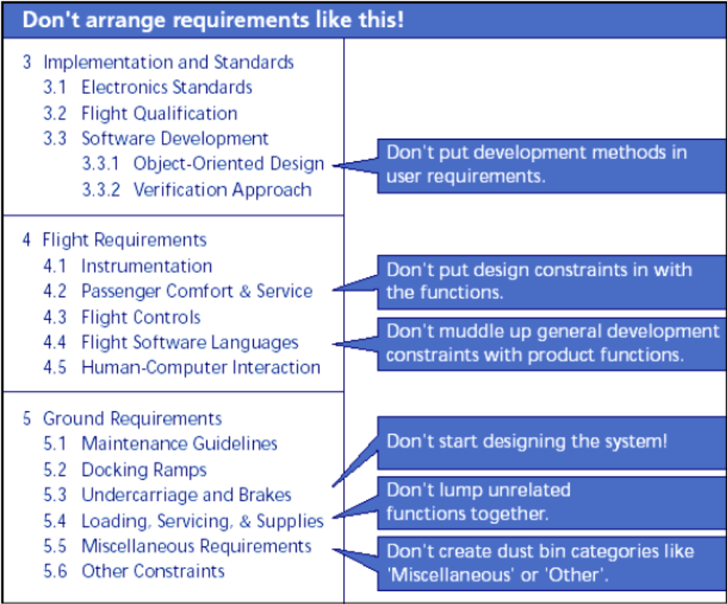
Pitfall Examples

Slide 26
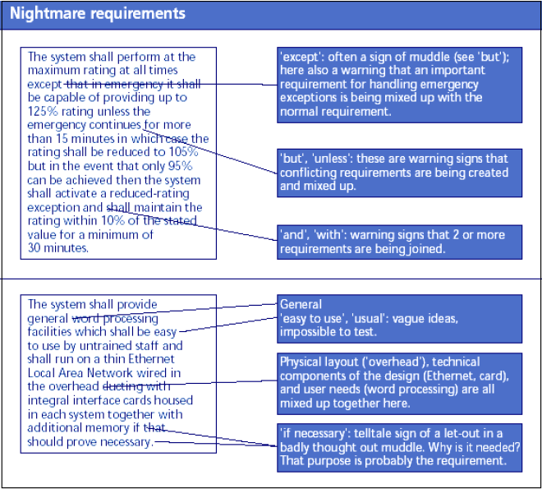
Pitfall Examples

Slide 27
Pitfall Examples
If the landed radio with mute status presses PTT to initiate a conversation, after release PTT, the landed radio will still be mute state on the landed channel if Auto Reset Mode is disabled until the Vote Scan is resumed.
If the calling radio cancelled the include call by pressing clear button or "*#" or menu exit button whilst the call request in progress, the radio will display “Cancelling”, then revert to traffic channel display. Pressing clear button or "*#" or menu exit button in any other state will clear the original call and the radio will enter Trunking idle state.
MDC Selective Radio Inhibit Decode: The Selective Radio Inhibit feature enhances the user’s communication system security by making it possible to incapacitate stolen or missing radios. This is a valuable feature that will allow a system operator to manage delinquent customer accounts. The dispatcher or system administrator inhibits the radio. Once inhibited, the radio is inoperable until it is re-configured by dealer. This is MDC 1200 feature.

Slide 28
Top 10 requirements problems
Multiple requirements
Lack of structure: repetition or missing requirements
Ambiguity, vagueness, poor wording
No visible means of testing the requirement
Mixture of user and system requirements
Design mixed into the requirements
Methods and plans in the product requirements
Customer too passive or too intrusive
Configuration of requirement version not managed
Commitment to impractical set of requirements

Slide 29
Common problems with structure
Problem | Solution
All readers need to understand the requirements | Write requirements in everyday language
Long list of requirements is impossible to understand | Make a simple structure of chapters and sections to group the requirements
Requirements don't show what comes first | Organize the chapters and sections in time order
Some requirements can be applied simultaneously, or in any order—a sequence is an unnecessarily tight ordering | Mark whether sections in the structure are sequences, parallels, or alternatives
The basic sequence of requirements doesn't show what to do if something goes wrong | Add a section for each exception, at the place where it could occur in the normal sequence
Some constraints apply to several requirements | Use a requirements tool to link them together
Users find it hard to get an overview of the whole document | All the above solutions, or • Add a simple diagram • Write an overview • Find out why they find it hard and restructure the document

Slide 30
References
Writing Quality Requirements Guidelines, ZMY01-STD-2003A245, R01.00, 8-Dec-03
Get it Right the First Time: Writing Better Requirements, Telelogic, 2-Oct-03
Writing Better Requirements, Ian F. Alexander, Richard Stevens, A005.1

Slide 31

Any Questions?

Slide 32


