Slide 1
DEVICE MANAGEMENT
TEST STRATEGY FOR SAFe

Slide 2

Test in lifecycle
Scrum Team
UT/IT/FT/AT
…
UT/IT/FT/AT
UT/IT/FT/AT
…
UT/IT/FT/AT
…
PI1-Sprint 1
PI1-Sprint N
PI2-Sprint 1
PI2-Sprint N
Off Ramp
Off Ramp
Validation Test
Expert/UX Test
…
Validation Test
Expert/UX Test
Final
Validation Test
Validation Test
Expert/UX Test
Final Validation Test
Validation Test
Expert/UX Test
…
…
…
NFR Test
NFR Test
…
NFR Test
NFR Test
…
System Test Team
UT: Unit Test
IT: Integration Test
FT: Function Test
AT: Acceptance Test
NFR: Non-Functional Requirement
developer
developer
+ tester
tester
tester

Slide 3
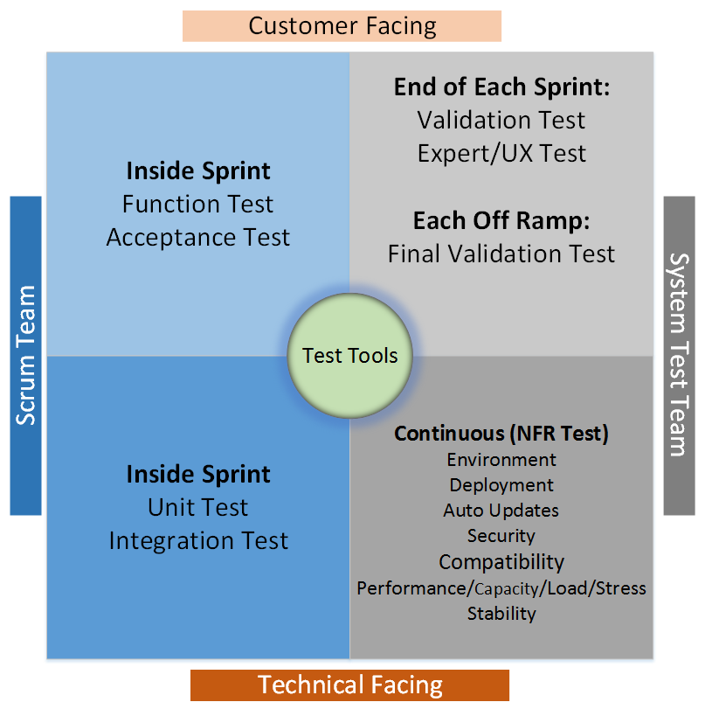
Test Responsibility
Left Half: Scrum Team
Top Left (Verification):
Requirements based testing
Ensure implementation meets customer use cases
Bottom Left (Verification):
UT/IT
Ensure the implementation works
Provide code coverage
Right Half: System Test Team
Top Right (Validation):
Validation of the software against customer use cases
Test real life usage of the software
Ensure software is of high quality
Bottom Right (Validation/Verification):
System level testing
Provide statistics on software performance
developer
developer
+ tester
tester
tester

Slide 4
Test Definition
Unit Test
Integration Test
Function Test/
Acceptance Test
System Test
Owner: Code author
Executed by: code author
Test Method:
White box
Automated
Test Object:
Function (flow) / (sub-) Interface / (sub-) Component
Auto UT embedded in CI workflow
Regression Test :
Fully regression
Owner: Scrum Team
Executed by: Scrum Team
Test Method:
White/Grey/Black Box
Manual / Automated (preferred)
Test Object:
Interfaces and interactions between components/features
Regression Test :
Risk based regression
Automated test case: fully regression
Manual test case: selected regression based on the impact analysis
Owner: Scrum Team
Executed by: Scrum Team
Test Method:
Grey/Black Box
Manual / Automated (preferred)
Test Object:
SRS (all happy paths + major unhappy paths)
Regression Test :
Risk based regression
Automated test case: fully regression
Manual test case: selected regression based on the impact analysis
Acceptance Test :
Targeted on “Done” new functions and changed functions in Sprint
Acceptance Criteria should be met before handover to ST
Owner: System Test Team
Executed by: System Test Team
Test Method:
Black Box
Manual / Automated (preferred)
Test Object:
Validation Test (Manual/Automated Test) - checking that the system will meet the customer’s actual needs
Targeted on all “Done” Features
Complex Customer’s Scenarios
System Wide Interactions
UI/UX - User Experience Test (Manual Test)
Expert/Exploratory Test (Manual Test)
Final Validation Test (Manual Test) - Appraisal for Ship Acceptance
Basic and Major Customer’s Scenarios
NFR Test (Automated Test, Continuous)
Performance / Capacity/Load/Stress
Deployment
Environment
Stability
Scalability
Security
Auto update
Regression Test :
Risk based regression
Automated test case: fully regression
Manual test case: selected regression based on the impact analysis
Scrum Sprints
Qualified Working Software

Slide 5
Procedural vs. Agile
OLD |  |  |  |  |  |  |  | NEW
 | Development |  |  |  |  |  |  |  | Scrum Team
 | Unit/Integration Test |  |  |  |  |  |  |  | Unit/Integration Test
 | Constraints |  |  |  |  |  |  |  | Constraints
 | Field |  |  |  |  |  |  |  | Field
 | MVO |  |  |  |  |  |  |  | MVO
 | Pack/Unpack |  |  |  |  |  |  |  | Pack/Unpack
 | Feature performance |  |  |  |  |  |  |  | Feature performance
 | Etc. |  |  |  |  |  |  |  | Etc.
 | Sanity Test
 |  |  | BOX TEST |  |  |  |  |  | Function Test
 |  |  | Radio Features | Constraints | Regression Valid Path/Invalid Path |  |  |  | Radio Features Test on UI |  | Regression Valid Path/Invalid Path
 |  |  |  | Field
 |  |  |  | MVO
 |  |  |  | Pack/Unpack
 |  |  |  | Etc.
 |  |  | Platform | GUI |  |  |  |  | Platform | GUI
 |  |  |  | Communications |  |  |  |  |  | Communications
 |  |  |  | Access Control |  |  |  |  |  | Access Control
 |  |  |  | Import/Export |  |  |  |  |  | Import/Export
 |  |  |  | Upgrade/FLASHport |  |  |  |  |  | Upgrade/FLASHport
 |  |  |  | CFS |  |  |  |  |  | CFS
 |  |  |  | Help/Reports |  |  |  |  |  | Help/Reports
 |  |  |  | Etc. |  |  |  |  |  | Etc.
 |  |  | Acceptance Test |  |  |  |  |  | Acceptance Test |  |  |  | System Test Team
 |  |  | System | Performance/Capacity/Stress | Regression Valid Path/Invalid Path |  |  |  |  |  |  |  | NFR | Performance/Capacity/Stress | Regression Valid Path/Invalid Path
 |  |  |  | Deployment |  |  |  |  |  |  |  |  |  | Deployment
 |  |  |  | Install/Auto Update |  |  |  |  |  |  |  |  |  | Install/Auto Update
 |  |  |  | Localization |  |  |  |  |  |  |  |  |  | Localization
 |  |  |  | Compatibility |  |  |  |  |  |  |  |  |  | Compatibility
 |  |  |  | IA |  |  |  |  |  |  |  |  |  | Environment(OS, LA, Etc)
 |  |  |  | NFR (Environment) |  |  |  |  |  |  |  |  |  | Scalability
 |  |  |  | Etc. |  |  |  |  |  |  |  |  |  | Security (IA)
 |  |  |  |  |  |  |  |  |  |  |  |  |  | Etc.
 |  |  |  |  |  |  |  |  |  |  |  |  | Validation Test
 |  |  |  |  |  |  |  |  |  |  |  |  | UI/UX Test
 |  |  |  |  |  |  |  |  |  |  |  |  | Expert/Exploratory Test
 |  |  |  |  |  |  |  |  |  |  |  |  | Final Validation Test
developer
developer
+ tester
tester
tester

Slide 6
THANK YOU

