Slide 1
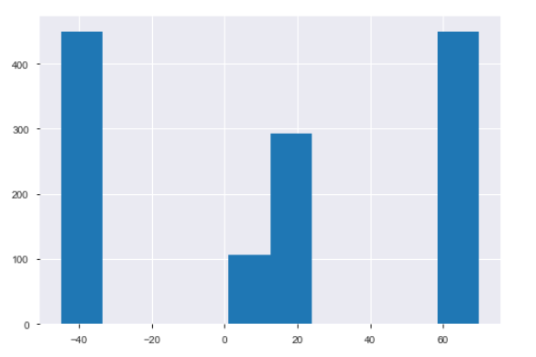
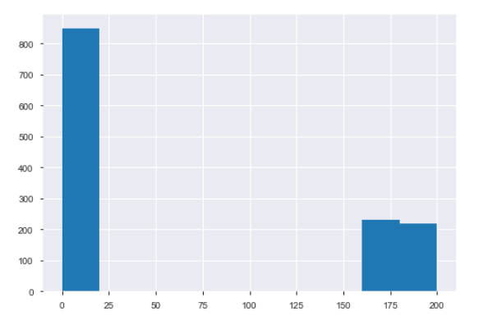
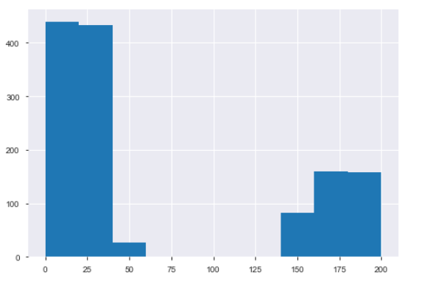
Outlier Definition
Temperature Outliers
Precipitation Outliers
Wind Speed Outliers
http://eltiempo.lasprovincias.es/las-cosas-del-clima/records-meteorologicos-espanoles

Slide 2
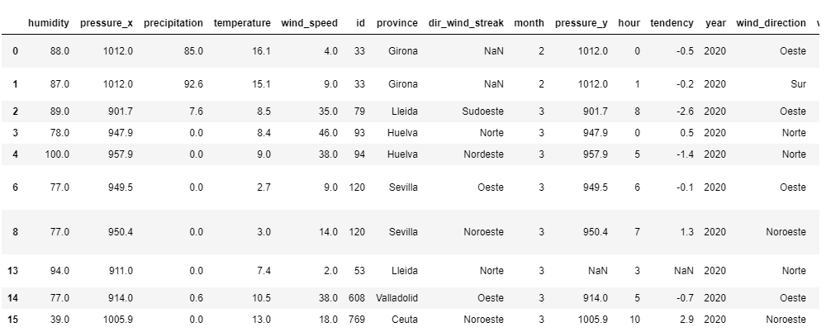
Detected outliers on the test data

Slide 3
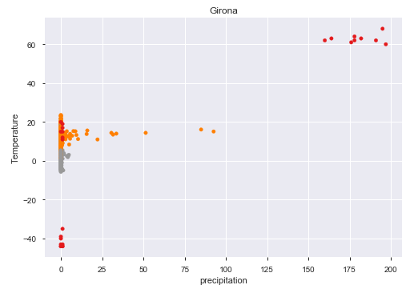
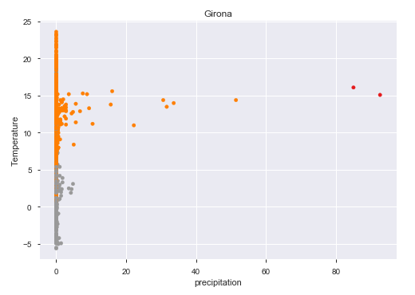
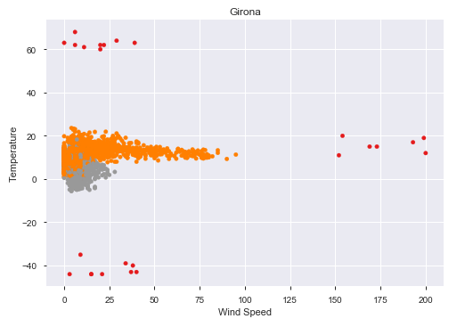
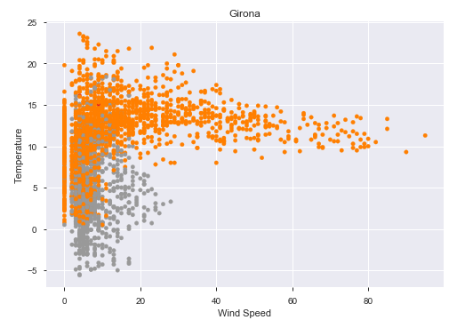
Visualization of detected outliers - Girona
Train Set
Test Set

Slide 4
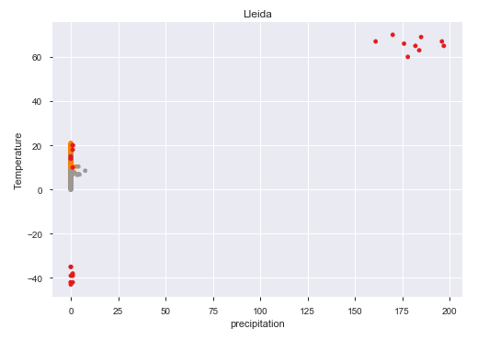
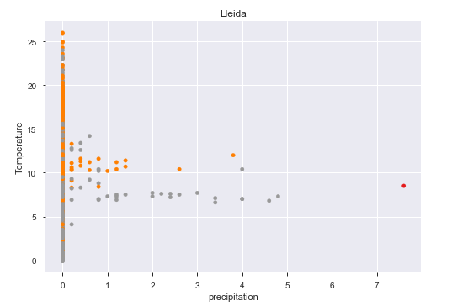
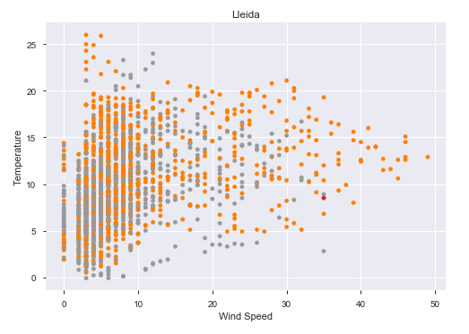
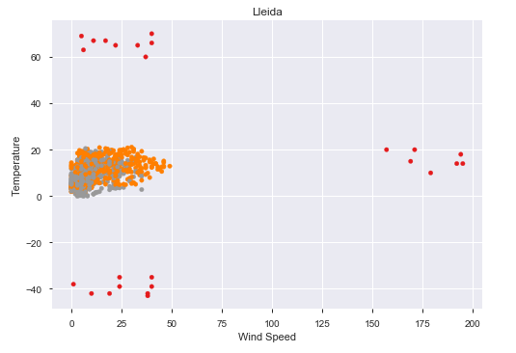
Visualization of detected outliers - Lleida
Train Set
Test Set

Slide 5
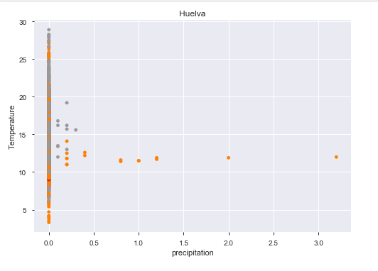
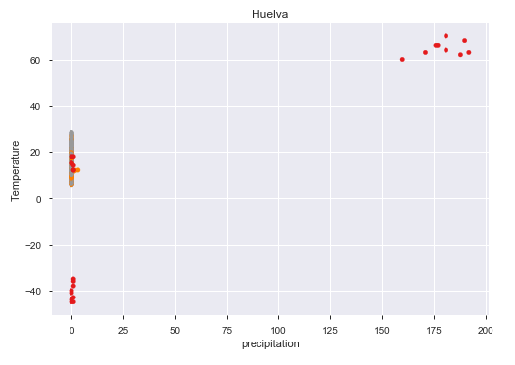
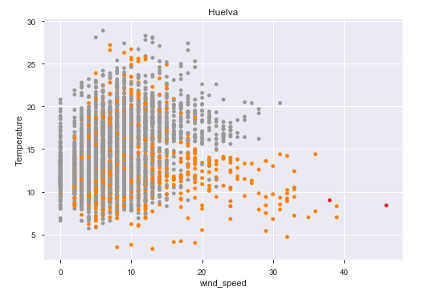
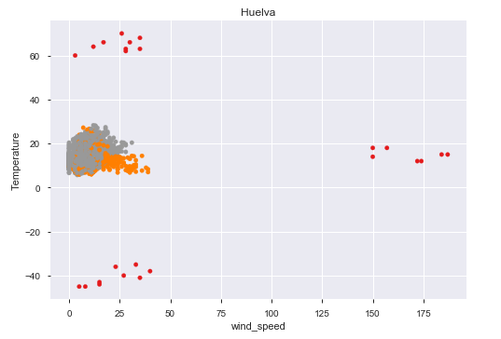
Visualization of detected outliers - Huelva
Train Set
Test Set

Slide 6
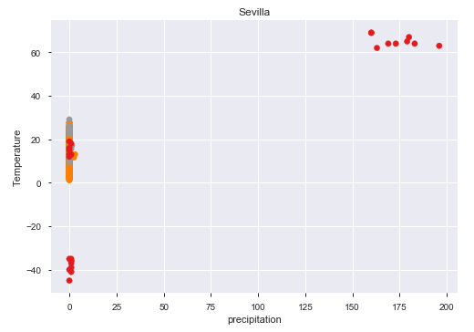
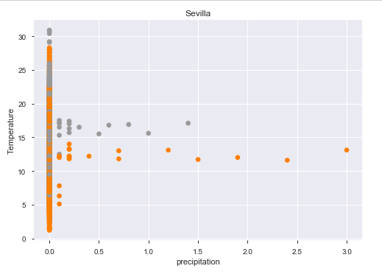
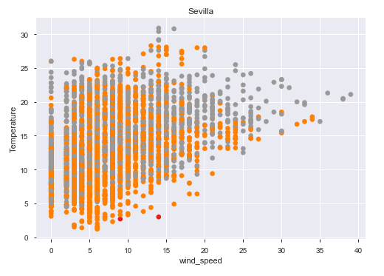
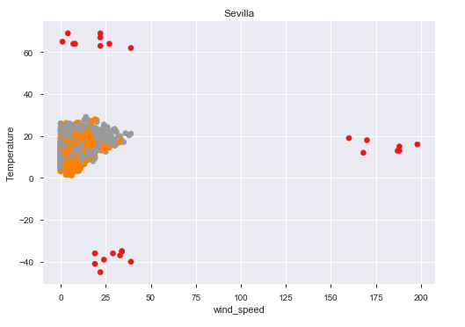
Visualization of detected outliers - Sevilla
Train Set
Test Set

Slide 7
Visualization of detected outliers - Sevilla
Train Set
Test Set

Slide 8
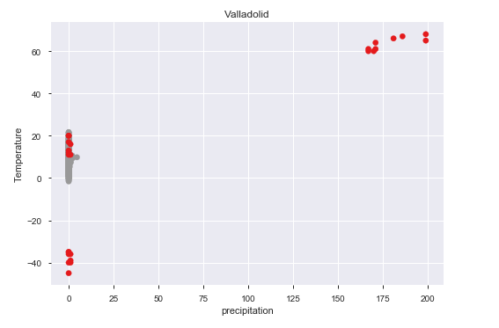
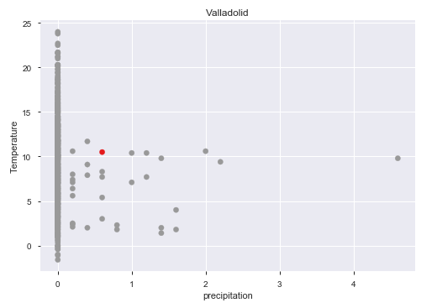
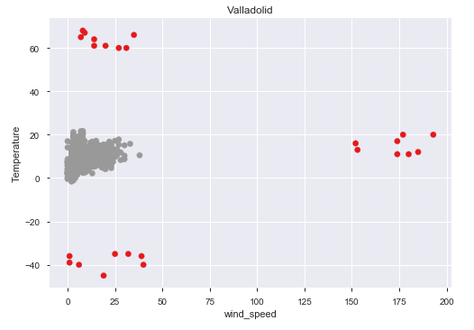
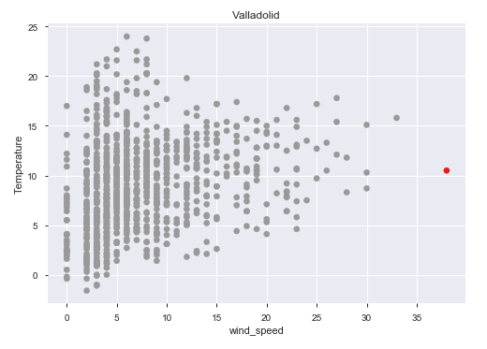
Visualization of detected outliers - Valladolid
Train Set
Test Set

Slide 9
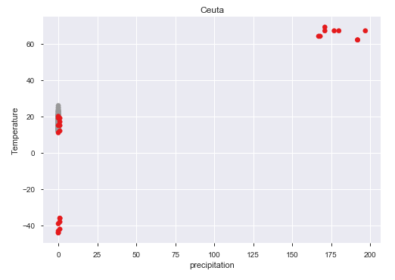
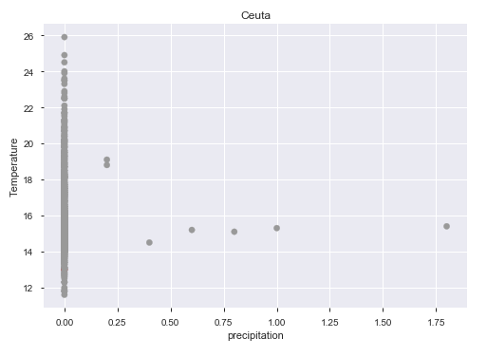
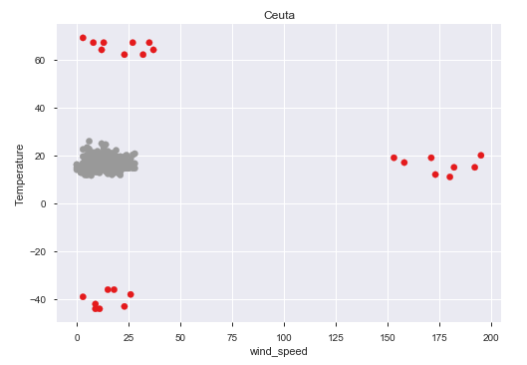
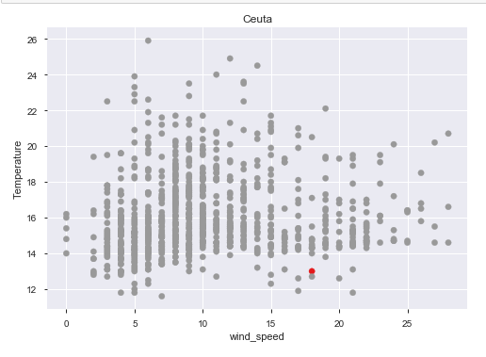
Visualization of detected outliers - Ceuta
Train Set
Test Set

Slide 10
Conclusions
Isolated points, even if they are normal are considered as anomalies.
For this, maybe reducing the number or artificially added outliers could lead to a decrease on the “min_simples” -> That could help us in these errors on predictions.
Sevilla and Ceuta anomalies exhibit a strange behaviour, that cannot by easily identified by eye.

