Slide 1
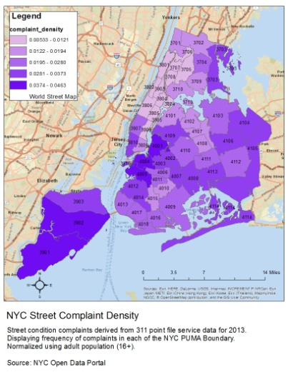
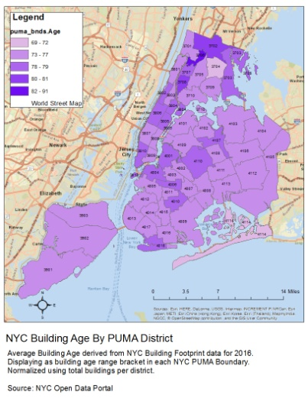
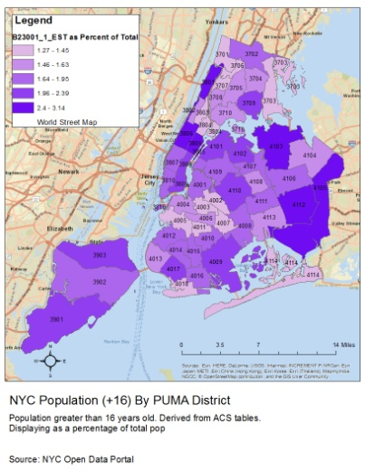
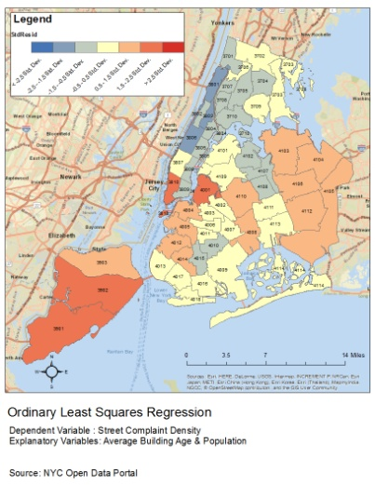
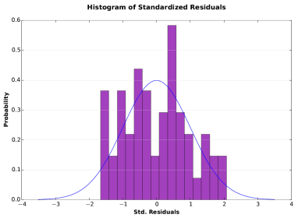
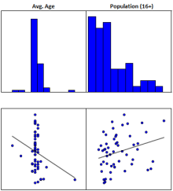
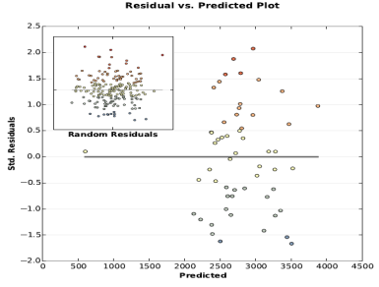
Analyzing NYC 311 Street Complaints with OLS Regression Course – GTECH 70900 Student - Adrian Ferrar
Research Question
Methodology Cont’d
What explanatory variables influence the distribution of 311 street complaints in New York City?
Intersected 311 street complaint
selection with puma bands dataset.
Calculated frequency of complaints by puma district.
Converted building footprint layer and puma band layer to file geodatabase format.
Joined building and puma layer, exported new attribute table to excel.
Calculated average construction date per building by puma district and converted to building age.
Created choropleth maps for street complaints density, avg. building age, and population size.
Ran Ordinary Least Squares Regression analysis for prev. mentioned variables.
Test Variables
Dependent : St. Complaint Density
Independent: Average Building Age
Population Size
Hypothesis
Ho : Avg. Building Age → Positive Correl.
Population Size → Positive Correl.
Ha : No Correlations
Results & Conclusions
Methodology
Utilized Datasets :
Census PUMA Boundaries
American Community Survey Tables
311 Service Line Point Features
NYC Open Portal Building Footprints
From 311 Complaint data, selected for:
Sidewalk Condition
Street Condition
Street Light Condition
Street Sign - Damaged
Street Sign - Dangling
Street Sign - Missing
Traffic Signal Condition
Results & Conclusions Cont’d
Adjusted R-Squared : 0.109118
The population/age model explains approximately 10.9% of the spatial variation in street complaints.
Vertical distribution of building age scatter plot illustrates no correlation.
Further analysis is necessary to fully tell the NYC street complaint story.

