Slide 1
Content Curation
AFFAN SHAIKH
SHREEYA DESHPANDE
PRANJALI KULKARNI
Guided by: Prof. P. Ghadekar

Slide 2
MOTIVATION
A huge amount of data is present online and the network must ensure that it keeps the user away from the unwanted and misleading information. We decided to use the concepts of machine learning and natural language processing to design an algorithm and develop a working prototype of the same to detect abusive content.

Slide 3
INTRODUCTION
We had used concepts like TFIDF, Count Vectorizers, and applied machine learning algorithms on textual data. We implemented a hybrid model with many approaches to combine them. We used count Vectorizer, TFIDF and LSTM.

Slide 4
STEP 1: UNDERSTANDING THE DATA
Dataset contains 15k rows.
Each sentence is a tweet taken from twitter.
Labels specify whether the tweet is abusive or not.
Abusive(1) and non-abusive(0)
STEP 2: PREPROCCESSING
Cleaning the tweet.
Tokenizing the data.
Removing stopwords.
Removing special characters.

Slide 5
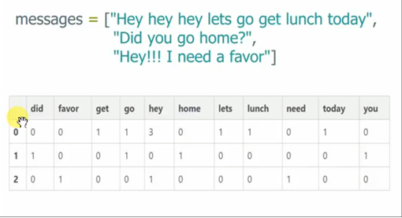
STEP 3.1: Count Vectorizer
Accuracies:
1)Logistics regression:- 92.83%
2)Random Forest:-92.74%
3) KNN:-88.38%

Slide 6
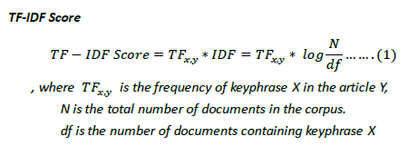
Tfidf
STEP 3.2: TFIDF
Accuracies:
1)Logistics regression:- 92.06%
2)Random Forest:-92.35%
3) KNN:-67.56%

Slide 7
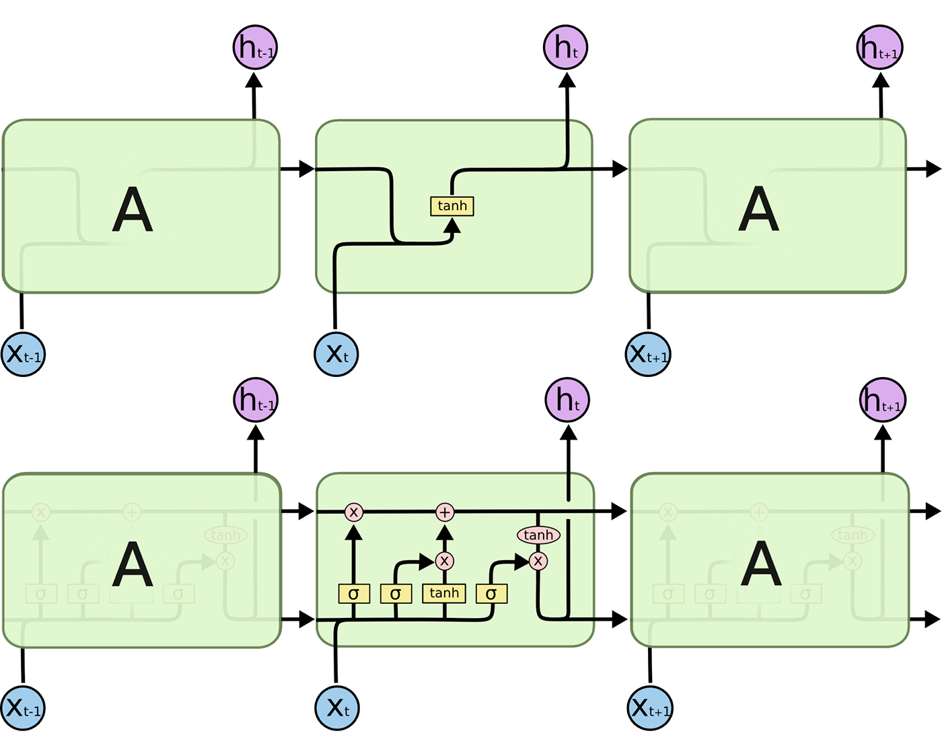
STEP 3.3: LSTM
Accuracies:
After 30 epochs: 79.98%
After 50 epochs: 86.02%

Slide 8
LR
Count Vectorizer
RF
KNN
LR
Raw Data
(Input)
Pre-processing
TFIDF
Hypothesis
RF
KNN
LSTM

Slide 9
STEP 3.1: Comparing Tables
 | Count Vectorizer | TFIDF
Logistic | 92.83 | 92.06
Random Forest | 92.74 | 92.35
KNN | 88.38 | 67.56
 | LSTM
30 epochs | 79.98
50 epochs | 86.02
Accuracy of Hybrid Model: 93.49

Slide 10
Classification report
 | Precision | Recall | F1-score | Support
0 | 0.91 | 0.97 | 0.94 | 1443
1 | 0.97 | 0.90 | 0.93 | 1459

Slide 11
THANK YOU

