Slide 1
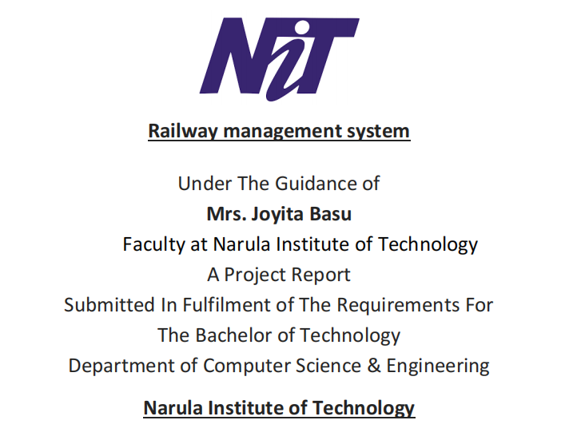

Slide 2
SOFTWARE ENGINEERING PROJECT
NAMES ROLL NO.
1. SOHAM BISWAS - 129
2. MD TANVIR ALFESANI - 131
3. VIVEK SINGH - 133
4. RAHUL SEN - 134
5. MD AFFAN ASGHAR - 135

Slide 3
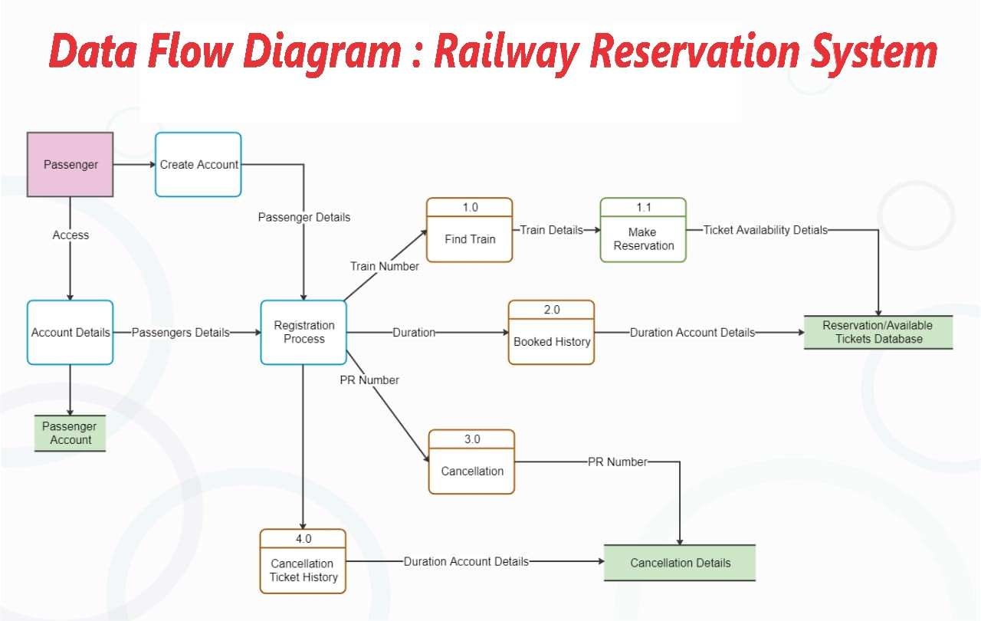

Slide 4
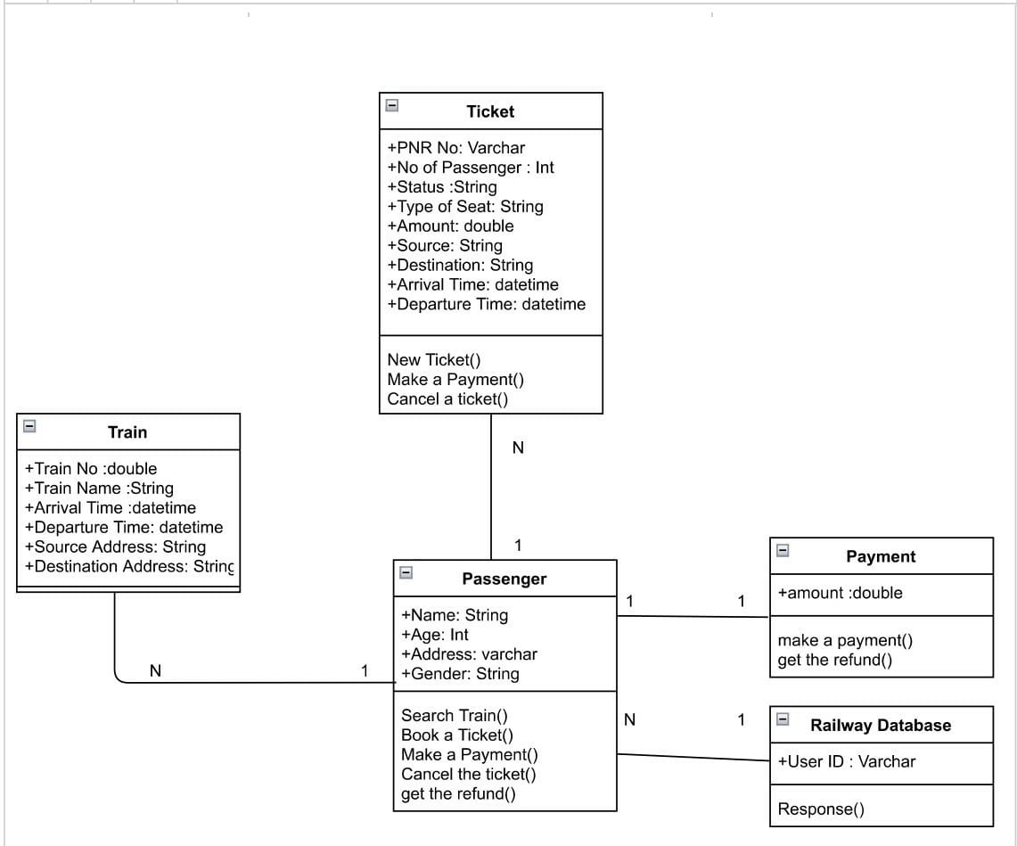
Class Diagram of Railway Reservataion System

Slide 5
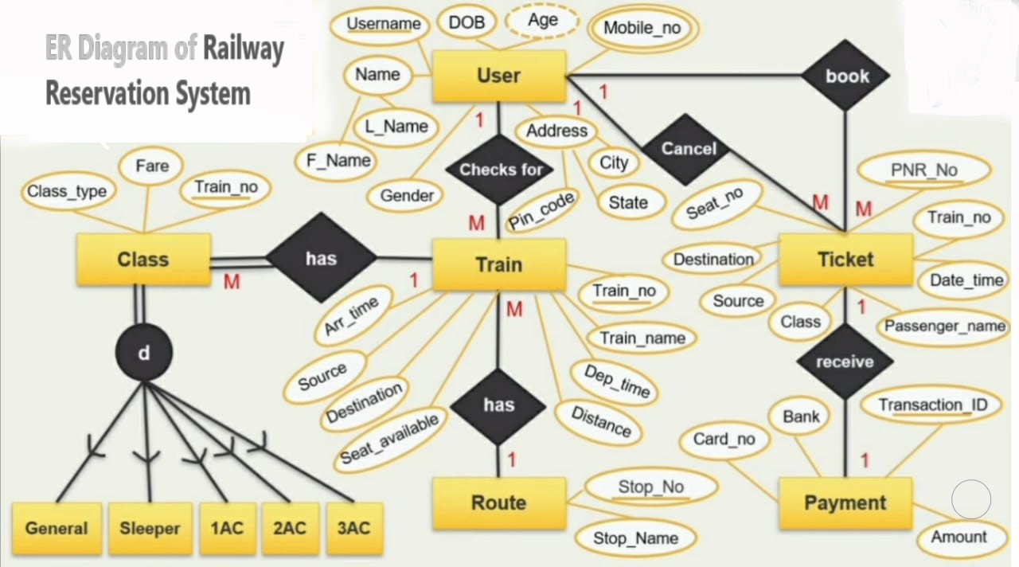

Slide 6
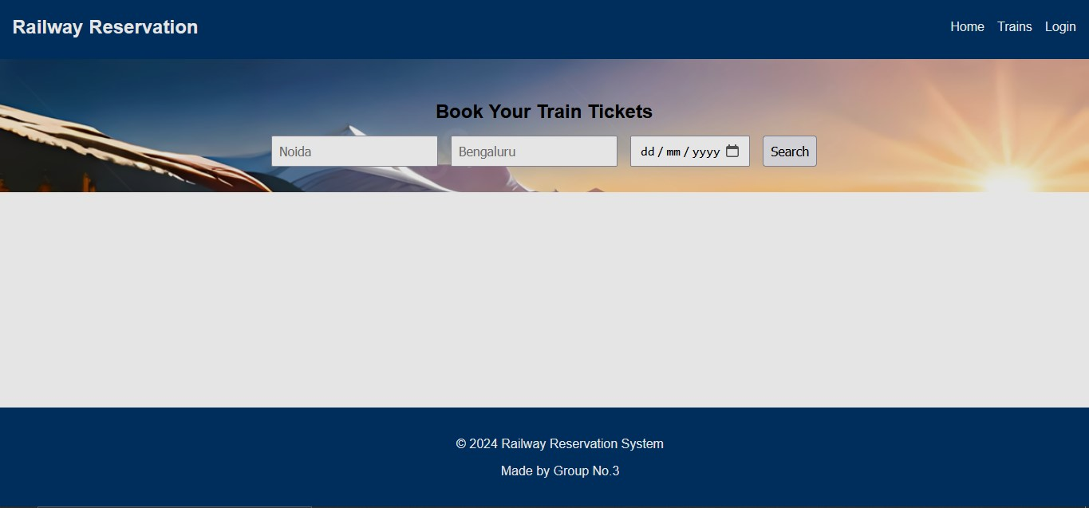
Images of Railway Reservation System Project

Slide 7
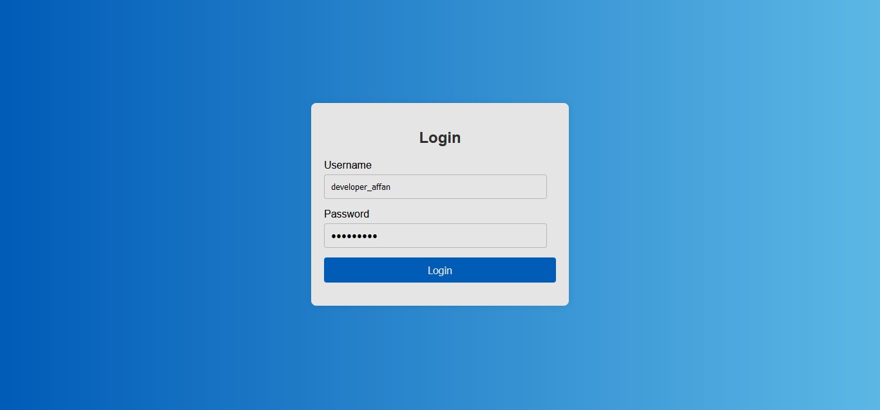

Slide 8
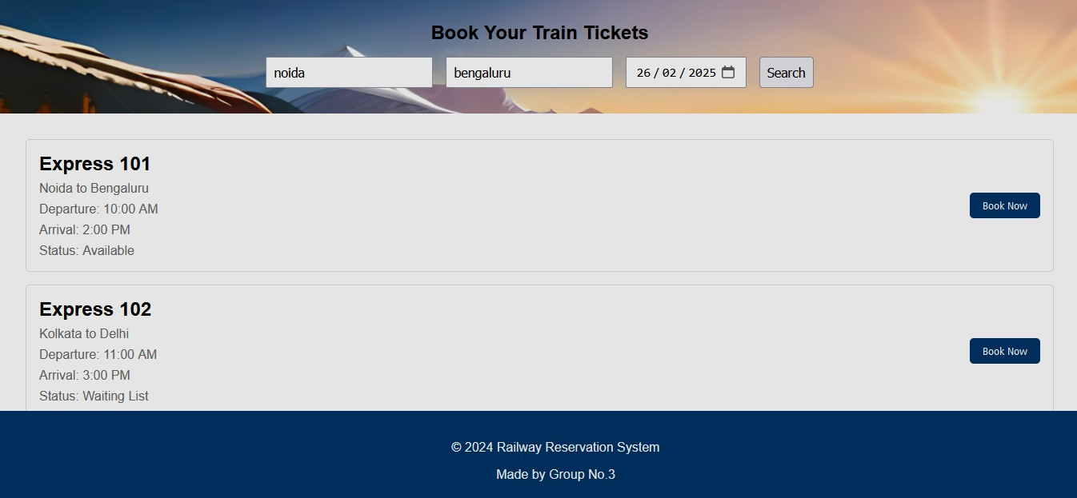

Slide 9
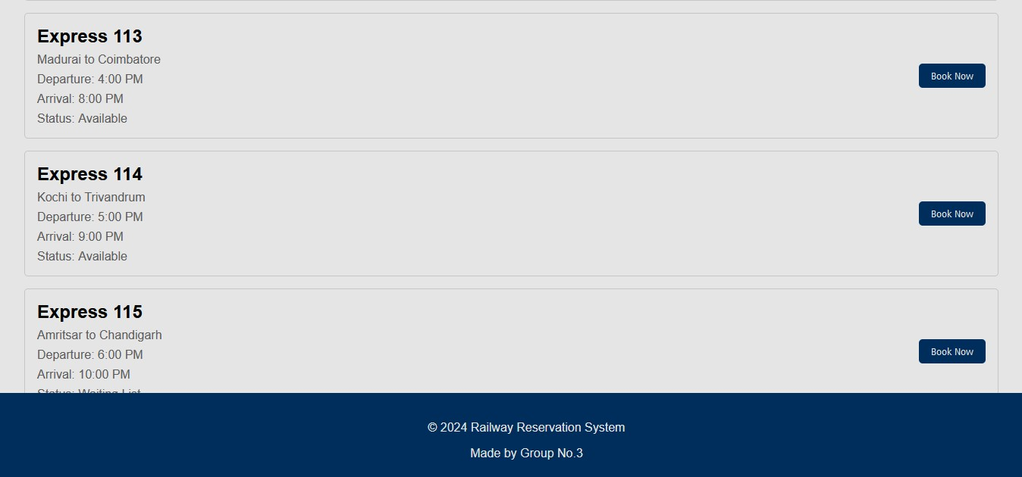

Slide 10
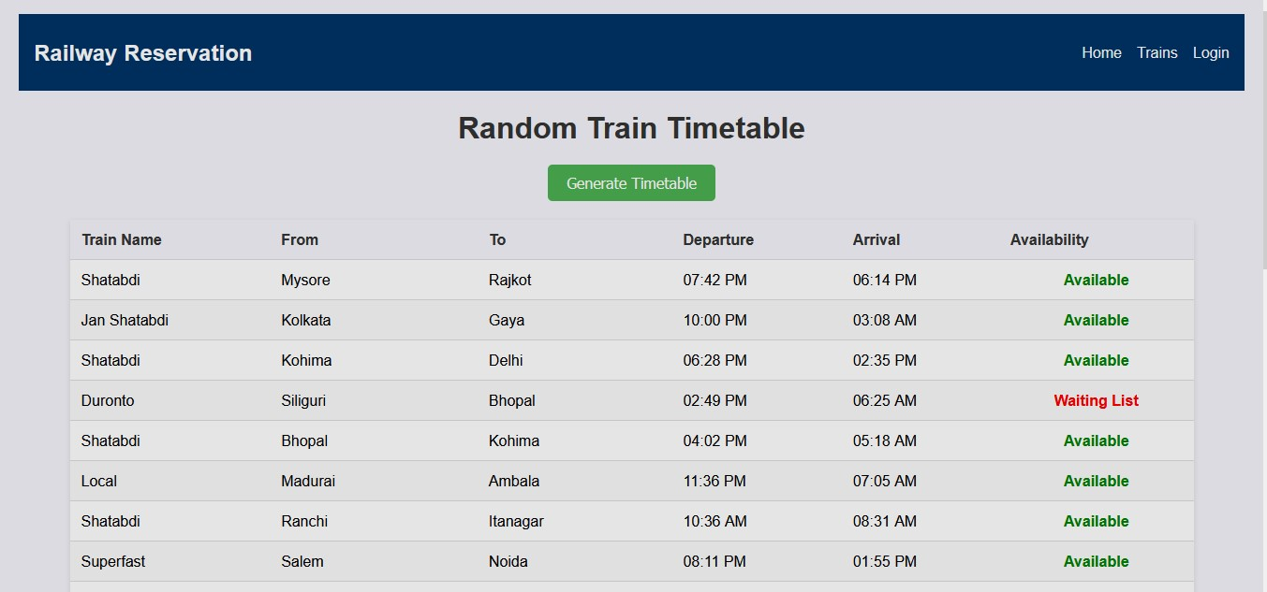

Slide 11
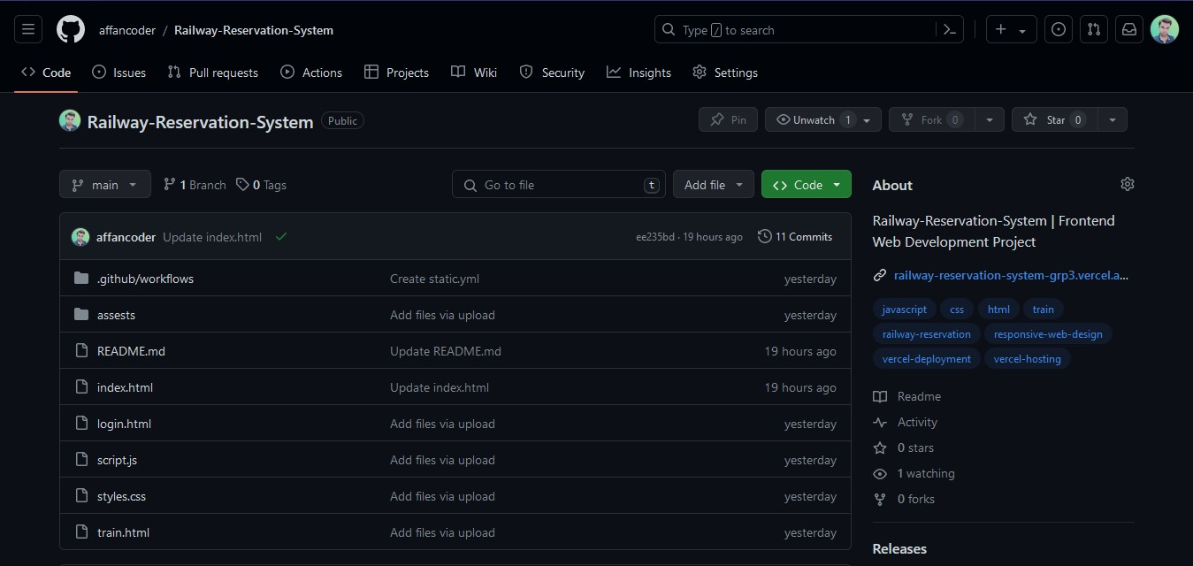
Github Repository

Slide 12
Report on Railway Reservation System Project
Introduction:
This report outlines the design and implementation of a Railway Reservation System. The system comprises various components, including data flow diagrams, class diagrams, entity-relationship diagrams, frontend, backend, coding implementation, and monitoring.
Data Flow Diagram (DFD)
A Data Flow Diagram (DFD) represents the flow of information within the system. It helps visualize how data moves from one process to another and how it is stored.
Context Level DFD
- *Entities*: Users, Admins
- *Processes*: Reservation System
- *Data Stores*: User Information, Train Information, Reservation Records

Slide 13
Level 1 DFD
- *Processes*:
1. User Registration and Authentication
2. Train Search and Schedule Viewing
3. Ticket Booking and Reservation
4. Payment Processing
5. Admin Management
- *Data Stores*:
- User Database
- Train Database
- Reservation Database
- Payment Database
Class Diagram
A class diagram illustrates the structure of the system by showing the system's classes, their attributes, methods, and the relationships between the classes.

Slide 14
1. *User*
- Attributes: userId, name, email, password, phoneNumber
- Methods: register(), login(), logout()
2. *Train*
- Attributes: trainId, trainName, source, destination, departureTime, arrivalTime, seatAvailability
- Methods: searchTrain(), getSchedule()
3. *Reservation*
- Attributes: reservationId, userId, trainId, bookingDate, travelDate, seatNumber, status
- Methods: bookTicket(), cancelTicket(), viewReservation()
4. *Payment*
- Attributes: paymentId, reservationId, amount, paymentDate, paymentStatus
- Methods: processPayment(), refundPayment()
5. *Admin*
- Attributes: adminId, name, email, password
- Methods: manageTrains(), manageUsers(), generateReports()

Slide 15
Entity-Relationship Diagram (ERD)
An Entity-Relationship Diagram (ERD) illustrates the relationships between different entities in the system.
Entities and Relationships
1. *User*
- Primary Key: userId
- Relationships: Makes Reservation
2. *Train*
- Primary Key: trainId
- Relationships: Has Reservations
3. *Reservation*
- Primary Key: reservationId
- Foreign Keys: userId, trainId
- Relationships: Includes Payment
4. *Payment*
- Primary Key: paymentId
- Foreign Key: reservationId

Slide 16
Frontend
The frontend of the Railway Reservation System is developed using HTML, CSS, and JavaScript. It provides an intuitive user interface for users to interact with the system.
Technologies Used
- *HTML*: Structure of the web pages
- *CSS*: Styling and layout
- *JavaScript*: Interactive elements and form validations
- *React.js*: For building a dynamic and responsive user interface
Key Features
- User Registration and Login
- Train Search and Schedule Viewing
- Ticket Booking and Payment Processing
- User Dashboard to view and manage reservations

Slide 17
Backend
The backend of the system is developed using Node.js and Express.js, ensuring efficient handling of requests and responses.
Technologies Used
- *Node.js*: Server-side scripting
- *Express.js*: Web application framework
- *MongoDB*: Database for storing user, train, and reservation data
Key Features
- RESTful API endpoints for user, train, and reservation management
- Secure user authentication using JWT
- Data validation and error handling

Slide 18
Monitoring
To ensure the system operates smoothly and efficiently, monitoring is crucial. Various tools and techniques are employed to track performance, detect issues, and ensure security.
Tools Used
- *PM2*: Process manager for Node.js applications
- *MongoDB Atlas*: Monitoring and managing the database
- *New Relic*: Application performance monitoring
- *Log Monitoring*: Using tools like Winston and Loggly for logging and monitoring application logs
Key Monitoring Metrics
- Server uptime and performance
- Database performance and query optimization
- User activity and usage patterns
- Error tracking and alerting

Slide 19
Conclusion
The Railway Reservation System project encompasses a comprehensive design and implementation approach, including data flow diagrams, class diagrams, entity-relationship diagrams, frontend and backend development, coding implementation, and monitoring. This report provides a detailed overview of each component, ensuring a well-rounded understanding of the system's architecture and functionality.
Live Hosting : https://railway-reservation-system-grp3.vercel.app/

