Slide 1


December 7, 2025
Tumble-POP Game Report
Tumble-POP 2D Game Development

Slide 2
Section 1: Introduction

Slide 3
Project Overview
An engaging 2D game development report
Tumble-POP is a 2D arcade-style action platformer developed using C++ and the SFML library. The game puts the player in the shoes of a "Ghostbuster" character equipped with a vacuum device. The primary objective is to clear stages by sucking up various monsters Skeletons, Ghosts, and projectile-firing enemies and ejecting them, all while navigating complex environmental hazards.

Slide 4
Gameplay Overview

Slide 5
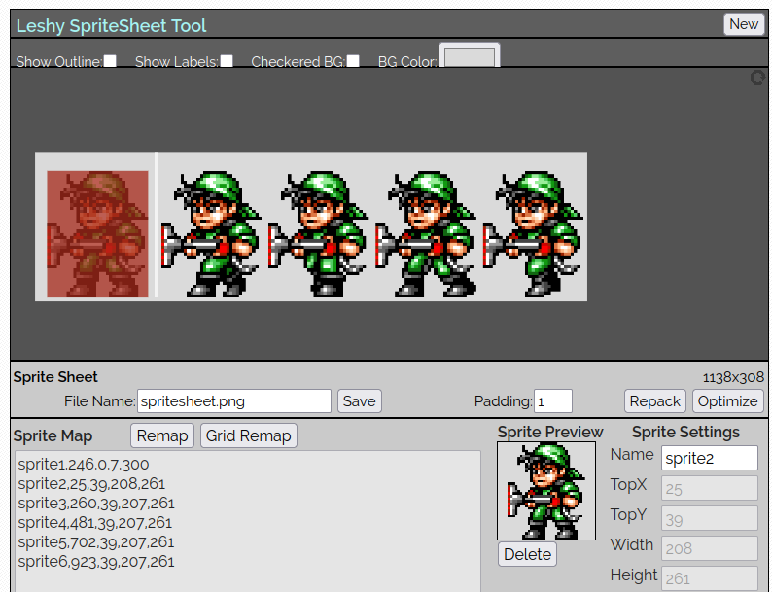
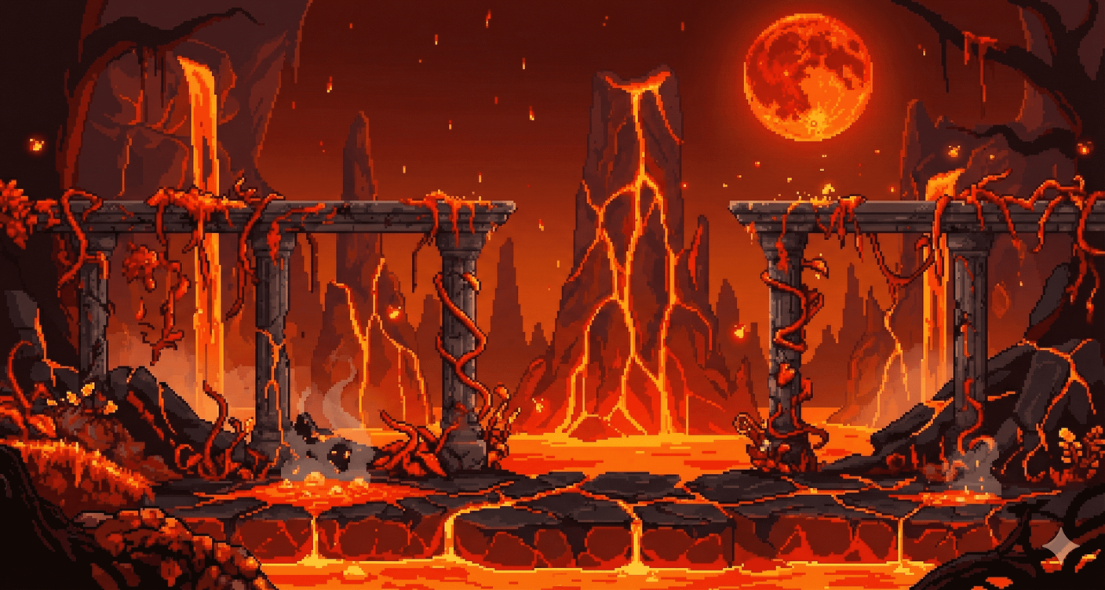
2. Technologies and Tools Used
te a visually engaging and functional game, the following tools were utilized:
Programming Language: C++ (Standard 11/17).
Graphics Library: SFML (Simple and Fast Multimedia Library) for rendering graphics, window management, and input handling.
Integrated Development Environment (IDE): Visual Studio / VS Code.
Asset Management:
Leshy SpriteSheet Tool: Used to map sprite sheets and calculate the exact IntRect coordinates (x, y, width, height) required for character and enemy animations.
Banana Pro: Used for generating high-quality 2D aesthetic assets and background art.

Slide 6
3. System Architecture & Data Structure
3.1. Entity Management
Instead of a single object for an enemy, data is split across multiple arrays sharing the same index [i]. For example, the Invisible Man enemy uses:
const int NUM_INVISIBLE = 3;
float inv_x[NUM_INVISIBLE]; // X Coordinate
float inv_y[NUM_INVISIBLE]; // Y Coordinate
float inv_speed[NUM_INVISIBLE]; // Movement speed
int inv_capture_state[NUM_INVISIBLE]; // 0=Walking, 1=Being Sucked, 2=Dead
bool inv_is_visible[NUM_INVISIBLE]; // Visibility flag
ragraph text

Slide 7
3.2. Game State Machine
The game flow is controlled by a simple integer state machine inside the main loop:
State 0: Start Screen
State 1: Character Select Menu (P1 / P2 selection)
State 3: Level 1 (Standard Platforming)
State 4: Level 2 (Advanced Physics/Slopes)
State 5: Game Over

Slide 8
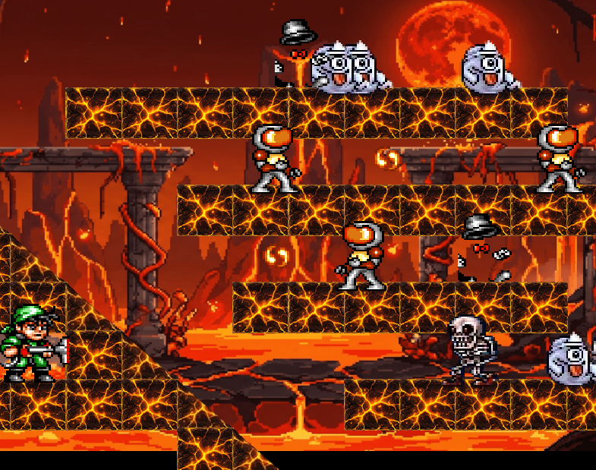
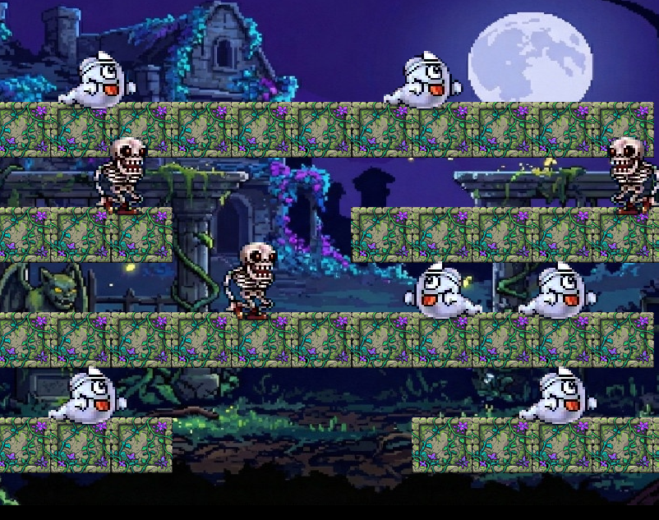
4. Technical Implementation & Custom levels
player_gravity(...): This function applies constant downward acceleration to the player. It uses predictive collision detection to check if the player's "feet" will hit a floor block (#) or a solid wall (@) in the next frame. If a collision is detected, it snaps the player to the top of the block and resets vertical velocity.
movement(...): Handles user input (Left, Right, Up, Down). It manages texture flipping (facing direction) and sprite animation frames. Crucially, it manages the Texture Swapping logic when the Spacebar is held, changing the player from "Walking" mode to "Vacuuming" mode.

Slide 9
MORE FUNCTIONS
Enemy Artificial Intelligence (AI)
spawn_enemy(...): A universal spawner that ensures enemies do not spawn inside walls or in mid-air. It checks the grid coordinates to ensure a valid floor exists beneath the spawn point.
update_enemy_logic(...): Controls enemy patrolling. It checks ahead of the enemy's current path. If a wall or a ledge (gap) is detected, the speed is multiplied by -1, causing the enemy to reverse direction.
initialize_enemy_group(...): A helper function designed to initialize entire groups of enemies (Skeletons, Ghosts, Chelnovs) at once, assigning them textures and random starting directions.

Slide 10
5. Development Workflow
Map Design: The levels were designed using a 2D char array (char** lvl), where symbols represent game objects (# for bricks, @ for walls, & for slopes).
Asset Integration: Sprites were cut using the Leshy Tool to get precise pixel coordinates for IntRect.
Physics Implementation: Gravity and collision were implemented first to ensure the character could traverse the map.
Enemy Logic: Basic patrolling AI was added, followed by the specific vacuum capture mechanic.
Polish: Level 2's unique slope mechanic and specific enemy types (Invisible Man, Chelnov) were added in the final phase.

Slide 11
Challenges & Solutions
Overcoming obstacles in game development
Challenge: The player would sometimes get stuck inside walls during high-speed movement.
Solution: We implemented a predictive collision check in movement() that looks ahead by speed pixels before actually moving the player.
Challenge: The "Invisible Man" enemy needed to blink without disappearing for everyone simultaneously.
Solution: In the initialization loop, we assigned a random starting value to inv_vis_timer[i], ensuring their invisibility cycles were desynchronized.

Slide 12
Future Enhancements Ahead

Slide 13

Future Enhancements
Sound Effects: Integrating sf::SoundBuffer for vacuum and jump sound effects.
Boss Fight: Adding a large boss enemy with a health bar for Level 3.
High Score Saving: Using file handling (fstream) to save player scores permanently

