Slide 1

A Parallel Algorithm for Constructing Multiple Independent Spanning Trees in Bubble-Sort Networks
Authors: Shih-Shun Kao, Ralf Klasing, Ling-Ju Hung, Chia-Wei Lee, Sun-Yuan Hsieh.
Presented by:
Affan Ali 22i-1215
Abdul Majeed 22i-1216
Abdul Wasay 22i-0947

Slide 2

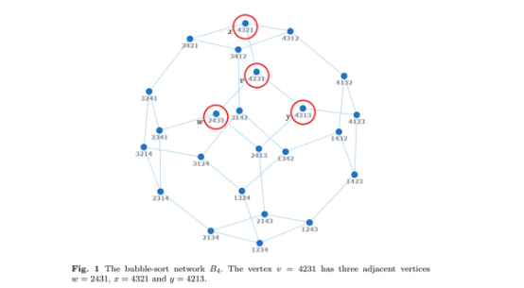
Introduction to Bubble-Sort Networks
Bubble-sort network ( B_n ) is a Cayley graph. Vertices are permutations of ( {1, 2, ..., n} ). Edges connect permutations differing by adjacent transpositions.
Key properties include ( n! ) vertices, connectivity of ( n-1 ), and diameter of ( n(n-1)/2 ).
Vertex-transitive
Significance
Vertex-transitive for ( n >= 4 ), but not edge-transitive.
Used in parallel computing for interconnection networks.

Slide 3
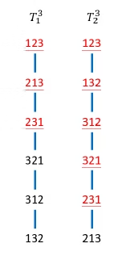

Problem Addressed
Constructing multiple independent spanning trees (ISTs) in bubble-sort networks.
ISTs enhance network reliability and security by providing disjoint paths.
1
Applications
Fault tolerance and secure data transmission.
2
Challenge
Previous algorithm was recursive, making parallelization difficult.

Slide 4



Proposed Parallel Algorithm
Algorithm 1 constructs ( n-1 ) ISTs rooted at the identity permutation ( 1_n = 12...n ).
Key features: Non-recursive and fully parallelized.
Auxiliary Functions
Pre-processing
FindPosition and Swap determine the parent.
Computes inverse permutation in O(n) time.

Slide 5

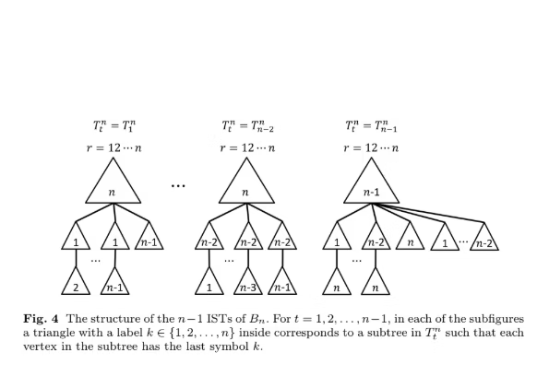

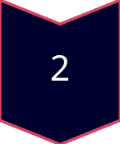
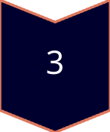
Algorithm Workflow
Pre-process each vertex to compute inverse permutation and ( r(v) ).
For each vertex v≠1_n​ and tree Ttn​ (where t=1,...,n−1): Apply rules based on the last symbol ( v_n ) to determine the parent.
Use FindPosition and Swap to determine the parent.
CASE A
( v_n = n ) handles root connections.
CASE B
( v_n = n-1 ) manages transitions to ( n ).
CASE C
( v_n = j ) for ( j ∈ {1, ..., n-2} ) general case.

Slide 6
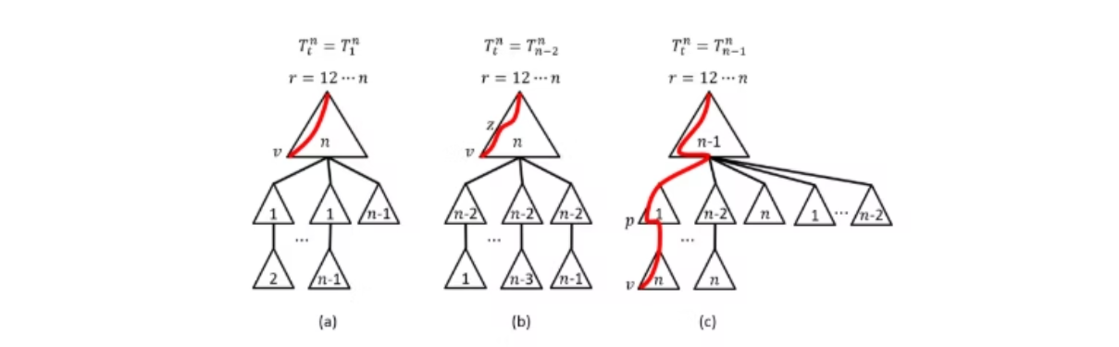
Results Obtained
Time Complexity: ( O(n . n!) ), asymptotically optimal.
Correctness (Theorem 1):
Constructs ( n-1 ) ISTs with unique, vertex-disjoint paths.
Each vertex computes its parent in constant time
Height of ISTs (Theorem 2):
Maximum height: D(Bn)+n−1 = n(n−1)/2+n−1.
Ensures efficient communication paths.

Slide 7
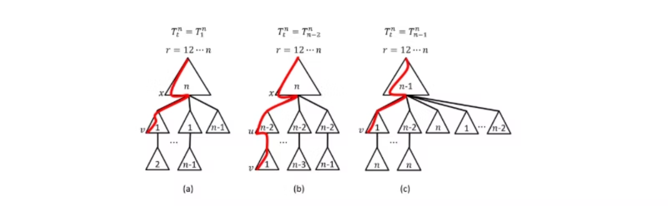
Key Contributions
Developed a parallel, non-recursive algorithm.
Achieved asymptotically optimal time complexity ( O(n . n!) ).
ISTs
Fault Tolerance
Future Work
Ensured maximum number of ISTs (( n-1 )).
Enhanced fault tolerance and security.
Extending to ((n, k))-bubble-sort graphs and butterfly graphs.

Slide 8
Proposed Parallelization Strategy
METIS for Graph Partitioning:
MPI for Inter-Node Communication:
OpenMP/OpenCL for Intra-Node Parallelism:
Partition ( B_n ) into ( k ) balanced subgraphs.
Handle communication between partitions.
Parallelize parent computation within each subgraph.
Assign each subgraph to an MPI process.
Minimal communication due to independent parent computation.
OpenMP for multi-core CPUs; OpenCL for GPUs if available.
Workflow:
Partition graph using METIS.
Distribute subgraphs to MPI processes.
Parallelize vertex computations using OpenMP/OpenCL.
Combine results via MPI.

Slide 9
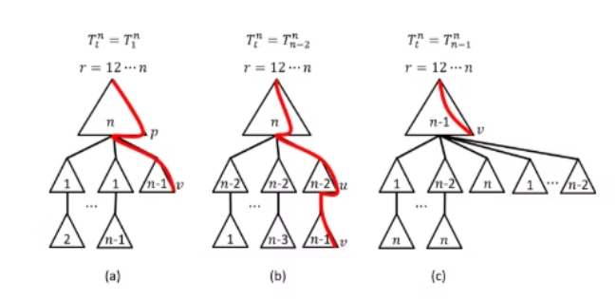
Practical Implications
1
Applications:
Fault-tolerant broadcasting in distributed systems.
Secure message distribution in network communication.
2
Benefits:
Scalable for large networks due to parallel design.
Optimal complexity ensures efficiency.
3
Relevance to Project:
Aligns with learning parallel and distributed computing.
Prepares for Phase 2 implementation and scalability analysis.

Slide 10
Conclusion
Addressed Challenge
We developed a parallel algorithm for IST construction in bubble-sort networks.
Optimal Complexity
The algorithm is non-recursive with optimal time complexity.
Parallelization Strategy
We outlined parallelization using METIS, MPI, and OpenMP/OpenCL.

Slide 11
References
Kao, S.-S., Klasing, R., Hung, L.-J., Lee, C.-W., & Hsieh, S.-Y. (2023). A parallel algorithm for constructing multiple independent spanning trees in bubble-sort networks. Journal of Parallel and Distributed Computing.

