Slide 1
Afiniti IME & React.js
Affan Shahid – Insights

Slide 2
Objectives
End goal: Learn the steps involved in porting design mockups to React
Our job will be to take the designs/HTML from Jason Whitney’s team and pull them into our framework in a scalable way
Given the short timelines we will need to develop an efficient pace at which this work can be done
This is a large project and so must be engineered in a way as to facilitate future developers who would be maintaining or extending the code written today
This is not a generic React workshop, this will be very much focused towards the information required in order to achieve the end goal

Slide 3
Stops along the way
Some of the fundamentals of React. We will not be delving too deep into this
How to think in terms of “components”
How to identify tight coupling between components and alternatives
Using Redux to provide component reusability
Client-side rendering vs server-side rendering
How to create type-safe React components

Slide 4
Schedule
Part 1
Part 2
Part 3
React
Setting up React
JSX and the React ecosystem
Identifying components
Class components
Functional components
Presentational components
Container components
Next.js
Server-side rendering
Project structure
Routing
Material-UI
JSS
Typescript
Enriching javascript with types
Providing compile time safety
Leveraging benefits of Typescript within the IDE

Slide 5
Schedule
Part 4
Part 5
Porting a page to react
Get to work

Slide 6
React
What is react?

Slide 7
What is React
React is an un-opinionated “library” for building Uis
Based on the concept of components (similar to directives from Angular 1)
Components are reusable chunks of the UI
Massive ecosystem (Don’t re invent the wheel)
Helps “bind” the UI to data (similar to D3 in that regard)
Virtual DOM

Slide 8
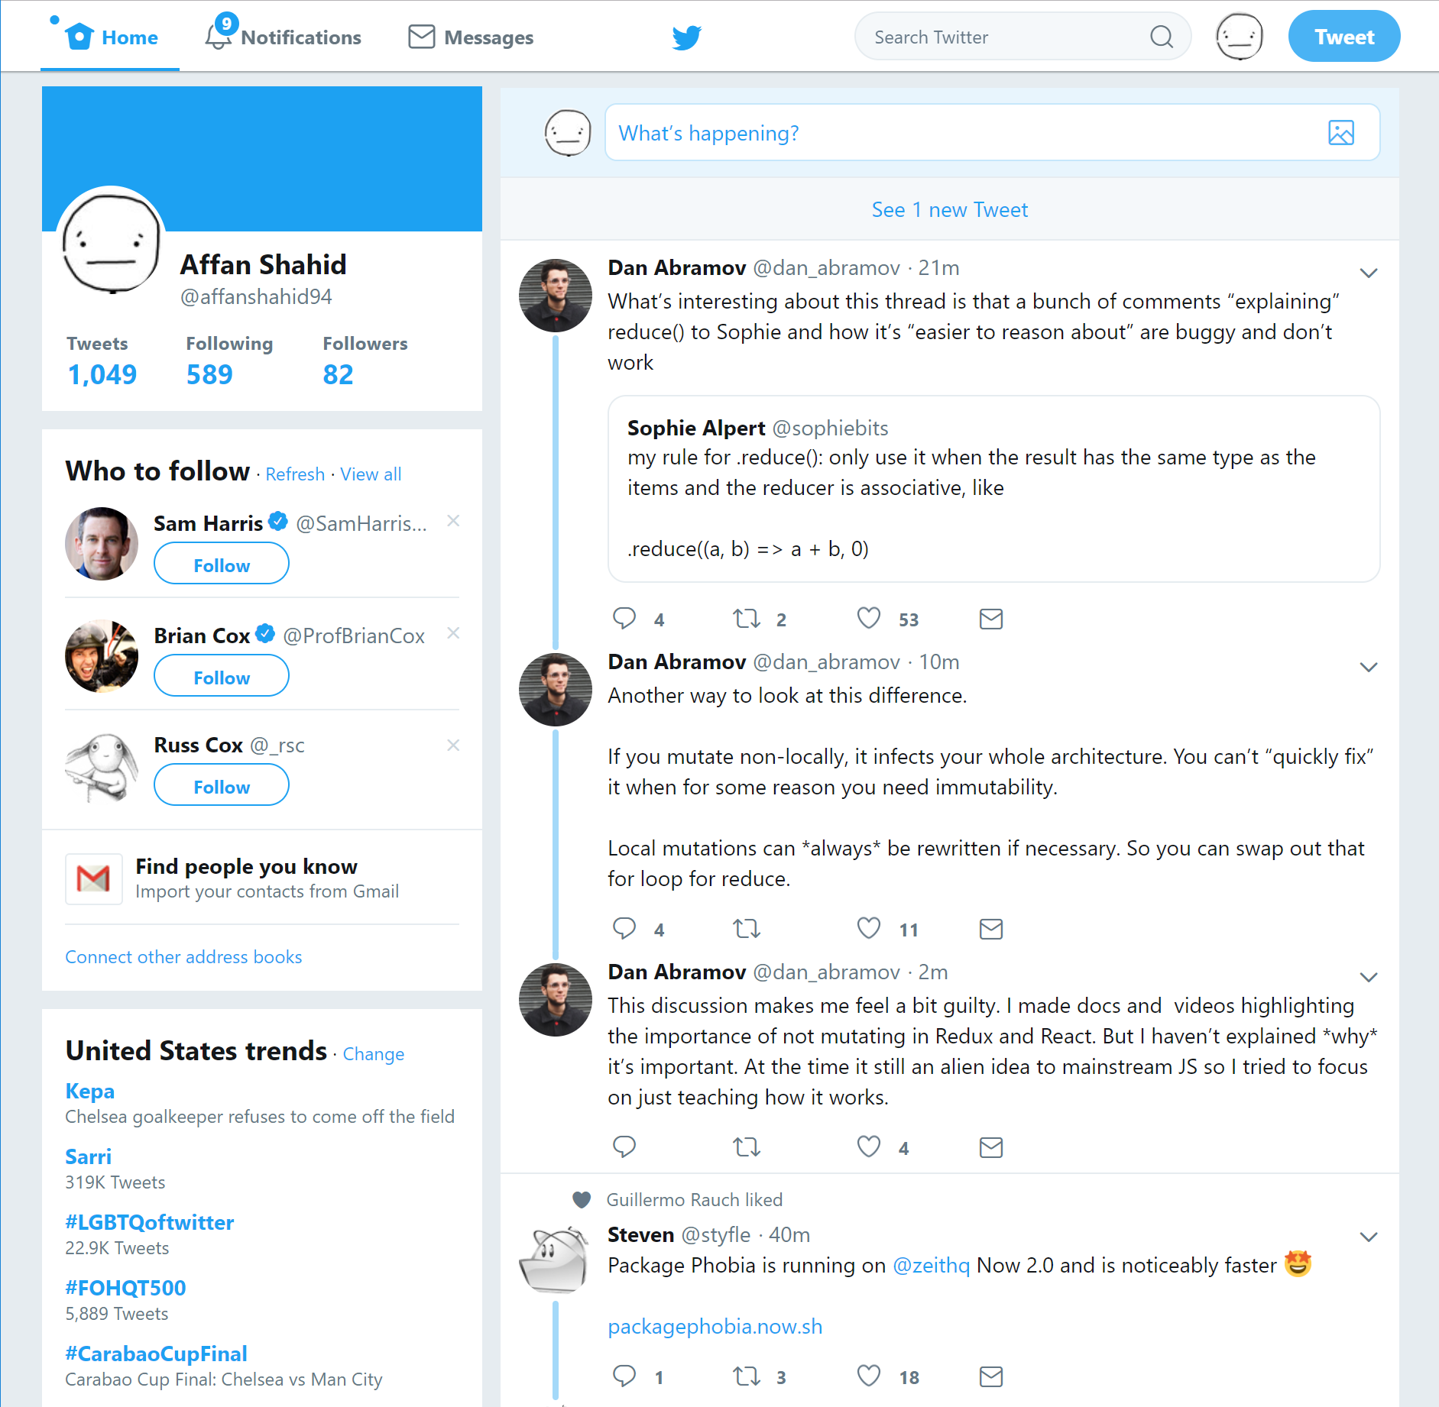

Slide 9
Setting up React
Atleast 3 methods
Without any fuss, like any other JS library (Codepen)
Setting up Webpack and Babel manually
Using create-react-app
Next.js?

Slide 10
Types of components
Functional
Class

Slide 11
Component Classifications
Presentational Components
Container Components
HOCs
Controlled components
Render props

