Slide 1

Do Now - Recap
Explain the following using examples:
Transactional Data
Targeted Marketing

Slide 2
Do Now Answers
Transactional Data
E-commerce: Customer ID, products bought, date and time of purchase, total amount spent, and applied discounts.
Banking: Records of deposits, withdrawals, and transfers.
Customer service: Details about customer support cases, including the type of issue and resolution.
Logistics: Information on shipping status, suppliers, and delivery partners.
Human resources: Time logs from workers on a timesheet.
Targeted Marketing:
An online clothing store shows ads for athletic shoes to users who have previously searched for running gear on a search engine.
A streaming service offers a discount to a user based on their past viewing habits, such as shows they have watched or genres they have shown interest in.

Slide 3
Features of IT Systems 1
Information Technology Systems

Slide 4

Introduction
It’s not just online services that have had a major impact on how organisations do business. In fact, IT systems, in general, have changed nearly every single aspect of business.
Whether tracking business data, developing and releasing new products, or completing administrative tasks, IT systems have made work faster and more efficient and helped reduce errors.
In this lesson, we’ll learn about:
Stock Control
Data Logging
Data Analysis
General Office Tasks

Slide 5

Stock Control
All retailers and suppliers use IT systems to monitor and control their stock.
Database software running on central servers linked to EPOS till systems accurately monitor current stock levels by automatically updating them when sales are made.
The system records minimum and maximum stock levels for items and can alert staff when stock levels are too high or low for action.
For example, it could alert staff to reorder new stock when it reaches below its minimum level. This minimum level can often be calculated automatically based on the item’s current sale rates.
The system may also automatically generate orders for suppliers.

Slide 6
Stock Control
This automated stock control can also allow the business to implement ‘Just In Time’ (JIT) stock control.
JIT is where products are only ordered as they are needed.
This allows them to hold less stock on-site, which really helps improve efficiency.

Slide 7

Stock Control Advantages
Accurate Stock Recording and Automatic Reordering
Stock levels are recorded more accurately and re-ordering stock can happen automatically once a reorder level is met. This means businesses are less likely to run out of stock.
Reduced Stock Holding and Cost Savings
Less stock will need to be held, especially with JIT. This can allow the business to save money on storage space and can reduce the likelihood of wastage.

Slide 8

Stock Control Disadvantages
High Implementation and Training Costs
Stock control systems can be very expensive to implement. They will also likely require additional staff training, which will add additional costs.
Inaccurate Stock Levels Due to Theft
Stock levels are not always accurate due to theft, and so a completely automated system would not be aware of this and may lead to a business running out of stock.

Slide 9

Data Logging
This is the collection of data over a period of time.
IT systems can use data loggers that connect to sensors to monitor a process and automatically log the data it gathers from its sensor readings.
This allows us to monitor and record data 24/7 at very regular intervals to give us detailed data to work with.
Data logging is used in a wide range of industries.

Slide 10
Data Logging
Automated health recording logs data on many factors, such as vital signs to capture the state of a patient over time and can alert staff of changes in their condition.
Flight data recorders collect data on aircraft performance. We commonly know this as the “black box” and it’s heavily used in accident and emergency investigations to discover why something went wrong on a flight.
Weather station recording devices will monitor data on wind speed, temperature, humidity, etc. in order to be used in forecasting future weather patterns as well as for scientific investigation.

Slide 11

Data Logging Advantages
Increased Accuracy with Automated Systems
Automated systems using sensors allow for logging without human intervention and with far greater accuracy than manual data logging.
Better Tracking of Trends and Patterns
Data can be logged far more regularly over long periods of time which allows for much better tracking of changes over time to spot trends and patterns.

Slide 12

Data Logging Disadvantages
Reliance on Wireless Connectivity
A lot of data-logging sensors rely on wireless connectivity. If this is interfered with, or something goes wrong with the sensors, then readings can be missed.
Calibration Issues
If the sensors have not been calibrated correctly then all of the readings taken will not be accurate which will lead to incorrect conclusions being drawn from the data.

Slide 13

Data Analysis
Data, such as that gathered by data logging, often need to be analysed.
This allows a business to spot patterns and trends and to analyse the performance of their business or of employees.
Data mining is a term we use to describe a particular area of data analysis in which extremely large data sets (often referred to as “big data”) are analysed to predict future trends.
Data analysis is used in many different applications.

Slide 14
Data Analysis
In supermarkets, loyalty card schemes are used heavily to gather data on customers.
This allows them to analyse customer habits to better advertise to specific customers. For example, they can use buying habits to predict when a customer is pregnant and target those customers with promotions for nappies.
We also see similar data mining performed on e-commerce websites like Amazon.
When you purchase a product, it often advertises other products you may be interested in. This is done through in-depth analysis of customer buying trends based on similar purchases and your purchase history.

Slide 15

Data Analysis Advantages
Identifying Trends and Improving Efficiency
Analysis of data can help spot trends and patterns that allow a business to improve itself and become more efficient, such as identifying a weak-performing employee or product.
Flexible Data Output Formats
Data can be outputted into different formats simply to help make it easier to interpret the data, especially for less technical users of the data.

Slide 16

Data Analysis Disadvantages
Dependence on Accurate Data
Computers lack common sense, so any analysis performed is only as good as the data itself. If incorrect data is provided, then incorrect analysis is performed.
Vulnerability to Data Breaches
Data must first be stored before it can be analysed. Stored data can be threatened by malicious users, such as hackers, who intend to access it and misuse it.

Slide 17

General Office Tasks
The completion of general office tasks is now almost always completed using IT systems.
Office software applications are used for tasks such as producing reports, drafting correspondence (e.g. letters and emails) & transcribing meeting notes.
Other examples include accountancy applications for managing finances, generating invoices, and producing company accounts.
Video conferencing software is used for holding meetings with clients and colleagues remotely, while email software can improve communication and schedule appointments.

Slide 18

General Office Tasks Advantages
Increased Efficiency in Office Tasks
Office tasks can be completed much more efficiently. For example, mail merge tools can personalise letters for a large group of people automatically.
Reduced Need for Specialized Skills
Office tasks can require less specific skills and allow staff to perform a wider range of roles within the business. E.g. In a small business, accountancy software can allow you to manage finances without a specialist accountant.

Slide 19

General Office Tasks Disadvantages
Need for Advanced ICT Skills
Employees need much greater technical ICT skills than previously, which can be costly and can stress staff who have little experience with computers.
High Cost of IT Support
Businesses need to maintain IT support staff to help employees when technical issues arise with computer systems. This can be quite expensive.

Slide 20

Lesson Summary
Stock control uses IT for automated and JIT tracking, reducing admin needs but can be expensive and vulnerable to theft.
Data logging with sensors offers accuracy and trend tracking, but connectivity issues or incorrect calibration can cause errors.
Data analysis helps spot patterns and make predictions but relies on accurate data and is at risk of hacking.
General office tasks use IT for efficiency and versatility, requiring technical skills and costly IT support.

Slide 21
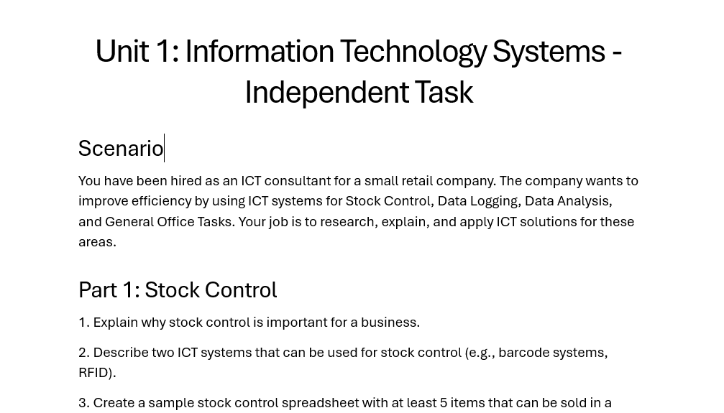
Task

Slide 22
Plenary
Students to explain the advantages and disadvantages of each:
Stock Control
Data Logging
Data Analysis

Slide 23
Copyright © 2024 KnowItAllNinja.com
This presentation and its associated worksheets are protected by copyright and are licenced for resale by KnowItAllNinja.com. No part of these publications may be reproduced, distributed, or transmitted in any form or by any means, including photocopying, recording, or other electronic or mechanical methods, without the prior written permission of KnowItAllNinja.com, except as per the terms of use.
Terms of Use
By purchasing and downloading these resources you are entering a licence agreement that allows for you to share these resources with members of a single educational institution. They must not be shared with or used by any third-party outside of the institution in any form.

