Slide 1


COSMOS Cultivate Resilient Smart Objects for Sustainable City Applications
COSMOS Marketplace concept and guide
George Kousiouris (ICCS/NTUA)

Slide 2
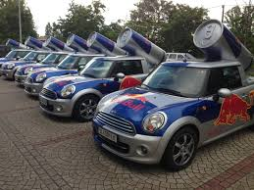





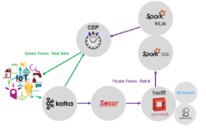
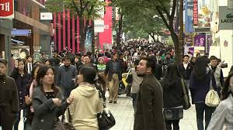
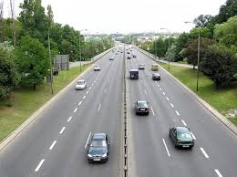


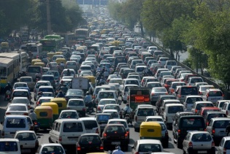
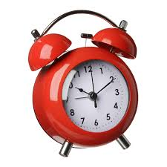

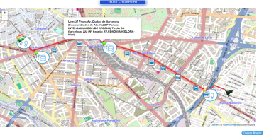

Concept of Awareness on top of awareness (events on top of events)

Slide 3
Exploited through a marketplace structure
The concept focuses around an Events Marketplace, which is a brokering entity between publishers and subscribers of Events
Publishers forward their generated events information, get paid and rated by subscribers
Subscribers enroll for receiving the events, pay publishers
A subscriber may receive an event, combine it with another piece of information/event and produce new events, that are then themselves sold through the market place
Types of Events: Events that do not have to do with private data, events created from available public information formulated accordingly, Smart events reasoned through big data analytics approaches
Examples from COSMOS: Madrid Traffic notifications, Large Crowd Concentration from Twitter
Main target group: Application Developers
Early version available!
Eventflows.com

Slide 4

Roles
Uses events A&B to generate event C
Consumer Y
COSMOS SE flow on BLUEMIX
Consumer/Producer Z
Uses events in app
Producer X
COSMOS Events Market Place
Other implementation
Produce events
Pub/Sub system
Billing/Access Management
Developer (freelance, company etc.)
Consume events

Slide 5
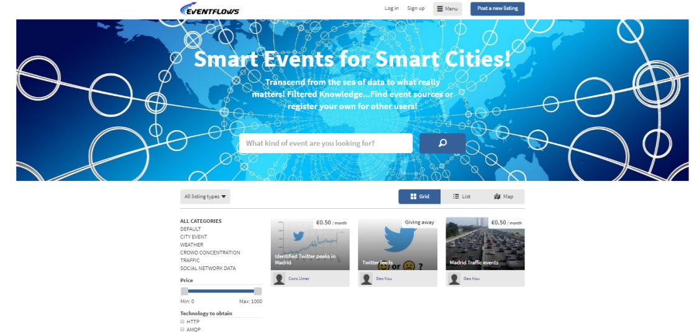
Marketplace Entity (www.eventflows.com)
Join as user-producer and register your events notifications or as a user-consumer and check out the existing events!
At the moment you can specify your own endpoints for publication
In the following weeks we will also extend the backend to include the Pub/Sub flow
Tools to assist developers
Publication/Consumption flows
Example flows from existing COSMOS developments at
https://github.com/COSMOSFP7
Bluemix flow to be made available as starting point for big data ingestion and analytics

Slide 6
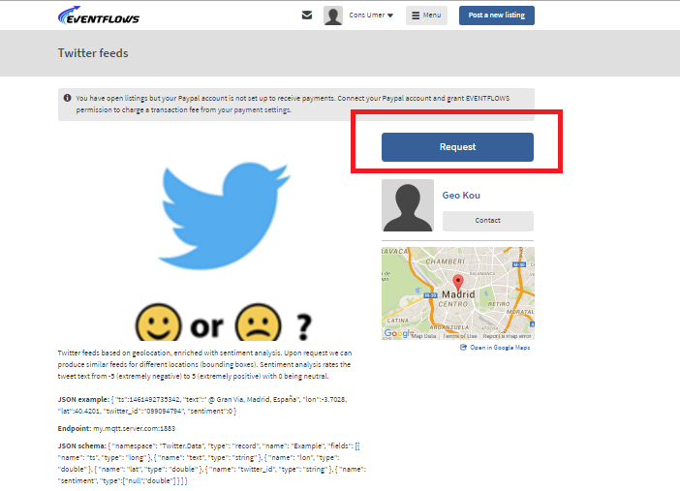
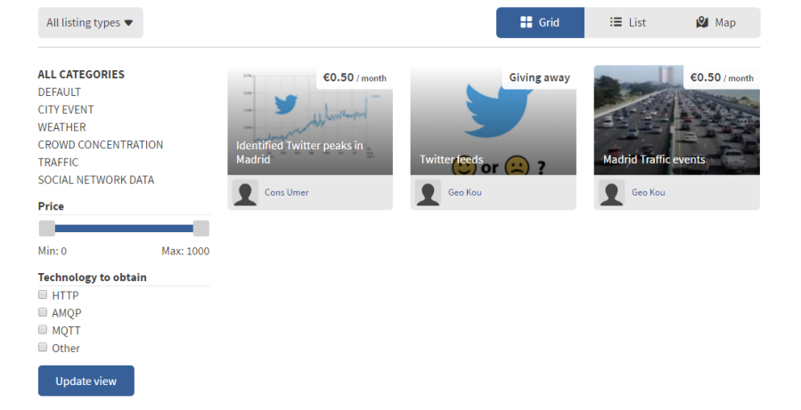
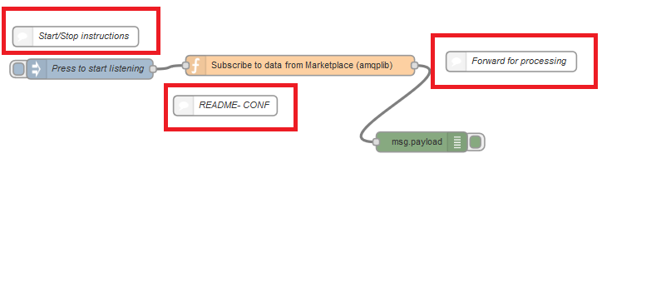
Marketplace Steps
Create free account on www.eventflows.com
Can link with paypal account for making or receiving payments as a consumer or producer respectively
No need for that if you want to consume/produce a free event
As a consumer
Check and filter offered events from website
Register for an event
Credentials for accessing the Messaging system (AMQP protocol) will be sent via email along with the endpoint
Use and configure provided Node-RED flows or Java clients for consuming data from the respective endpoint (https://github.com/COSMOSFP7/Eventflows-Marketplace/tree/master/NodeRED_Clients)

Slide 7
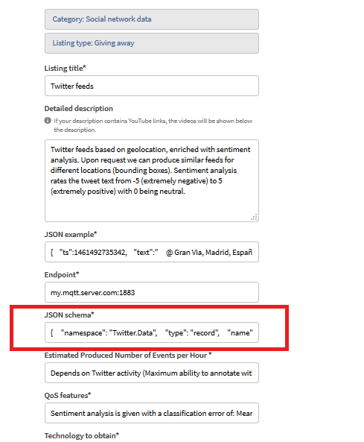
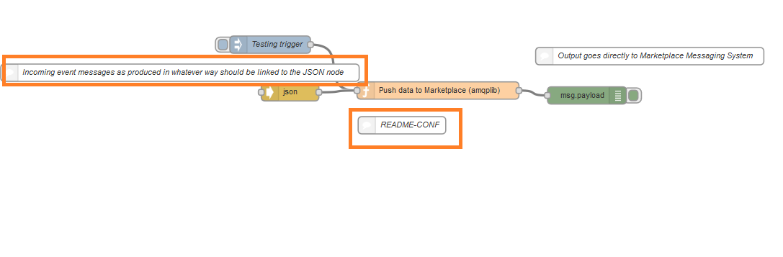
Marketplace Steps as a producer
Check out flows from COSMOS that may assist you to get started
https://github.com/COSMOSFP7/COSMOS-Platform-side
Imagine a combination of data or data&processing that can help identify an interesting event and create the sequence that generates it
Register your event in the marketplace and insert the necessary descriptions
E.g. data schema of messages
Credentials for accessing the Messaging system (AMQP protocol) will be sent via email along with the endpoint
Use and configure provided Node-RED flows or Java clients for pushing data to the provided endpoint
https://github.com/COSMOSFP7/Eventflows-Marketplace/tree/master/NodeRED_Clients

Slide 8
Access Rights on the Messaging System
Producers
Only write privileges on their vhost and exchange
Consumers
Only read privileges on their registered queues
Do not try to configure the Messaging System
E.g. create your own exchanges, queues etc.
You will be refused by the system

Slide 9
Example from Marketplace: Twitter data flow
Implemented data flow for registering to Twitter and getting data. Available here:
https://github.com/COSMOSFP7/COSMOS-Platform-side/tree/master/DataIngestion/TwitterDataIngestion
Registers to Twitter API and receives tweets based on geolocation
Can be manipulated afterwards in multiple ways
Stored e.g. in a DB , object storage etc. and analyzed statistically to find peaks
Passed through sentiment analysis to find happy and sad spots
Can be taken directly via the flow (check next slides) or through registration to the marketplace and link to the Pub/Sub system (check previous slides on consumer flows)

Slide 10
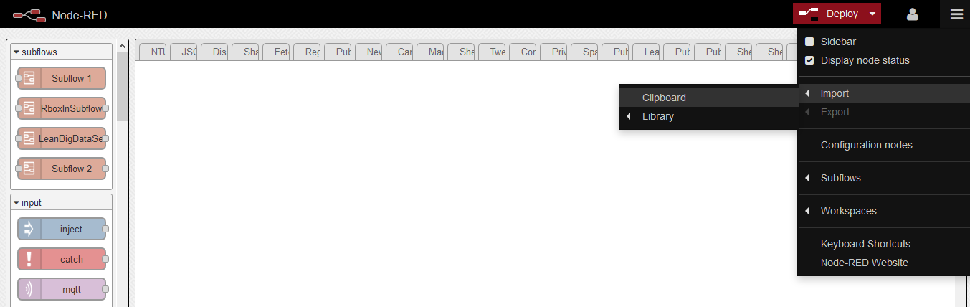
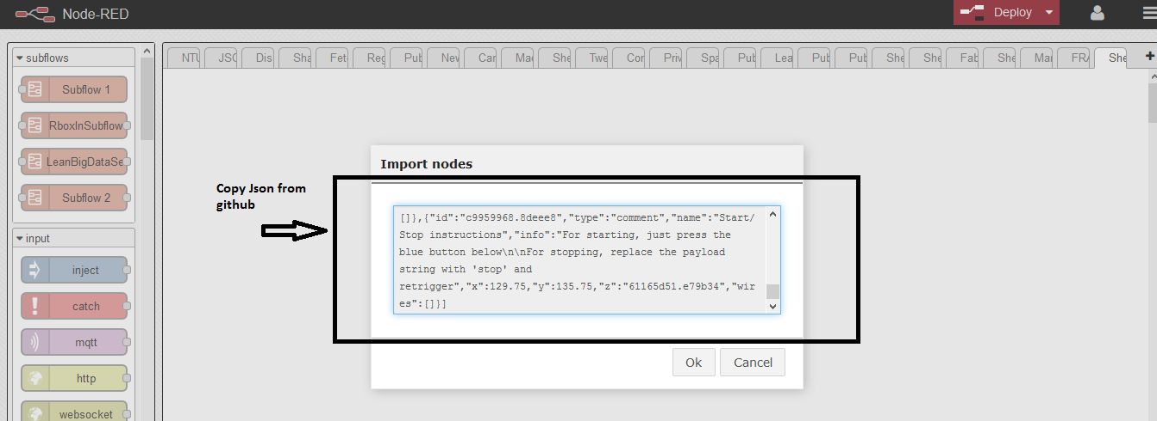
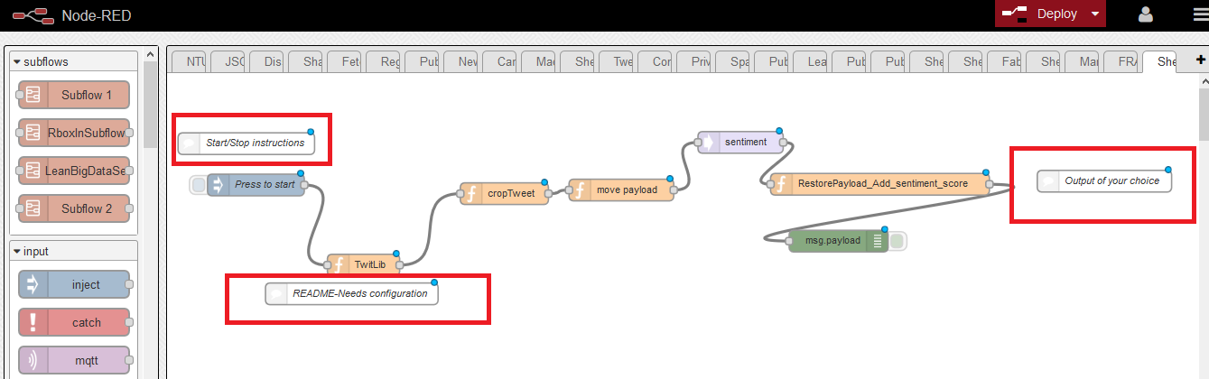
Example from Marketplace: Twitter data flow Usage
Copy the json file and paste it in a Node-RED tab
Import-> From Clipboard
Paste json file
Flow will appear in Tab (can be connected to whatever output e.g. MQTT node etc.)
Needs configuration! Check out comments in flow
Credentials as a Twitter registered developer
Configuration of geographical coordinates if you are interested in another area other than Madrid

Slide 11

Thank you! Any questions?
For any questions contact George Kousiouris
gkousiou@mail.ntua.gr
www.iot-cosmos.eu
The research leading to these results has received funding from the EC Seventh Framework Programme FP7/2007-2011 under Grant Agreement n° 609043

