Slide 1
IoT Challenge 2018- Clustering and Twitter flows Intro
16-17 March 2018

Slide 2
Clustering flow
Objective: implement a simple generic L architecture in Node-RED
Specific example: Exploit street speed data from Madrid and group speeds in two states (good and bad state)
Store and process, extract high and low speed clusters for a single point
Can be generalized for all points, extended to use a database or used in a different data source

Slide 3
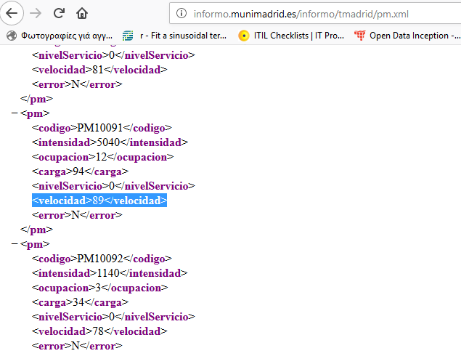
Clustering flow
Exploit open street data from madrid
http://informo.munimadrid.es/informo/tmadrid/pm.xml
Be careful, not all PMs have speed (velocidad field) in them

Slide 4
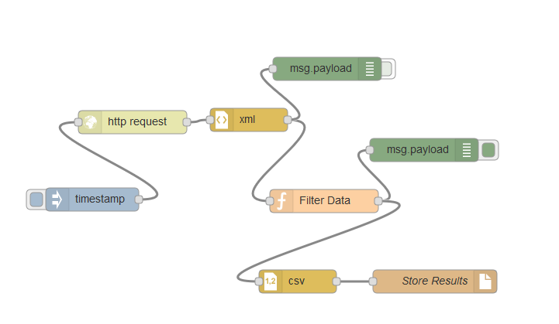
Clustering flow horizontal L architecture
Http GET call to Madrid for data
Transformation from XML to JSON
Filter to get only the point we need
Check returned JSON from Madrid for the structure of the data!!
Transform to csv and store in file

Slide 5
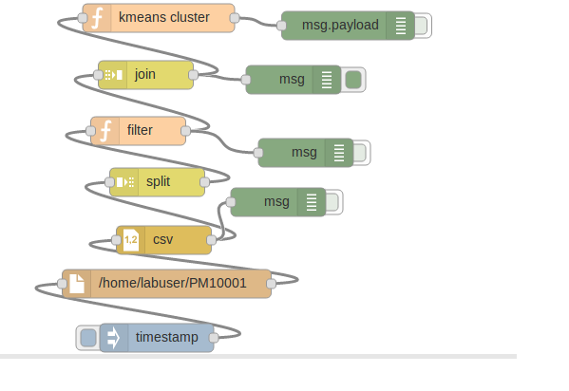
Clustering flow- Vertical part
Usage of external node.js function ‘clusters’ in kmeans cluster function node
Be sure to include it in settings.js file
This needs data inserted in a specific form
Array of arrays of data points
[[ 2,4],[3,5]…]
Data points come as array of objects from csv file
Transformed in array of arrays in the split-filter-join part of the flow
Read file produced from the previous flow

Slide 6
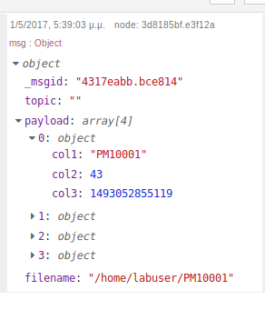
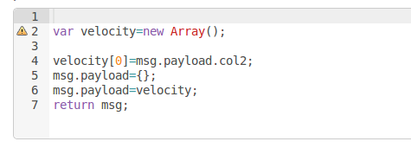
Object to array code in filter function node
If more dimensions are needed in the clustering case, one can add more points in the array

Slide 7
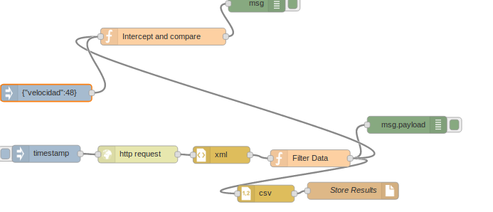
Clustering flow- diagonal part
Retrieve real time value and compare with cluster centroids
Current value is already extracted from the horizontal flow
Current value

Slide 8
Intercept and compare function
var velocity=msg.payload.velocidad; localclusters=global.get("foundclusters"); var overall_cluster=-1; var diff; var min=10000000; for (var k=0;k<localclusters.length;k++){ diff=Math.abs(localclusters[k].centroid[0]-velocity); if (diff<min){ overall_cluster=k; min=diff; } console.log(diff)); } if (overall_cluster===0){ msg.payload="bad state"; } if (overall_cluster===1){ msg.payload="good state"; } msg.payload.cluster_number=overall_cluster; return msg;

Slide 9
Overall flow

Slide 10
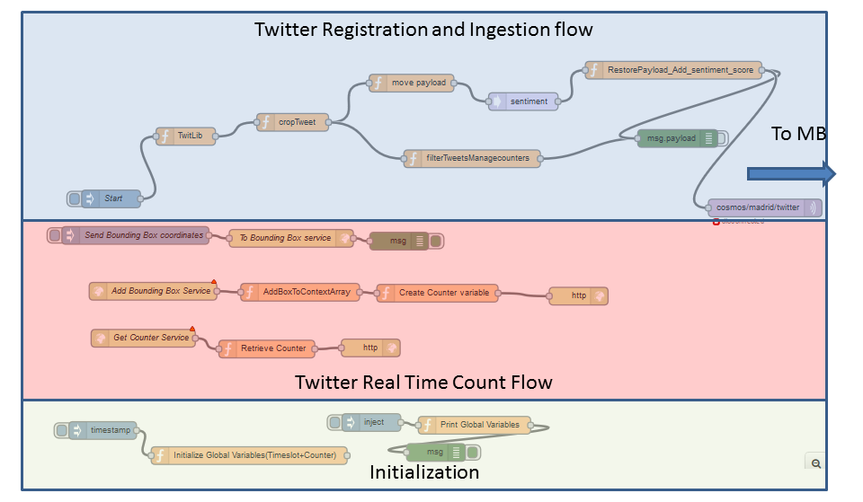
Twitter count per location flow
Dependencies
https://github.com/ttezel/twit
To be added in settings.js

Slide 11
Twitter count per location flow
Functionalities
Register in Twitter Streaming API (needs credentials from a Twitter account inside the Twitlib function node)
REST Service to register a location bounding box for monitoring
http://localhost:1880/PostBox
REST Service to get current counters for all bounding boxes
http://localhost:1880/counters
REST Service to delete a bounding box from monitoring
http://localhost:1880/deleteBox

