Slide 1
IoT Challenge 2018- AffectUs Intro
16-17 March 2018,
Department of Informatics and Telematics,
Harokopion University of Athens

Slide 2
What is TagItSmart (TIS)
H2020 IoT project aiming at utilizing smart QR sensors in the IoT Thing lifecycle
Embedded sensing into the sensors using smart ink
Detects parameters such as temperature, luminocity, humidity etc.
Set of services to enable management of Things and their related scanned data
Primary part of interest: EVRYTHNG platform http://evrythng.com/

Slide 3
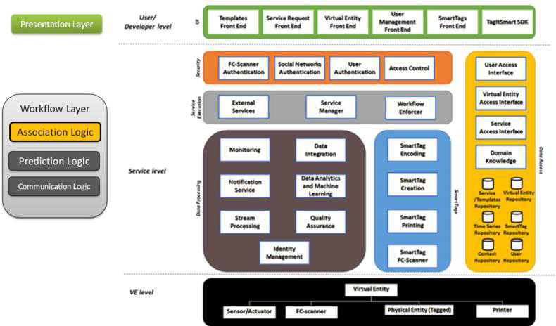
What is AffectUs?
Extension project for TIS
Exploit thing management from EVRYTHNG
Enable app developers and product owners to describe and model their supply chain
Detect various erroneous states, e.g. illegal transitions, timing of transitions etc.
Enable external developers to create and forward event notifications based on external data
Fuse information from different but dependent verticals and supply chains as well as affecting external sources of events
Thus proactively generate early warnings and mitigate the effects of a specific event.

Slide 4
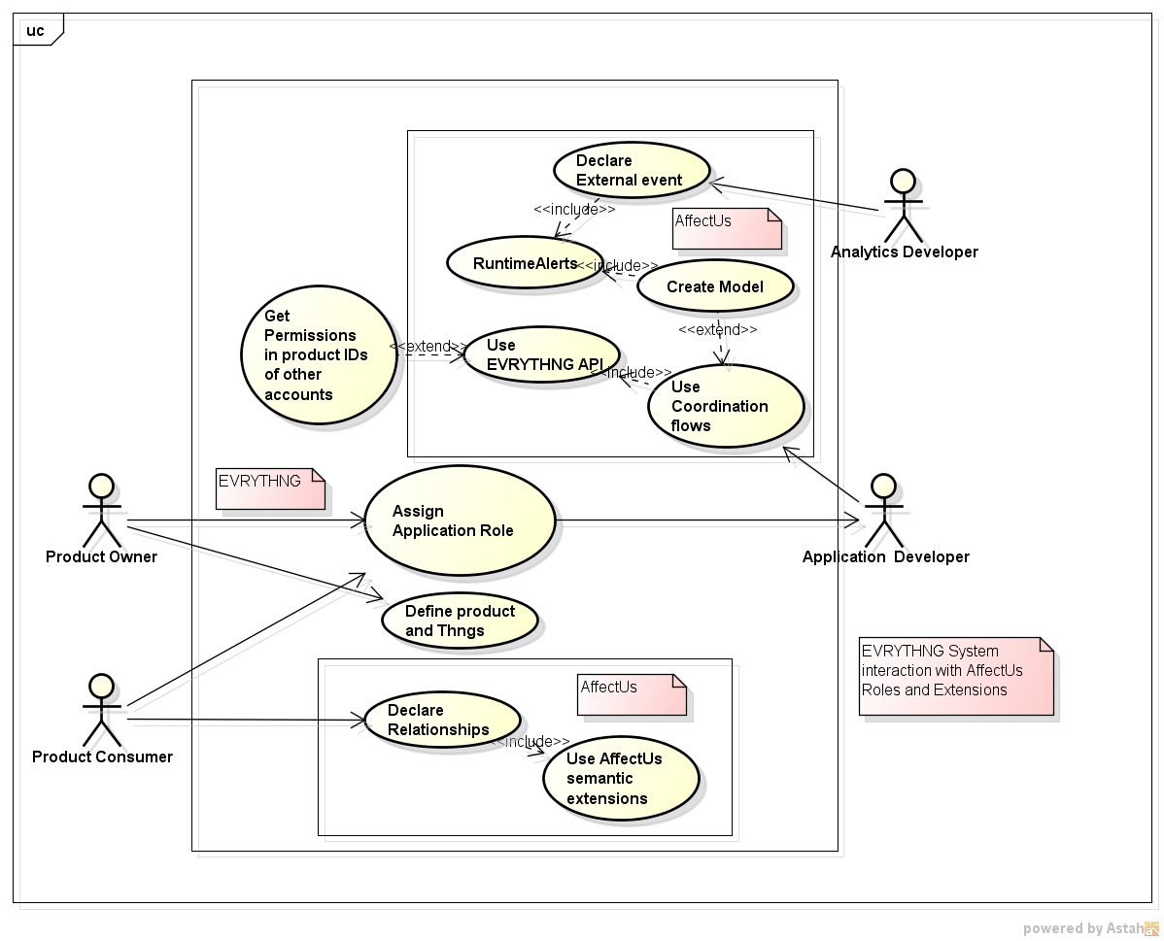
High Level Use Case- General Process of AffectUs

Slide 5
Relation to EVRYTHNG platform
AffectUs utilizes the OATH mechanism of EVRYTHNG in order to bridge information from two accounts based on semantic declarations from the app developers of these accounts
Correlate scan data information with supply chain stage
Model expected duration of stage
Check correct order of scan arrivals
Or from externally produced events

Slide 6
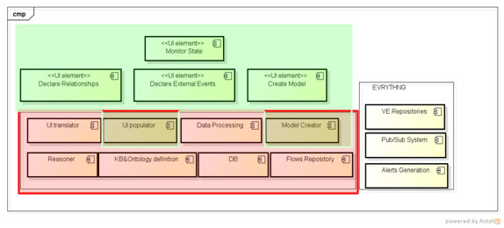
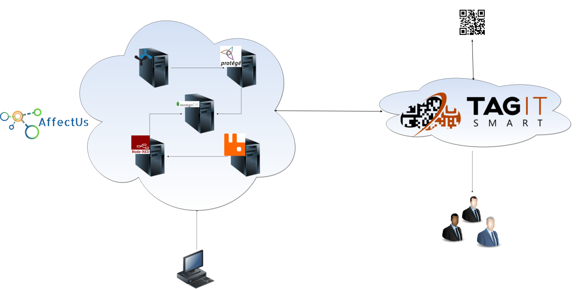
AffectUs internals

Slide 7

IoT Challenge@HUA 2018
Opening event: 16 March 17:30
Tools presentation
Development Support: 17 March 10:00-18:00
Submission of implementations within one week
Announcement for first three awards: the week after
Program for Today:
Welcome and Intro to AffectUs
–List of a scenarios
Scenario A Slot
Intro on Node-RED
Intro on L architectures
Intro on helper flows (clustering, weather, dashboard, tensorflows etc.)
Scenario B Slot
Intro on EVRYTHNG, Product Owner UI and backend operations
Intro on App Dev UI, supporting tabs (e.g. chain monitoring) and backend operations
Intro on ExtDev UI and backend operations
Available System Tools and packaging

Slide 8
Scenario A
Scenario A refers to the exploitation of one or more Open Data sources from Smart Cities (regardless of which city)
Includes data ingestion, processing and extraction of events of interest, following the DIKW paradigm. As an example, obtaining raw data and applying clustering techniques can help categorize them in two or more categories of interest that are automatically extracted based on non-supervised machine learning approaches.
The final outcome (the created event and its publication endpoint) should finally be declared through the AffectUs ExtDev UI in order to test its functionality and provide feedback.

Slide 9
Scenario practicals
Search for open data sources that are easily retrievable
You will probably need to include a database to store information for later processing and analysis
Think of intelligent combinations that can produce knowledge not evident from the baseline data
Integrate at least one external data source and one data management solution (of your choice) in order to store the retrieved data.
Apply at least one filtering/processing layer (could be based on Machine Learning, statistical analysis etc).
Consider individualization of the event based on some kind of user input
E.g. location, time etc

Slide 10
Scenario B
Scenario B refers to the rationale of building a supply chain from Things and modelling the chain through AffectUs case.
For this scenario, the EVRYTHNG platform (http://evrythng.com/) may be used in order to create and manage things, while the modelling of the chain may be performed through the AffectUs respective App Dev UI.
Given that there are no actual things involved, simulation of scanned data (QR code labels) from the things, feeding into EVRYTHNG and then to AffectUs would be needed.
The purpose of this scenario is to create an inventory of things in EVRYTHNG, and the respective model of the supply chain through the AffectUs platform.

Slide 11
Scenario practicals
Create an account and Things scenario on EVRYTHNG
Use the AffectUs UI to enable OATH access to the created products and use the Product Owner and Create model UIs
Achieve the data flow from EVRYTHNG to AffectUs backend and notification mechanisms
Describe the chain, create dummy data and try out the modelling phase

Slide 12
Material
Code and documentation available for the hackathon
Github: https://github.com/affectus-hua/tools
Slack channels: affectus.slack.com
Channels per topic
One general channel
One system oriented channel (for VM and Docker oriented questions)
One machine learning oriented channel
One semantics oriented channel
One Node-RED and UI oriented channel
Invite link
https://join.slack.com/t/affectus/shared_invite/enQtMzE3OTI3MTU2MzA2LWQzODJlNTA1YTkyNDQ3YzMyN2JjNTk5MDE5MGJkNTdjNTJkZTU2MzNhZWMxOGIyMjE4MjI5OTRhOTBmOTdmZTM
Automatic inclusion in all available channels
Email: affectus(a)hua.gr
Or gkousiou(a)hua.gr

Slide 13
Submission of final prototypes
You can send your prototype files along with a small number of slides detailing what you did and how one can execute the produced software
affectus_hackathon(a)hua.gr
Be sure to include your names and emails in the communication so we can get back to you!
Add your name, team members and email so that we can contact you!
https://docs.google.com/forms/d/e/1FAIpQLSdFEN1YMHCfbQTx_DPSYn0cL2qTBYpW6sA5LS4Qzu6Uezg0pA/viewform

Slide 14
Rating criteria
Logic and usefulness of implemented scenario, combinatorial logic of data sources and identified events
Ability to be reused in different contexts
Completeness and visualization aspects
Included feedback on used flows/material from affectUs including benefits and drawbacks etc

