Slide 1
IoT Challenge 2018- Product Owner/EVRYTHNG Intro
16-17 Μαρτίου 2018

Slide 2
EVRYTHNG Account
http://evrythng.com/
Create account
Create project
Create products
Create Things
Objects of the Product Class

Slide 3
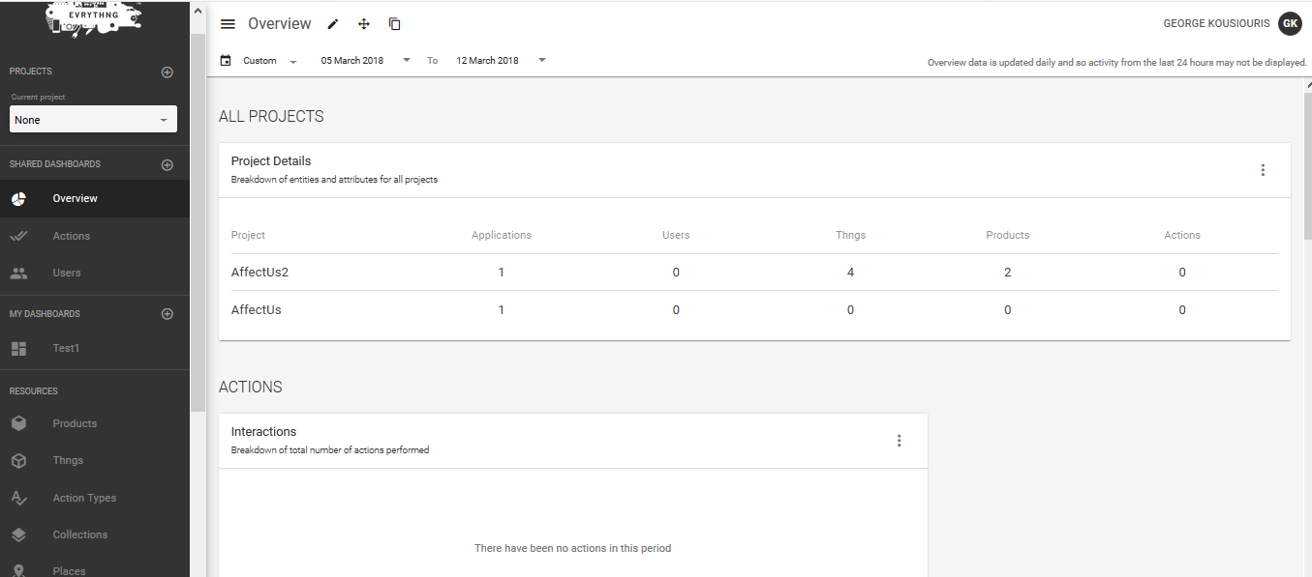
EVRYTHNG Account
Select project

Slide 4
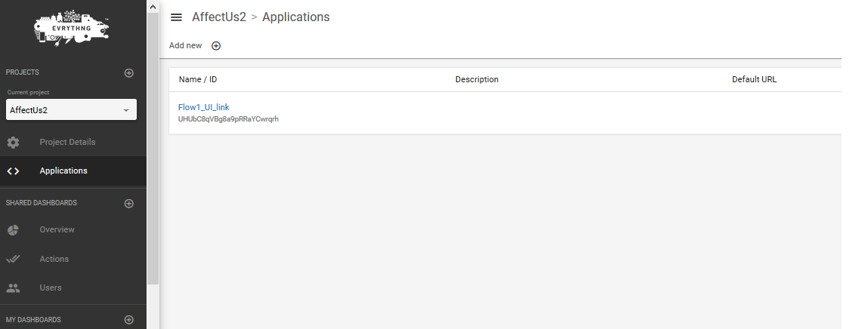
EVRYTHNG Account
API Key is shown once clicked

Slide 5
EVRYTHNG Account application role permissions

Slide 6
EVRYTHNG APP Role
Select project from dashboard
If none available you need to create it
Select Applications tab
If none available you need to create one
Assign role to Application
A role dictates the access rights and is configurable
There is a baseline role available
Once created, the application will have generated an API key
Copy API key and distribute it to the entities you want
For example to your node-RED flows for making HTTP calls to the EVRYTHNG API or to the Product Owner UI

Slide 7
HTTP Calls to EVRYTHNG
Use the simple EVRYTHNG Get flow
Add your API key
Fix the call parameters
Method
URL
Any inputs needed
Details on available methods on:
https://developers.evrythng.com/reference#standard-api-introduction

Slide 8
HTTP Calls to EVRYTHNG
Function node example code

Slide 9
Example of returned JSON from EVRYTHNG regarding product list

Slide 10
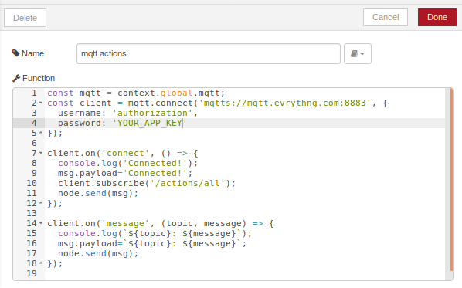
Registration to get the scans
You can use EVRYTHNG mqtt flow
Be sure to check endpoints you want to register to
https://developers.evrythng.com/docs/pubsub

Slide 11
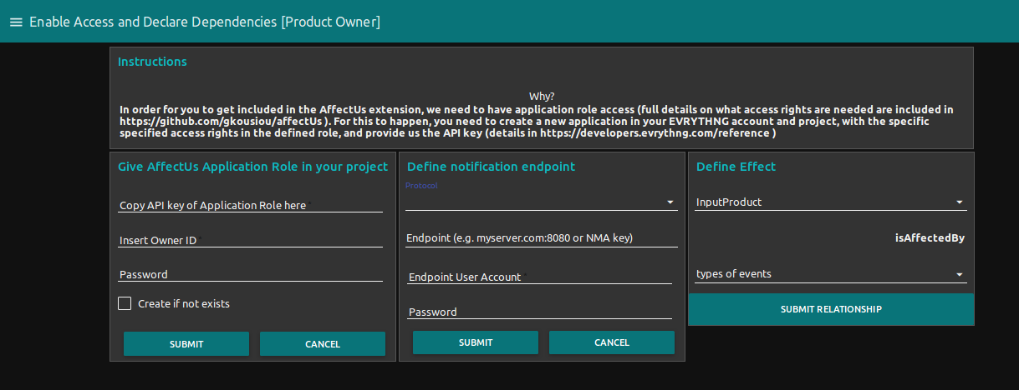
Product Owner UI
Copy API key
Edit notification endpoint and credentials if needed
Define generic effects

Slide 12
Product Owner UI back end
Once received, the information is stored in the back-end database in order to maintain the product-api key mapping
This is needed in order to be able to retrieve product/thing based information on later stages
Endpoint is where notifications need to be sent to the product owner

Slide 13
Product Owner UI back end

