Slide 1


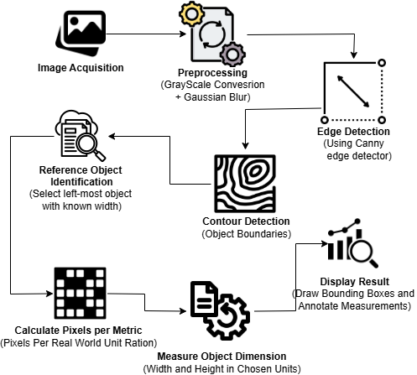
Object Dimension Detection via OpenCV
Supervisor Name: Dr. Usman Ghani
Department of Computer Science, University of Engineering & Technology, Lahore
Abstract
Tools & Libraries Used
This project presents an OpenCV-based system for accurately measuring object dimensions in images using a reference object. It supports real-time, contactless size estimation in multiple units (inches, centimeters), offering practical solution for applications where manual measurement is impractical.
Python 3
OpenCV
NumPy
SciPy (spatial)
imutils
argparse
CLI-based Script
Introduction
In many real-world scenarios, physical measurement tools are limited by accessibility, safety, or scale. With the rise of computer vision, digital approaches to spatial measurement have become more viable. This project explores the use of image processing to automatically detect object boundaries and calculate their dimensions using a known reference. The system combines contour detection, perspective correction, and unit conversion to deliver precise measurements — without requiring specialized hardware.
Results
The object measurement system was tested on various images containing known-sized reference objects. The following observations were made:
Accurate Measurements: The system achieved high accuracy in measuring object dimensions when provided with a correct reference width.
Multi-Unit Support: Dimensions were successfully converted into inches, centimeters, and meters, enhancing flexibility.
Noise Filtering: Applying Gaussian Blur effectively reduced image noise, improving edge detection and contour precision.
Real-Time Processing: The method processed images quickly, making it suitable for real-time or batch processing applications.
Related Work
Comparison of Existing Object Measurement Techniques and Our Approach
Table : Comparison of Existing Object Measurement Techniques
Approach | Description | Pros | Cons
Traditional Photogrammetry | Uses multiple images and physical reference markers to calibrate scale and measure objects. | High precision | Time-consuming, requires specialized equipment
Deep Learning Models | CNNs detect and segment objects, estimating size based on learned patterns from datasets. | Automated, adaptable | Requires large datasets and high computation
My Approach | Single-image contour-based measurement with multi-unit support and simple CLI interface. | Flexible, easy to use, multi-unit support | Relies on clear object boundaries and known reference object
Table : Comparison Between Original and Measured Object Dimensions
Object | Actual Width (inches) | Measured Width (inches) | Error (%)
Coin | 0.69 | 0.67 | 2.90%
Metro Card | 3.25 | 3.33 | 2.46%
Adapter | 1.94 | 1.94 | 0%
USB | 2.37 | 2.39 | 0.84%
Conclusion
Methodology
The system accurately measures object dimensions from images using contour detection and a reference object. It supports unit conversions and applies noise removal for precision.
Future Directions
Integrate deep learning for enhanced object detection accuracy.
Enable real-time measurement using live camera input.
Extend functionality to support 3D size estimation.
Implement auto-calibration using known reference objects.
Apply in domains like logistics, retail, healthcare, and manufacturing.
Group Members
Fig: Step-by-Step Process for Measuring Object Dimensions from Images
Afeera Fatima 2022-CS-151

