Slide 1
Project
File created on: 19/6/2024 7:55:32 PM

Slide 2
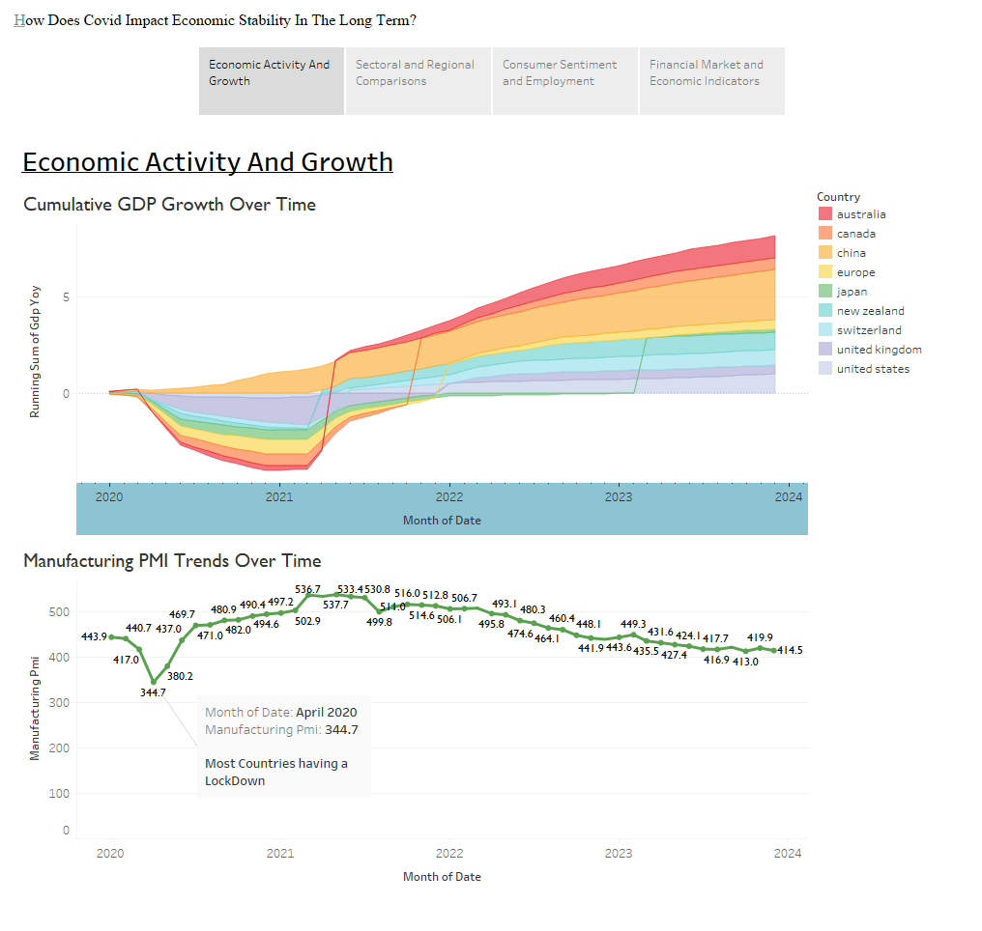

Slide 3
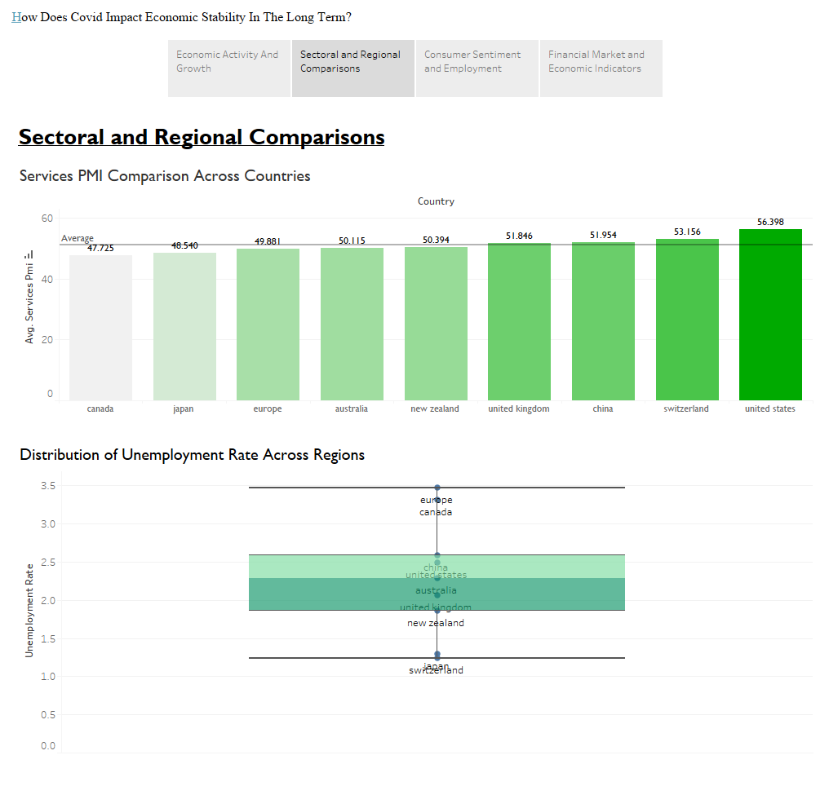

Slide 4
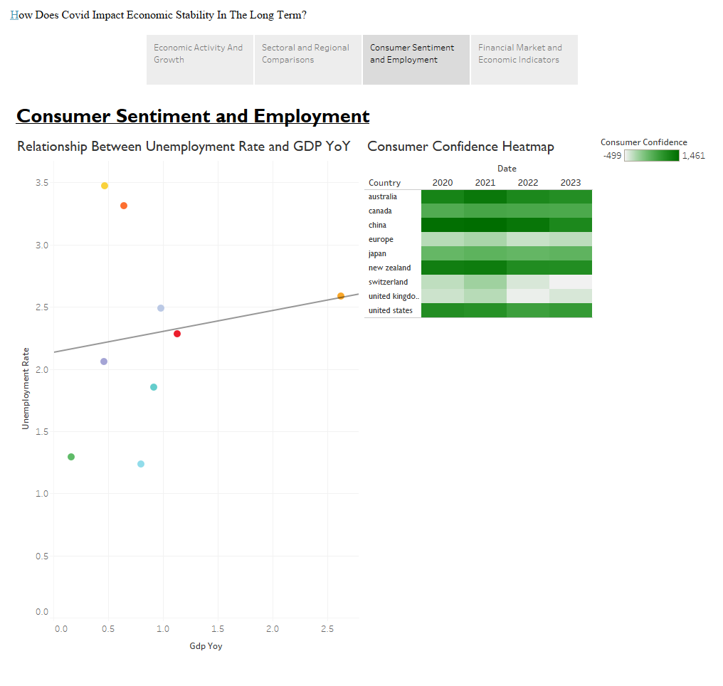

Slide 5
