Slide 1
Shaping Optimization
of
Turbine Disk
and
Bearing Seal
Shen-Yeh Chen
Structures Dept., Product Design
Honeywell ES&S, Phoenix, Arizona
Aug 2001

Slide 2
Turbine Disk Optimization
July, 2001

Slide 3
Challenges
No parametric model available. No time to rebuild
Need the result in few hours

Slide 4
Tools & Methodologies
NLP optimizer
  Feasible Direction Methods with customized modification
In house Optimization Code
  AnsysOpt : fully compatible with ANSYS. Allows infinite, flexible, and programmable linking possibilities between design parameters
  CoNShape : Allow reverse parametric model creation with only FE mesh. Settings are saved inside ANSYS parameters
  Using ANSYS as the FE analysis code

Slide 5
Example Input File
Read in ANSYS data.ConShape data
also defined in parameters
/FILNAME,TEST01
CDREAD,DB,TEST01,CDB
!A2DESIGN,INSERTDV
x_cnsh,0,1
/PREP7
:
:
x_esum,’AREA01’
OPVAR,AREA01,OBJ,,,
OPVAR,DV001,DV,-0.4,0.0,0.0
OPVAR,DV002,DV, 0.0,0.4,0.0
OPVAR,DV001,SV,-0.4,0.4,0.0
/SOLU
EQSLV,SPARSE
SOLVE
!A2DESIGN,NDCONS,PART0001,SEQ,,34000
!A2DESIGN,NDCONS,PART0001,S11,-30000,30000
!A2DESIGN,NDCONS,PART0001,S33,-7400,7400
!A2DESIGN,FDM,MAX_ACT,500
!A2DESIGN,FDM,MAX2FSBL,40
!A2DESIGN,ANSMEM,40,400
!A2DESIGN,FDM,IAF_LMT1,1
!A2DESIGN,FDM,IAF_OPEN,1
!A2DESIGN,FDM,ICFDM,4
SAVE
Put as many commands as
you want, anywhere
AnsysOpt specific :
Ask AnsysOpt to write in new design
variables values here
ANSYS macro :
Calling CoNShape to change
the model shape
Calling a macro to
calculate total area
Define optimization parameters
Same as ANSYS optimization
no “/OPT” needed
AnsysOpt specific :
Define constraints on
components
AnsysOpt specific :
Optimizer parameters

Slide 6
Problem Definition
Need to minimize the stress and the weight
Stress has to be below certain level (hard constraints), and weight has to be as small as possible (soft constraints)

Slide 7
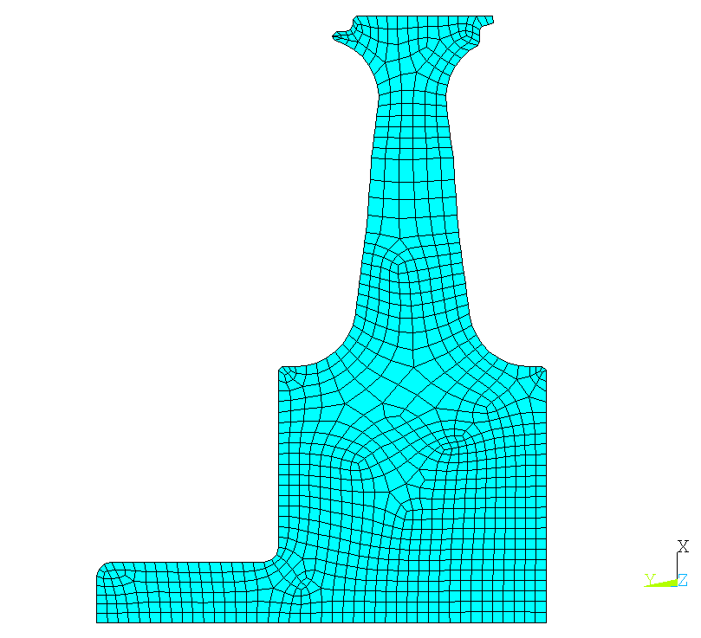
Initial Design and Design Variables :
X&Y Coordinates of the
Controlling Nodes in Red Circles
7
6
8
5
4
9
10
3
11
2
12
13
1
14

Slide 8
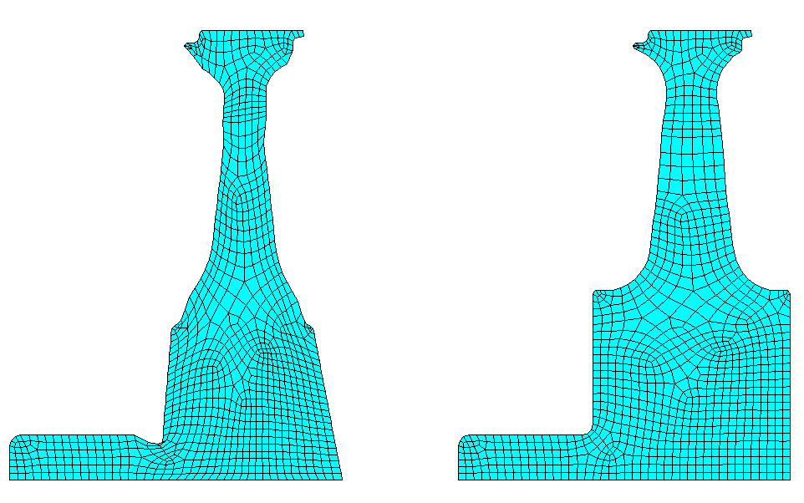
Optimal Shape and Associated Mesh
Optimal Design
Original Design

Slide 9
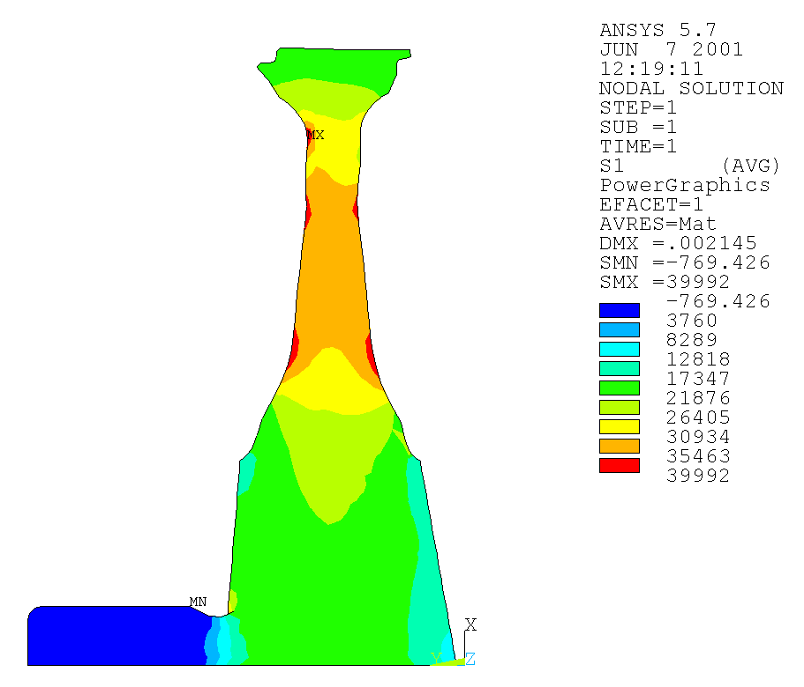
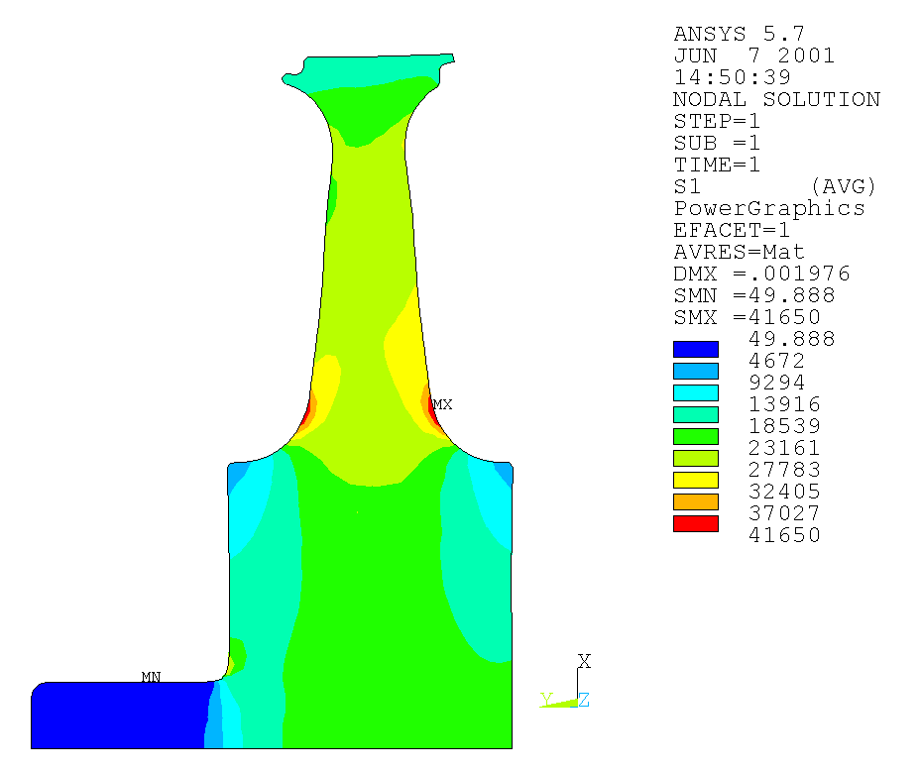
Optimal Shape and Associated Stress
Optimal Design
Original Design

Slide 10
Conclusion
Optimization model built in 10 minutes
Each run takes about 5 to 10 minutes
Take few hours, few runs to fine-tune the result
  Reducing Disk Weight by 22%
  Reducing Maximum Stress by 25%

Slide 11
Bearing Seal
Design Optimization
September 2000
Shen-Yeh Chen
Structures Dept., Product Design

Slide 12
Challenges
Refined FE model with contact elements
  Some nonlinearity involved
  Mesh distortion can be a problem
  Medium size model with 10395 nodes and 9441 elements
No parametric model available. Impossible to rebuild
Geometric manufacturability constraints
  Requires flexible design parameters linking
Very “narrow” feasible domain
  Manual iteration of several months failed to get a feasible solution
  Very nonlinear optimization problem
Need the result in few days.

Slide 13
Tools & Methodologies
NLP optimizer
  Feasible Direction Methods with customized modification
In house Optimization Code
  AnsysOpt : fully compatible with ANSYS. Allows infinite, flexible, and programmable linking possibilities between design parameters
  CoNShape : Allow reverse parametric model creation with only FE mesh. Settings are saved inside ANSYS parameters
  Using ANSYS as the FE analysis code

Slide 14
Problem Definition
Need to minimize the stress
Several geometry constraints exists
  Minimum thickness
  Minimum radius
  Parallel shape variation on certain areas
Also subjected to stress constraints

Slide 15
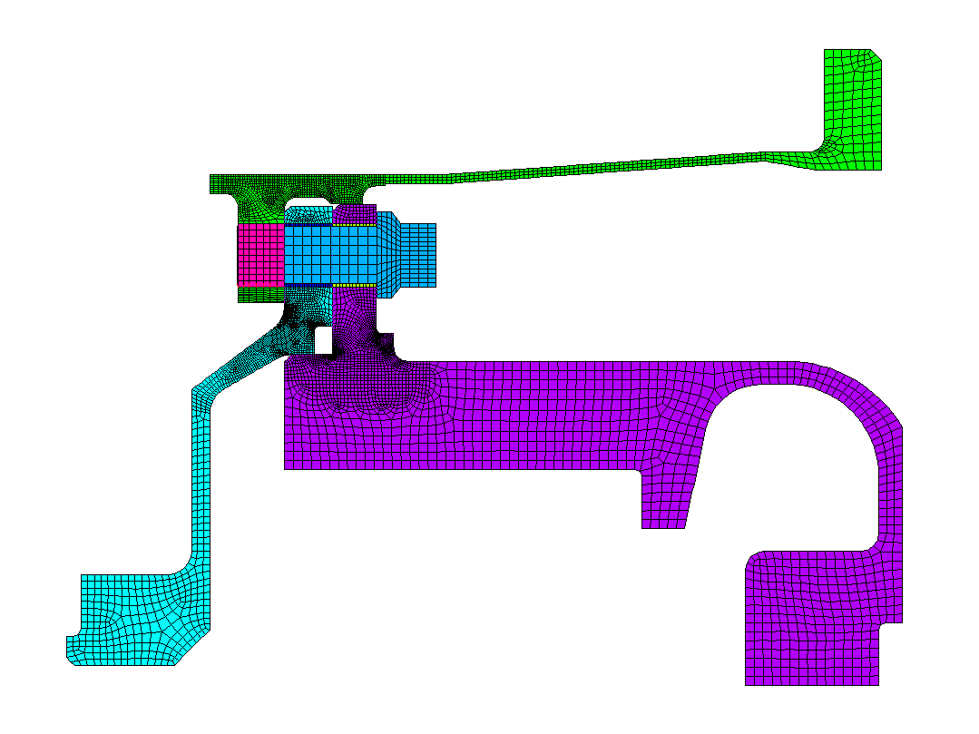
Constraints : Geometry Constraints
Manufacturing Constraints
Stress Constraints
Objective : to minimize the normalized violation of the stress constraints
X
Y

Slide 16
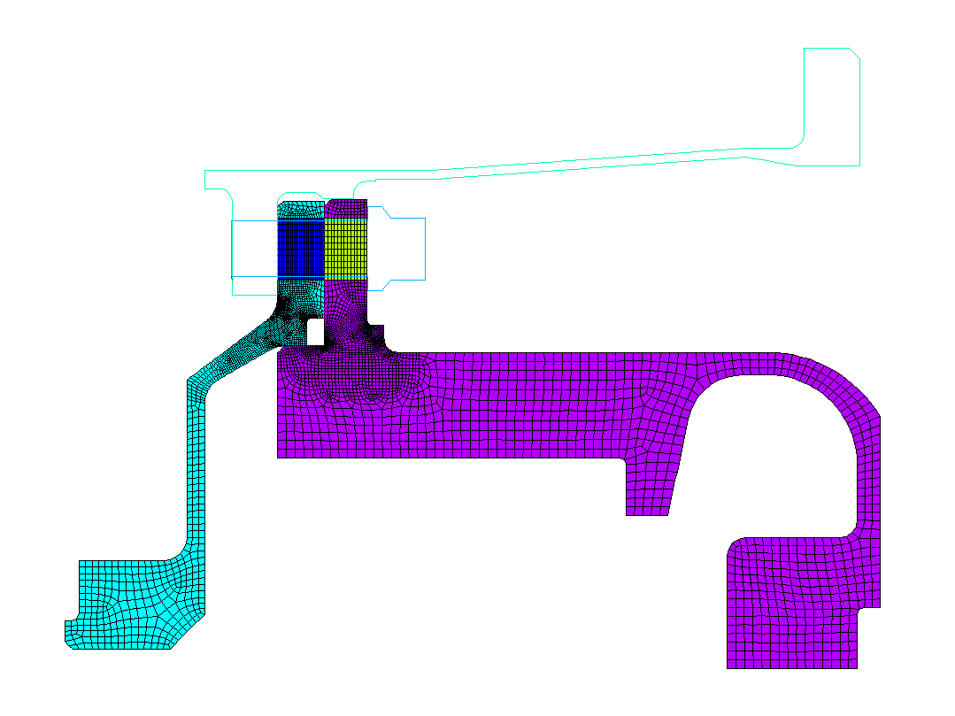
Constraint : Chamber remains the same dimension
Constraint : Thickness Can not be Smaller
DV1 : changes in Y direction
Stress Constraint :PART0002
SEQV< 60,000 (initial design =86,594)
|S1| < 60,000 (initial design =89,722)
|S2| < 60,000 (initial design =-100,517)
Constraint : Radius Can not be Smaller
X
Y

Slide 17
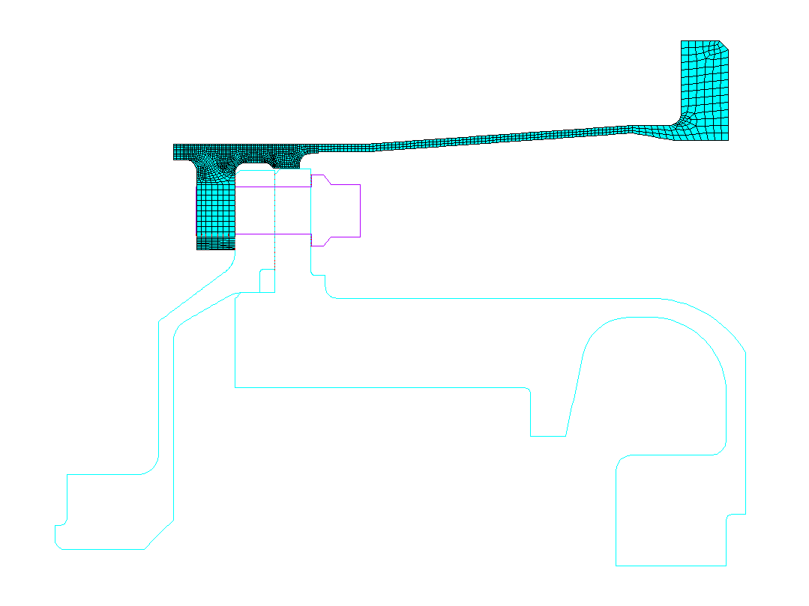
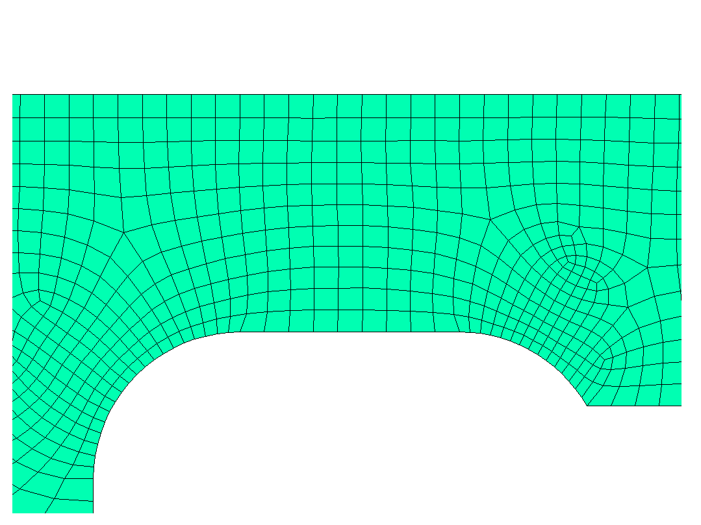
Stress Constraint : PART0001
SEQV< 154,000 (initial design= 160,852)
|S1| < 154,000 (initial design= 155,315)
|S3| < 154,000 (initial design=-105,706)
Constraint : T > 0.07
DV3 : changes in Y direction
Constraint : T > 0.17
DV2 : chainege in X direction for the curve keypoint
X
Y

Slide 18
DV4~DV9 : changes in Y direction
DV4
DV5
DV6
DV7
DV8
DV9
X
Y

Slide 19
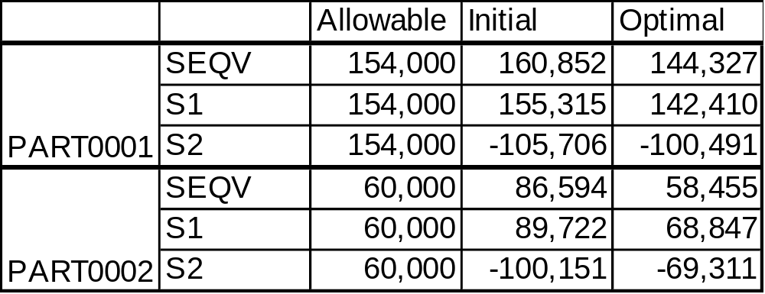

Slide 20
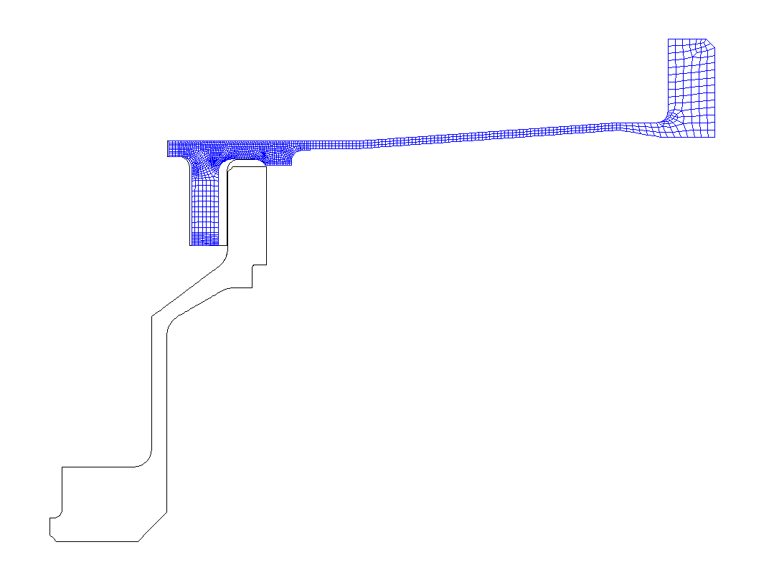
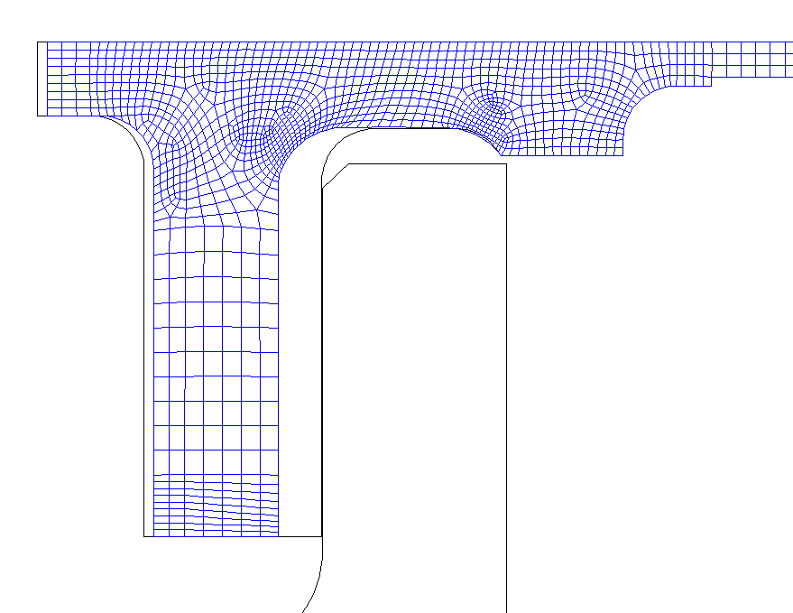
Optimal Design
Initial Design
Optimal Design
Initial Design

Slide 21
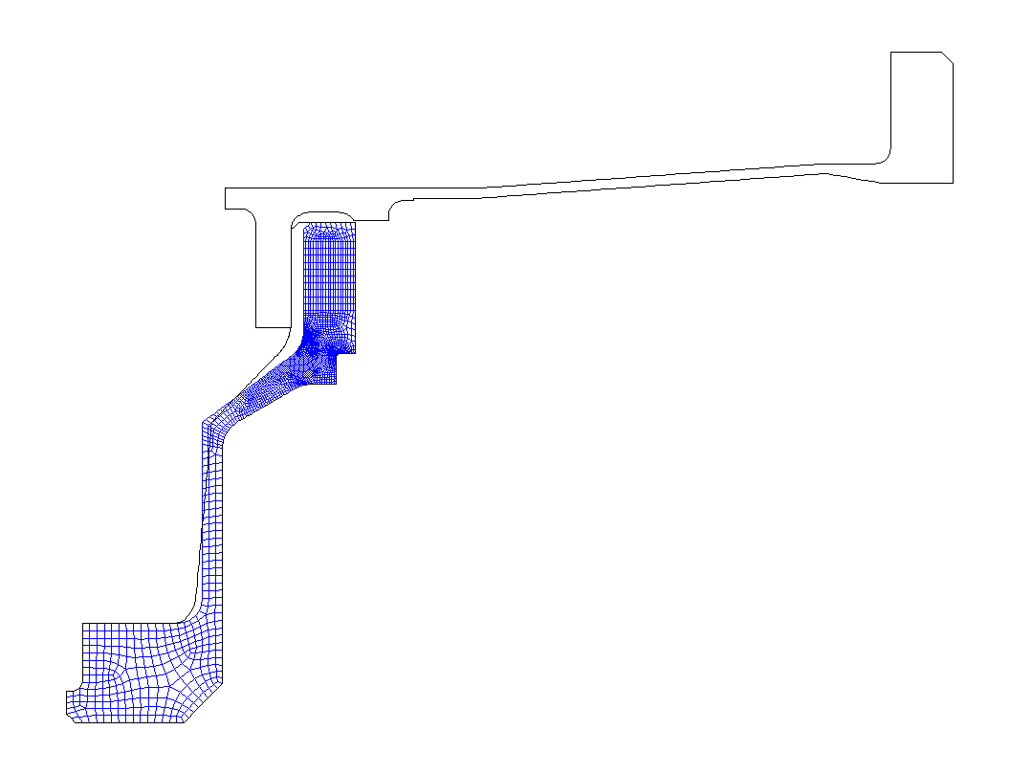
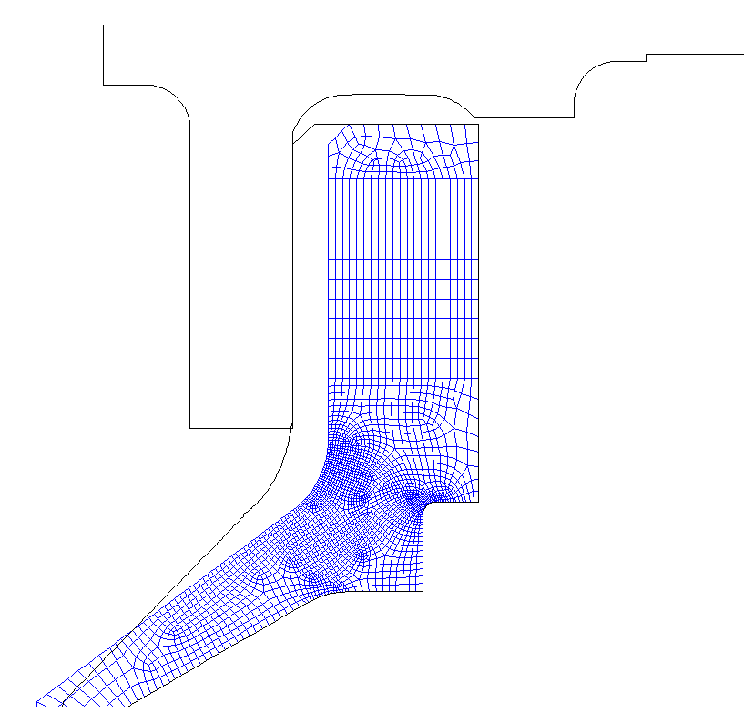
Initial Design
Optimal Design

Slide 22
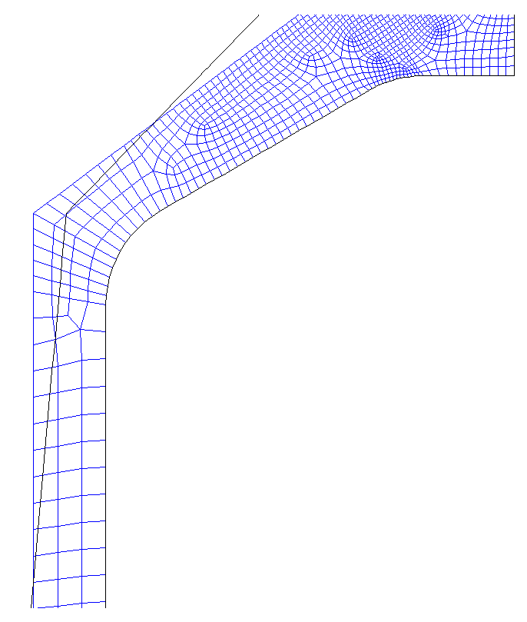
Optimal Design
Initial Design

Slide 23
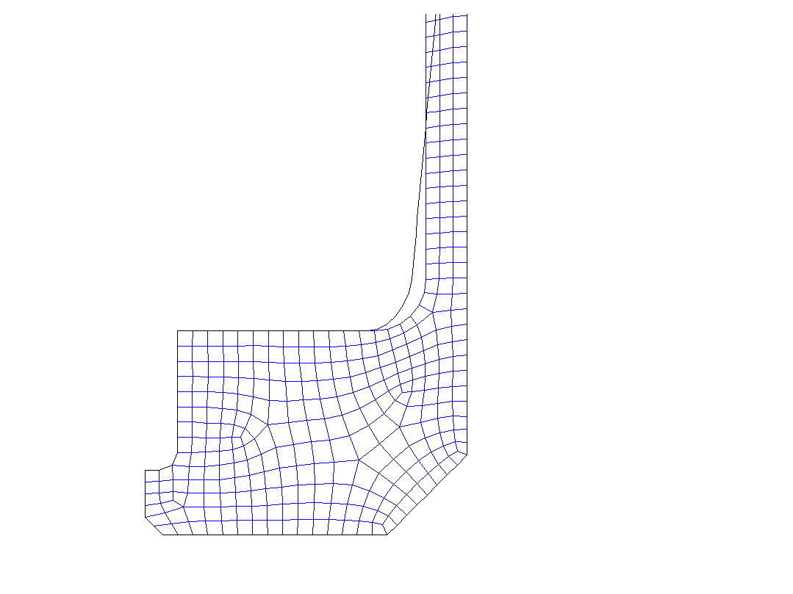
Optimal Design
Initial Design

Slide 24
Conclusion
Optimization model built in one and half hours
Optimization completed in 8 hours
Stress reduced below targeted value
No weight increase
Optimum design without manufacturing difficulty
Less time than manual iteration

