Slide 1

IBM CLOUD
IBM CLOUD
Migrar un contenedor Docker a CloudFoundry de IBM Cloud
Andrés Felipe Forero Correa
IBM Developer Advocate
andres.forero@ibm.com
Notes:
Intro of who I am
Using IBM Smart Meetings – Chat on the right

Slide 2
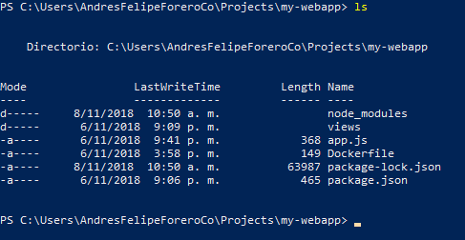
Clonamos el proyecto my-webapp > git clone github.com/afforeroc/my-webapp
Notes:
Intro of who I am
Using IBM Smart Meetings – Chat on the right

Slide 3
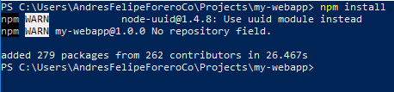
Instalamos las librerías requeridas > npm install
Si es del caso, instalamos express y pug
> npm install express
> npm install pug
Notes:
Intro of who I am
Using IBM Smart Meetings – Chat on the right

Slide 4
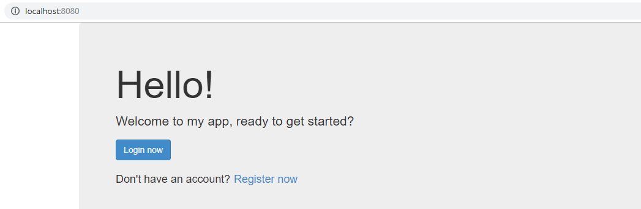
Probamos my-webapp en local > node app.js
Notes:
Intro of who I am
Using IBM Smart Meetings – Chat on the right

Slide 5
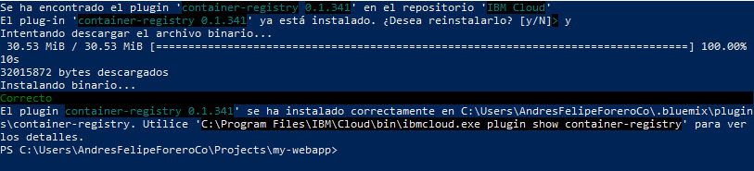
Instalamos el plugin de cr > ibmcloud plugin install container-registry -r Bluemix
Notes:
Intro of who I am
Using IBM Smart Meetings – Chat on the right

Slide 6
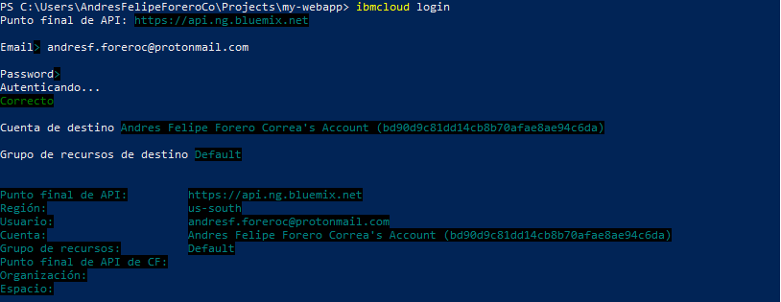
Iniciamos sesión en IBM Cloud > ibmcloud login > ibmcloud cr login
Notes:
Intro of who I am
Using IBM Smart Meetings – Chat on the right

Slide 7
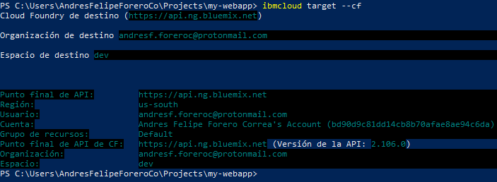
Establecemos la organización y el espacio de trabajo > ibmcloud target --cf
Notes:
Intro of who I am
Using IBM Smart Meetings – Chat on the right

Slide 8

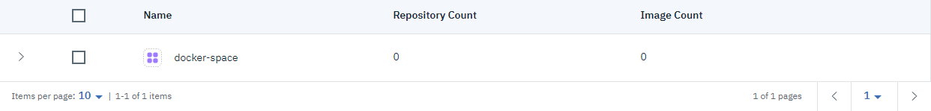
Agregamos un espacio al container registry > ibmcloud cr namespace-add docker-space
Verificamos en Containers de IBM Cloud https://console.bluemix.net/containers-kubernetes/registry/main/namespaces
Notes:
Intro of who I am
Using IBM Smart Meetings – Chat on the right

Slide 9
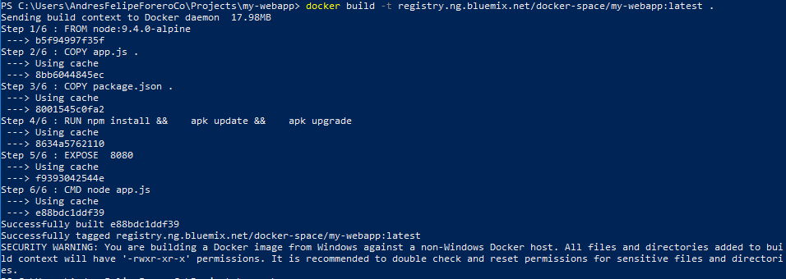
Construimos la imagen de Docker > docker build –t registry.ng.bluemix.net/docker-space/my-webapp:latest .
Notes:
Intro of who I am
Using IBM Smart Meetings – Chat on the right

Slide 10
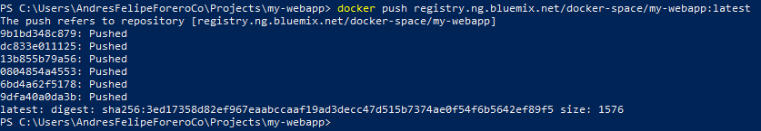
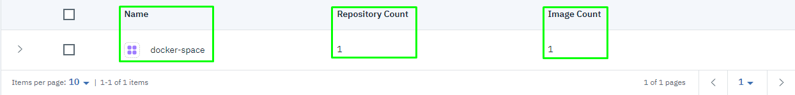
Subimos la imagen de Docker > docker push registry.ng.bluemix.net/docker-space/my-webapp:latest
Verificamos en Containers de IBM Cloud https://console.bluemix.net/containers-kubernetes/registry/main/namespaces
Notes:
Intro of who I am
Using IBM Smart Meetings – Chat on the right

Slide 11
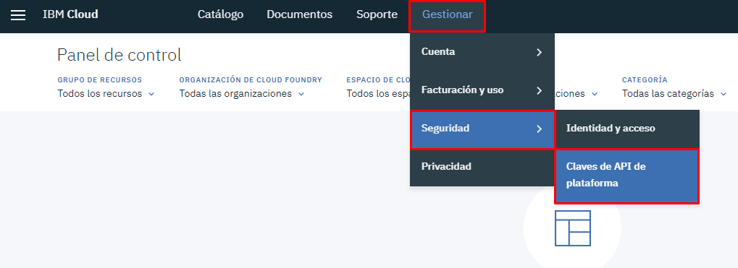
Accedemos al panel de gestión de API keys https://console.bluemix.net/iam/#/apikeys
Notes:
Intro of who I am
Using IBM Smart Meetings – Chat on the right

Slide 12
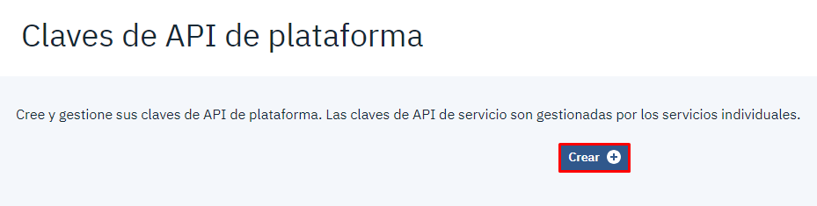
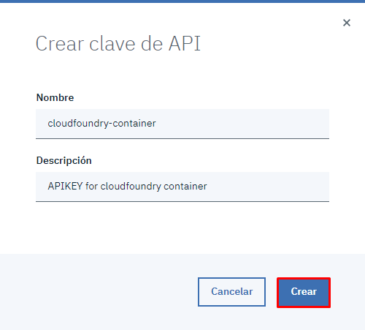
Creamos una API key genérica
Notes:
Intro of who I am
Using IBM Smart Meetings – Chat on the right

Slide 13
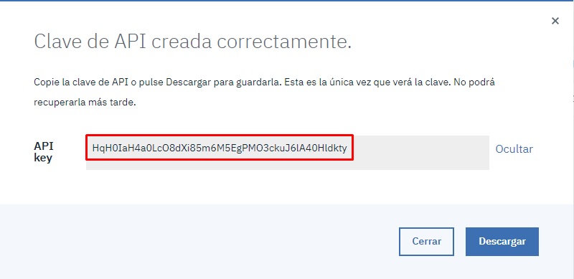
Copiamos la API key creada
Notes:
Intro of who I am
Using IBM Smart Meetings – Chat on the right

Slide 14
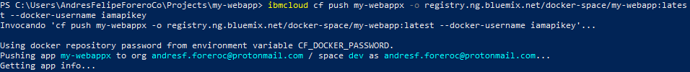
Almacenamos el API key de forma temporal > $env:CF_DOCKER_PASSWORD="HqH0IaH4a0LcO8dXi85m6M5EgPMO3ckuJ6lA40Hldkty"
Desplegamos la aplicación dockerizada > ibmcloud cf push my-webappx -o registry.ng.bluemix.net/docker-space/my-webapp:latest --docker-username iamapikey
Notes:
Intro of who I am
Using IBM Smart Meetings – Chat on the right

Slide 15
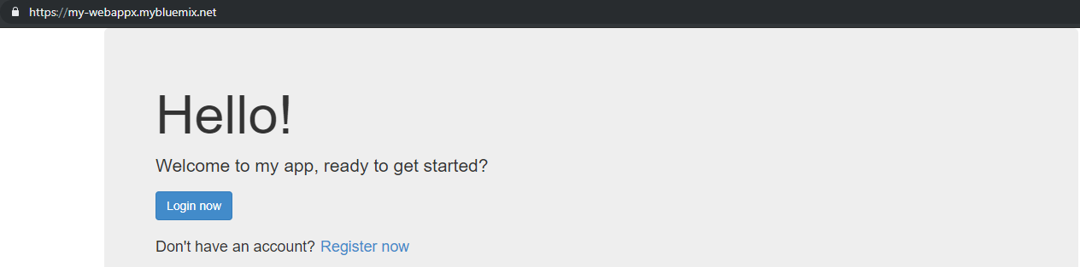
Verificamos que la aplicación este activa
Notes:
Intro of who I am
Using IBM Smart Meetings – Chat on the right

