Slide 1


Kabul University
Faculty of Computer Science
SE Department
Course:
Data Structure and Algorithms
Lesson 1 Data Structure
Semester: 4th
Lecturer: M. Salim Hamdard
Instructor : Ziaur Rahman
Computer Science Faculty
Prepared by: M. Salim Hamdard
JAHAN UNIVERSITY
year: 1402

Slide 2
Table of Contents
Introduction to data structure
Importance of data structure
Linear and non-linear data structures
Data Structure Operations

Slide 3
Objectives
To Introduce data structure and its importance in CS.
To overview on types of DS including Linear and non-linear data structures
To list down and undetstand Data Structure Operations

Slide 4
What is the Data Structure ?
Data: Facts, statistics, quantities, characters, or symbols on which operations are performed by a computer.
Structure: The arrangement and relations between data of complex system.

Slide 5
Data Structure
Data Structure is a systematic way to organize data in order to use it efficiently.
The idea is to reduce the space and time complexities of different tasks.
Almost every enterprise application uses various types of data structures in one or the other way e.g. Facebook, Google etc.

Slide 6
Importance of Data Structure
As applications are getting complex, there are some common problems
that applications face now-a-days.
Store small or large data
Update or modify data
Search data
Data retrieval in time (execution time)
Efficient use of memory (memory requirements)
To solve the above-mentioned problems, well planned and systematic data structures are needed.

Slide 7
Foundation term of Data Structure
Interface − Each data structure has an interface. Interface represents the set of operations that a data structure supports. An interface only provides the list of supported operations, type of parameters they can accept and return type of these operations.
Implementation − Implementation provides the internal representation of a data structure. Implementation also provides the definition of the algorithms used in the operations of the data structure.

Slide 8
Characteristics of Data Structure
Correctness − Data structure implementation should implement its interface correctly.
Time Complexity − Running time or the execution time of operations of data
structure must be as small as possible.
Space Complexity − Memory usage of a data structure operation should be
as little as possible.

Slide 9
Execution Time Cases
There are three cases which are usually used to compare various data structure's execution time in a relative manner.
Worst Case − This is the scenario where a particular data structure operation takes maximum time.
Average Case − This is the scenario depicting the average execution time of an operation of a data structure.
Best Case − This is the scenario depicting the least possible execution time of an operation of a data structure.

Slide 10
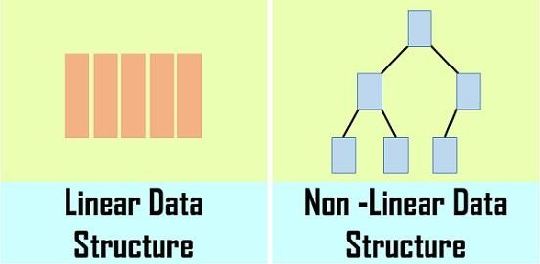
Data Structure Types
Linear datastructure
Non-Linear Data Structure

Slide 11
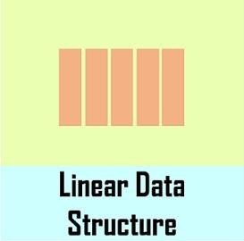
Linear Data Structure
Linear data structure is one in which the data items are placed in the memory contiguously i.e. one after the other.
Examples of linear data-structures are:
Arrays

Slide 12
Linear Data Structure
Pros
If we search the first data item, then it is very easy to find the next data items
Cons
Size of the array must be know prior to allocation
Requires contiguous memory, But free memory space is not utilized for memory allocation

Slide 13
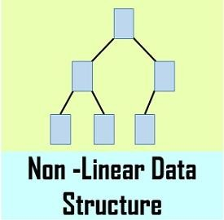
Non- Linear Data Structure
A non-linear data structure is a data structure in which a data item is connected to several other data items. So that a given data item has the possibility to reach one-or-more data items.
Examples of non-linear data-structures are:
Graphs
Trees

Slide 14
Non- Linear Data Structure
Pros
Uses memory efficiently
The length of the data items is not necessary to be known prior to allocation
Cons
Overhead of the link to the next data item

Slide 15
Data Structure Operation
The basic operations that are performed on data structure are as follows:
Insertion: Adding a new record to the structure.
Deletion: Removing the record from the structure.
Searching: Searching involves searching for the specified record in a data structure.

Slide 16
Data Structure Operation
Traversing: Traversal of a data structure means processing all the data elements present in it.
Sorting: Managing the data or record in some logical order(Ascending or descending order).
Merging: Combining the record in two different sorted files into a single sorted file.

Slide 17
Summary and Student’s Evaluation
Introduction to data structure
Importance of data structure
Linear and non-linear data structures
Data Structure Operations

Slide 18











Any Questions?

Slide 19
Next Topic
Algorithms
20

