Slide 1




Course: Data Structure and Algorithms
Kabul University
Faculty of Computer Science SE Department
Algorithms
Lesson 2
Semester: 4th
Lecturer: M. Salim Hamdard
Instructor : Ziaur Rahman
Computer Science Faculty
Prepared by: M. Salim Hamdard
JAHAN UNIVERSITY
year: 1402

Slide 2
Contents
Algorithms
History of algorithms
Pseudo language and Conventions
Algorithms notations

Slide 3
Objectives
To understand Algorithms and its usage.
To overview on History of algorithms.
To know about Algorithms notations.

Slide 4
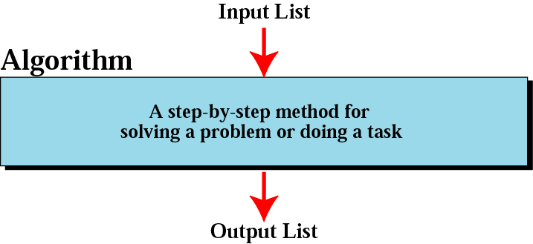
Algorithm
An algorithm is a series of specific steps which solve a particular problem.
1

Slide 5

History of Algorithm
The word algorithm comes from the name of a Persian mathematician Abu Ja’far Mohammed ibn-i Musa al Khowarizmi.
In computer science, this word refers to a special method useable by a computer for solution of a problem.
The statement of the problem specifies in general terms the desired input/output relationship.
For example, sorting a given sequence of numbers into nondecreasing order provides fertile ground for introducing many standard design techniques and analysis tools.
2

Slide 6
ALGORITHMS AND FLOWCHARTS
A typical programming task can be divided into two phases:
Problem solving phase
produce an ordered sequence of steps that describe solution of problem
this sequence of steps is called an algorithm
Implementation phase
implement the program in some programming language
3

Slide 7
Steps in Problem Solving
First produce a general algorithm (one can use pseudocode)
Refine the algorithm successively to get step by step detailed algorithm that is very close to a computer language.
Pseudocode is an artificial and informal language that helps programmers develop
algorithms. Pseudocode is very similar to everyday English.
4

Slide 8
Rules for Pseudocode (Conventions)
Write only one statement per line
Capitalize initial keyword
Indent to show hierarchy
End multiline structures
Keep statements language independent

Slide 9
One Statement Per Line
Each statement in pseudocode should express just one action for the computer. If the task list is properly drawn, then in most cases each task should correspond to one line of pseudocode.
Task List
Read name, hours worked, rate of pay
Perform calculations
gross = hours worked * rate of pay
Write name, hours worked, gross
Pseudocode
READ name, hoursWorked, payRate gross = hoursWorked * payRate WRITE name, hoursWorked, gross

Slide 10
Capitalize Initial Keyword
In the example below note the words: READ and WRITE. There are just a few keywords to use, others are listed bellow:
READ, WRITE, IF, ELSE, ENDIF, WHILE, ENDWHILE
Pseudocode
READ name, hoursWorked, payRate gross = hoursWorked * payRate WRITE name, hoursWorked, gross

Slide 11
Indent to Show Hierarchy
Each design structure uses a particular indentation pattern
READ name, grossPay, taxes IF taxes > 0
net = grossPay – taxes
ELSE
net = grossPay ENDIF
WRITE name, net
Sequence:
Keep statements in sequence all starting in the same column
Selection:
Indent statements that fall inside selection structure, but not the keywords that form the selection
Loop:
Indent statements that fall inside the loop but not keywords that form the loop

Slide 12
End Multiline Structures
READ name, grossPay, taxes
IF taxes > 0
net = grossPay – taxes
ELSE
net = grossPay
ENDIF
WRITE name, net
See the IF/ELSE/ENDIF as constructed above, the ENDIF is in line with the IF. The same applies for WHILE/ENDWHILE etc…

Slide 13
Language Independence
Write in language in which you are most comfortable with, in the long run you will save time. Remember you are describing a logic plan to develop a program, you are not programming!

Slide 14
Advantages & Disadvantages
Pseudocode Advantages
Easily modified
Implements structured concepts
Done easily on Word Processor
Pseudocode Disadvantages:
Not visual
No accepted standard, varies from company to company

Slide 15
Pseudocode & Algorithm
Example 1: Write an algorithm to determine a student’s final grade and indicate whether it is passing or failing. The final grade is calculated as the average of four marks.

Slide 16
Pseudocode & Algorithm
Pseudocode:
Input a set of 4 marks
Calculate their average by summing and dividing by 4
if average is below 50
Print “FAIL”
else
Print “PASS”

Slide 17
Pseudocode & Algorithm
Detailed Algorithm
•
Step 1:
Step 2:
Step 3:
Input M1,M2,M3,M4
GRADE ← (M1+M2+M3+M4)/4
if (GRADE < 50) then
Print “FAIL”
else
Print “PASS”
endif

Slide 18
Example 2
Write an algorithm to convert the length in feet to centimeter.
Pseudocode:
Input the length in feet (Lft)
Calculate the length in cm (Lcm) by multiplying LFT with 30
Print length in cm (LCM)
18

Slide 19
Example 3
Write an algorithm that reads two values, determines the largest value and prints
the largest value with an identifying message.
ALGORITHM
Step 1:
Step 2:
Input VALUE1, VALUE2
if (VALUE1 > VALUE2) then
MAX ← VALUE1
else
MAX ← VALUE2
endif
Print “The largest value is”, MAX
Step 3:
18

Slide 20
Summery & Students Evaluation
Algorithms
History of algorithms
Pseudo language and Conventions
Algorithms notations

Slide 21











Any Questions?

Slide 22
Next Topic
Array
25

