Slide 1



Course:Data Structure and Algorithms
Kabul University
Faculty of Computer Science SE Department
Array
Lesson 3
Semester: 4th
Lecturer: M. Salim Hamdard
Instructor : Ziaur Rahman
Computer Science Faculty
Prepared by: M. Salim Hamdard
JAHAN UNIVERSITY
year: 1402

Slide 2
Contents
Introduction to Array
Representation of Array
Basic Operations on Array
Implementation in Java or C++
Array traversing
Array insertion and deletion

Slide 3
Objectives
To be able to use Array in algorithms and programming.
Working with Representation of Array.
Be able to work with basic operations on Array.
To be able to work with Array Implementation in programming.
To be able to work with Array traversing, Array insertion and deletion

Slide 4
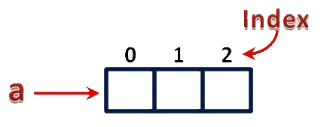
Arrays
An array is a variable which can store multiple values of same data type at a time.
Collection of similar data items stored in continuous memory locations with single name
int a[3];
1

Slide 5
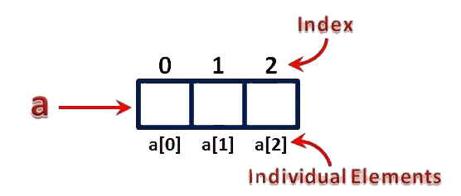
Arrays
Element − Each item stored in an array is called an element.
Index − Each location of an element in an array has a numerical index, which is used to
identify the element.
int a[3];
2

Slide 6
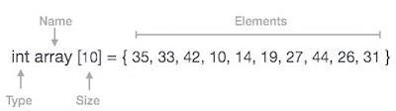
Array Representation
Arrays can be declared in various ways in different languages. For illustration, let's
take C++ array declaration.
3

Slide 7
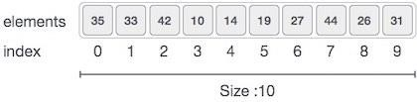
Array Representation
As per the below illustration, following are the important points to be considered.
Index starts with 0.
Array length is 10 which means it can store 10 elements.
Each element can be accessed via its index. For example, we can fetch an element at index 6 as 19.
4

Slide 8
Basic Operations on Arrays
Following are the basic operations supported by an array.
Traverse − print all the array elements one by one.
Insertion − Adds an element at the given index.
Deletion − Deletes an element at the given index.
Search − Searches an element using the given index or by the value.
Update − Updates an element at the given index.

Slide 9
Insertion
Insertion refer to the process of adding a new element to an existing one dimensional array.
Insertion can be at
Any random position within array
The end of an array
Inserting an element at any arbitrary position, all the elements starting from the specified position are shifted towards right to make a vacant position for new insertion.
Insertion at the end is very easy process as there is no shifting of elements.

Slide 10
Method for Insertion Operation
Insertion at any arbitrary position
Lets take array of size 6 elements.
0 | 1 | 2 | 3 | 4 | 5
10 | 20 | 30 | 40
0
1
2
3
4
6
Suppose, we want to insert a new element 35 at 2 location of array, then shifting of
elements is required to vacant the location 2.
Now First of all , shift the element 40 to location 4

Slide 11
Cont...
0 | 1 | 2 | 3 | 4 | 5
10 | 20 | 30 |  | 40
Next shift element 30 to location 3.
0 1 2 3 4 5
10 | 20 |  | 30 | 40
Vacant for insertion
So, here we got the vacant location to insert element 35.

Slide 12

Method for Insertion Operation
Insertion at the end
Lets take array of size 5 elements.
0 | 1 | 2 | 3 | 4
25 | 35 | 40
If we want to insert element 45 at the end of this array, then there is no need of shifting of elements.
0 | 1 | 2 | 3 | 4
25 | 35 | 40 | 45
Inserted here

Slide 13
Algorithm for Insertion Operation
Step 1: Start Step 2: i ⬅ n-1
Step 3: Repeat steps 4 and 5 while i >= k Step 4: a[i+1] ⬅ a[i]
Step 5: i⬅i -1
[end of while loop] Step 6: a[k] ⬅ item
Step 7: n⬅ n+1 Step 8: end
Note: n denotes the size of an array, k denotes the position of new element for insertion.

Slide 14
Deletion
Deletion refers to a process of removing an existing element from an array.
To delete an element, first search it, using a searching technique.
After locating the specified element, remove it from array.
When the specified element is removed then shift backwards all the elements to maintain the order of an array.
If the specified element for deletion is the last element, then it is very easy to
delete to as there is no need of shifting of remaining element.

Slide 15
Method for Deletion Operation
Lets take array of size element.
0 | 1 | 2 | 3 | 4 | 5
10 | 20 | 30 | 40 | 50 | 60
Suppose, we want to delete element 40 from of an array.
First of all, Searching operation is performed to locate the element 40.

Slide 16
Method for Deletion Operation
When Search method locate the element 40 at index 3.
Now delete the element 40 from array in such a way that the element at index 4 shifted to index 3 and element at index 5 shifted to index 4 so on.
0 | 1 | 2 | 3 | 4 | 5
10 | 20 | 30 | 50 |  | 60
Element 40 is deleted and 50 shifted to index 3

Slide 17
Cont...
Now to maintain the order of elements in an array, element 60 shift to index 4.
0 | 1 | 2 | 3 | 4 | 5
10 | 20 | 30 | 50 | 60
Element 40 is deleted from array and remaining elements shift upwards.

Slide 18
Algorithm for Deletion Operation
Step 1: start
Step 2: Repeat for i=k to n-1 Step 3: a[i] ⬅ a[i + 1 ]
[end of for loop]
Step 4: n ⬅ n-1
Step 5: end

Slide 19
Advantages of Array
Here are the advantages of arrays:
Very efficient, in terms of both time and space
Convenient syntax
Accessing an element by its index is very fast (constant time)
20

Slide 20
Disadvantage of Array
Here are the disadvantages of arrays:
All elements must be of the same type
The array size is fixed and can never be changed
Insertion into arrays and deletion from arrays is very slow
wasting memory if not fully used
21

Slide 21
Assignment
Create a Program to Implement Insertion and Deletion operation on array.
Submission date : next class

Slide 22
Summery & Students Evaluation
Introduction to Array
Representation of Array
Basic Operations on Array
Implementation in Java

Slide 23











Any Questions?

Slide 24
Next Topic
Searching
25

