Slide 1



Course:Data Structure and Algorithms
Lesson 4 Searching
Kabul University
Faculty of Computer Science SE Department
Semester: 4th
Lecturer: M. Salim Hamdard
Instructor : Ziaur Rahman
Computer Science Faculty
Prepared by: M. Salim Hamdard
JAHAN UNIVERSITY
year: 1402

Slide 2
Contents
Linear Search
Binary Search

Slide 3
Objectives
To be able to work with Linear Search in array or any other data structure.
To work with Binary Search and understand its benefits.

Slide 4
Searching
Searching is the process of determining whether or not a given value exists in a data structure or a storage media.
We will discuss two searching techniques:
Linear search
Binary search

Slide 5
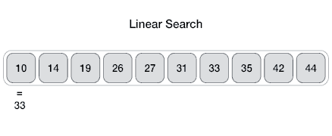
Linear Search
Linear search is a method for finding a particular value in a array list, that consists of checking every one of its elements, one at a time in sequence, until the desired one is found.
It is also known as sequential search.
linear search can be applied to both sorted and unsorted arrays.
Example: Finding the Element 33

Slide 6
Linear Search Algorithm
Unordered-Linear-Search[A, n, x]
for i 1 to n
do if A[i] = x
then return i
else i=i + 1
return “x not found”

Slide 7
Linear Search
Advantages
Easy algorithm to understand
Array can be in any order
Disadvantage
Inefficient (slow): for array of N elements,
N elements for value not in array

Slide 8
Binary Search
A binary search algorithm finds the position of a specific value within a sorted array.
This search algorithm works on the principle of divide and conquer.
This search algorithm can be quite fast, but the limitation is that the data has to be in a sorted form.
A binary search is also known as half-interval search or logarithmic search.
Binary search is a fast search algorithm with run-time complexity of Ο(log n).

Slide 9
Binary Search
Binary search looks for a particular item by comparing the middle most item of the collection.
If a match occurs, then the index of item is returned.
If the middle item is greater than the item, then the item is searched in the sub-
array to the left of the middle item.
Otherwise, the item is searched for in the sub-array to the right of the middle item.
This process continues on the sub-array as well until the size of the subarray reduces to zero.

Slide 10

Binary Search
Always look at the center value. Each time you get to discard half of the remaining list.

Slide 11

How Binary Search Works
for a binary search to work, it is mandatory for the target array to be sorted.
We shall learn the process of binary search with a pictorial example.
The following is our sorted array and let us assume that we need to search the location of value 31 using binary search.

Slide 12
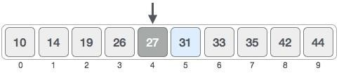
How Binary Search Works (Cont...)
First, we shall determine half of the array by using this formula −
mid = low + (high - low) / 2
Here it is, 0 + (9 - 0 ) / 2 = 4 (integer value of 4.5). So, 4 is the mid of the array.

Slide 13

How Binary Search Works (Cont...)
Now we compare the value stored at location 4, with the value being searched,
i.e. 31.
We find that the value at location 4 is 27, which is not a match.
As the value is greater than 27 and we have a sorted array, so we also know that the target value must be in the upper portion of the array.

Slide 14
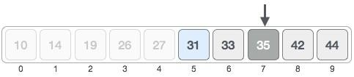
How Binary Search Works (Con...)
We change our low to mid + 1 and find the new mid value again.
low = mid + 1 where mid = low + (high - low) / 2
Our new mid is 7 now. We compare the value stored at location 7 with our target
value 31.

Slide 15

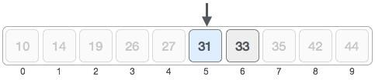
How Binary Search Works (Con...)
The value stored at location 7 is not a match, rather it is more than what we are looking for. So, the value must be in the lower part from this location.
Hence, we calculate the mid again. This time it is 5.

Slide 16

How Binary Search Works (Con...)
We compare the value stored at location 5 with our target value. We find that it is a match.
We conclude that the target value 31 is stored at location 5.
Binary search halves the searchable items and thus reduces the count of comparisons to be made to very less numbers.

Slide 17
Binary Search
Advantage
Much more efficient than linear Search (for array of N elements, performs at most log2N comparisons)
Disadvantage
Requires that array elements be sorted
14

Slide 18
How Fast is a Binary Search?
Worst case: 11 items in the list took 4 tries
How about the worst case for a list with 32 items ?
1st try - list has 16 items
2nd try - list has 8 items
3rd try - list has 4 items
4th try - list has 2 items
5th try - list has 1 item
14

Slide 19
Runtime Examples
N | Linear Search | Binary Search
1 thousand | 1,000 | 10
1 million | 1,000,000 | 20
1 billion | 1,000,000,000 | 30
15

Slide 20
Efficiency of Binary Search
The binary search algorithm is extremely fast compared to an algorithm that tries all
array elements in order
About half the array is eliminated from consideration right at the start
Then a quarter of the array, then an eighth of the array, and so forth
1

Slide 21
Summery & Students Evaluation
What is Linear Search?
How to use Linear search?
When to use Linear Search?
When and how to use Binary Search?

Slide 22











Any Questions?

Slide 23
Next Topic
Sorting
26

