Slide 1



Course:Data Structure and Algorithms
Kabul University
Faculty of Computer Science SE Department
Sorting
Lesson 5
Semester: 4th
Lecture: M. Salim Hamdard
Instructor : Ziaur Rahman
Computer Science Faculty
Prepared by: M. Salim Hamdard
JAHAN UNIVERSITY
year: 1402

Slide 2
Contents
Understanding Sorting Techniques
Understanding Selection Sort
Working With Bubble Sort
Working With Insertion Sort

Slide 3
Objectives
To Understand and use Sorting Techniques in programming.
To be able to use Selection Sort in programming.
To be able to use Working With Bubble Sort.
To be able Working With Insertion Sort.

Slide 4
Sorting Techniques
Sorting refers to arranging data in a particular format.
Sorting algorithm specifies the way to arrange data in a particular order.
Most common orders are in numerical or lexicographical order.
The importance of sorting lies in the fact that data searching can be optimized to a very high level, if data is stored in a sorted manner.
Sorting is also used to represent data in more readable formats.

Slide 5
Sorting Techniques
Following are some of the examples of sorting in real-life scenarios −
Telephone Directory − The telephone directory stores the telephone numbers of people sorted by their names, so that the names can be searched easily.
Dictionary − The dictionary stores words in an alphabetical order so that
searching of any word becomes easy.

Slide 6
Sorting Techniques
Selection sort
Insertion sort
Bubble sort
Merge sort
Quick sort

Slide 7
Selection Sort
Selection sort is a simple sorting algorithm. It works as its name as it is.
Here are basic steps of selection sort algorithm:
Find the minimum element in the list
Swap it with the element in the first position of the list
Repeat the steps above for all remainder elements of the list starting at the second position.
It is called selection sort because it repeatedly selects the next-smallest element and swaps it into the right place.

Slide 8


How Selection Sort Works?
Consider the following depicted array as an example.
For the first position in the sorted list, the whole list is scanned sequentially.
The first position where 14 is stored presently, we search the whole list and find that 10 is the lowest value.

Slide 9


How Selection Sort Works? (Cont.)
So, we replace 14 with 10. After one iteration 10, which happens to be the minimum value in the list, appears in the first position of the sorted list.
For the second position, where 33 is residing, we start scanning the rest of the list in a linear manner.

Slide 10


How Selection Sort Works? (Cont.)
We find that 14 is the second lowest value in the list and it should appear at the
second place. We swap these values.
After two iterations, two least values are positioned at the beginning in a sorted
manner.

Slide 11
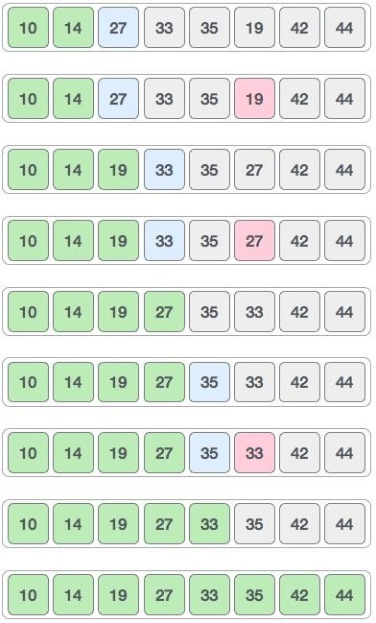
How Selection Sort Works? (Cont.)
The same process is applied to the rest of the items in the array.
Following is a pictorial depiction of the entire sorting process −
8

Slide 12
Selection Sort Program
Step 1 − Set MIN to location 0
Step 2 − Search the minimum element in the list
Step 3 − Swap with value at location MIN
Step 4 − Increment MIN to point to next element
Step 5 − Repeat until list is sorted

Slide 13
Insertion Sort
This is an in-place comparison-based sorting algorithm. Here, a sub-list is maintained which is always sorted. For example, the lower part of an array is maintained to be sorted. An element which is to be 'insert'ed in this sorted sub-list, has to find its appropriate place and then it has to be inserted there. Hence the name, insertion sort.
The array is searched sequentially and unsorted items are moved and inserted into the sorted sub-list (in the same array). This algorithm is not suitable for large data sets as its average and worst-case complexity are of Ο(n²), where n is the number of items.

Slide 14

How Insertion Sort Works?
We take an unsorted array for our example.
Insertion sort compares the first two elements.

Slide 15


How Insertion Sort Works? (Cont.)
It finds that both 14 and 33 are already in ascending order. For now, 14 is in sorted sub-list.
Insertion sort moves ahead and compares 33 with 27.

Slide 16


How Insertion Sort Works? (Cont.)
And finds that 33 is not in the correct position.
It swaps 33 with 27. It also checks with all the elements of sorted sub-list.
Here we see that the sorted sub-list has only one element 14, and 27 is greater than 14.
Hence, the sorted sub-list remains sorted after swapping.

Slide 17


How Insertion Sort Works? (Cont.)
By now we have 14 and 27 in the sorted sub-list. Next, it compares 33 with 10.
These values are not in a sorted order.

Slide 18


How Insertion Sort Works? (Cont.)
So we swap them.
However, swapping makes 27 and 10 unsorted.

Slide 19


How Insertion Sort Works? (Cont.)
Hence, we swap them too.
Again we find 14 and 10 in an unsorted order.

Slide 20

How Insertion Sort Works? (Cont.)
We swap them again. By the end of third iteration, we have a sorted sub-list of 4 items.
This process goes on until all the unsorted values are covered in a sorted
sub-list.

Slide 21
Insertion Sort Algorithm
Now we have a bigger picture of how this sorting technique works, so we can derive simple steps by which we can achieve insertion sort
Step 1 − If it is the first element, it is already sorted. return 1;
Step 2 − Pick next element
Step 3 − Compare with all elements in the sorted sub-list
Step 4 − Shift all the elements in the sorted sub-list that is greater than the value to be sorted
Step 5 − Insert the value
Step 6 − Repeat until list is sorted

Slide 22
Bubble Sort
Bubble sort is a simple sorting algorithm. This sorting algorithm is comparison- based algorithm in which each pair of adjacent elements is compared and the elements are swapped if they are not in order.
This algorithm is not suitable for large data sets as its average and worst case
complexity are of Ο(n²) where n is the number of items.

Slide 23


How Bubble Sort Works?
We take an unsorted array for our example. Bubble sort takes Ο(n²) time so
we're keeping it short and precise.
Bubble sort starts with very first two elements, comparing them to check
which one is greater.

Slide 24


How Bubble Sort Works? (Cont.)
In this case, value 33 is greater than 14, so it is already in sorted locations.
Next, we compare 33 with 27.
We find that 27 is smaller than 33 and these two values must be
swapped.

Slide 25


How Bubble Sort Works? (Cont.)
The new array should look like this −
Next we compare 33 and 35. We find that both are in already sorted positions.

Slide 26


How Bubble Sort Works? (Cont.)
Then we move to the next two values, 35 and 10.
We know then that 10 is smaller 35. Hence they are not sorted.

Slide 27


How Bubble Sort Works? (Cont.)
We swap these values. We find that we have reached the end of the array.
After one iteration, the array should look like this −
To be accurate, we are now showing how an array should look like after each iteration. After the second iteration, it should look like this −

Slide 28


How Bubble Sort Works? (Cont.)
Notice that after each iteration, at least one value moves at the end.
And when there's no swap required, bubble sorts learns that an array is completely sorted.

Slide 29
Bubble Sort Algorithm
Each two adjacent elements are compared
Swap with lighter elements
Move forward and swap with each lighter item
If there is a heavier element, then this item begins to bubble to the surface
Finally, the Heaviest Element is on its place

Slide 30
Summery & Students Evaluation
What is Sorting Techniques?
When to use sorting?
Understanding Selection Sort
Working With Bubble Sort
Working With Insertion Sort

Slide 31











Any Questions?

Slide 32
Next Topic
Sorting
33

