Slide 1



Course:Data Structure and Algorithms
Kabul University
Faculty of Computer Science SE Department
Sorting
Lesson 6
Semester: 4th
Lecturer: M. Salim Hamdard
Instructor : Ziaur Rahman
Prepared by: M. Salim Hamdard
year: 1402

Slide 2
Contents
Understanding Advanced Sorting Techniques
Understanding Merge Sort
Working With Quick Sort

Slide 3
Merge Sort
Merge sort is a sorting technique based on divide and conquer technique. Merge sort first divides the array into equal halves and then combines them in a sorted manner.
Divide and Conquer
If we can break a single big problem into smaller sub-problems, solve the smaller sub-problems and combine their solutions to find the solution for the original big problem, it becomes easier to solve the whole problem.

Slide 4
Divide and Conquer
The concept of Divide and Conquer involves three steps:
Divide the problem into multiple small problems.
Conquer the subproblems by solving them. The idea is to break down the problem into atomic subproblems, where they are actually solved.
Combine the solutions of the subproblems to find the solution of the actual problem.

Slide 5
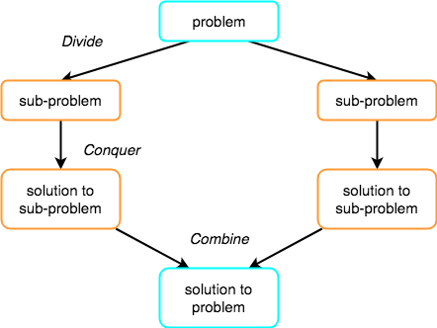
Divide and Conquer

Slide 6


How Merge Sort Works?
To understand merge sort, we take an unsorted array as the following −
We know that merge sort first divides the whole array iteratively into equal halves unless the atomic values are achieved.
We see here that an array of 8 items is divided into two arrays of size 4.

Slide 7

How Merge Sort Works? (Cont.)
This does not change the sequence of appearance of items in the original. Now we divide these two arrays into halves.
We further divide these arrays and we achieve atomic value which can no
more be divided.

Slide 8

How Merge Sort Works? (Cont.)
Now, we combine them in exactly the same manner as they were broken down. Please note the color codes given to these lists.
We first compare the element for each list and then combine them into another list in a sorted manner. We see that 14 and 33 are in sorted positions. We compare 27 and 10 and in the target list of 2 values we put 10 first, followed by 27. We change the order of 19 and 35 whereas 42 and 44 are placed sequentially.

Slide 9

How Merge Sort Works? (Cont.)
In the next iteration of the combining phase, we compare lists of two data values, and merge them into a list of found data values placing all in a sorted order.

Slide 10

How Merge Sort Works? (Cont.)
After the final merging, the list should look like this −

Slide 11
Merge Sort Algorithm
Merge sort keeps on dividing the list into equal halves until it can no more be divided. By definition, if it is only one element in the list, it is sorted. Then, merge sort combines the smaller sorted lists keeping the new list sorted too.
Step 1 − if it is only one element in the list it is already sorted, return.
Step 2 − divide the list recursively into two halves until it can no more be divided.
Step 3 − merge the smaller lists into new list in sorted order.

Slide 12
Quick Sort
Quick sort is a highly efficient sorting algorithm and is based on partitioning of array of data into smaller arrays.
A large array is partitioned into two arrays one of which holds values smaller than the specified value, say pivot, based on which the partition is made and another array holds values greater than the pivot value.
Quick sort partitions an array and then calls itself recursively twice to sort the two resulting subarrays.
This algorithm is quite efficient for large-sized data sets.

Slide 13
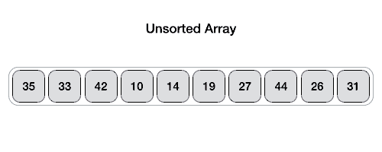
Partition in Quick Sort
Following animated representation explains how to find the pivot value in an array.
The pivot value divides the list into two parts. And recursively, we find the pivot for each sub-lists until all lists contains only one element.

Slide 14
Quick Sort Algorithm
Using pivot algorithm recursively, we end up with smaller possible partitions. Each partition is then processed for quick sort. We define recursive algorithm for quicksort as follows −
Step 1 − Make the right-most index value pivot Step 2 − partition the array using pivot value Step 3 − quicksort left partition recursively Step 4 − quicksort right partition recursively

Slide 15
Summery & Students Evaluation
Understanding Advanced Sorting Techniques
Understanding Merge Sort
Working With Quick Sort

Slide 16











Any Questions?

Slide 17
Next Topic
Stack
31

