Slide 1
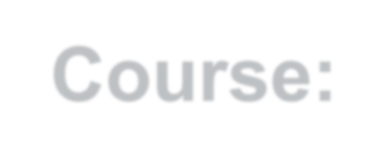
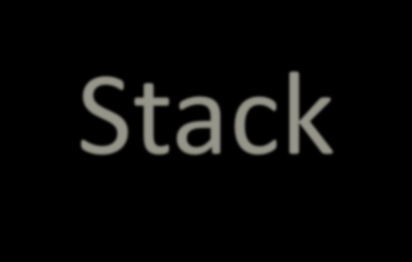

Course:Data Structure and Algorithms
Kabul University
Faculty of Computer Science SE Department
Stack
Lesson 8
Semester: 4th
Lecturer: M. Salim Hamdard
Instructor : Ziaur Rahman
Prepared by: M. Salim Hamdard
year: 1402

Slide 2
Contents
Introduction to Stack
Stack applications
Push algorithm and its implementation

Slide 3
Objectives
To be able to define Stack
To be able to use Stack in programming.
To know about Push algorithm and its implementation

Slide 4
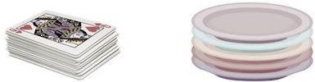
STACK
A stack is an Abstract Data Type (ADT)
A stack is an ordered collection of same data type items that follows the
LIFO (Last In First Out) principle.
The addition of new items or the removal of existing items takes place at the same end.
The end of the stack is known as the top and the opposite is known as the bottom. The newest elements are near the top, and the oldest elements are near the base.

Slide 5
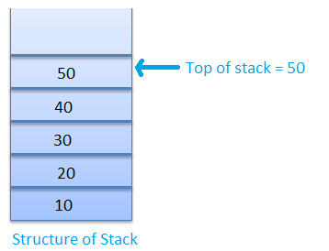
STACK
A stack can be implemented by means of Array, Pointer, and Linked
List.
Stack can either be a fixed size (Array implementation) or it may have
dynamic resizing (Link list implementation).
Here, we are going to implement stack using arrays, which makes it a fixed size stack implementation.

Slide 6
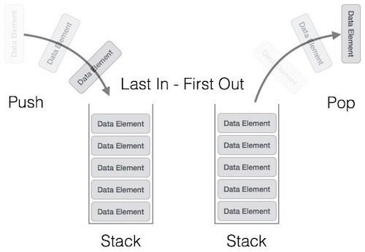
STACK Representation
The following diagram depicts a stack and its operations -

Slide 7
Applications of Stack
The simplest application of a stack is to reverse a word. You push a given word to stack - letter by letter - and then pop letters from the stack.
There are other uses also like:
Parsing
Expression Conversion(Infix to Postfix, Postfix to Prefix etc)

Slide 8
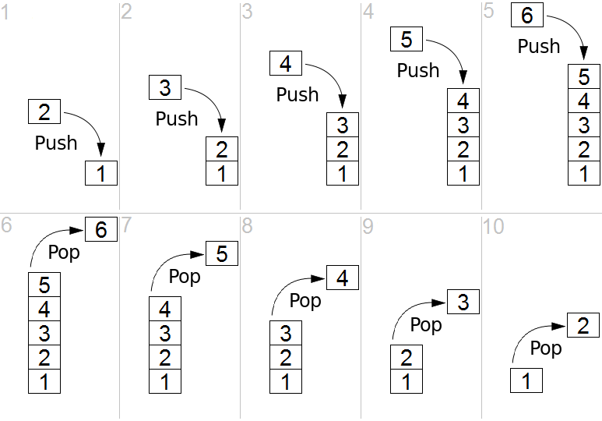
STACK-Operations
Push operation adds an element at the top
Pop operation removes an element from the top

Slide 9
Algorithm for PUSH Operation
The process of putting a new data element onto stack is known as a Push Operation. Push operation involves a series of steps −
Step 1 − Check if the stack is full or not.
Step 2 − If the stack is full, then produces an error and exit the program.
Step 3 − If the stack is not full, then increment the top and add the element.

Slide 10
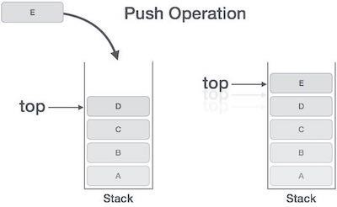
Push-Operations

Slide 11
Summery & Students Evaluation
Introduction to Stack
Stack applications
Push algorithm and its implementation

Slide 12
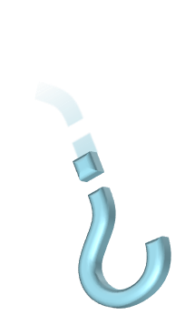

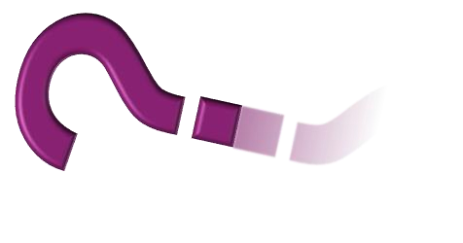


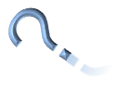


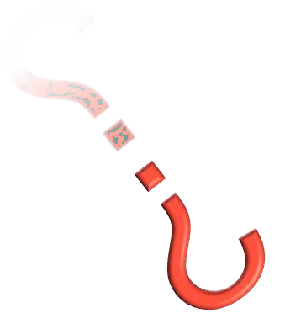


Any Questions?

Slide 13
Next Topic
Stack (continue)
15

