Slide 1
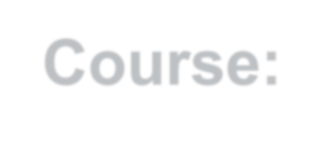






Course:Data Structure and Algorithms
Kabul University
Faculty of Computer Science SE Department
Lesson 8
Semester: 4th
Lecture: M. Salim Hamdard
Instructor : Ziaur Rahman
Prepared by: M. Salim Hamdard
year: 1402

Slide 2
Pop algorithm and its implementation
Midterm Exam: 1.5 credit will be exams & remaining will be the lecture

Slide 3
Contents
POP-Operation
Algorithm for POP Operation
Applications of Stack
Array Implementation of Stack

Slide 4
Objectives
To know about Push algorithm and its implementation
To know POP-Operation.
To be able to use Algorithm for POP Operation
Applications of Stack
Array Implementation of Stack

Slide 5
POP-Operation
Accessing the content while removing it from the stack, is known as a Pop Operation.
In an array implementation of pop() operation, the data element is not actually removed, instead top is decremented to a lower position in the stack to point to the next value.
In linked-list implementation, pop() actually removes data element and de- allocates memory space.
8

Slide 6
Algorithm for POP Operation
A Pop operation may involve the following steps −
Step 1 − Checks if the stack is empty or not.
Step 2 − If the stack is empty, then produces an error and exit the program. Step 3 − If the stack is not empty, then print the data element at the top and decrement the top.
9

Slide 7
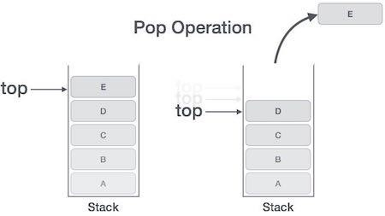
POP-Operation
10

Slide 8
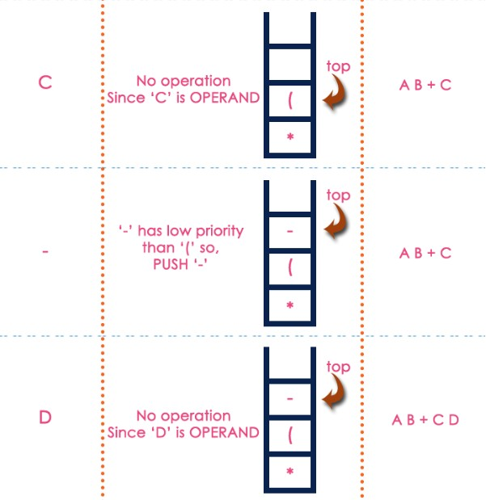
Infix to Postfix Conversion
Example : ( A + B ) * ( C - D )
23

Slide 9
Array Implementation of Stack
Push() operation
int size = 8, stack[8], top = -1; void push (int value) {
if(top >= size-1)
{
cout<<"Stack overflow " <<endl;
}
else
{
top++;
stack[top]=value;
}
}
1

Slide 10
Array Implementation of Stack
Pop() operation
void pop()
{
if (top <= -1)
cout<<"Stack underflow "<<endl;
else
{
cout<<"The Poped element is " <<stack[top] <<endl;
top--;
}
}
1

Slide 11
Array Implementation of Stack
Display()
void display()
{
if(top >= 0)
{
cout<<"Stake elements are: ";
for(int i = top; i >= 0; i--)
cout<<stack[i] <<" "; cout<<endl;
}
else
{
cout<<"Stack is empty" <<endl;
}
}
1

Slide 12
Array Implementation of Stack
main()
int main()
{
int ch, val;
cout<<" 1 : Push in Stack " <<endl; cout<<" 2 : Pop from stack " <<endl; cout<<" 3 : Display stack " <<endl <<endl;
do {
cout<<"Enter Your choice " <<endl; cin>>ch;
1

Slide 13
Array Implementation of Stack
main()
switch (ch)
{
case 1:
{
cout<<"Enter value to be pushed : "<<endl;
cin>>val; push(val); break;
}
case 2:
{
pop(); break;
}
case 3:
{
1

Slide 14
Summery & Students Evaluation
What are POP-Operation?
What is Algorithm for POP Operation?
What are Applications of Stack?
How Array Implementation of Stack can be coded?

Slide 15











Any Questions?

Slide 16




Mid Term Exam

