Slide 1



Course:Data Structure and Algorithms
Kabul University
Faculty of Computer Science SE Department
Linked List
Lesson 11
Semester: 4th
Lecture: M. Salim Hamdard
Instructor : Ziaur Rahman
Computer Science Faculty
Prepare by: M. Salim Hamdard
year: 1402
JAHAN UNIVERSITY

Slide 2
Contents
Doubly Linked List
Double Linked List Representation
Basic Operations
Advantage of Link List
Points to Remember

Slide 3
Objectives
To know Doubly Linked List.
To be able to explain Double Linked List Representation
To be able to work with Basic Operations
To know Advantage of Link List

Slide 4
Doubly Linked List
In doubly linked list, each node contains a data part and two addresses, one for the pervious node and one for the next node.
Data − Contains data/values to be stored.
Next − Contains a link to the next node called Next.
Prev − Contains a link to the previous node called Prev.
NODE
Prev | Data | Next

Slide 5
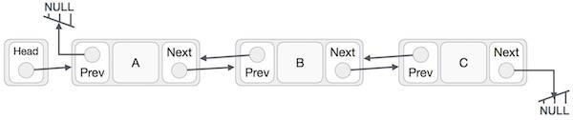
Double Linked List Representation

Slide 6
Basic Operations
Following are the basic operations supported by a list.
Insertion − Adds an element at the beginning of the list.
Deletion − Deletes an element at the beginning of the list.
Insert Last − Adds an element at the end of the list.
Delete Last − Deletes an element from the end of the list.
Insert After − Adds an element after an item of the list.
Delete − Deletes an element from the list using the key.
Display forward − Displays the complete list in a forward manner.
Display backward − Displays the complete list in a backward manner.

Slide 7
Inserting a new element at any position:
Inserting a new item in the doubly linked list is very similar to the single linked list.
In the single linked list we only control one pointer (next)
In the doubly linked list we have to control both next and previous pointers.

Slide 8
Inserting a new element at first position:
If the list is empty, we simply need to point head and tail to the new node.
If not, the current node is the reference to the first element of the list.
Set new node next pointer to current node and head will point to the new node (it will be the first element of the list).
The current node prev pointer will be pointing to the new element instead of null. And the new node prev pointer is already null

Slide 9
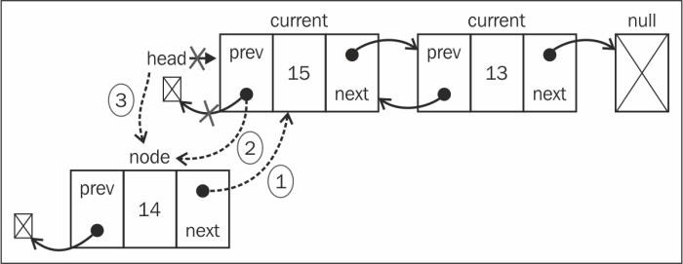
Inserting a new element at first position:

Slide 10
Inserting a new element at last position:
The Current variable references the last element in the list.
New Node prev pointer will reference Current Node.
The Current node next pointer will point to New Node.
New Node next pointer will be pointing to null.
Then, there is only one thing left to be done, which is updating tail, which will point to node instead of current.

Slide 11
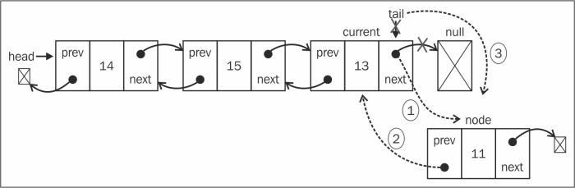
Double Link List
Inserting a new element at last position:

Slide 12
Inserting a new element at middle position:
Iterate the list until we get to the desired position.
We will be inserting the new element between the current and previous elements.
First, new node next pointer will point to current and previous next will point to
new node, so that we do not lose the link between the nodes.
Then, current prev pointer will point to new node and new node prev will point to previous.

Slide 13
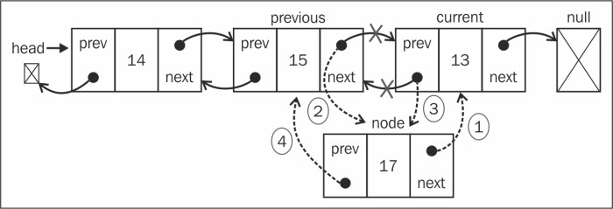
Double Link List
Inserting a new element in the middle position:

Slide 14
Removing an Element from the Begining
The current variable is a reference to the first element of the list, the one we want to remove.
Change reference of head to current.next.previous
Update the current.next previous pointer to null(as the first element prev pointer is a reference to null).
As we also need to control the tail reference, we can check whether the element we are trying to remove is the first one and if positive, all we need to do is set tail to null as well

Slide 15
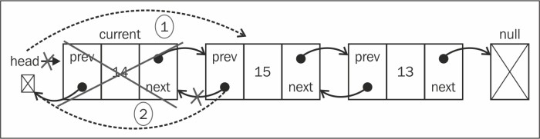
Removing an Element from the Begining
Current.next

Slide 16
Removing an Element from the last position
As we have the reference to the last element already (tail), we do not need to iterate the list to get to it.
So, we can assign the tail reference to the current variable as well.
Next, we need to update the tail reference to the second-last element of the
list .
And now that tail is pointing to the second-last element, all we need to do is
update the next pointer to null.

Slide 17
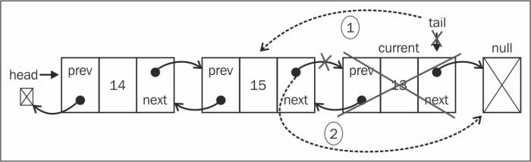
Removing an Element from the last position

Slide 18
Removing an Element from the middle position
First, we need to iterate until we get to the desired position.
The element we want to remove would be referenced by the current variable.
So, to remove it, we can skip it in the list by updating the references of
previous.next and current.next.prev.
So, previous.next will point to current.next and current.next.prev will point to
previous

Slide 19
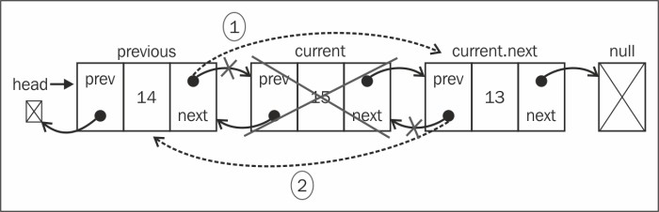
Removing an Element from the middle position

Slide 20
Advantage of Link List
They are a dynamic in nature which allocates the memory when required.
Insertion and deletion operation ca be easily implemented.
Stacks and queues can be easily executed.
Linked List reduces the access time.

Slide 21
Disadvantage of Link List
The memory is wasted as pointers require extra memory for storage.
No element can be accessed randomly; it has to access each node sequentially.
Reverse traversing is difficult in linked list.

Slide 22
Application of Link List
Linked lists are used to implement stacks, queues, graphs, etc.
Linked lists let you insert element at beginning and end of the list.
In Linked List we don’t need to know the size in advance.

Slide 23
Summery & Students Evaluation
What is Doubly Linked List?
How Double Linked List Represented?
What are Basic Operations of list?
What are Advantage of Link List?
What main Points related to list?

Slide 24











Any Questions?

Slide 25
Next Topic
Hash Table
33

