Slide 1



Course:Data Structure and Algorithms
Kabul University
Faculty of Computer Science SE Department
Trees
Lesson 13
Semester: 4th
Lecturer: M. Salim Hamdard
Instructor : Ziaur Rahman
Prepared by: M. Salim Hamdard
year: 1402

Slide 2
Table of Contents
Introduction to Tree
Binary Tree and Its Types
Binary Search Tree
General Tree

Slide 3
Objectives
To be able to introduce Trees in programming.
To know Binary Tree and Its Types
To be able to use Binary Search Tree
To be able to use General Tree.

Slide 4
Tree
Tree is a non-linear data structure which organizes data in hierarchical structure.
In tree data structure, every individual element is called as Node.
Node in a tree data structure, stores the actual data of that particular element
and link to next element in hierarchical structure.
A
B C D E
F G H
I J K
L M
N

Slide 5
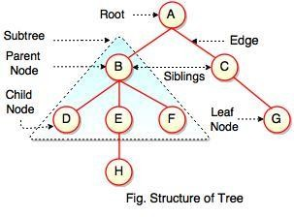
Tree

Slide 6
Tree Terminology
The basic terminologies related to tree are as follows:
Root
Edge
Parent
Child
Siblings
Leaf
Degree
Level
Height
Depth
Path
Subtree

Slide 7
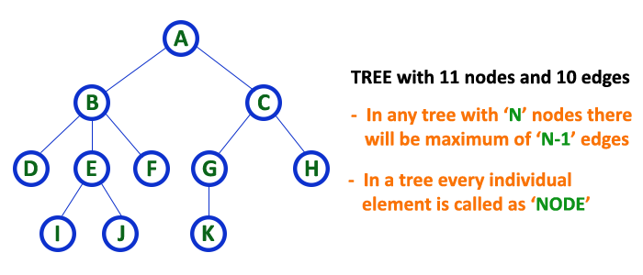
Tree

Slide 8
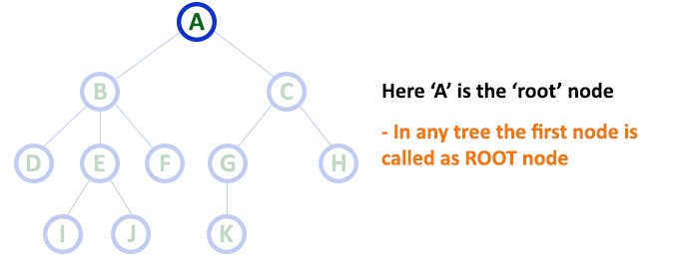
Root
In a tree data structure, the first node is called as Root Node. Every tree must have root node. We can say that root node is the origin of tree data structure. In any tree, there must be only one root node. We never have multiple root nodes in a tree.

Slide 9
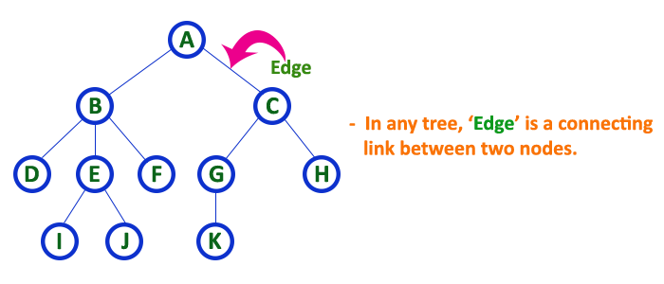
Edge
In a tree data structure, the connecting link between any two nodes is called as EDGE. In a tree with 'N' number of nodes there will be a maximum of 'N-1' number of edges.

Slide 10
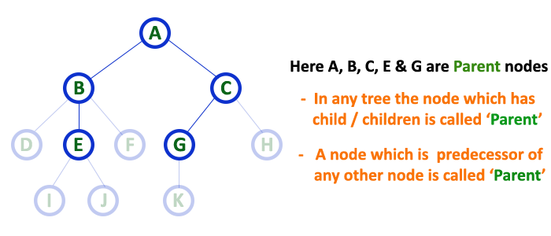
Parent / Internal Node
In a tree data structure, the node which is predecessor of any node is called as PARENT NODE. In simple words, the node which has branch from it to any other node is called as parent node. Parent node can also be defined as "The node which has child / children".

Slide 11
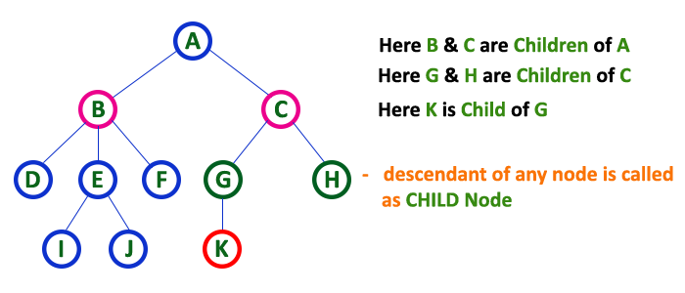
Child
In a tree data structure, the node which is descendant of any node is called as CHILD Node. In simple words, the node which has a link from its parent
node is called as child node. In a tree, any parent node can have any number of child nodes. In a tree, all the nodes except root are child nodes.

Slide 12
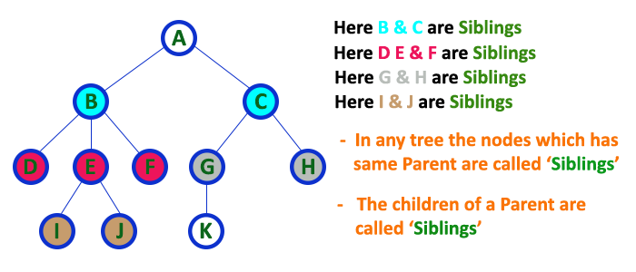
Siblings
In a tree data structure, nodes which belong to same Parent are called
as SIBLINGS. In simple words, the nodes with same parent are called as Sibling nodes.

Slide 13
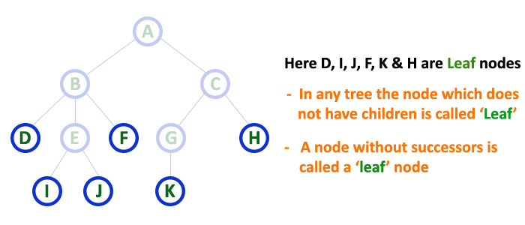
Leaf Node / External Node / Terminal Node
In a tree data structure, the node which does not have a child is called as LEAF Node. In simple words, a leaf is a node with no child.

Slide 14
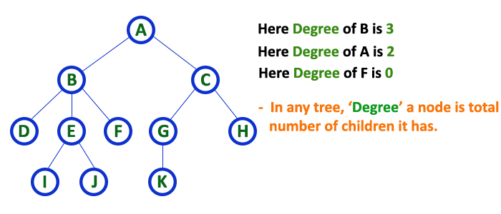
Degree
In a tree data structure, the total number of children of a node is called
as DEGREE of that Node.
The highest degree of a node among all the nodes in a tree is called as 'Degree of Tree‘.

Slide 15
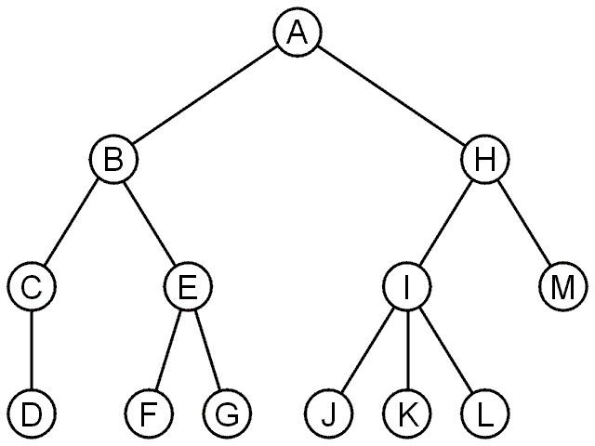
Tree
Degree | Nodes
0 | D, F, G, J, K, L, M
1 | C
2 | B, E, H
3 | I

Slide 16
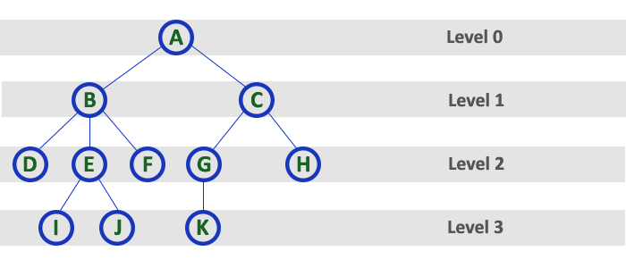
Level
The root node is said to be at Level 0 and the children of root node are at Level 1 and the children of the nodes which are at Level 1 will be at Level 2 and so on...

Slide 17
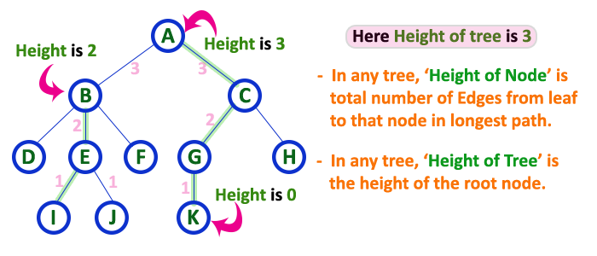
Height
In a tree data structure, the total number of edges from leaf node to a particular node in the longest path is called as HEIGHT of that Node. In a tree, height of the root node is said to be height of the tree. In a tree, height of all leaf nodes is '0'.

Slide 18
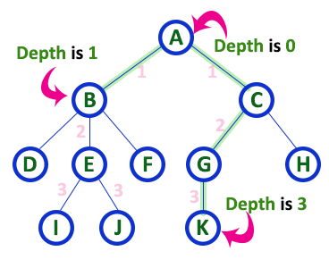
Depth
In a tree data structure, the total number of edges from root node to a particular
node is called as DEPTH of that Node.
In a tree, the total number of edges from root node to a leaf node in the longest path is said to be Depth of the tree.
In simple words, the highest depth of any leaf node in a tree is said to be depth of that tree.
In a tree, depth of the root node is '0'.

Slide 19
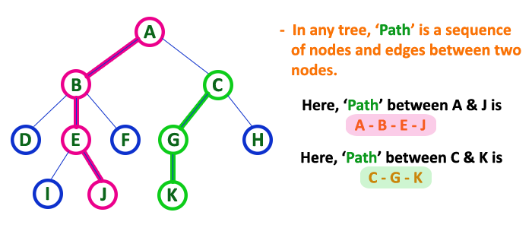
Path
The sequence of Nodes and Edges from one node to another node is called as PATH between that two Nodes.
Length of a Path is total number of nodes in that path. In below example the path A - B - E - J has length 4.

Slide 20
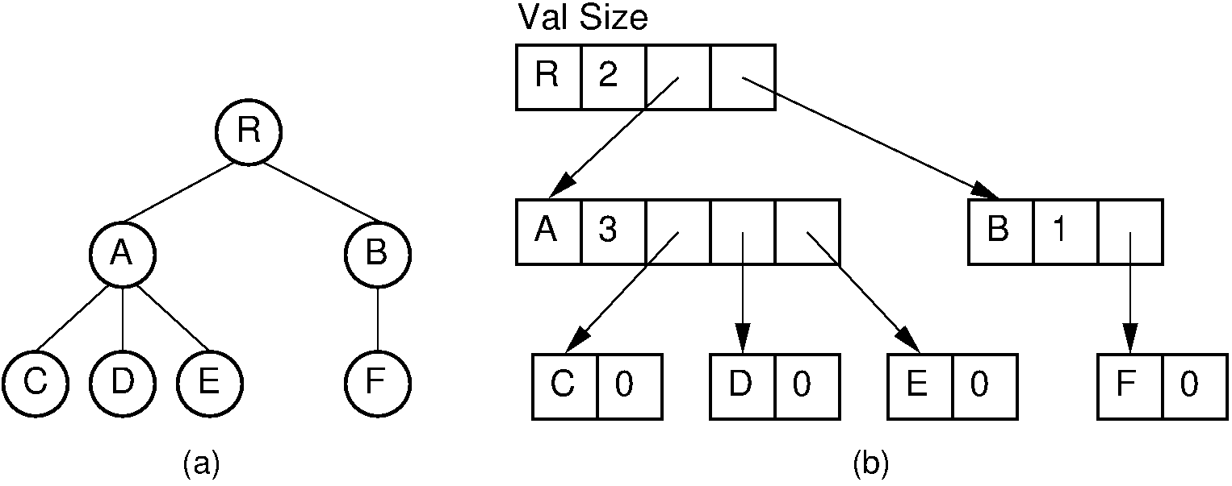
Tree Representation as List
The current number of children for each node is stored explicitly in a size field. The child pointers are stored in an array with size elements.

Slide 21
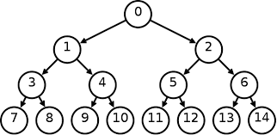
Binary Tree
A tree in which every node can have a maximum of two children is called as Binary Tree. In a binary tree, every node can have either 0 children or 1 child or 2 children but not more than 2 children.

Slide 22
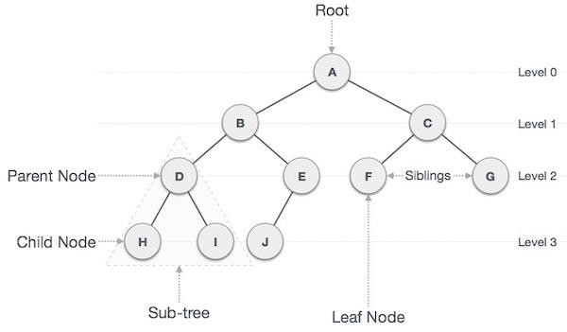
Binary Tree

Slide 23
Types of Binary Tree
There are four types of binary tree:
Full Binary Tree
Complete Binary Tree
Skewed Binary Tree
Extended Binary Tree

Slide 24
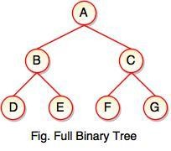
Full Binary Tree
If each node of binary tree has either two children or no child at all, is said to be a Full Binary Tree.
Full binary tree is also called as Strictly Binary Tree.

Slide 25
Complete Binary Tree
A binary tree in which every internal node has exactly two children and all leaf nodes are at same level is called Complete Binary Tree.
Complete binary tree is also called as Perfect Binary Tree
At every level of complete binary tree there must be 2^{level} number of nodes.
For example, at level 2 there must be 2² = 4 nodes and at level 3 there must be 2³ = 8 nodes.

Slide 26
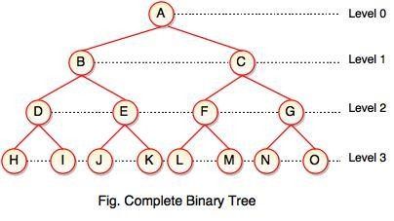
Complete Binary Tree

Slide 27
Skewed Binary Tree
If a tree which is dominated by left child node or right child node, is said to be a Skewed Binary Tree.
In a left skewed tree, most of the nodes have the left child without corresponding right child.
In a right skewed tree, most of the nodes have the right child without
corresponding left child.

Slide 28
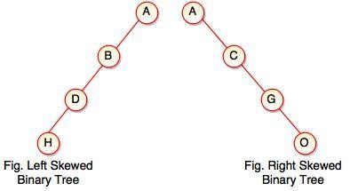
Skewed Binary Tree

Slide 29
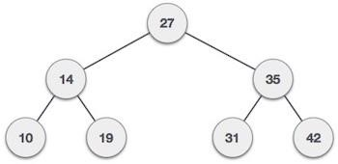
Binary Search Tree
Binary Search Tree is a tree in which nodes are arranged such that all the nodes in a left sub tree having values less then root node and all the nodes in a right sub tree having values greater then root node.
Thus, we can say that Binary Search Tree is an ordered binary tree. Following Figure represents Binary Search Tree:

Slide 30
Binary Search Tree
Binary Search Tree having two characteristics:
All the nodes in a left sub tree having values less then root node.
All the nodes in a right sub tree having values greater then root node.
Because of the above mentioned characteristics Binary Search tree allows faster insertion, deletion and searching facility.

Slide 31
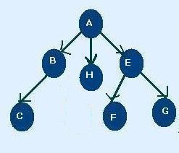
General Tree
A Tree in which each node having either 0 or more child nodes is called general tree.
So we can say that a Binary Tree is a specialized case of General tree.
Consider Following Figure:

Slide 32
Advantages
Trees are so useful and frequently used, because they have some very serious advantages:
Trees reflect structural relationships in the data
Trees are used to represent hierarchies
Trees provide an efficient insertion and searching
Trees are very flexible data, allowing to move subtrees around with minimum effort

Slide 33
Summery & Students Evaluation
Introduction to Tree
Binary Tree and Its Types
Binary Search Tree
General Tree

Slide 34











Any Questions?

Slide 35
Next Topic
AVL Tree
50

