Slide 1

Course:Data Structure and Algorithms
Kabul University
Faculty of Computer Science SE Department
Queue
Lesson 9
Semester: 4th
Lecture: M. Salim Hamdard
Instructor : Ziaur Rahman
Prepared by: M. Salim Hamdard
year: 1402

Slide 2
Contents
Introduction to Queue
Queue Application
Enqueue and Dequeue algorithm and its implementation

Slide 3
Problem to be Solved
It is so often necessary to wait one’s turn before having access to something
We may want to simulate a real life situation of a waiting line, like
A line of people waiting to purchase tickets, where the first person in line is the first
person served
With in a computer system there may be lines of tasks
Waiting for the printer
Waiting for access to disk storage
Or in a time sharing system for use of the CPU
The data structures used to solve this type of problems is called Queue
3

Slide 4
The Queue
Queue is a linear data structure which follows FIFO i.e. First-in-First-Out method.
The insertion and deletion operations are performed at two different ends which is known as Front and Rear.
One end is always used to insert data (enqueue) and the other is used to remove data (dequeue).
Insertion take place at the Rear (tail)and elements are removed from the Front (head).

Slide 5
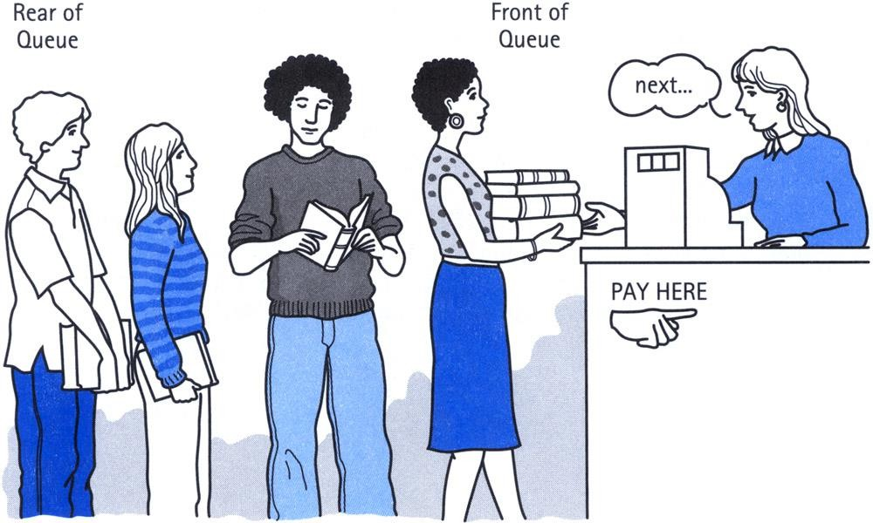

The Queue

Slide 6








The Queue
Assume an initially empty queue and following sequence of insertions and deletions:

Slide 7
Application of Queues
The most common application is in client-server models
Multiple clients may be requesting services from one or more servers.
Some clients may have to wait while the servers are busy.
Those clients are placed in a queue and serviced in the order of arrival.
Grocery stores, banks, and airport security use queues.
Queues are mostly used in operating systems.
Waiting for a particular event to occur.
Scheduling of processes.

Slide 8
Queue Implementation
Queue data structure can be implemented in two ways. They are as follows...
Using Array
Using Linked List
When a queue is implemented using array, that queue can organize only
limited number of elements.
When a queue is implemented using linked list, that queue can organize
unlimited number of elements.

Slide 9
Operations on a Queue
The following operations are performed on a queue data structure...
enqueue(value) - (To insert an element into the queue)
dequeue() - (To delete an element from the queue)
display() - (To display the elements of the queue)

Slide 10
Algorithm for Enqueue Operation
Queues maintain two data pointers, front and rear. Therefore, its operations are comparatively difficult to implement than that of stacks.
The following steps should be taken to enqueue (insert) data into a queue −
Step 1 − Check if the queue is full.
Step 2 − If the queue is full, then produce overflow error and exit program. Step 3 − If the queue is not full, then increment rear and add data element, where the rear is pointing.

Slide 11
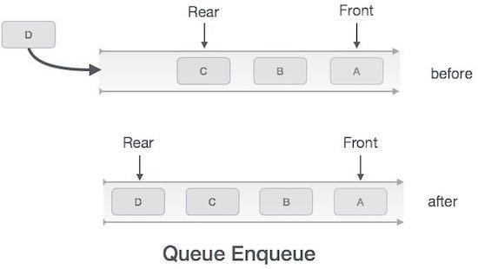
Algorithm Enqueue (item)

Slide 12
Algorithm for Dequeue Operation
Accessing data from the queue is a process of two tasks − access the data
where front is pointing and remove the data after access.
The following steps are taken to perform dequeue operation −
Step 1 − Check if the queue is empty.
Step 2 − If the queue is empty, then produce underflow error and exit program.
Step 3 − If the queue is not empty, then access the data at front and increment the front to the next available data element.

Slide 13
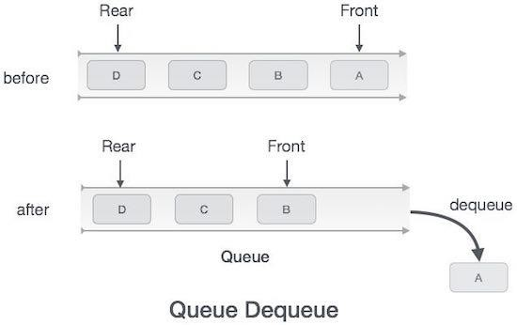
Dequeue Operation

Slide 14
Priority Queue
In normal queue data structure, insertion is performed at the end of the queue and deletion is performed at the front based on the FIFO principle.
This queue implementation may not be suitable for all situations.

Slide 15
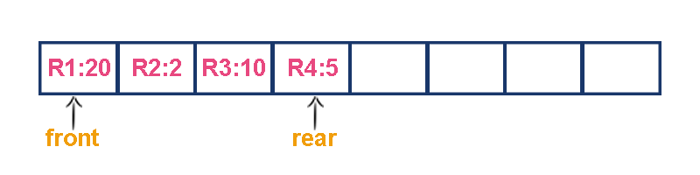
Priority Queue
Consider a networking application where server has to respond for requests
from multiple clients using queue data structure.
Assume four requests arrived to the queue in the order of
R1 requires 20 units of time,
R2 requires 2 units of time,
R3 requires 10 units of time
R4 requires 5 units of time. Queue is as follows...

Slide 16
Priority Queue
Now, check waiting time for each request to be complete.
R1 : 20 units of time R2 : 22 units of time R3 : 32 units of time R4 : 37 units of time
Here, average waiting time for all requests (R1, R2, R3 and R4) is
(20+22+32+37)/4 ≈ 27 units of time.

Slide 17
Priority Queue
If we serve according to their required amount of time.
That means, first we serve R2 which has minimum time required (2)
then serve R4 which has second minimum time required (5)
then serve R3 which has third minimum time required (10)
and finally R1 which has maximum time required (20).

Slide 18
Priority Queue
Now, check waiting time for each request to be complete.
R2 : 2 units of time
R4 : 7 units of time R3 : 17 units of time R1 : 37 units of time
Here, average waiting time for all requests (R1, R2, R3 and R4) is
(2+7+17+37)/4 ≈ 15 units of time.

Slide 19
Priority Queue
From above two situations, it is very clear that, by using second method server can complete all four requests with very less time compared to the first method. This is what exactly done by the priority queue.
A (regular) queue has first-in, first-out (FIFO) behaviour, where items must enter at the rear and leave from the front.
In a priority queue items must leave from the front, but they enter on the basis of a priority (key) value. The queue is kept sorted by this value.

Slide 20
Examples of Priority Queue
CPU process queues
Print queues
Event-driven simulation (traffic flows)
Artificial intelligence search algorithms

Slide 21
Operations on Priority Queues
Create: Create a new PQ of a given maximum size
Add: Add an element to a PQ based on its priority (key)
Remove: Remove and return the element in a PQ with highest priority
Full: Return whether or not the PQ is full
Empty: Return whether or not the PQ is empty

Slide 22
Summary
Introduction to Queue
Queue Application
Enqueue and Dequeue algorithm and its implementation

Slide 23











Any Questions?

