Slide 1


DevChat #1 Intro to Twitter Bootstrap: A Crash Course on Web Development for Noobs
Ahmed Haque
PhD Candidate – Rice Bioengineering
afhaque@rice.edu
Jan 24. 2015 | Duncan 1046

Slide 2
Introduction

Slide 3
Learning is Frustrating
“You can’t tell whether you’re learning something when you’re learning it—in fact, learning feels a lot more like frustration.
What I’ve learned is that during this period of frustration is actually when people improve the most, and their improvements are usually obvious to an outsider. If you feel frustrated while trying to understand new concepts, try to remember that it might not feel like it, but you’re probably rapidly expanding your knowledge.”
Phillip Dickey, Author of Write Modern Web Apps with the MEAN Stack: Mongo, Express, AngularJS, and Node.JS

Slide 4
Agenda
Introduction
A Primer on HTML / CSS
Behold! Bootstrap
Sketching / Grid Layouts
Key Bootstrap Parts
Time to Build!
Translating Sketch into “Rows, Columns, and Containers”
Initializing Project
Building a Navbar
Adding Images
Adding Tables
Adding Forms
Formatting the Look

Slide 5
What to Takeaway!
If you’re a…
Total Beginner to Coding:
Walk away with an understanding of what HTML/CSS is, how it works, and where Bootstrap fits in.
Understanding grid layouts would be good too!
Coded Before, New to Web:
Walk away understanding how to translate a grid layout into HTML/CSS using Bootstrap “rows, columns, and containers ”.
Also, understand how to use the Bootstrap documentation to “pick and place” resources as necessary.
HTML/CSS Fiddler:
Learn tricks to develop more systematically
Gain the confidence to build your own site from scratch!

Slide 6
How to Keep Up!
As we go through this workshop…
Feel encouraged to ask your neighbors for help. It’s the fastest way to get help
If no one around you knows the answer – feel free to stop me and ask!
(We can Google it together ☺)

Slide 7
A Primer on HTML/CSS

Slide 8
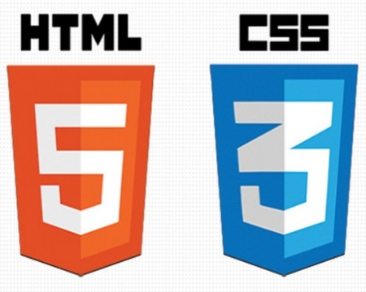

HTML / CSS Definitions (*yawn* unimportant)
HTML: Hypertext Markup Language – (Content)
CSS: Cascading Style Sheets – (Appearance)
HTML/CSS are the “languages of the web”. Together they define both the content and the aesthetics of a webpage – handling everything from the layouts, colors, fonts, and content placement. (Javascript is the third – handling logic, animation, etc.)

Slide 9
Key HTML Tags
Headers:
<h1> </h1> - Header 1 (Largest Header)
<h2> </h2> - Header 2 (Next Largest Header)
<h3> </h3> - Header 3
…
Containers:
<html> </html> - Wraps the entire page
<body> </body> - Wraps the main content
<div> </div> - Logical Container ***
<p> </p> - Wraps individual Paragraphs
Others:
<img> (images), <a href> (links), <li> (list items) , <head> (top content), <script> (javascript), etc…

Slide 10
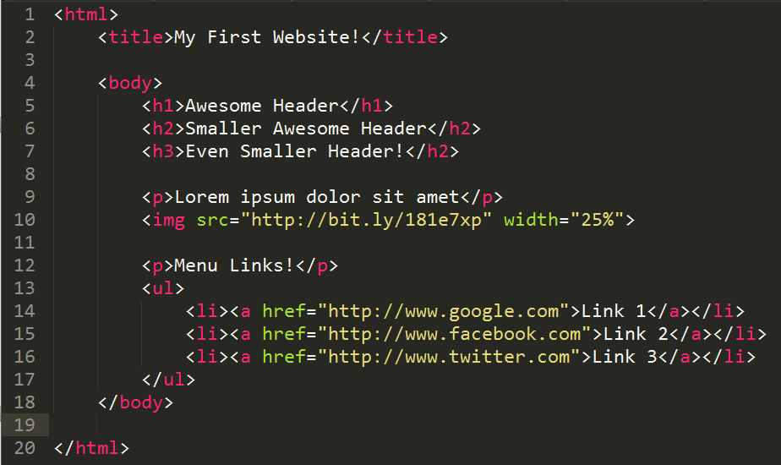
Basic HTML Example
Webpage Title
Headers
Image / Text
Links / List

Slide 11
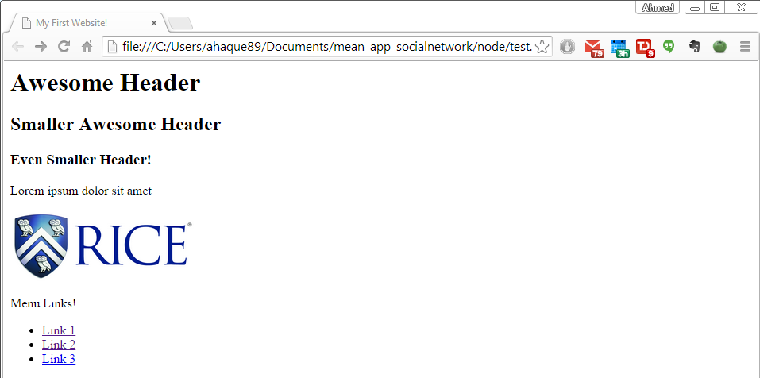
Basic HTML Example

Slide 12
Basic HTML Example
Hella boring.

Slide 13
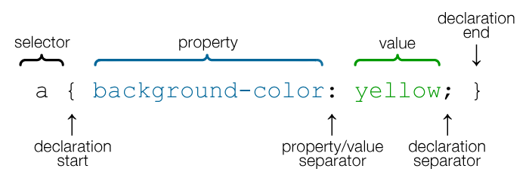
CSS Selectors: “Classes” and “IDs”
CSS works by “hooking” onto selectors added into HTML using “classes and identifiers”.
In order to use classes we simply add “class=className” or “id=IDName” into the HTML tag.
We then create a correlating class style (.className) or id style (#IDName) in the CSS file.

Slide 14
CSS Selector Example
CSS works by “hooking” onto selectors added into HTML. (Like highlighting)
In the below example the “Header” would be turned blue and MUCH larger, because of the CSS.
Example (HTML):
<p class=“bigBlue”>Header</p>
Example (CSS):
.bigBlue
{
font-size: 100px;
color: blue;
}

Slide 15
Key CSS Attributes
Font / Color:
color: Sets color of text
font-size: Sets size of the font
font-style: Sets italics
font-weight: Sets bold
Alignment / Spacing:
margin-top(bottom/left/right): Adds space between element and its own border.
margin-top (bottom/left/right): Adds space between element and surrounding elements.
float: Forces elements to the sides, centers, or tops
Background:
background-color: sets background color
background-image: sets background image

Slide 16
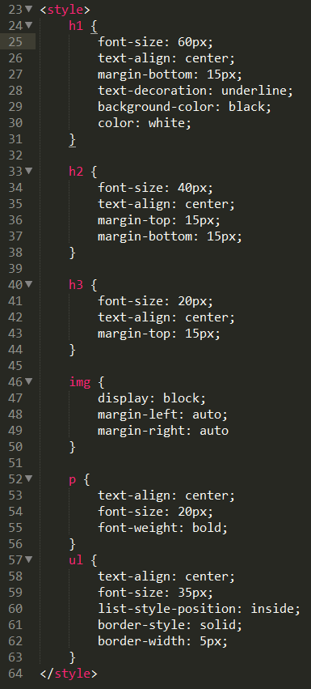
Enter CSS!

Slide 17
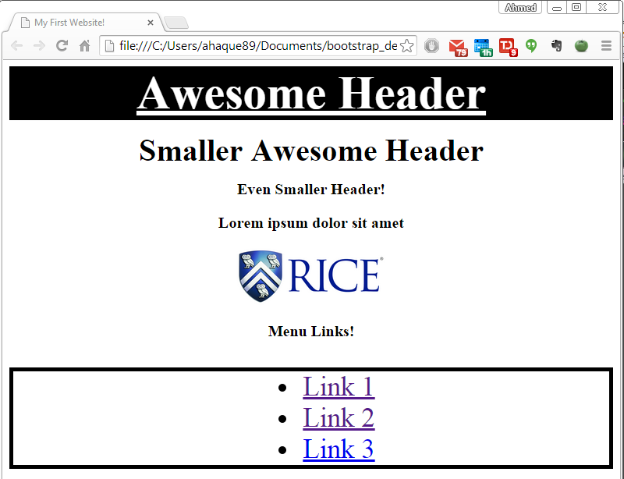
Our basic website after css…

Slide 18
Our basic website after css…
Still boring…
but better!

Slide 19


HTML / CSS Analogy
HTML Alone
Like writing papers in “Notepad”.
Can only write unformatted text.
HTML / CSS
Like writing papers in Microsoft Word.
Can format text, page settings, alignment, etc. based on “highlighting” and menu options.

Slide 20
Powerful Duo
Believe it or not… HTML / CSS is all you need to develop a full-blown rich looking website.

Slide 21
Powerful Duo
Believe it or not… HTML / CSS is all you need to develop a full-blown rich looking website.
But this would totally suck.

Slide 22
Behold! Bootstrap

Slide 23

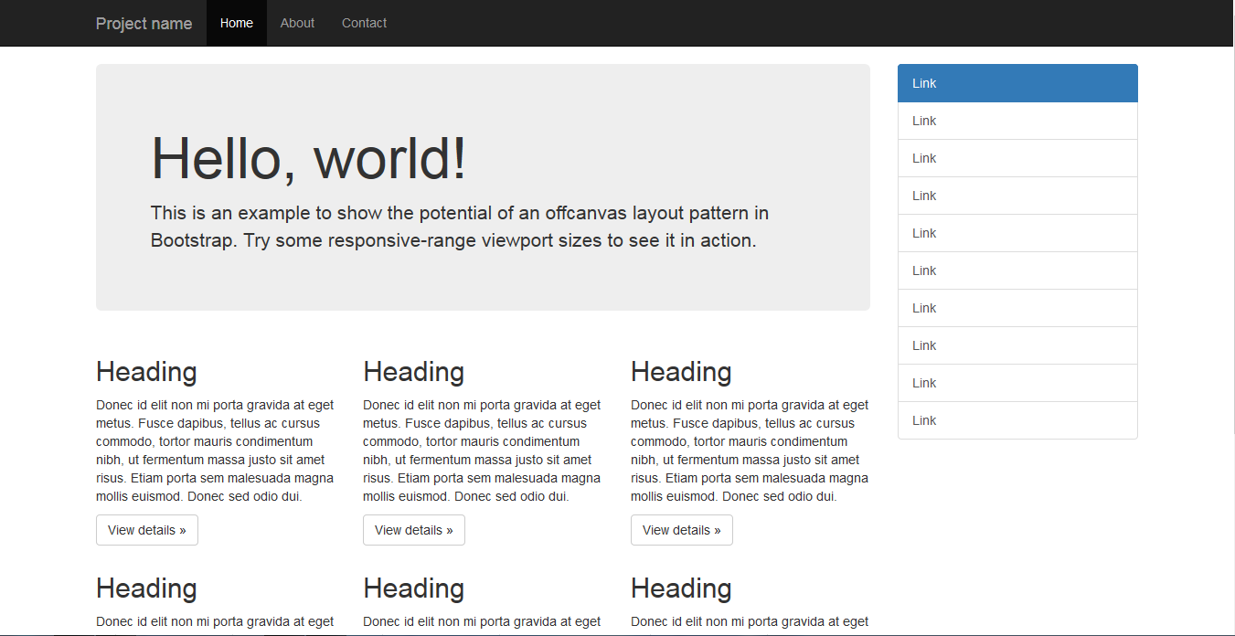
Bootstrap Definition
Twitter Bootstrap is a free collection of tools for creating websites and web applications.
It comes with a pre-built design template for typography, forms, buttons, navigation, UI elements, and javascript.
Documentation here: http://getbootstrap.com/

Slide 24
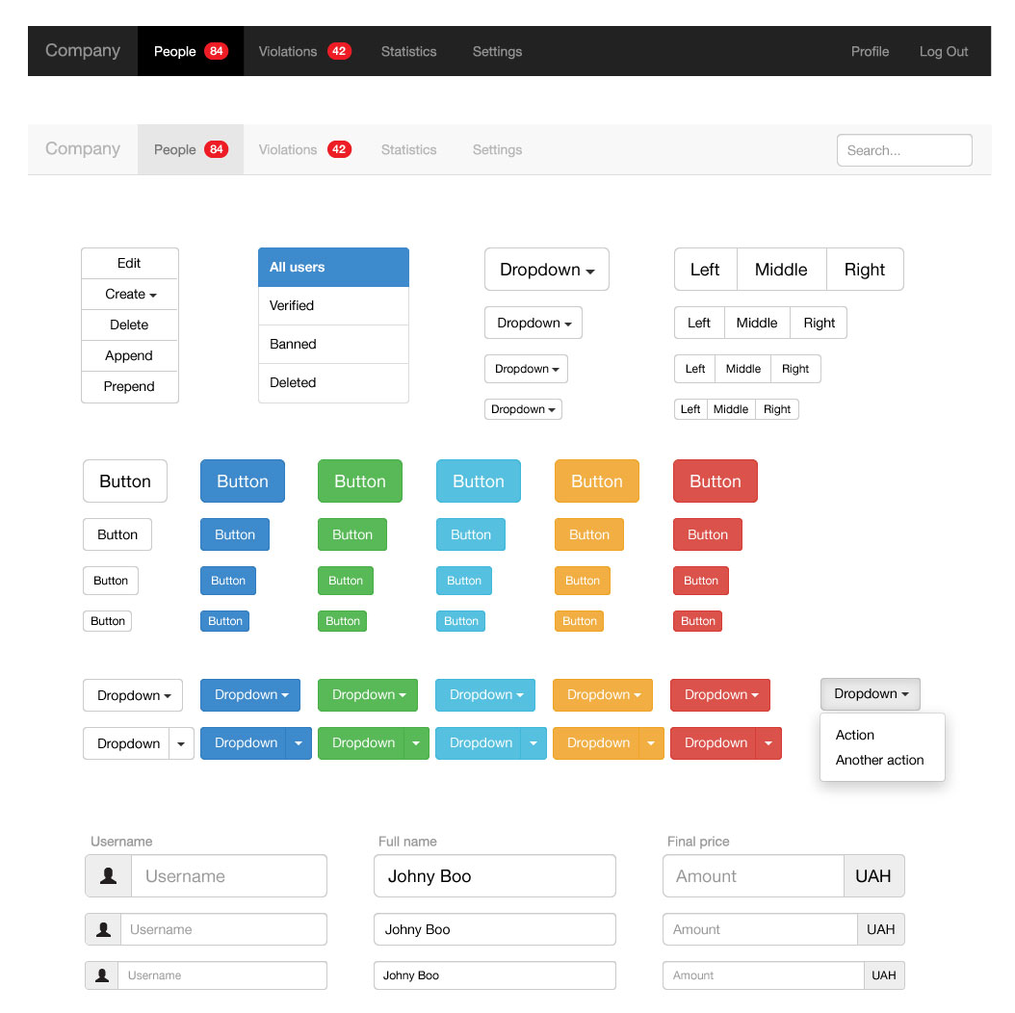
Why Use Bootstrap? (#1)
Reason #1: UI Kit
Familiarize yourself with the UI features it offers via the documentation.
Once Bootstrap is active, you can simply copy snippets from the documentation to save yourself major time of creating elements yourself.

Slide 25
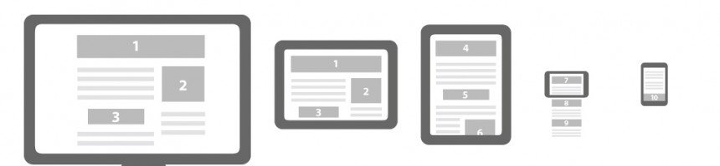
Why Use Bootstrap? (#2)
Reason #2: Mobile Responsiveness
One of the most compelling reasons to use Bootstrap is the default mobile-responsive quality it provides.
This means that your website will look “good” automatically when viewed on screens ranging from monitors to tablets to phones. Visit www.ricedevchats.org for an example.

Slide 26
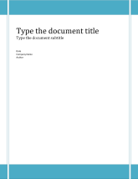
HTML / CSS / Bootstrap Analogy
HTML Alone
Like writing papers in “Notepad”.
Can only write unformatted text.
HTML / CSS
Like writing papers in Microsoft Word.
Can format text, page settings, alignment, etc. based on “highlighting” and menu options.
HTML / CSS & Bootstrap
Like writing papers in Microsoft Word with a prebuilt template.
You can still customize, but now have a pre-built style and aesthetic look.

Slide 27
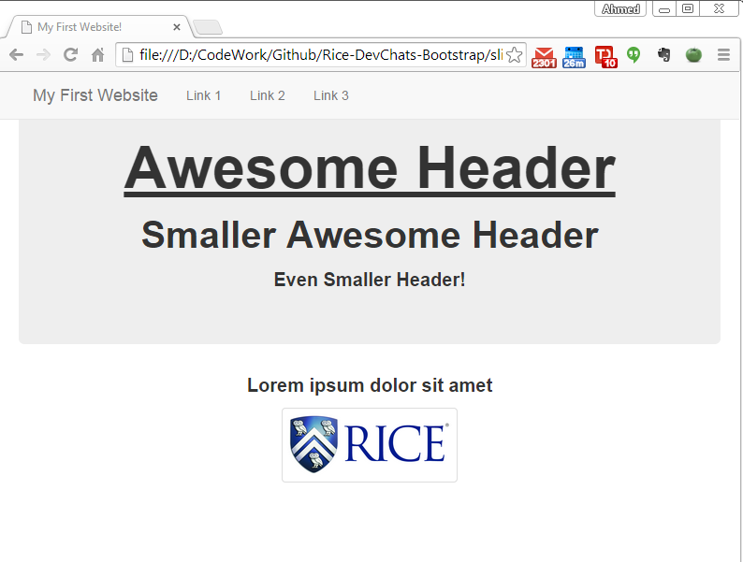
Our basic website with Bootstrap…
Hot
Damn!

Slide 28
Sketching / Grid Layouts

Slide 29
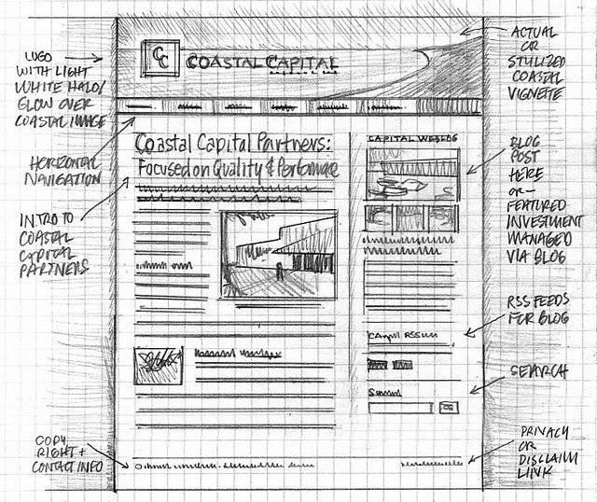
Importance of Sketches
Because every aspect of a site’s “look” is defined by HTML/CSS – it is crucial to have a detailed sketch going in.
Pay particular attention to the location of navigation bars, titles, headers, content, images, footers etc.
When imagining alignments, in particular, be mindful of the grid

Slide 30
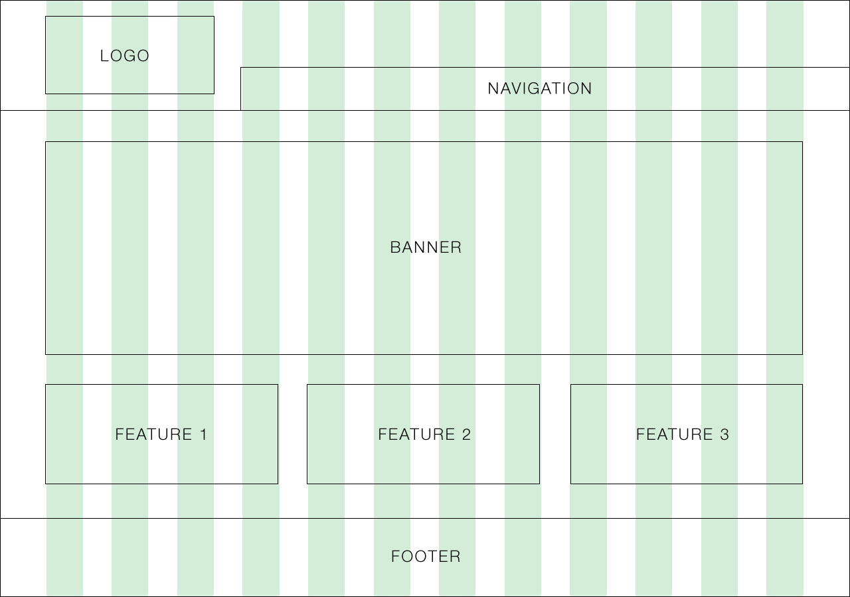
Designing with a Grid in Mind
Grids serve to align elements aesthetically.

Slide 31
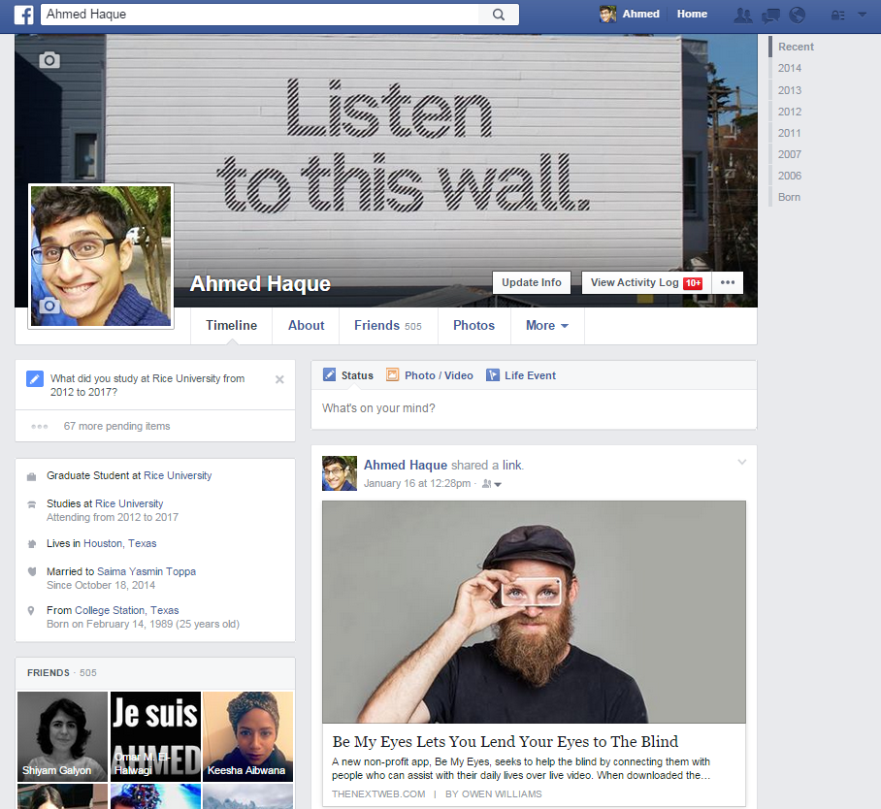
Facebook’s Grid
Facebook is a perfect example of a website where the “grid-layout” is obvious.
Grids make it easy to have content (text, images, and regions) align aesthetically.

Slide 32
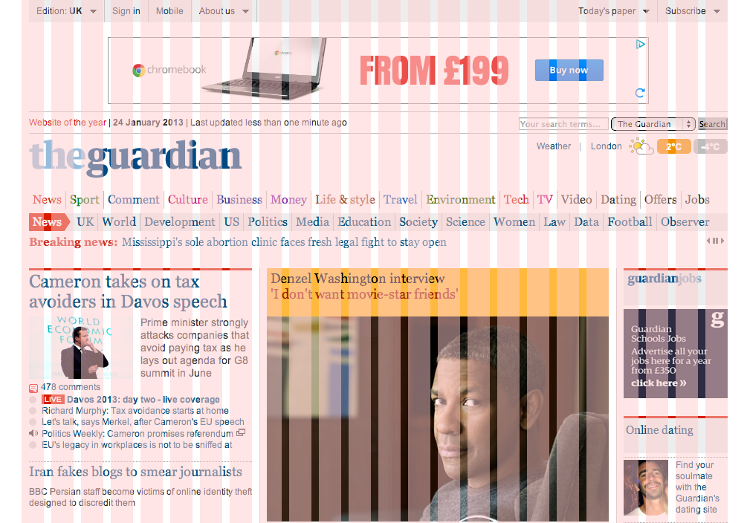
A More Complex Grid…

Slide 33
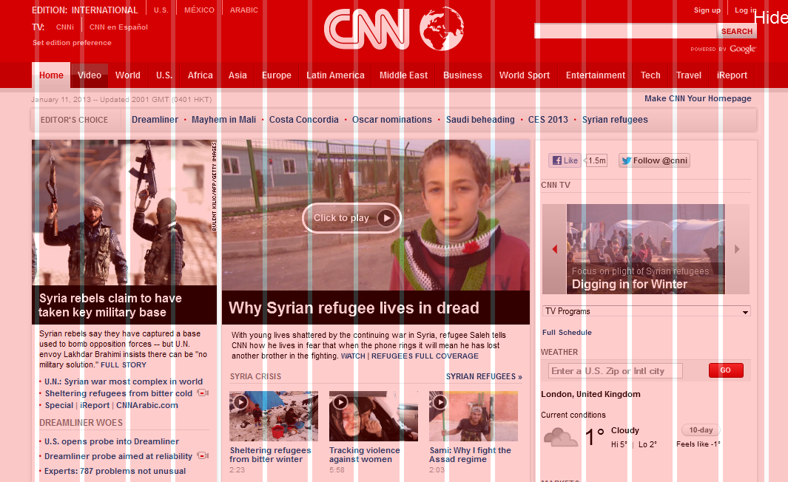
A More Complex Grid…

Slide 34
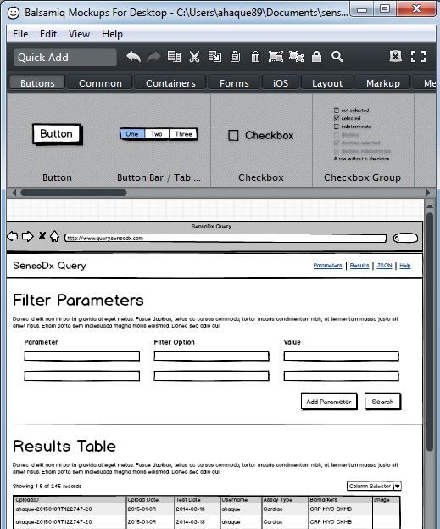
Tools for Sketch / Grid Creation
Wireframing Tools:
Balsamiq***: https://balsamiq.com/
Framebox: http://framebox.org/
Pen and Paper: Your notebook
Grids for Photoshop / Illustrator:
960 GS: http://960.gs/
GuideGuide: http://framebox.org/
Designing with Grids Guides:
960 Grid System Made Easy: http://bit.ly/1sjYaFC
Design by Grid: http://www.designbygrid.com/
Designing with Grid-Based Approach: http://bit.ly/1CM4Hzo

Slide 35
Key Bootstrap Parts

Slide 36
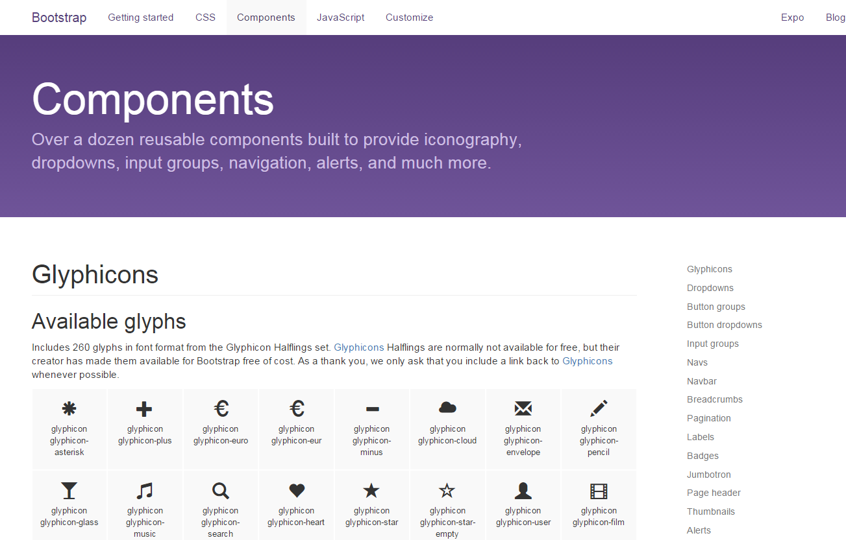
Bootstrap Guide
Bootstrap offers a wide range of components for inclusion in your next web project. Best way to use them is to simply flip through the documentation and incorporate elements as necessary.

Slide 37
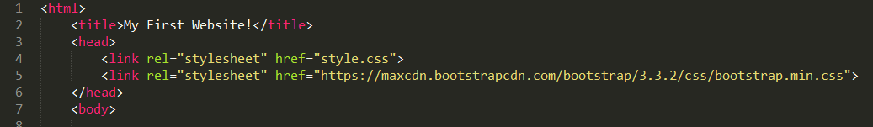
Incorporating Bootstrap
To add Bootstrap styling to your web project simply incorporate the CDN reference in the header section of your HTML.
Example:
<link rel="stylesheet“ href="https://maxcdn.bootstrapcdn.com/bootstrap/3.3.2/css/bootstrap.min.css ">

Slide 38
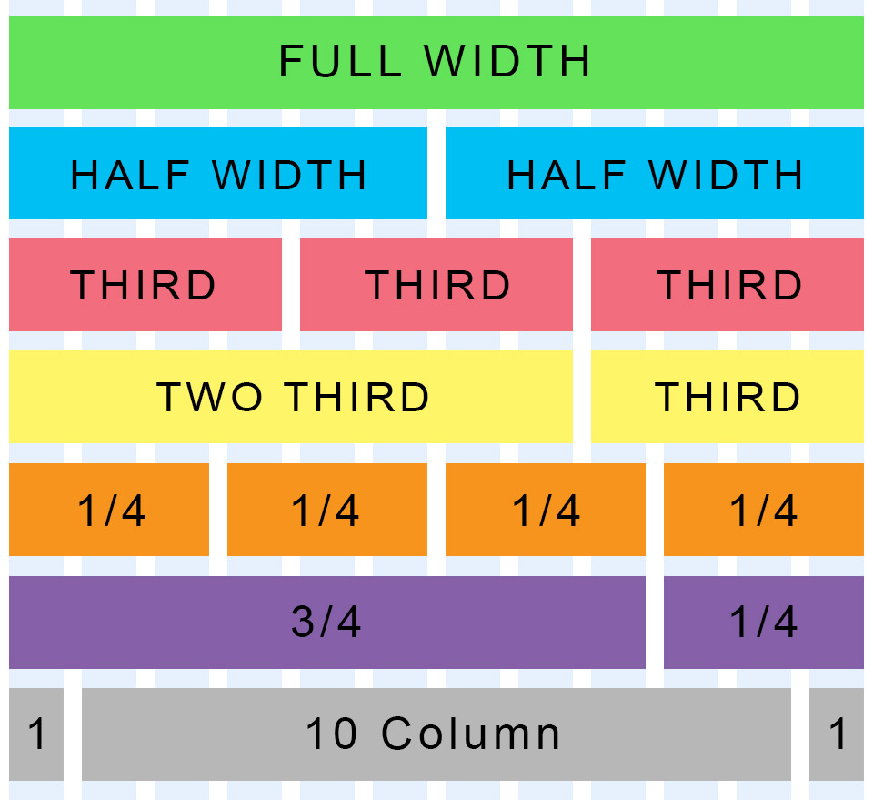
Bootstrap Grid System
Bootstrap lets you organize content based on the “number of columns” a div spans – out of a total 12 columns.
Example:
<div class="col-md-12">
(Spans full width)
<div class="col-md-4">
(Spans 1/3 of full width)

Slide 39
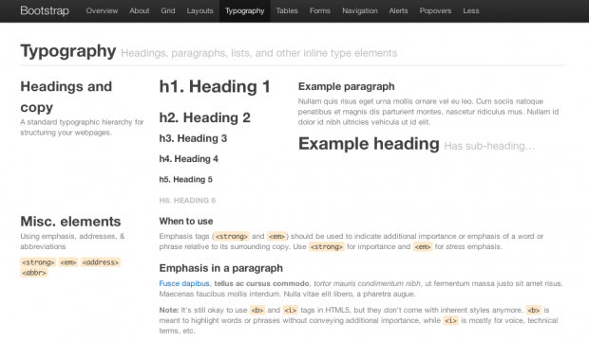
Bootstrap Typography
By default, Bootstrap offers nice looking fonts / size ratios of headers and paragraphs. These come without you needing to do anything!
<p></p>, <h1></h1>, <h2></h2, etc

Slide 40
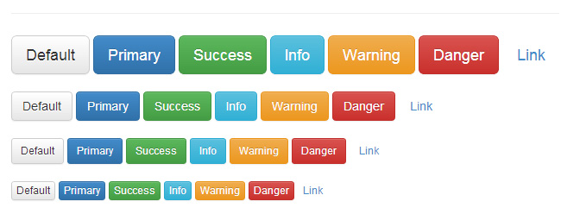
Bootstrap Buttons
Bootstrap also helps you quickly create buttons of various size/colors
Example:
<button class="btn btn-default" type="submit">Button</button>

Slide 41
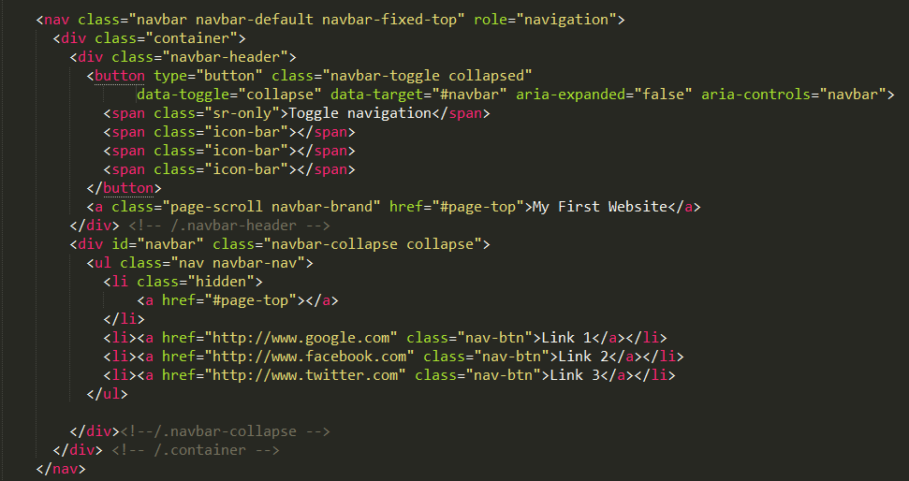
Bootstrap Navbar

Slide 42
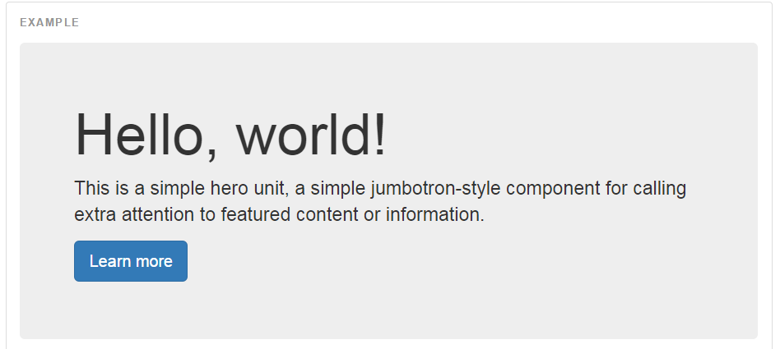
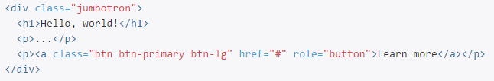
Bootstrap Jumbotron

Slide 43
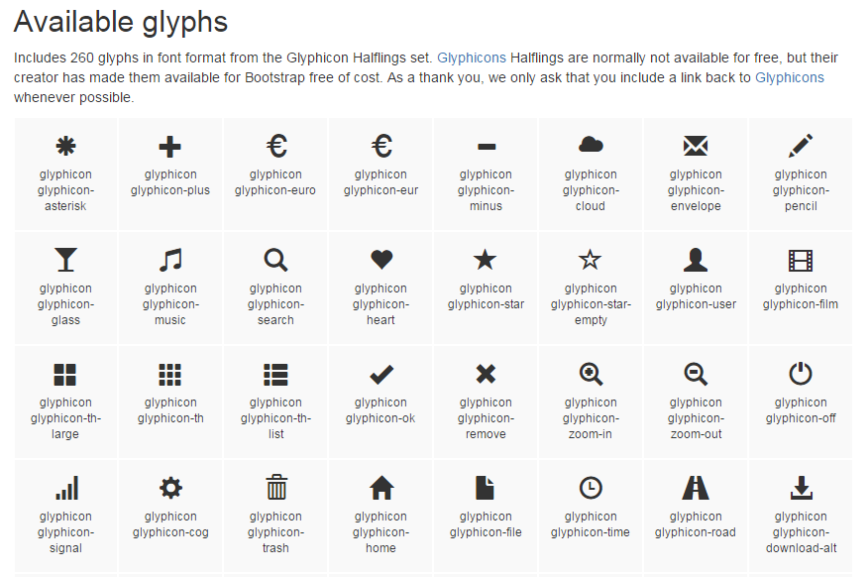
Bootstrap Glyphicons
Example:
<span class="glyphicon glyphicon-certificate"></span>

Slide 44
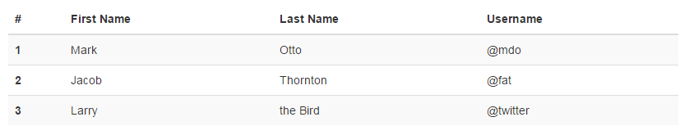
Bootstrap Tables
Example:
<table class="table table-striped">
<tr>
<th>First Name</th>
<th>Last Name</th>
<th>Username</th>
</tr>
<tr>
<td>Mark</td>
<td>Otto</td>
</td>@mdo</td>
</tr>
…
</table>

Slide 45
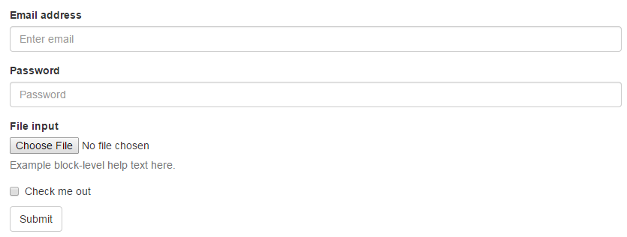
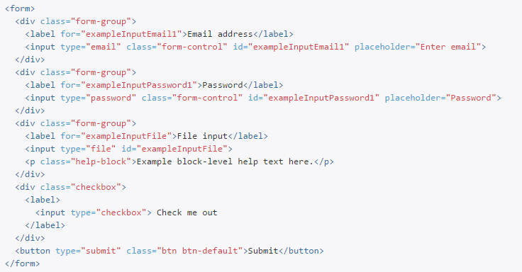
Bootstrap Forms

Slide 46
Time to Build!
See Code Base:
https://github.com/afhaque/Rice-DevChats-Bootstrap
Start at Commit: 4342549ace9f99684b4192ea5c983b11624c6277
Go to Commit: 62a29269d29d264536ccff4ab707d44493480da7

Slide 47
Questions?

Slide 48

Thanks for attending!
Liked it? Hated it? Let us know:
ricedevchats.org/reviews

