Slide 1

Crowdfunding Platform
Submitted to,
Shammi Akhtar
Assistant Professor
Dept. of CSE, UAP

Slide 2


Problem Statement
Third party.
Investor can’t track.
Scam.
Trust issue.
Don’t donate.
Find investment for Startup
Problems with Share and Equity

Slide 3
What is Crowdfunding?
Crowdfunding is a financing method that involves funding a project with relatively modest contributions from a large group of individuals, rather than seeking substantial sums from a small number of investors.
It is a form of crowdsourcing and Alternative Finance.
Organizations, businesses, and individuals alike can use crowdfunding for any type of project, for example: charitable cause; creative project; business startup; school tuition; or personal expenses.
It enables fundraisers to collect money from a large number of people via online platforms.
Crowdfunding has made it possible for people to offer direct support to those who need emergency financial assistance, contributing to the larger trend of individual giving.

Slide 4
Crowdfunding Platform
Blockchain is a linked list that employs Hash Pointers rather than regular pointers.
This allows each blockchain node to not only locate the next node but also verify whether the data in that node has changed.
The Crowdfunding platform in block-chain makes different possibilities for the startups by raising the funds to create their own digital currency.
It is peer-to-peer fund raising model.
Some of the famous crowdfunding cryptocurrencies are coinspace, swarm, judobaby etc.
Anyone with an internet connection can use this system.

Slide 5
Working of the project for Admin
In Crowd-Funding System, to log in to the system the admin can log in with a username and password. The admin has access to the company's information as well as all previous and pending projects. Additionally, the admin has the authority to accept or reject the project proposal.
The admin can view all the projects that have been approved, filter them by category or domain, and view investor transactions from this platform. A list of all rejected projects can be viewed, along with information about the project and the company.
In the transaction, a list of approved projects is displayed along with details about whether or not they tampered with the crowdsourcing process. The admin can view the list of registered users and their information.

Slide 6
Working of the Project for User
For users to access information, they have to register their account and log in using a username and password. The user has access to the list of projects for which they want funding.
They can view transactions by investors from this platform with a status of whether the transaction is manipulated and apply filters by domain or category, project and company details, and more.
They can invest the money; if even one transaction is discovered to have been manipulated, investing will not be permitted by the system.

Slide 7
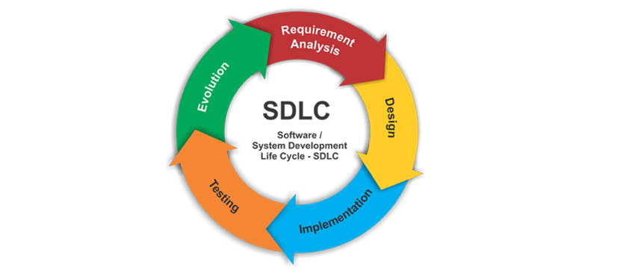
Systems Development Life Cycle

Slide 8
What is SDLC?
SDLC stands for Software development life cycle.
Software Development Life Cycle is a process used by the software industry to design, develop and test high quality software.
The SDLC aims to produce a high-quality software that meets or exceeds customer expectations, reaches completion within times and cost estimates.
SDLC is a framework defining tasks performed at each step in the software development process.
It consists of a detailed plan describing how to develop, maintain, replace and alter or enhance specific software.

Slide 9
Phases in SDLC
1. Planning: During this phase, all the relevant information is collected from the customer to develop a product as per their expectations. Business analyst and Project Manager set up a meeting with the customer to gather all the information like what the customer wants to build, who will be the end-user, what is the purpose of the product. Before building a product a core understanding or knowledge of the product is very important.
2. Analysis: Once the planning is done the next step is to clearly define and document the product requirements and get them approved from the customer or the market analysts. This is done through an SRS (Software Requirement Specification) document which consists of all the product requirements to be designed and developed during the project life cycle.
3. Design: In this phase, the requirement gathered in the SRS document is used as an input and software architecture that is used for implementing system development is derived. There are two types of design - Logical design and physical design.

Slide 10
Phases in SDLC
4. Implementation: In this stage of SDLC the actual development starts and the product is built. The programming code is generated as per DDS during this stage. If the design is performed in a detailed and organized manner, code generation can be accomplished without much hassle.
5. Maintenance: The main focus of this SDLC phase is to ensure that needs continue to be met and that the system continues to perform as per the specification mentioned in the first phase.
Bug fixing – bugs are reported because of some scenarios which are not tested at all
Upgrade – Upgrading the application to the newer versions of the Software
Enhancement – Adding some new features into the existing software

Slide 11

THANKS FOR YOUR ATTENTION

