Slide 1

Netflix Content Analysis Dashboard
Power BI Project
by Afia Basri

Slide 2
📊 Project Overview
• Goal: Analyze Netflix's content trends using interactive Power BI dashboard.
• Focus: Content type, rating, genre distribution, release trends.
• Outcome: Multi-page dashboard with actionable insights.

Slide 3
📂 Dataset & Tools Used
• Source: Netflix dataset (Kaggle)
• Records: 8,800+ titles with fields like type, rating, release year, etc.
• Tools: Power BI Desktop, Python (for preprocessing), Excel
• Visuals: Donut chart, bar chart, treemap, heatmap, slicers, KPIs

Slide 4
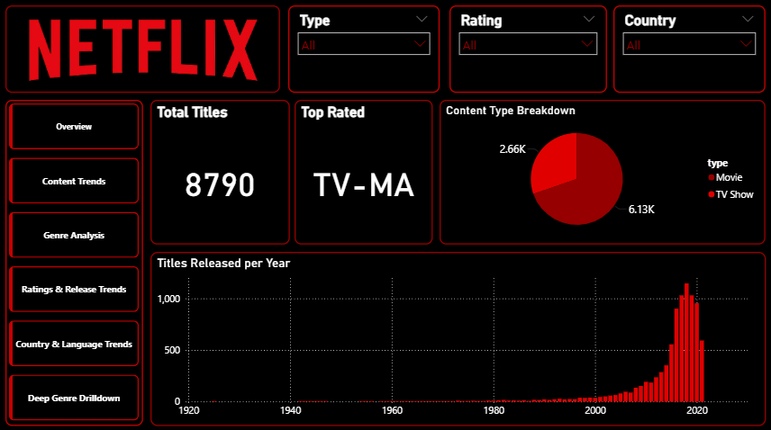
📄 Page 1: Overview
Notes:
This page provides a high-level overview of Netflix's content library. It displays the total number of titles on the platform, clearly distinguishing between Movies and TV Shows, with Movies making up the majority. It also highlights the most common content rating and trends in content additions over the years. Users can interactively explore the data using filters for type, rating, and country.

Slide 5
This page gives a snapshot of the overall Netflix content.
It highlights the total number of titles available on the platform, with a breakdown between Movies and TV Shows — showing that movies make up most of the library. It also displays the most common content rating (e.g., TV-MA, PG-13) and shows how content has been added over time. With slicers for content type, rating, and country, users can filter the entire dashboard to focus on specific segments.
Notes:
This page highlights content addition trends on Netflix. The donut chart displays the percentage distribution of titles added each month, indicating seasonal spikes. The line chart shows the number of titles released each year, reflecting Netflix’s growth. These visuals help uncover how Netflix schedules and scales its content strategy annually.

Slide 6
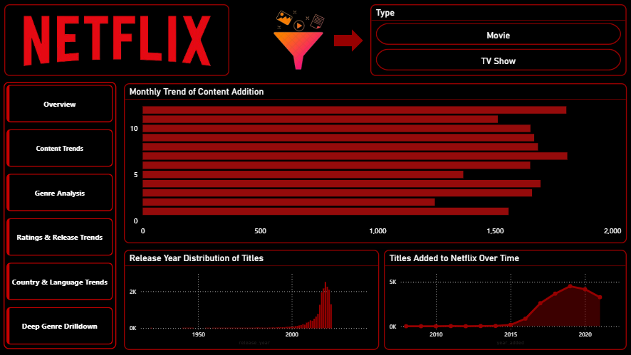
📈 Page 2: Content Trends
Notes:
This genre-focused page compares how different content types are distributed across genres. A 100% stacked column chart shows the genre breakdown between Movies and TV Shows, while a treemap reveals genre dominance visually. A table at the bottom lists the top titles, providing a comprehensive view of Netflix’s genre landscape.

Slide 7
This page gives a clear look at how Netflix’s content has grown and changed over time.
The clustered column chart shows how many titles were released each year.
The bar chart highlights which months see the most content additions, showing Netflix’s seasonal patterns.
The line chart gives a big-picture view of how the titles has increased over the years.
There’s also a slicer to filter the visuals by Movies or TV Shows, so users can explore trends more closely.
Notes:
Here, we explore how Netflix content has evolved over time in terms of ratings and movie durations. The line chart displays the trend in average movie durations by release year, indicating whether movies are becoming longer or shorter. A bar chart presents rating distribution, and a summary card highlights the most common rating on the platform.

Slide 8
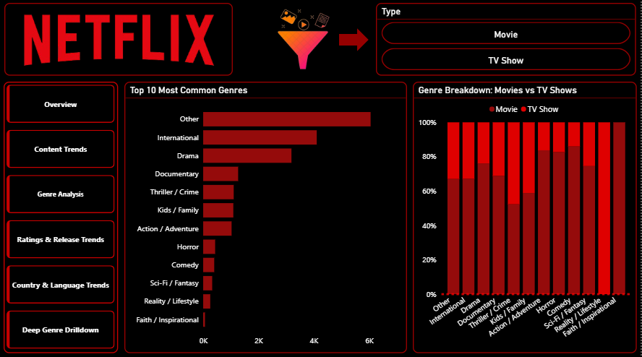
🎭 Page 3: Genre Analysis
Notes:
This page explores regional distribution of Netflix content. A horizontal bar chart showcases the top 10 countries with the most titles available, helping identify major content-producing or hosting regions. Filters for type and rating allow users to explore the regional mix across different content categories.

Slide 9
This page provides insight into the variety of content available on Netflix.
The clustered bar chart highlights the top 10 most frequently occurring genres, helping identify the dominant content categories on the platform.
The 100% stacked column chart breaks down these genres by content type, showing whether Movies or TV Shows lead in each genre.
A slicer allows users to filter the visuals by type, enabling focused exploration of genre trends within Movies or TV Shows specifically.
Notes:
This deep dive focuses on genre changes over time. A heatmap or stacked chart visualizes how different genres have shifted across release years. A treemap highlights the share of each genre group in the library. The detailed table lists top titles by genre and offers deeper insights into content diversity and viewer preferences over the years.

Slide 10
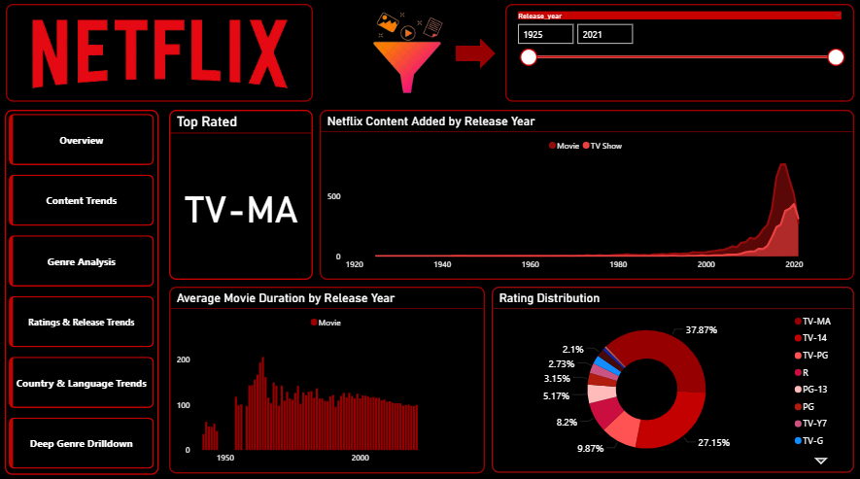
🔢 Page 4: Rating & Release Trends
Notes:
This page focuses on how Netflix content is rated and how it has evolved over time. A line chart shows the trend in average movie duration by release year, helping determine if movies are getting shorter or longer. A bar chart displays the distribution of content ratings, which helps understand what audience Netflix targets the most (e.g., mature viewers, families). The bonus card highlights the most frequent rating on the platform.

Slide 11
This page explores how Netflix’s content has evolved over time in terms of quantity, duration, and audience ratings.
The line chart shows the trend of titles added by release year, giving a clear view of how Netflix’s content library has grown.
The clustered column chart displays the average movie duration by year, helping assess whether Netflix movies are getting shorter or longer.
The donut chart visualizes the distribution of content ratings, showing what types of audience Netflix content is targeting.
A card highlights the most common rating across the dataset.
A release year slicer allows users to focus on a specific period for more detailed analysis.

Slide 12
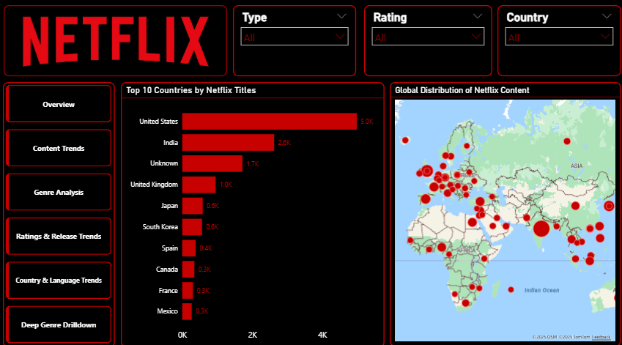
🌍 Page 5: Country Insights
Notes:
Here, we explore the geographical diversity of Netflix content. The bar chart ranks the top countries by the number of available titles — typically led by the United States, followed by India, the UK, etc. This helps identify content hubs and Netflix's focus regions. If implemented, a heatmap or pie chart can show language availability or regional spread visually, offering insight into Netflix's international content strategies.

Slide 13
Here, we explore the geographical diversity of Netflix content.
The bar chart ranks the top countries by the number of available titles — typically led by the United States, followed by India, the UK, etc. This helps identify content hubs and Netflix's focus regions.
A map can show regional spread visually, offering insight into Netflix's international content strategies.

Slide 14
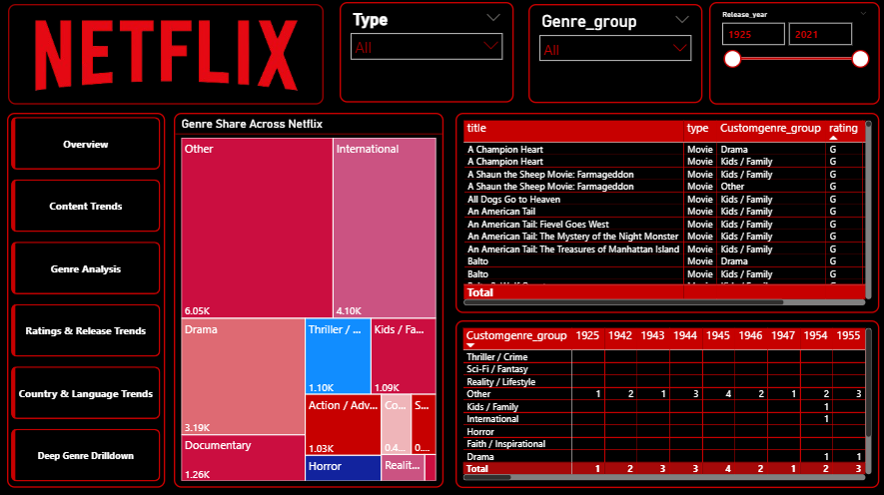
📌 Page 6: Deep Genre Drilldown
Notes:
This final page offers a granular look into how genres have evolved over time. A heatmap or stacked chart maps genre popularity across years, revealing shifts in audience preferences. The treemap reinforces genre share, while a detailed table showcases the most notable titles per genre. This page is ideal for analyzing long-term trends in storytelling, market demand, and strategic content creation.

Slide 15
This page provides a comprehensive breakdown of Netflix's content by genre, helping to uncover distribution patterns and genre dominance.
The treemap titled “Genre Share Across Netflix” visually emphasizes the most common genres, with larger blocks indicating higher content volume (e.g., International, Drama, Kids/Family).
The table on the right displays detailed title-level information, including title name, content type, genre group, and rating, allowing for granular exploration.
The matrix at the bottom shows how genres have trended over the decades, with content counts broken down by genre group and release year.
Slicers for type, genre_group, and release_year offer interactive filtering, enabling users to focus on specific content categories and time periods.

Slide 16

Conclusion
• Netflix prioritizes Movies over TV Shows.
• Drama, International, and Documentaries are most common genres.
• Content growth is steady, with ratings clustered around TV-MA and PG-13.
• Dashboard enables quick filtering by type, genre, and release year.

Slide 17


Thank You
📌 Created by Afia Basri
🔗 Fiverr: https://www.fiverr.com/seller_dashboard
🔗 GitHub: https://github.com
Feel free to reach out for custom dashboards and data insights.

