Slide 1
KRISH-E
1

Slide 2
Hello!
TEAM MEMBERS:
1.Fahmida Tasnim Lisa,170042020
2.Razia Zaman Ela,170042071
3.Afia Muntakim Rodoshe,170042029
2

Slide 3
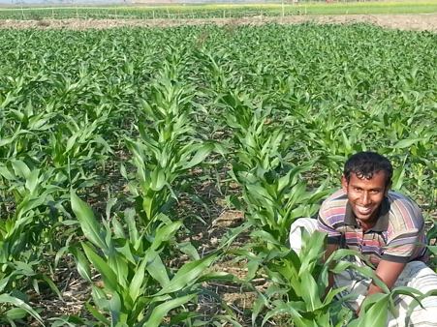
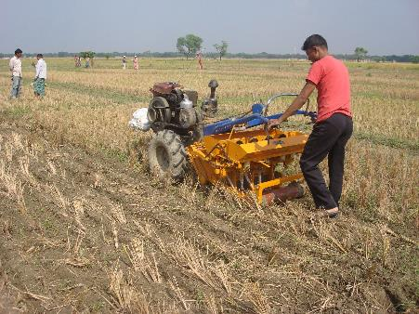
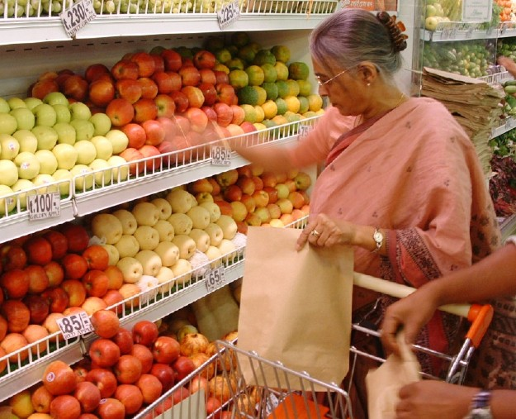
Krish-e :
An E-platform for farm mechanisation to improve food security and livelihood
3

Slide 4
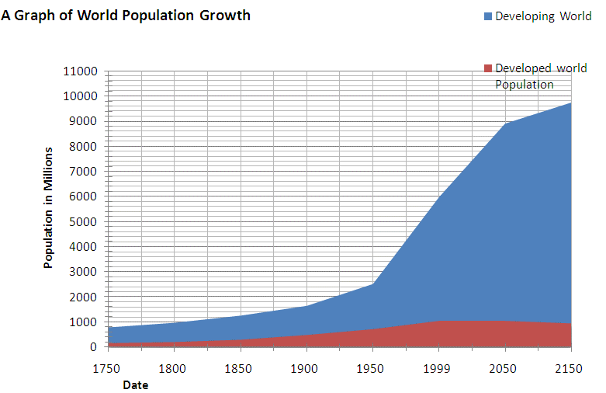
World Population Particularly in South and Southeast Asia Growing Rapidly
Total in S & SE Asia: 2.3 billion
More people need more food!
4
Source: The World Fact Book, 2014

Slide 5
Agriculture facing many challenges
labor price increased significantly in most countries since 2005
labor availability drastically reduced in many countries
Agricultural land decreasing @ 1% per year in Bangladesh
Bangladesh Case
Source: 1993-2007: An Analysis of Real Wage in Bangladesh and Its Implications for Underemployment and Poverty ; 2008-2013 : Farmers Focus Group Discussion
5
Notes:
While Bangladesh is famous for its high population density, the availability of farm labour has declined rapidly in the last 3-5 years. Lack of availability is a bigger constraint than cost although cost has increased substantially.
Having developed a form of agriculture that made use of abundant labour in the past, farmers are rapidly having to redesign their farming operations to use les labour. Mechanisation and herbicides for weed control are two obvious shifts underway.

Slide 6
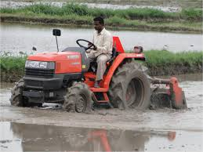
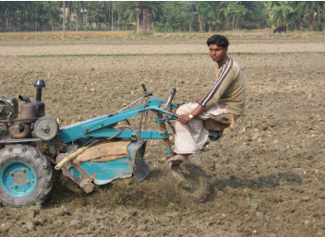
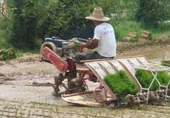
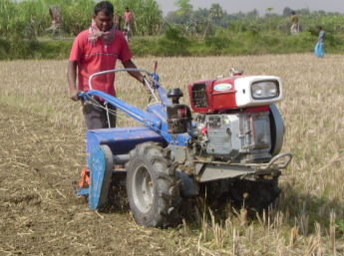
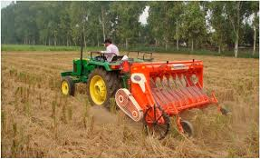
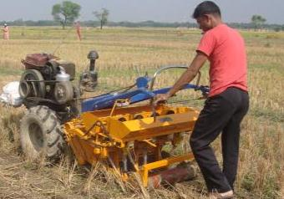
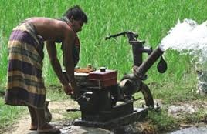
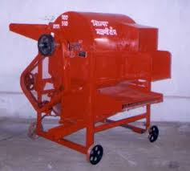
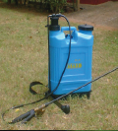
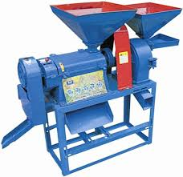
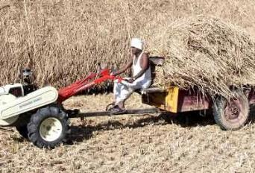
Mechanization as an opportunity
Small scale farm mechanization already well available in Bangladesh
Save labor
Save time
Lower costs of production
6
>300 types of farm implements are being used in S & SE Asian Countries

Slide 7

Why USE KRISH-E?
7

Slide 8
WHY FARMER TO FARMER NETWORKING:
Farmers not being able to afford all kinds of machineries
To establish connection between farmers
Farmers being able to buy crops/insecticides at low cost
Farmers being able to earn money
Ensuring production quality improvement
Less time wasted
8

Slide 9
WHY FARMER TO CONSUMER NETWORKING:
Better relationship
Better quality of food crops at wholesale
Low cost of foods
Any crops/vegetable are available for the consumers to buy from farmers
9

Slide 10
FEATURES:
Search and Filter
4
Chat box/Voice Call
Order management
1
details of place of delivery
delivery time information
payment information
Push notification
5
2
6
Real-time Location
3
Rent Management
list of farm machinery rented
consumer’s and farmer’s information
Maintain calendars
Instant reservation confirmation
payment information
Rent Management
10

Slide 11
FUTURE SCOPE:
Add multiple language to the application
Add video chat option
Add cash on delivery
Add payment option Mobile Banking, other Banking option
Add security system to recognize real user
Add consultant to help the user about their requirement
Weather update
11

Slide 12
Project Timeline
Milestone
Milestone
Milestone
2019
Dec | Jan | Feb | Mar | Apr | May
Phase 1
Phase 2
Phase 3
12
Notes:
© Copyright PresentationGO.com – The free PowerPoint template library

Slide 13
WORKING PHASE:
PHASE 1
PHASE 3
Development
Testing
Deployment
Team formation
Planning & research
Wireframe
Technical Feasibility Assessment
PHASE 2
Prototype
Design
User authentication
50%
13

Slide 14
1.Firebase
2.Android Studio
1.Adobe XD
Resources involved:
Designing:
14

Slide 15
Mock up

Slide 16
Thank you

