Slide 1
Leukemia Cell Classification Using Deep Learning Model
A final year design project for thesis defense and supervisor evaluation.

Slide 2
Team Information
Afia Tasnim Ria (0112231058)
Salah Uddin Selim (0112230512)
Sajedur Rahman (0112230857)
Tanvin Chowdhury (011222124)
Tasnema Ferdous (011222123)
Final Year Project Design
CSE 4000A | FYDP 1
Class Teacher Al-Sakib Khan Pathan
Professor, Dept. of CSE
Supervisor Muhammad Nomani Kabir
Professor, Dept. of CSE

Slide 3
Introduction
Leukemia, a cancer of blood-forming tissues, impacts blood and bone marrow, necessitating early and accurate detection for effective treatment.
Leukemia, a cancer of blood-forming tissues, impacts blood and bone marrow, necessitating early and accurate detection for effective treatment.
Leukemia Overview:
Cancer affecting blood and bone marrow.
Early Detection:
Crucial for improving patient outcomes.
AI in Diagnosis:
Machine learning and deep learning offer advanced diagnostic capabilities.

Slide 4
Background: Traditional Diagnosis
Microscopic Examination
Conventional leukemia diagnosis relies on manual microscopic analysis of blood samples.
This method is labor-intensive and requires specialized expertise.
Limitations
Time-consuming process
Dependency on expert hematologists
Susceptible to human error and subjectivity

Slide 5
Problem Statement
1
Manual Detection Challenges
Slow, subjective, and resource-intensive diagnostic process.
2
Early-Stage Identification
Difficult to detect leukemia in its nascent stages using current methods.
3
Lack of Automated Tools
Absence of efficient, consistent, and automated classification tools.

Slide 6




Motivation: Why This Research Matters
Global Impact
Improved Survival
AI Assistance
Addressing the severity and widespread impact of leukemia.
Early detection significantly enhances patient survival rates.
AI-based models can empower hematologists with better diagnostic support.
Reduced Delays
Automation minimizes diagnostic delays and alleviates workload.

Slide 7

Paper Name | Result / Outcome | Contribution | Solution / Approach
Detection and Classification of Acute Lymphoblastic Leukemia Utilizing Deep Transfer Learning | MobileNetV2: 99.69% accuracy | Proved effectiveness of transfer learning for leukemia detection | MobileNetV2 + Custom CNN, SMOTE, data augmentation
Identification of Leukemia Subtypes from Microscopic Images Using CNN | 88% (binary), 81% (multi-class) | First CNN-based multi-subtype leukemia classification | CNN with ALL-IDB & ASH datasets, augmentation
Deep Learning Model for Early ALL Detection Using Microscope Images | 96% accuracy | Optimized CNN outperformed ResNet50 & YOLOv8 | Deep CNN with heavy augmentation
Diagnosing Leukemia Using Ensemble & Pretrained CNN (ResNet) | ResNet superior to basic CNN | Showed depth improves performance | Pretrained ResNet + ensemble learning
Leukemia Cell Classification Using Machine & Deep Learning (ResNet) | 95% accuracy, F1 = 93% | Demonstrated ResNet captures cellular features well | Transfer learning ResNet + preprocessing
Quantifying Imbalanced Classification Methods for Leukemia Detection | > 90% accuracy | Highlighted importance of imbalance handling | Oversampling, undersampling, cost-sensitive learning

Slide 8
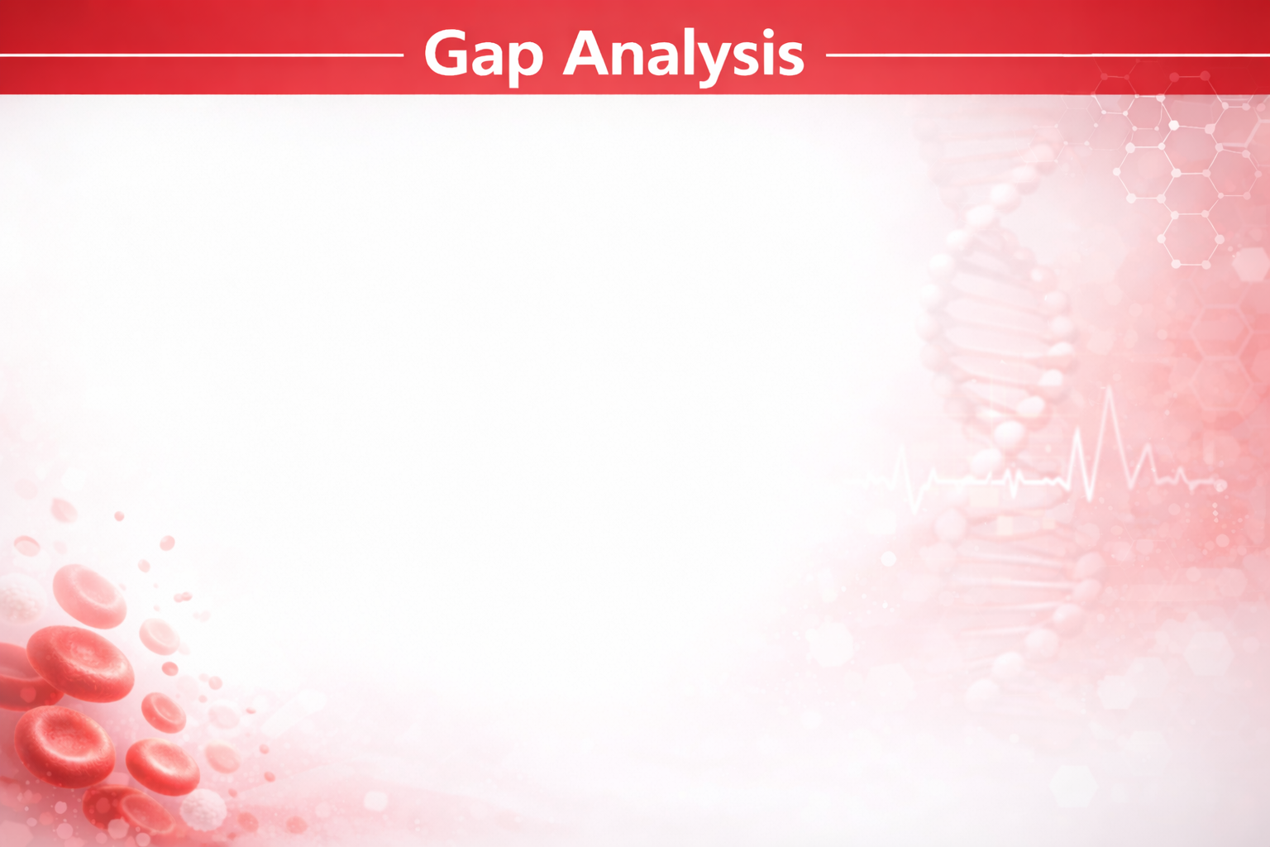
Current Challenges
Limited and Single-Center Datasets
Class Imbalance and Data Quality Issues
Focus on Limited Leukemia Subtypes
Black-box models with high computation cost
Lack of Standardized Evaluation and Cross-Domain Testing
Proposed Solution
Collect large multi-hospital dataset
Advanced data balancing and preprocessing
Multi-class leukemia detection
Optimized, Interpretable and End-to-End Deep Learning Framework
Standardized Evaluation and Cross-Hospital Validation

Slide 9
Research Methodology Overview
This presentation focuses on the core model architectures employed for leukemia blood cancer detection.
01
02
03
Model Selection
Architectural Design
Performance Evaluation
Choosing optimal Machine Learning and Deep Learning algorithms.
Developing and refining model structures for specific tasks.
Assessing model accuracy and efficiency post-training.

Slide 10
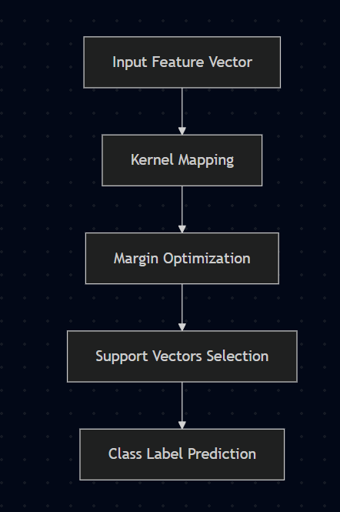
Support Vector Machine (SVM)
Constructs an optimal separating hyperplane in a high-dimensional space.
Utilizes kernel functions to transform data for effective non-linear classification.
Maximizes the margin between classes, enhancing generalization capabilities.

Slide 11
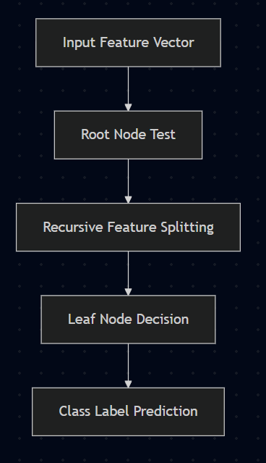




Decision Tree
Employs a hierarchical structure of feature-based rules for classification.
Splits data at each node based on specific feature values.
Reaches a decision at leaf nodes, representing the predicted class.

Slide 12
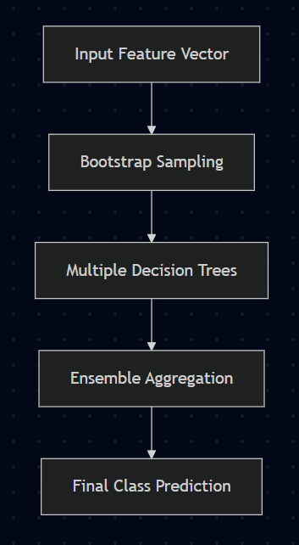
Random Forest
Combines predictions from multiple individual decision trees.
Utilizes ensemble learning to improve accuracy and reduce overfitting.
Aggregates results through majority voting for the final classification.

Slide 13
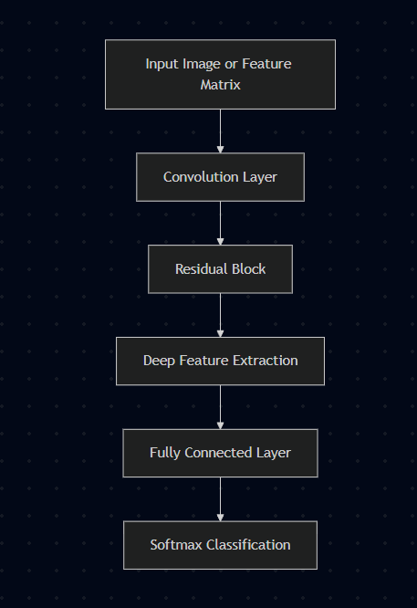
Resnet(Residual Network)
Leverages deep convolutional layers for intricate feature extraction.
Incorporates residual connections to mitigate vanishing gradient problems.
Enables training of extremely deep networks for effective feature learning.

Slide 14
Comparative Analysis
Evaluating the strengths of each model for leukemia detection.
SVM
Effective with clear margin of separation, robust in high dimensions.
Decision Tree
Interpretable, handles non-linear relationships well.
Random Forest
Reduces overfitting, high accuracy through ensemble methods.
ResNet
Superior for complex image data, deep feature learning.

Slide 15
Model Selection Rationale
Each model offers unique advantages for specific aspects of blood cell image analysis.
Traditional ML
Deep Learning
SVM, Decision Tree, and Random Forest provide robust baselines and interpretability for feature-based classification.
ResNet excels in automatically learning complex hierarchical features directly from raw image data, crucial for subtle visual cues.

Slide 16



Future Directions
Potential enhancements and extensions for the current model architectures.
Hybrid Models
Combining strengths of ML and DL for improved performance.
Explainable AI
Integrating techniques for better model interpretability.
Real-time Processing
Optimizing models for faster diagnostic capabilities.

